Slide 1
whodunnit
Windows Event Log Filtration
Cam Downs

Slide 2
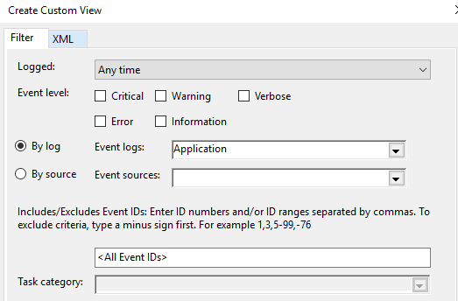
Background
Windows Event Viewer is great
Allows sorting + filtering logs
But it’s only a GUI
No CLI alternative
Except VBScript

Slide 3
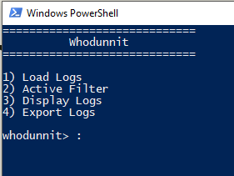
Purpose
Provide a PowerShell alternative
Improve scripting options
Allow for automation
Created for investigators
Reduce time at scene
Reduce time at keyboard

Slide 4
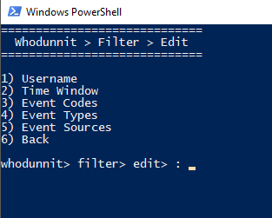
Current Status
Functional GUI
Loads logs from local
Edit filter
Export filter and logs

Slide 5
Future Outlook
Modularity (allow dot sourcing)
Requires refactoring
Support ranged inputs
Read logs from a forensic image
Read MFT
C:\Windows\system32\winevt\logs

Slide 6
Lessons Learned
PowerShell Export-CSV
Doesn’t work on arrays
PowerShell is incredibly useful
Lots of industry professionals don’t have experience making tools or scripting

Slide 7
Demo
Load in logs on my home machine
Set up a filter which excludes all logs generated by my account
Display statistics on matching logs
Export matching logs to a file

Slide 8
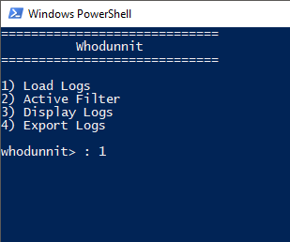
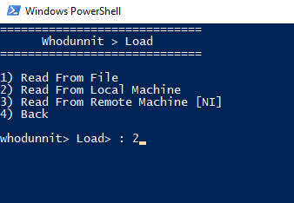
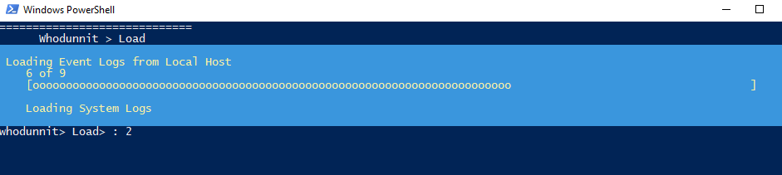
Loading Logs

Slide 9
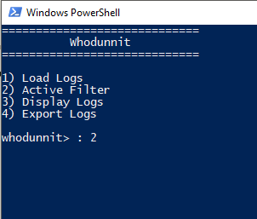
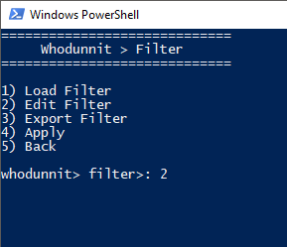
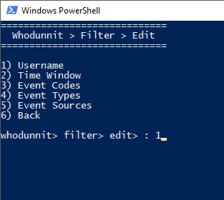
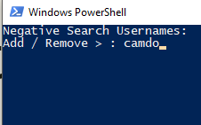
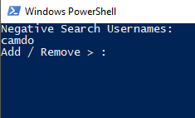
Filtration

Slide 10
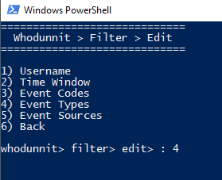
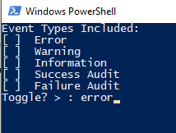
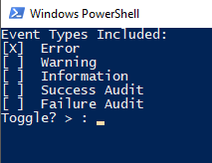
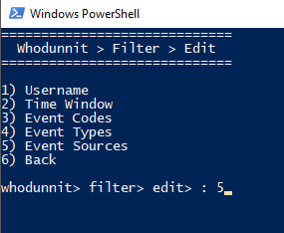
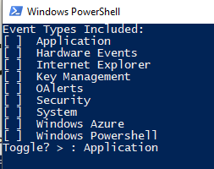
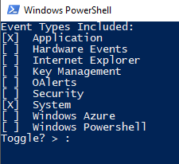
Filtration (cont.)

Slide 11
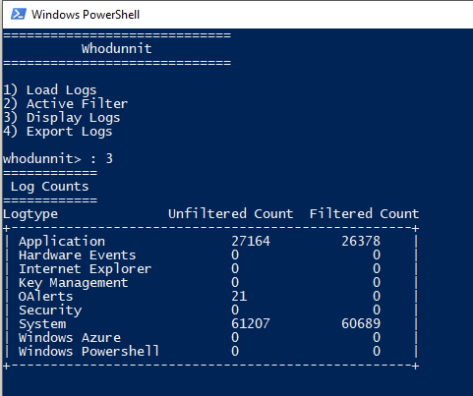
Display Log Stats

Slide 12
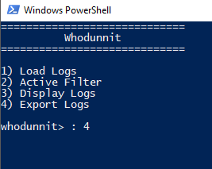
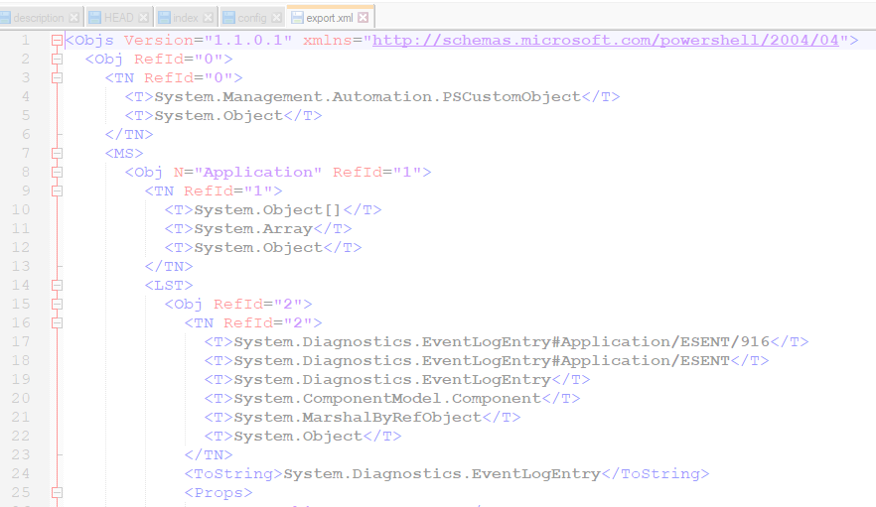
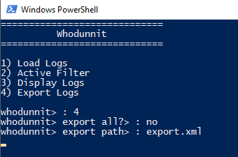
Export Logs

