Slide 1
Earmark graph approach to de novo genome assembly
Mikhail Dvorkin, Alexander Kulikov, Max Alekseev, Pavel Pevzner
Algorithmic Biology Lab, Academic University, St. Petersburg, Russia http://bioinf.spbau.ru/en/

Slide 2
Problem setting
Input: a set of substrings (reads) ℛ ⊆ {A, C, G, T}^{𝑟} of an unknown circular string 𝑆 ∈ {A, C, G, T}* (genome);
Output: the genome 𝑆;
Complications: reads may contain errors.
Goal of approach: decrease memory usage.

Slide 3
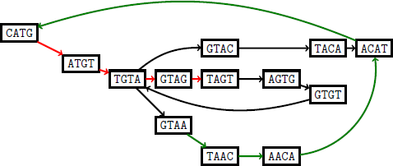
De Bruijn graph
Take all k-mers from each read as vertices
Connect two consecutive k-mers with an edge

Slide 4
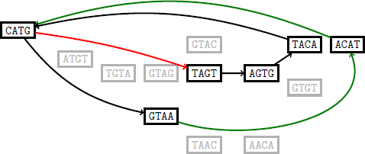
Earmark graph
Key idea: take some, not all k-mers from reads
Devise a rule on whether to use k-mer or not

Slide 5

Which k-mers to choose?
Don’t just take random k-mers from reads
Use some rules to “bias” the selection towards same k-mers in different reads

Slide 6

Rules of earmark selection (1)
Select luck function L(s), such that L(s)=L(s^{RC})
L(s) = min(h_{polynomial}(s), h_{polynomial}(s^{RC}))
The larger L(s), the more likely is this k-mer to be earmarked.

Slide 7
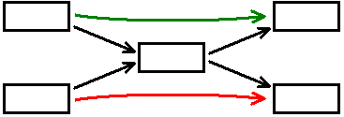
Rules of earmark selection (2)
Also to be included to “bias” the selection:
Information on trustiness from external sources
Frequency of this k-mer (in data sets with uniform coverage)
Try to discard k-mer that appear too often:

Slide 8
Procedure of earmark selection
Process all the reads of length at least k+Δ:
calculate L(s) for every its k-mer (note: takes O(r))
select t k-mers with largest L(s), earmark them.
(Optional, if t=1) process all the reads of length at least k+Δ:
if only one k-mer is earmarked, select k-mer with the second largest L(s) and earmark it.

Slide 9

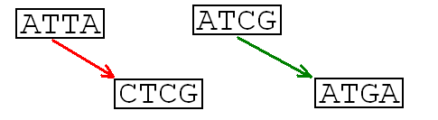
Induced tips
Reads that overlap need to be “connected”: leads to

Slide 10
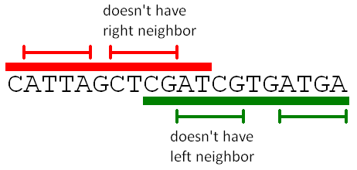
Tip extension procedure (1)
Process all the reads:
find all earmarked k-mers in the read
mark all but first as “having-left-neighbor”
mark all but last as “having-right-neighbor”
Define tip as “not having left or right neighbor”

Slide 11
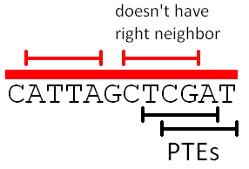
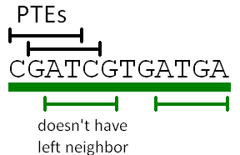
Tip extension procedure (2)
Process all the reads that have tip k-mers:
Mark all k-mers to the correct side from the tip as Possible Tip Extensions (PTE)

Slide 12
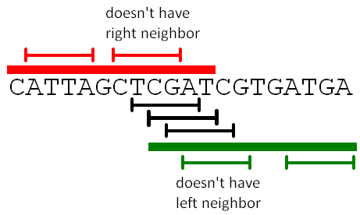
Tip extension procedure (3)
Process all the reads that have PTE k-mers:
for each PTEs, memorize whether there are earmarked k-mers to left and to the right

Slide 13
Tip extension procedure (4)
For each tip, choose its extension:
(most preferred) PTE already chosen as another tip’s extension;
PTE that has both left and right earmarked neighbors
(least preferred) PTE that is furthest away (in bps)

Slide 14
Advantages over de Bruijn graph
Smaller size (in terms of both memory and number of vertices)
fully controllable by parameter t
corner case: actually, de Bruijn graph
Simpler “local” structure
small repeats resolved
small bulges removed
Natural use of external trustiness information

Slide 15
Practical results
 |  | De Bruijn graph | Earmark graph
First 10% of E. Coli | # of vertices | 809730 | 62420
 | # of edges | 810354 | 62900
+ compression | # of vertices | 5020 | 1376
 | # of edges | 5644 | 1856
+ tip clipping | # of vertices | 1310 | 818
 | # of edges | 1934 | 1298
+ bulge removal | # of vertices | 964 | 472
 | # of edges | 1410 | 750

Slide 16
Thank you for your attention!
And for your hospitality! Questions and feedback appreciated! mikhail.dvorkin@gmail.com

