Slide 1
Design Patterns
E-Portfolio
DHBW Karlsruhe – Mario Kaiser
TINF14B4

Slide 2
Outline
Refreshing
What is a Design Pattern?
Elements of a Design Pattern
Advantages
Make best use
Some important Design Patterns (Java)
It‘s your turn
Hands On and Exercise with the Builder Pattern

Slide 3

What is a Design Pattern?
„In software engineering, a software design pattern is a general reusable solution to a commonly occurring problem within a given context in software design.
It is not a finished design that can be transformed directly into source or machine code.
It is a description or template for how to solve a problem that can be used in many different situations. ”
Notes:
occurs over and over again in our environment
and then describes the core of the solution
you can use this solution a million times
over, without ever doing it the same way twice

Slide 4
Elements of a Design Pattern
Design Pattern
Name
Improves communication
Problem
When to apply the pattern
Solution
Consequences
Provides template
Impact on flexibility and extensibility
Trade-offs
Language / Implementation issues
Description, Context, Symptomatic
How can the problem be solved
WHEN
HOW
Elements
„Design Patterns - Elements of Reusable Object-Oriented Software Catalog“ includes 23 design patterns.
Notes:
Not tutorial book
Reference book

Slide 5
Advantages / Why to use?
They give the developer a selection of tried and tested solutions to work with
→ They can save time by using tested solutions
They are language neutral and so can be applied to any language that supports object-orientation
They aid communication by the very fact that they are well documented and can be researched if that is not the case.
They are highly flexible and can be used in practically any type of application or domain
Notes:
Theoretical concept

Slide 6
Beware of incorrect assumptions
Patterns are the solution for all problems
The usage of patterns improve your code
More patterns lead to better software
You can import patterns easily from existing libraries
Additional complexity, more classes, reducing of maintainability
Notes:
Not the case, patterns for problems which are occuring frequently.
problems which occures with the release of new programming languages or new technologies can not be solved by a pattern
In our environment as a software developer, it‘s very probable, that there is no solution until now
Additional complexity, more classes, more objects for runtime
You have not to use all the patterns → if you can solve the problem without a pattern → ok
-keep in mind - only a theoretical concept

Slide 7
Make best use
No rigid rules – only a recommendation
Customize them to your own needs and requirements!
Be aware of advantages and disadvantages for the different design patterns
Find the fitting pattern for your problem, not the fitting problem for the pattern!
Notes:
Own problem fits to pattern → can use
Otherwise you have to customize more

Slide 8
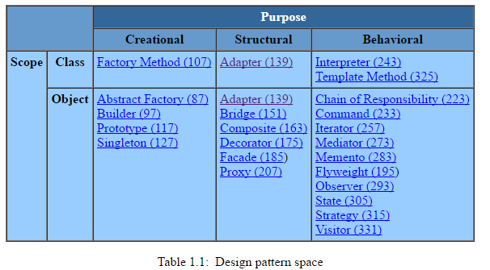
Organizing Design Patterns (GoF)
„Design Patterns - Elements of Reusable Object-Oriented Software Catalog“ includes 23 design patterns.
Source: http://www.cs.unc.edu/~stotts/GOF/hires/chap1fso.htm

Slide 9
Important Design Patterns
Creational pattern
Builder
Problem:
Creating objects is complex
Many optional parameters and parts
Creation requires more than one step
→ The builder pattern is used to create complex objects with constituent parts that must be created in the same order or using a specific algorithm.
Notes:
Different variations
Dont want to create soo many subclasses
Some parameters are not fitting together – figure out if the constellation is valid

Slide 10
Important Design Patterns
Creational pattern
Builder: Specifies an abstract interface for creating parts of a Product object.
ConcreteBuilder:
Constructs and assembles parts of the product by implementing the Builder interface.
Defines and keeps track of the representation it creates.
Director:
Constructs an object using the Builder Interface.
Product:
Includes classes that define the constituent parts, including interfaces for assembling the parts into the final result.

Slide 11
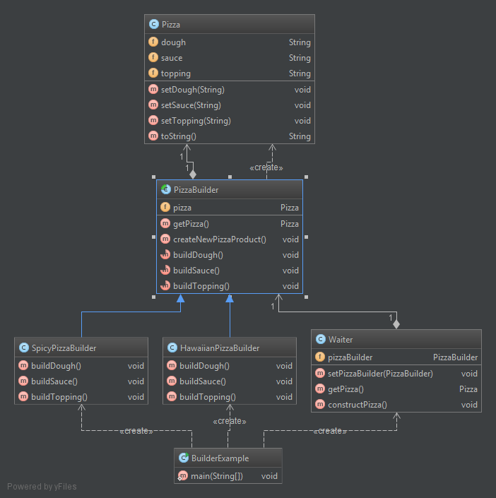
Important Design Patterns
Product
Creational pattern
Builder (abstract)
ConcreteBuilder
Director

Slide 12
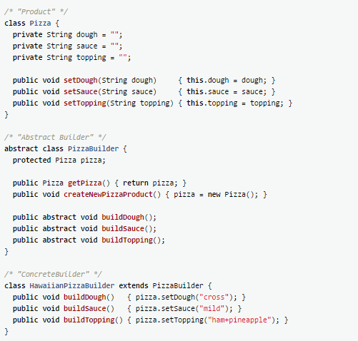
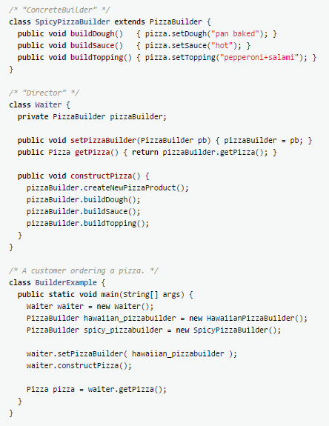

Slide 13
Important Design Patterns
Structural pattern
Composite
Problem:
Objects in tree structure
Client want to treat all objects in the same way
→ Composite pattern is used where we need to treat a group of objects in similar way as a single object. Composite pattern composes objects in term of a tree structure to represent part as well as whole hierarchy.

Slide 14
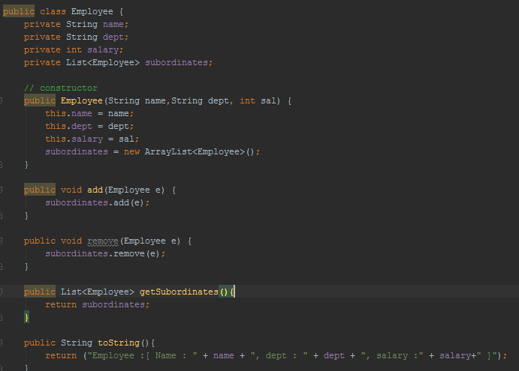
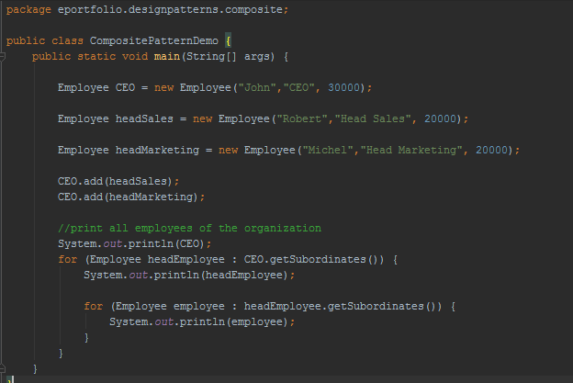
Important Design Patterns
Structural pattern

Slide 15
Important Design Patterns
Behavioral pattern
Visitor
→ Represent an operation to be performed on the elements of an object structure. Visitor lets you define a new operation without changing the classes of the elements on which it operates.
Benefits:
Follows the open/closed principle
Allows a new operation to be defined without changing the implementation in class
Notes:
Example: extend code
Without touching interface or classes

Slide 16
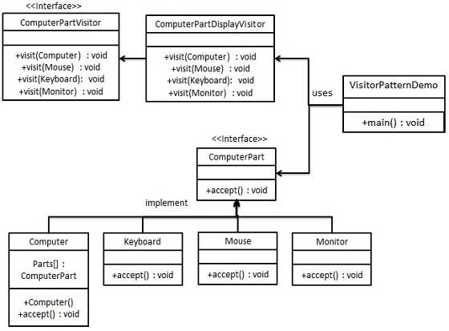
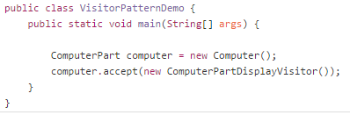
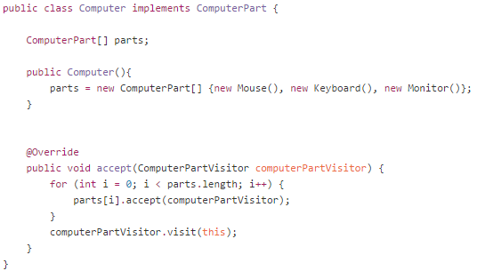
Important Design Patterns
Behavioral pattern

Slide 17
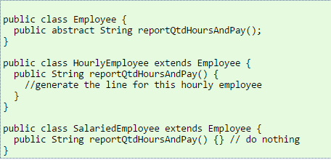
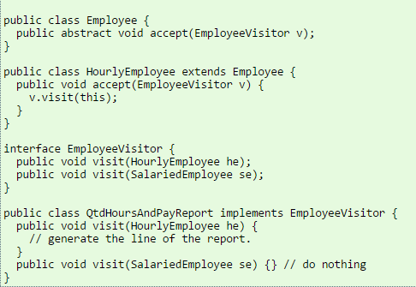

Important Design Patterns
Behavioral pattern
Without Visitor
With Visitor
Problem: we coupled format and content of a report to Employee object.
Violates the Single Responsibility Principle
Fix: use Visitor pattern
Source: http://butunclebob.com/ArticleS.UncleBob.IuseVisitor

Slide 18
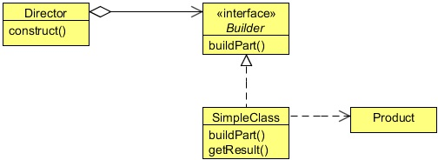
It‘s your turn!
Implement the Builder Pattern
Existing Class „Car“ can be found here:
https://github.com/1developer1/EPortfolio_Design_Patterns/tree/master
EPortfolio_Design_Patterns/src/eportfolio/designpatterns/builderExercise/
Implement the interface CarBuilder.
Implement two ConcreteBuilders (e.g. SportsCarBuilder), which implements the Builder Interface.
Create a Director, which can construct an object using the Builder Interface.
Write a „TestBuilder“ class to test the functionality!

Slide 19
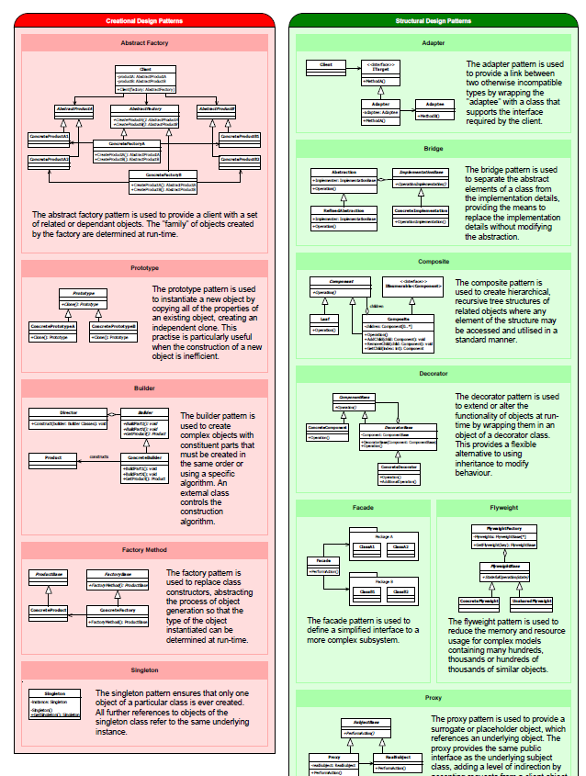
Tip
Reference card with all GoF design patterns.
Link:
http://www.blackwasp.co.uk/GangOfFour.aspx

Slide 20

Thank you for your attention!

