Slide 1
Tutorial Builder Pattern

Slide 2
Important Design Patterns
Creational pattern
Builder
Problem:
Creating objects is complex
Many optional parameters and parts
Creation requires more than one step
→ The builder pattern is used to create complex objects with constituent parts that must be created in the same order or using a specific algorithm.

Slide 3
Important Design Patterns
Creational pattern
Builder: Specifies an abstract interface for creating parts of a Product object.
ConcreteBuilder:
Constructs and assembles parts of the product by implementing the Builder interface.
Defines and keeps track of the representation it creates.
Director:
Constructs an object using the Builder Interface.
Product:
Includes classes that define the constituent parts, including interfaces for assembling the parts into the final result.

Slide 4
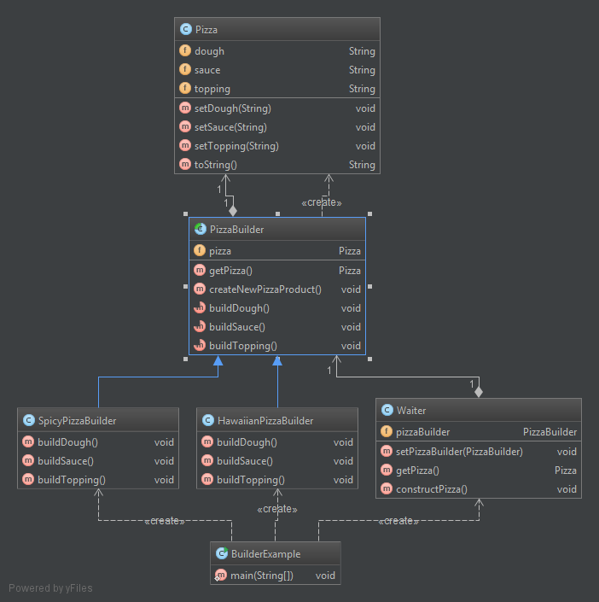
Important Design Patterns
Product
Creational pattern
Builder (abstract)
ConcreteBuilder
Director

Slide 5
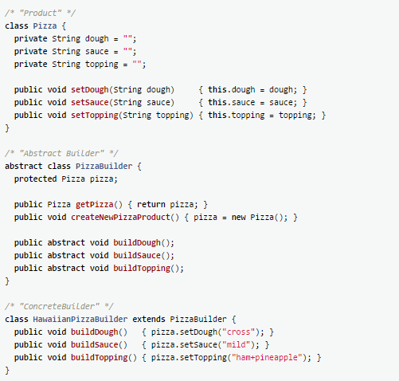
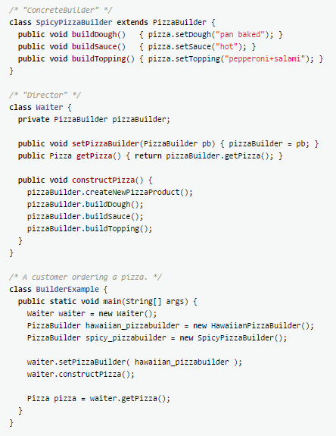

Slide 6
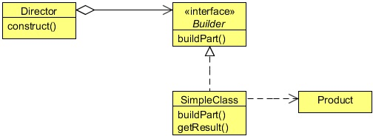
It‘s your turn!
Implement the Builder Pattern
Existing Class „Car“ can be found here:
https://github.com/1developer1/EPortfolio_Design_Patterns/tree/master
EPortfolio_Design_Patterns/src/eportfolio/designpatterns/builderExercise/
Implement the interface CarBuilder.
Implement two ConcreteBuilders (e.g. SportsCarBuilder), which implements the Builder Interface.
Create a Director, which can construct an object using the Builder Interface.
Write a „TestBuilder“ class to test the functionality!

Slide 7
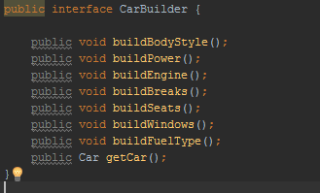
Step 1: Implement the CarBuilder interface
We have already our class Car (Product) which contains some of the important components of the car that are required in order to construct the complete car object.
The CarBuilder is the builder interface contains set of common methods used to build the car object and its components.
So we need one build method for each attribute of our class “Car”.
The “getCar” method is used to return the final car object.

Slide 8
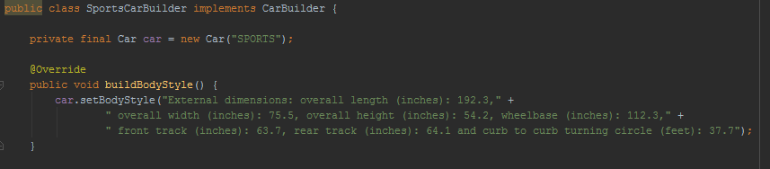
Step 2: Implement a Concrete Builder
Now we can create a Concrete Builder by implementing the existing interface „CarBuilder“
Implement all methods, which have to be overwritten. Therefore you can use the setter-methods of the car object to set your attributes according your preferences

Slide 9
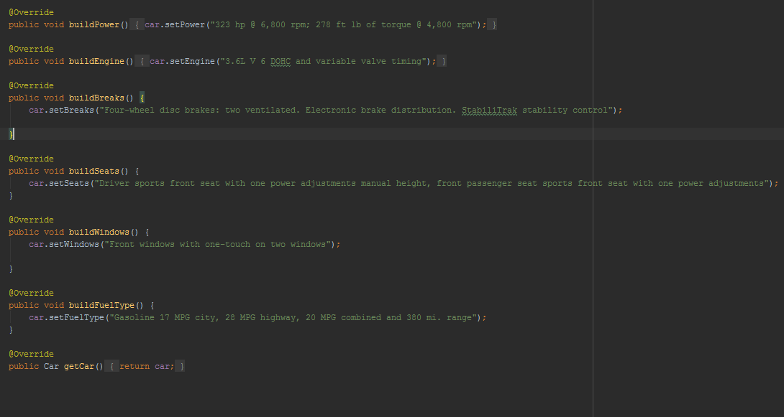
Step 2: Implement a Concrete Builder

Slide 10
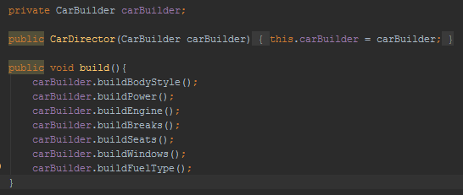
Step 3: Implement a Director class
The „Director“ class must have a method, where you call all your buildMethods from the carBuilder.

Slide 11
Step 4: Test your Builder
Last but not least: write something to test the Builder!
Create a new object from one of your ConcreteBuilder classes.
Create a director and use the ConcreteBuilder object as a parameter.
Build your car by calling the build method in your director.
Get your Car by calling getCar() and print it to your Console.
Verify your output!
You are done! ☺

