Slide 1

An introduction to MPEG transport streams
all you should know before using TSDuck
version 5

Slide 2
Agenda
Transport streams
packets, sections, tables, PES, demux
DVB SimulCrypt
architecture, synchronization, ECM, EMM, scrambling
Standards
MPEG, DVB, others

Slide 3
packets and packetization
Transport streams

Slide 4
Standard key terms
Service / Program
DVB term : service
MPEG term : program
TV channel (video and / or audio)
data service (software download, application data)
Transport stream
aka. « TS », « multiplex », « transponder »
continuous bitstream
modulated and transmitted using one given frequency
aggregate several services
Signalization
set of data structures in a transport stream
describes the structure of transport streams and services

Slide 5
MPEG-2 transport stream
Structure of MPEG-2 TS defined in ISO/IEC 13818-1
One operator uses several TS
TS = synchronous stream of 188-byte TS packets
4-byte header
optional « adaptation field », a kind of extended header
payload, up to 184 bytes
Multiplex of up to 8192 independent elementary streams (ES)
each ES is identified by a Packet Identifier (PID)
each TS packet belongs to a PID, 13-bit PID in packet header
smooth muxing is complex, demuxing is trivial
Two types of ES content
PES, Packetized Elementary Stream : audio, video, subtitles, teletext
sections : data structures

Slide 6
Multiplex of elementary streams
A transport stream is a multiplex of elementary streams
elementary stream = sequence of TS packets with same PID value in header
one set of elementary streams for global signalization
describe the TS, the network, the operator, the services, the events, EMM’s, etc.
one set of elementary streams per service
a service is typically a TV channel
global signalization streams
PMT
service 1 streams
video
audio 1
audio 2
transport stream
subtitles 1
subtitles 2
service 2 streams
ECM 1
ECM 2

Slide 7
TS packet
4-byte header includes :
Sync byte = 0x47
PID : 13 bits
Continuity counter : 4 bits
Payload Unit Start Indicator (PUSI) : 1 bit
Transport scrambling control : 2 bits
Adaptation field presence : 1 bit
Payload presence : 1 bit
More…
Adaptation field may include :
Program Clock Reference (PCR / OPCR)
Private data
Stuffing (for PES stream padding)
More…
TS packet without adaptation field
AF = 0
47
header : 4 bytes
payload = 184 bytes
TS packet with adaptation field
AF = 1
adaptation field size
47
header : 4 bytes
adaptation field
payload < 184 bytes

Slide 8
Multiplexing and demultiplexing
Elementary stream = concatenation of all payloads of all TS packets with same PID
Elementary stream transport
packetization = cutting ES into packets payloads with same PID
setting Payload Unit Start Indicator (PUSI) in TS header on « unit » boundary
multiplexing = mixing with packets from other PID’s to build a complete TS
demultiplexing = extracting all packets with same PID from TS
depacketization = rebuilding ES from packets payloads with same PID
using PUSI to resynchronize on « unit » boundary
Elementary stream :
packetization
TS packets :
depacketization
Elementary stream :

Slide 9
Packetized Elementary Stream (PES)
A stream of PES packets
up to 65536 bytes per PES packet
start of PES packet identified by PUSI bit in TS header
PES packets can contain
video : MPEG-2 (H.262), AVC (H.264), HEVC (H.265), etc.
audio : MPEG-2 Layer 2, AAC, HE-AAC, AC-3, DTS, DTS-HD, etc.
DVB subtitles (text or bitmap)
teletext (deprecated but still used)
One elementary stream contains one single type of content
video
audio for one language (with or without « audio description »)
multi-channel audio (stereo, 5+1, etc.) within same PID
subtitles for one language (with or without « for hard of hearing »)
exception : one teletext stream is a multiplex of several text streams (« pages »)

Slide 10
Typical PES packetization
First TS packet for PES packet
PUSI = 1
PID = nn
PES packet start code prefix
47
PCR
00 00 01 …
header
adaptation field
(optional but typical)
payload < 184 bytes
As many intermediate TS packets as required for current PES packet
(multiplexed with TS packets from others PID’s)
PUSI = 0
PID = nn
47
header
payload = 184 bytes
Last TS packet for PES packet
fill adaptation field with enough stuffing so that end of PES packet matches end of TS packet
PUSI = 0
PID = nn
47
stuffing
header
adaptation field
payload < 184 bytes

Slide 11
PES streams robustness
TS packet loss is tolerated in audio and video streams
video « macro-block » effect
audio « glitch » effect
quality of recovery based on decoder implementation
TS packet loss detection based on continuity_counter
4-bit field in TS packet header
cannot detect loss of an exact multiple of 16 TS packets
resynchronization on next TS packet with PUSI
But video / audio decoders can resynchronize within PES packet
video / audio bitstream formats usually contain synchronization patterns
example : NAL unit boundary in AVC encoding

Slide 12
Sections streams
Contain data structures named « tables »
A table is split into one or more « sections »
section = smallest data unit, up to 4096 bytes
standard header and type-specific payload
table type identified by table_id in header
two types of section syntax : « short » and « long »
based on 1 bit in header
Each type of table defines its own syntax
use long or short sections
payload bitstream syntax
Descriptor
standard substructure with standard header and type-specific payload
most tables use generic « lists of descriptors »

Slide 13
Typical section packetization
TS packet containing the start of section n+1
pointer field (to first start of section)
section size
PUSI = 1
PID = nn
table id
47
end of section n
start of section n+1
header : 4 bytes
payload = 184 bytes
As many intermediate TS packets as required for section n+1
(multiplexed with TS packets from others PID’s)
PUSI = 0
PID = nn
47
continuation of section n+1
header : 4 bytes
payload = 184 bytes
Last TS packet for section n+1, start of next section
pointer field
section size
table id
section size
PUSI = 1
PID = nn
table id
47
end of section n+1
section n+2
start of section n+3
header : 4 bytes
payload = 184 bytes

Slide 14
Tables with short section
One section per table
section and table are equivalent
Each table brings new information
CAS EMM / ECM
date and time information (TDT / TOT)
No standard integrity check
except section length in section header
some table-specific mechanisms
cryptographic integrity in EMM / ECM
CRC32 in TOT

Slide 15
Tables with long sections
Up to 256 sections per table
need to receive all sections to rebuild the complete table
Same table repeatedly cycled
Content change notification
version number in long section header
each table is repeatedly broadcast with same version number
version number changes when table content changes
STB software sets demux filters to be notified of new tables only
Integrity check
CRC32 in each section
section rejected in case of corruption, can be detected at demux level
resynchronization on next TS packet with PUSI

Slide 16
Signalization: PSI / SI
DVB (mandatory)
DVB (optional)
MPEG-2
PID 16
PID 16
NIT Actual Network
NIT
Other Network
Network Information
PSI : Program Specific Info.
MPEG-defined
ISO / IEC 13818-1
TS structure: PAT, PMT
CA : CAT
SI : Service Information
DVB-defined
ETSI EN 300 468
private sections in MPEG terms
PID 0
PAT
PID 17
BAT
Bouquet Association
PID 1
CAT
PID 17
PID 17
SDT Actual TS
SDT
Other TS
Service Description
PMT
PID 18
PID 18
PID 18
EIT Actual TS
present / follow
EIT Actual TS
schedule
EIT Other TS
present / follow
schedule
Event Information
Extracted from DVB standard ETSI EN 300 468
PID 2
PID 20
PID 20
TSDT
TDT
TOT
Time & date
PID 19
RST
Running Status

Slide 17
MPEG-defined PSI
PAT : Program Association Table
repeated in PID 0
list of « services » in the TS, ie. TV channels or data channels
service id and PMT PID
PMT : Program Map Table
technical description of one service
list of elementary streams in the service
PID, type (audio, video, etc.), additional info using a list of descriptors
list of ECM streams for this service
CAT : Conditional Access Table
repeated in PID 1
list of EMM streams on this TS
CAT not present when no EMM on TS

Slide 18
DVB-defined SI (1/2)
SDT : Service Description Table
editorial description of the services in a TS
either in « actual » TS or « other » TS
service names and ancillary services
BAT : Bouquet Association Table
commercial operator description and services
several commercial operators may sell the same services
NIT : Network Information Table
technical description of a network
either « actual » network or « other » network
list of TS in this network
usually with frequency and tuning parameters
used for fast network scanning
list of services in each TS
service ids and « logical channel number »

Slide 19
DVB-defined SI (2/2)
EIT : Event Information Table
editorial description of events
either in « actual » TS or « other » TS
EIT « present / following »
short description of current and next event on each service
used to display information banner on screen
EIT « schedule »
long description of all events in the forthcoming days
used to display the EPG
optional, depends on operator’s good will and bandwidth availability
complete 7-day EPG for a large operator uses several Mb/s
sparse EIT schedule sections, rarely complete tables
TDT / TOT : Time and Date Table / Time Offset Table
current date and time, UTC (TDT) and local offset by region (TOT)
used to synchronize STB system time
typically one table every 10 to 30 seconds only

Slide 20
one network, several conditional access systems
DVB SimulCrypt

Slide 21
Standard key terms
CAS : Conditional Access System
CW : Control Word
content encryption key for video & audio
EMM : Entitlement Management Message
CAS-specific message to manage rights, smartcards, subscribers
sent to some identified set of subscribers, possibly only one
ECM : Entitlement Control Message
CAS-specific message to control a scrambled service
sent to everyone willing to watch the service

Slide 22
DVB SimulCrypt
Enforce coexistence of multiple CAS to protect the same content
DVB-defined standard
Use-cases
one broadcast operator, multiple commercial operators
transition between CAS generations
Broadcast
very simple architecture
common scrambling
multiple EMM and ECM streams with standard signalization
Head-end
complex architecture
multiple CAS equipment
common synchronization

Slide 23
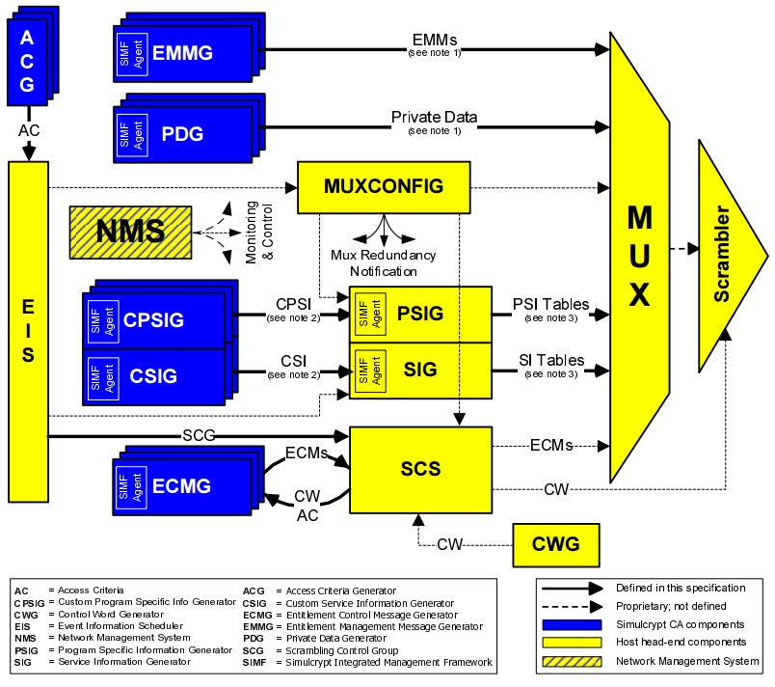
DVB SimulCrypt head-end diagram
Extracted from DVB standard ETSI TS 103 197

Slide 24
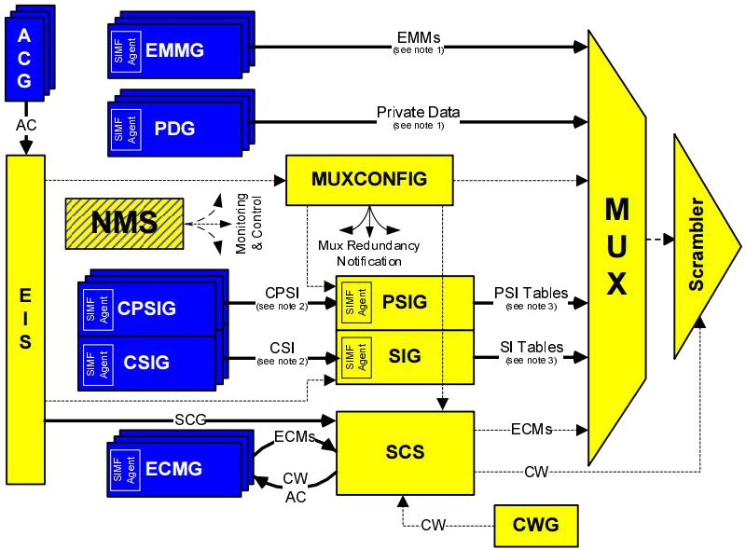
DVB SimulCrypt head-end
Interface between two worlds
one « MUX system » vendor
yellow components
multiple CAS vendors
blue components
DVB SimulCrypt protocols
specified between components of distinct worlds
protocols within the same world are not specified
proprietary, vendor specific
consistent nested tag-length-value (TLV) structures
using logical « channels » and « streams »
except ACG ⬄ EIS protocol (XML protocol)
EIS ⬄ SCS protocol is specified
so that EIS and SCS may in fact come from distinct vendors
TSDuck plugins
scrambler interacts with any standard ECMG
datainject interacts with any standard EMMG or PDG

Slide 25
EMM signalization
Using CA_descriptor in the CAT of the TS
standard part of CA_descriptor: CA system id, EMM PID
CA_system_id are allocated by DVB
http://www.dvbservices.com/identifiers/ca_system_id
private part of CA_descriptor: CAS-specific
used by the CA software in the STB
Number of EMM streams is CAS-specific
for instance, one EMM stream may contain all EMM’s for
one operator
one EMM type (e.g. individual, group, global)
or any other configuration
when they exist, operator id and EMM types are CAS-specific concepts
they are usually identified in the private part of the CA_descriptor

Slide 26
ECM broadcast
An ECM usually transports a CW pair and access criteria
specific to one or more audio or video streams
specific to one CAS
Each service (i.e. channel) has dedicated ECM streams
per scrambling group
per CAS
base mechanism for DVB SimulCrypt
Scrambling group
a set of audio or video elementary streams scrambled with the same CW
subtitles are usually not scrambled in practice (but could be in theory)
usually, all audio and video streams of a service are in the same scrambling group
in rare cases, audio and video streams are scrambled with distinct CW

Slide 27
ECM signalization
Using CA_descriptor in the PMT of the service
standard part of CA_descriptor : CA system id, ECM PID
same as EMM signalization
private part of CA_descriptor: CAS-specific
used by the CA software in the STB
CA_descriptor private part is usually different in CAT (EMM) and PMT (ECM)
sample content : operator id, public subset of access criteria
Two possible positions for CA_descriptors in PMT
at program level
only if one single scrambling group
at stream level
mandatory if different ES use different CW
take precedence over program level if both are used for same CA_system_id

Slide 28
Scrambling synchronization : principles
During one crypto-period (CP) number N
typically 10 seconds
scrambling using same CW_{N}
ECM_{N} carries CW_{N} and CW_{N+1}
initial ECM broadcast delayed from start of CP (CAS specific)
ECM_{N} is repeated several times during CP_{N} (typically 10 ECM/s)
if first ECM_{N+1} is missed, the descrambler already knows CW_{N+1} anyway
The CA software configures the descrambler with both CW_{N} and CW_{N+1}
either N or N+1 is « even », the other one is « odd »
TS packet header contains 2-bit transport_scrambling_control
used by the descrambler to select the appropriate CW
00 : clear, do not descramble (MPEG-defined: ISO 13818-1)
10 : use even CW (DVB-defined: ETR 289)
11 : use odd CW (DVB-defined: ETR 289)
Implemented in TSDuck plugin scrambler

Slide 29
Scrambling synchronization : head-end view
Based on crypto-period (CP) number
CP numbers are sequentially allocated by SCS
the full CP number stays on head-end
its parity is used in TS packets and ECM’s
CWG
TS packet
message
parity = odd CW = AA..AA
MUX / Scrambler
random stream
AA .. .. AA
BB .. .. BB
11
➔ transport_scrambling_control
scrambled with « odd » CW
SCS
CP number is odd
ECM
About to start
CP number 165
message CP num = 165 CW = AA..AA
CP num = 166 CW = BB..BB
ECMG
CW :
BB..BB
AA..AA
even
odd
CP number is even

Slide 30
Scrambling synchronization : head-end timeline
Crypto-periods timeline
Current CP number | 165 | 166 | 167
SCS → MUX | odd – AA..AA | even – BB..BB | odd – CC..CC
SCS → ECMG | 165 – AA..AA 166 – BB..BB | 166 – BB..BB 167 – CC..CC | 167 – CC..CC 168 – DD..DD
TS packet (t.s.c.) | 11 | 10 | 11
Scrambling CW | AA..AA | BB..BB | CC..CC
ECM (CW pair)
≈ 10 seconds
BB..BB
AA..AA
BB..BB
CC..CC
DD..DD
CC..CC
even
odd
even
odd
even
odd
time

Slide 31
Scrambling synchronization : receiver timeline
Loose synchronization
ECM’s may be missed
CW transition is blurry (video & audio PID’s)
No explicit synchronization between ECM’s and video/audio crypto-periods
Current CP number
165 (odd)
166 (even)
ECM content
BB..BB
AA..AA
BB..BB
CC..CC
even
odd
even
odd
Video PID CW
AA..AA
BB..BB
Audio PID CW
AA..AA
BB..BB
ECM received
ECM 0x80
ECM 0x81
ignored
(redundant)
ECM reception
time
missed
delay start (head-end)
t₁
t₂
t₃
t₄
t₅
t₆
t₇
t₈
t₉
t₁₀
t₁₁
t₁₂
t₁₃
t₁₄
t₁₅
t₁₆
t₁₇
t₁₈
t₁₉
t₂₀
ECM processing (smartcard)
descrambler setup (chipset)
BB..BB
AA..AA
BB..BB
CC..CC
even
even
even
even

Slide 32
TS vs. PES scrambling
ISO 13818-1 defines two possible levels of scrambling
TS level
each TS packet is scrambled individually
clear TS header and adaptation field, scrambled TS payload
PES level
each demuxed PES packet is scrambled individually
TS packet header marked as clear
PES packet header contains similar 2-bit PES_scrambling_control
clear PES header, scrambled PES payload
In practice, only TS-level scrambling is used
PES-level scrambling is technically much more difficult
scrambling is performed on multiplexed TS
ETR 289 specifies sub-scrambling of 184-byte super-blocks
PES packet boundaries not aligned on crypto-period boundaries
PES-level scrambling is never used in practice

Slide 33
EMM & ECM tables
CA-private in DVB-defined range
ETSI ETR 289 defines the range of private CA table ids
0x80 – 0x81 : ECM
0x82 – 0x8F : « CA private »
defined as « short sections »
no versioning
each section is an independent new table
Typical usage
0x80 and 0x81 alternating with crypto periods
ECM table id change used as trigger by CA software to submit ECM to smartcard or TEE
ECM table id and CP number do not necessarily have the same parity
0x82 – 0x8F used for EMM’s
CAS-specific
typically one table id for each EMM type, easier to filter in STB

Slide 34
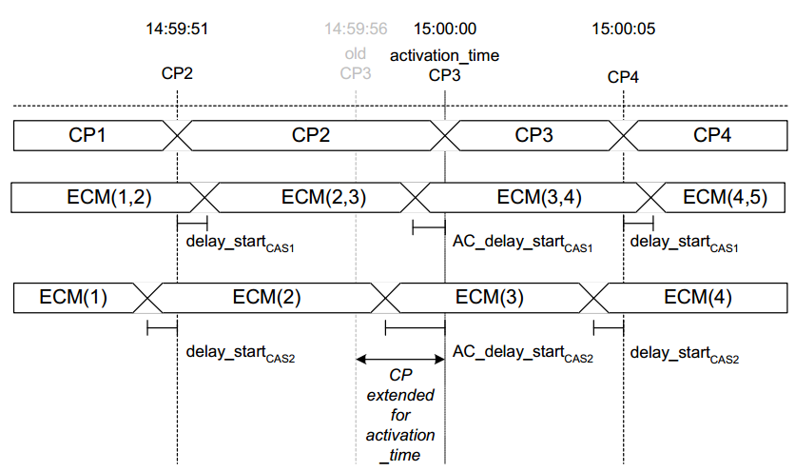
Access criteria transition
Use case : restricted event or pay-per-view event transition
Scenario :
the ECMG of each CAS had sent its own timing requirements to SCS
SCS synchronizes the generation of the ECM from each CAS
Extracted from DVB standard ETSI TS 103 197

Slide 35
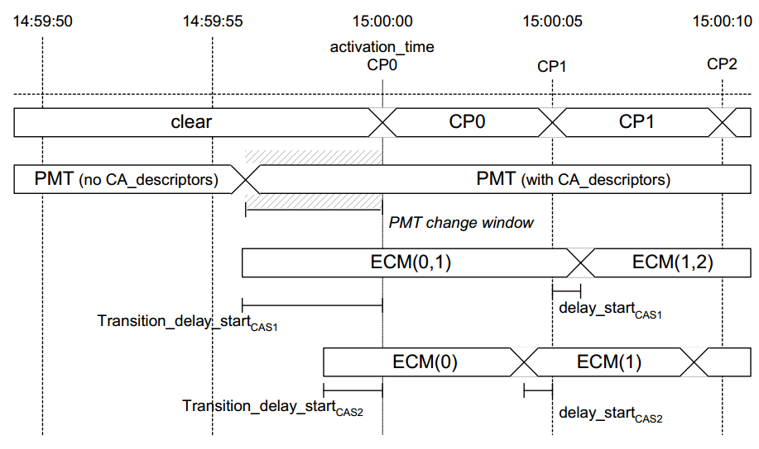
Clear-to-scramble transition
Use case : Pay-TV channel with public periods in the clear
Scenario :
the ECMG of each CAS had sent its own timing requirements to SCS
SCS synchronizes the generation of the ECM from each CAS
Extracted from DVB standard ETSI TS 103 197

Slide 36
DVB CSA-2
DVB Common Scrambling Algorithm
DVB proprietary algorithm
supposed to be « secret »
fully described in Wikipedia
open-source implementations online (libdvbcsa)
Algorithm
64-bit key (also known as « Control Words » or CW)
first pass : block cipher in reverse-CBC mode
use CW as key
block size : 64 bits
residue ignored
second pass : stream cipher
use CW as key and first block as seed (last processed block from reverse-CBC)
residue included
short payloads (1 to 7 bytes) are not encrypted
even if transport_scrambling_control is non-zero

Slide 37

DVB CSA-2 entropy reduction
Entering the twilight zone….
64-bit key
some national regulations from the 90’s prohibited 64-bit entropy
entropy was artificially reduced to 48 bits
cw[3] = (cw[0] + cw[1] + cw[2]) mod 256
cw[7] = (cw[4] + cw[5] + cw[6]) mod 256
entropy reduction is no longer required but still often applied
Operational issues
hardware scramblers and descramblers use plain 64-bit keys
CWG internally generates 64 random bits
where is the entropy reduction applied ?
common chain : CWG? SCS?
scrambling chain : MUX? scrambler?
descrambling chain : ECMG? smartcard? CA software in STB? descrambler?
who knows if entropy reduction must be applied anyway?

Slide 38
our essential references
Standards

Slide 39
Essential standards
MPEG
ISO 13818-1, MPEG-2 system layer (TS, packetization, PSI)
transport stream ➔ broadcast, blu-ray discs
program stream ➔ DVD
DVB / ETSI (Europe and more)
EN 300 468, DVB service information specifications (signalization)
TS 103 197, DVB simulcrypt head-end (CAS head-end)
ATSC (USA), ISDB (Japan, Brazil)
equivalent features as defined in DVB

Slide 40
Obtaining standards documents
ISO
https://www.iso.org/standards.html
must be purchased
DVB
http://www.etsi.org/standards
direct search : http://www.etsi.org/standards-search
allocated identifiers : http://www.dvbservices.com/identifiers/
ITU
http://www.itu.int/ITU-T/recommendations/
H.xxx series : http://www.itu.int/rec/T-REC-H/
IETF
https://tools.ietf.org/
NIST
http://csrc.nist.gov/publications/

Slide 41
Audio and video standards and nicknames
Origin | Type | ISO / IEC | ITU-T | Nicknames
MPEG-1 | Video | 11172-2 | H.261 | MPEG-1 video
MPEG-1 | Audio | 11172-3 |  | MPEG audio layer 1
MPEG-2 | Video | 13818-2 | H.262 | MPEG-2 video
MPEG-2 | Audio | 13818-3 |  | Layer 2: MPEG audio layer 2 Layer 3: MP3
MPEG-2 | Audio | 13818-7 |  | AAC (Advanced Audio Coding)
Dolby Digital | Audio |  |  | AC-3 (Audio Coding 3)
MPEG-4 | Video | 14496-2 | H.263 | DivX, Xvid (codecs)
MPEG-4 | Audio | 14496-3 |  | HE-AAC, EAAC (High Efficiency, Enhanced AAC)
MPEG-4 | Video | 14496-10 | H.264 | AVC (Advanced Video Coding)
MPEG-H | Video | 23008-2 | H.265 | HEVC (High Efficiency Video Coding)
Dolby Digital | Audio |  |  | AC-4

Slide 42
Thank you

