Slide 1

TSDuck
an extensible toolkit for
MPEG/DVB transport streams
https://tsduck.io

Slide 2

What is TSDuck ?
A general-purpose toolbox for digital TV engineers
Working on MPEG transport streams
Broadcast and IP-TV (but not OTT)
Flexible and extensible
Lots of small tools and plugins to be combined
Command line only, no GUI
Made for scripting
Available on Linux, Windows and macOS

Slide 3

TSDuck use cases
Digital television systems
test
demo
network monitoring
system integration
debug
lab

Slide 4
TSDuck sample usages
Acquisition or transmodulation : satellite, terrestrial, IP …
Analysis : TS, PSI/SI, bitrates, timestamps …
Monitoring : bitrates, A/V properties, signalization, crypto …
On-the-fly transformation or injection : content, PSI/SI …
Using and editing PSI/SI in XML or binary format
Modify, remove, rename, extract services
Inject or extract MPE, SCTE 35 splicing info
Extract T2-MI, Teletext subtitles
Test bed for CAS or STB, scrambling and DVB SimulCrypt

Slide 5
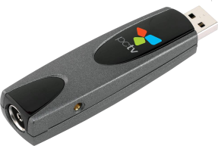
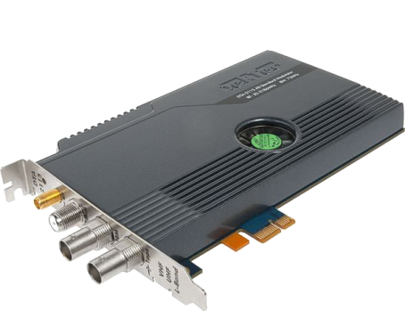
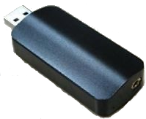
TSDuck input / output
Live transport stream or offline files equally
UDP/IP, HTTP
Specialized hardware
cheap DVB tuners (USB, PCI)
professional Dektec devices
cheap HiDes modulators
Re-route transport streams to / from other applications

Slide 6
TSP – the transport stream processor
Transport stream processing framework
combination of elementary processing using plugins
60+ standard plugins available
one input plugin
receive a TS from various sources
any number of packet processing plugins
perform transformations on TS packets
may remove packets
may NOT add packets
one output plugin
send the resulting TS to various destinations

Slide 7
TSP processing overview
tsp process
tsp executable
input plugin
packet processing plugin 1
packet processing plugin 2
packet processing plugin 3
output plugin
input TS
output TS

Slide 8

Sample MPE injection and extraction
MPE : Multi-Protocol Encapsulation
Linux or Windows
MPE encapsulation
inside existing TS
Linux or Windows
DVB
tuner
tsp
Dektec modulator
DVB
tuner
tsp
Modified destination
in UDP/IP datagrams:
230.2.3.4 : 7000
Multicast to
224.250.250.1 : 9000
Multicast to
230.2.3.4 : 7000
Network 1
Network 2
STB
Media Server
STB
STB
STB
STB

Slide 9
Multiple TSP using merge and fork plugins
Merge with a TS coming from another application
merge service references (PAT, CAT, SDT …)
Duplicate the TS to another application
tsp
tsp
input TS 1
input
plugin
plugin
file
file
plugin
plugin
output
output TS 1
tsp
input TS 2
input
plugin
merge
merge
plugin
fork
fork
output
output TS 2
tsp
tsp
input TS 3
input
plugin
plugin
file
file
plugin
plugin
output
output TS 3

Slide 10
Conditional Access System test bed
DVB SimulCrypt interface to standard CAS equipment
sample setup using French DVB-T network
UHF
antenna
MUX: R1, R2, R3, R4, R5, R6
UHF
coupler
Linux or Windows computer
STB
DVB-T
tuner
tsp
Dektec
DTA-110T
modulator
MUX: R9
ECMG
EMMG

Slide 11
Simple TSP examples
Transmodulation of a service over IP multicast
tsp –I dvb –-uhf 35 -P zap france2 –-audio fra -O ip 224.10.11.12:1000
On-the-fly replacement of a PSI / SI table
tsp -I dvb --uhf 24 -P inject nit.xml --pid 16 --replace –-stuffing -O dektec --uhf 24 --convolution 2/3 --guard 1/32
extract service « France 2 », keeping only one audio track
broadcast resulting SPTS to multicast IP address:port
replace content of PID 16 with table from XML file
send modified TS to a Dektec DVB-T modulator on same frequency

Slide 12
TSDuck utilities
TSP – transport stream processor
PSI/SI ⬄ XML compiler / decompiler
PSI/SI manipulation, extraction, injection
Analysis tools
TS files manipulation and recovery
Hardware devices configuration (tuners, modulators …)

Slide 13
TSDuck is extensible
Open source
https://github.com/tsduck/tsduck
Design based on a large TSDuck library
generic MPEG/DVB C++ library (400+ classes)
common API for Linux, Windows and macOS
programmer’s guide online
You may use this library to
develop new plugins
use in your own applications outside TSDuck

Slide 14
https://tsduck.io/

