Slide 1

VEHICLE DETECTION USING YOLOv8 AND Deep SORT
Presented By, | Under the guidance of, Prof. Manimegalai A Asst. Professor Department of CSE, EPCET
Pritish Ali(1EP21CS076)
Rupam Bhattacharyya(1EP21CS089)
Sushmitha S(1EP21CS108) Swathi S(1EP21CS109)

Slide 2
INTRODUCTION
Vehicle detection and tracking is a crucial task in various applications, including traffic monitoring, autonomous driving, and security surveillance. It involves identifying and locating vehicles in video streams or images and tracking their movements over time. YOLO (You Only Look Once) is a popular object detection algorithm that can efficiently detect multiple objects in an image. It employs a single-stage detection approach, making it faster than traditional two-stage detectors. Deep SORT is a multiple object tracking algorithm that utilizes Kalman filters and Hungarian matching to track objects in video sequences. It is known for its robustness and ability to track objects under challenging conditions such as occlusion and background clutter. Combining YOLO and Deep SORT enables a powerful vehicle detection and tracking system that can accurately identify and track vehicles in real-time. YOLO is used to detect vehicles in each frame of a video, and Deep SORT is used to track the detected vehicles across frames.

Slide 3
PROBLEM STATEMENT
Implementing a Vehicle Detection and Tracking Model using YOLO and DeepSORT
Objective:
Develop a robust and efficient vehicle detection and tracking system using YOLO and DeepSORT for real-time applications.
Challenges:
Accuracy
Real-time performance
Computational efficiency
Adaptability

Slide 4
EXISTING SYSTEM
Existing vehicle detection and tracking systems often employ traditional object detection methods, such as Viola-Jones or HOG (Histogram of Oriented Gradients), combined with tracking algorithms like Kalman filters or particle filters.
Limitations:
Limited Detection Accuracy
Real-time Performance Challenges
Susceptibility to Occlusions and Background Clutter
Limited Adaptability
Higher Computational Requirements

Slide 5
PROPOSED SYSTEM
The proposed system utilizes a combination of YOLO (You Only Look Once) for object detection and DeepSORT for multiple object tracking to achieve accurate and efficient vehicle detection and tracking.
ADVANTAGES:
Improved Detection Accuracy
Real-time Performance
Robust Tracking
Adaptability
Computational Efficiency

Slide 6
AIM OF THE PROJECT
The proposed project aims to develop an efficient and accurate vehicle detection and tracking system using the YOLO (You Only Look Once) object detection framework and Deep SORT (Deep Simple Online and Realtime Tracking). This system aims to leverage the real-time capabilities of YOLO for precise vehicle detection and utilize the tracking capabilities of Deep SORT to maintain consistent and reliable tracking of vehicles over consecutive frames. The overarching goal is to create a robust solution for real-world applications, enhancing the capabilities of surveillance, traffic monitoring, and other relevant domains through advanced computer vision techniques.

Slide 7
OBJECTIVES
Accurate Vehicle Detection
To analyze Real-time Performance
Perform Robust Tracking

Slide 8
LITERATURE SURVEY
Author | Title | Year | Description | Merit | Demerit
Aydin, I., et al. | Real-time Vehicle Detection and Tracking using YOLO-based Deep Sort Model | 2022 | Proposes a vehicle detection and tracking system using YOLOv4 and DeepSORT. Achieves a mean average precision (mAP) of 80% and a frames per second (FPS) of 45. | High detection accuracy and real-time performance. | May not be suitable for very low-light conditions.
Gupta, S., et al. | Vehicle Detection and Tracking using YOLO and DeepSORT | 2022 | Compares the performance of YOLOv3 and YOLOv4 in combination with DeepSORT for vehicle detection and tracking. Shows that YOLOv4 outperforms YOLOv3 in terms of both accuracy and speed. | Higher detection accuracy and faster processing speed than YOLOv3. | May require more computational resources than YOLOv3.
Fang, Y., et al. | City Tracker: A Multi-Object Tracker for Tracking Vehicles in Traffic Videos | 2020 | Proposes City Tracker, a multi-object tracking system that combines YOLOv3 and DeepSORT. Achieves a MOTA (Multiple Object Tracking Accuracy) of 0.8989 and a MOTP (Multiple Object Tracking Precision) of 0.4265. | High tracking accuracy and adaptability to complex traffic scenarios. | May not be as efficient as lighter-weight tracking algorithms.
Li, Y., et al. | Real-time Vehicle Detection and Tracking with Improved YOLO and DeepSORT Methods | 2022 | Proposes an improved YOLO and DeepSORT model for vehicle detection and tracking. Achieves a mAP of 85.84% and an FPS of 18.65. | Higher detection accuracy and faster processing speed than the original YOLO and DeepSORT models. | May require more computational resources than the original models.
Liu, Y., et al. | Research on Two-Way Detection of YOLO V5s+ Deep Sort Road Vehicles Based on Attention Mechanism | 2023 | Proposes a YOLO v5s and DeepSORT model with an attention mechanism for vehicle detection and tracking. Achieves a mAP of 87.2% and an FPS of 25. | Higher detection accuracy and better handling of occlusion compared to the original YOLO and DeepSORT models. | May require more computational resources than the original models.

Slide 9
HARDWARE REQUIREMENT
Processor : AMD Ryzen 5 3450U with Radeon Vega Mobile Gfx 2.10 GHz
Memory : 4GB
Disk : 40GB
Display : 15-inch color
RAM: At least 8 GB

Slide 10
SOFTWARE REQUIREMENTS
Coding : Python
Operating System : Windows 11
Platform : Python 3.12
Tool : Visual Studio Code
Libraries : NumPy, Ultralytics, PyTorch , OpenCV, Matplotlib

Slide 11
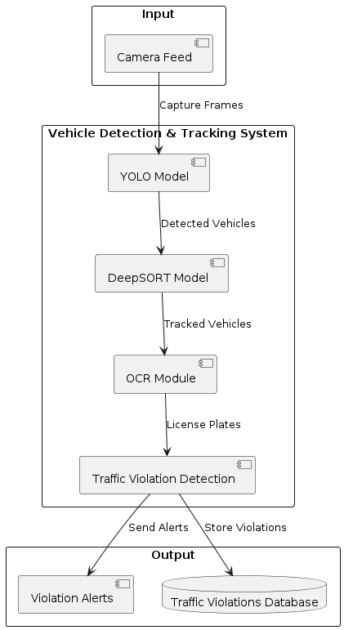
SYSTEM ARCHITECTURE

Slide 12
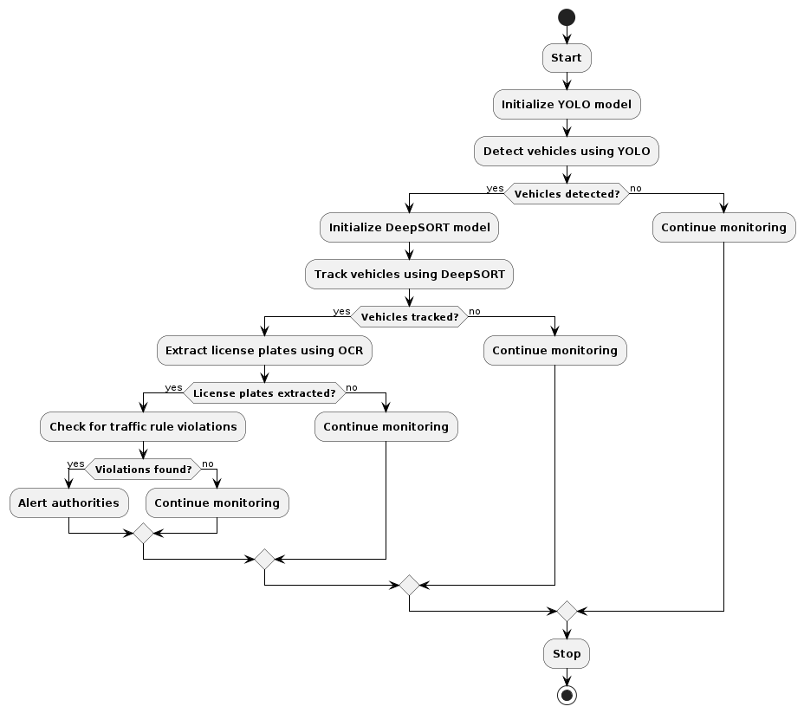
ACTIVITY DIAGRAM

Slide 13
SYSTEM IMPLEMENTATION
Environment Setup.
Download YOLO Model.
Configuration.
Code Implementation.
Run the code.

Slide 14
UNIT TESTING
Definition: Unit testing involves testing individual units or components of the software independently.
Tools Used: Python's unit test framework or pytest for writing and running unit tests.
Test Coverage: Ensure each function/method is tested with various input scenarios (e.g., different types of vehicle images).
Example: Test YOLOv8 detection functions with mock input data to validate expected outputs.

Slide 15
INTEGRATED TESTING
Definition: Integrated testing checks the combined behavior of components working together as a system.
Scope: Test interactions between YOLOv8 (vehicle detection) and Deep SORT (tracking) modules.
Mocking: Use mock objects or stubs to simulate dependencies during integration testing.
Example: Test YOLOv8 outputs as inputs to Deep SORT to ensure proper tracking initiation.

Slide 16
SYSTEM TESTING
Definition: System testing evaluates the overall behavior of the system as a whole.
Test Scenarios: Define test scenarios (e.g., detecting vehicles in different weather conditions, tracking vehicles in crowded scenes).
Performance Metrics: Measure system performance (e.g., accuracy, real-time processing speed).
Example: Run the entire pipeline on a diverse dataset and assess detection and tracking accuracy.

Slide 17
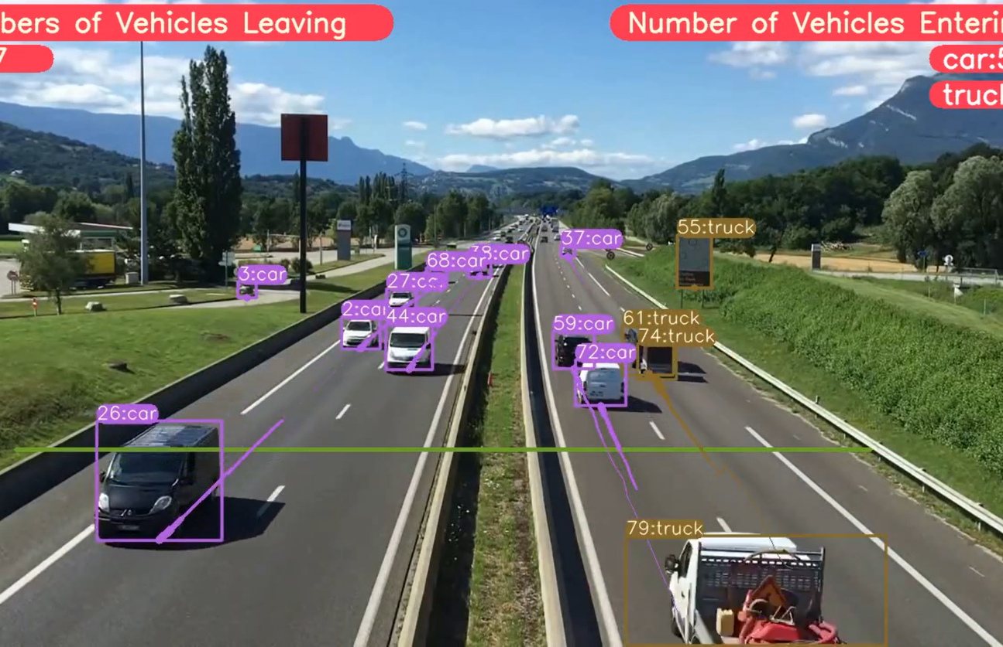
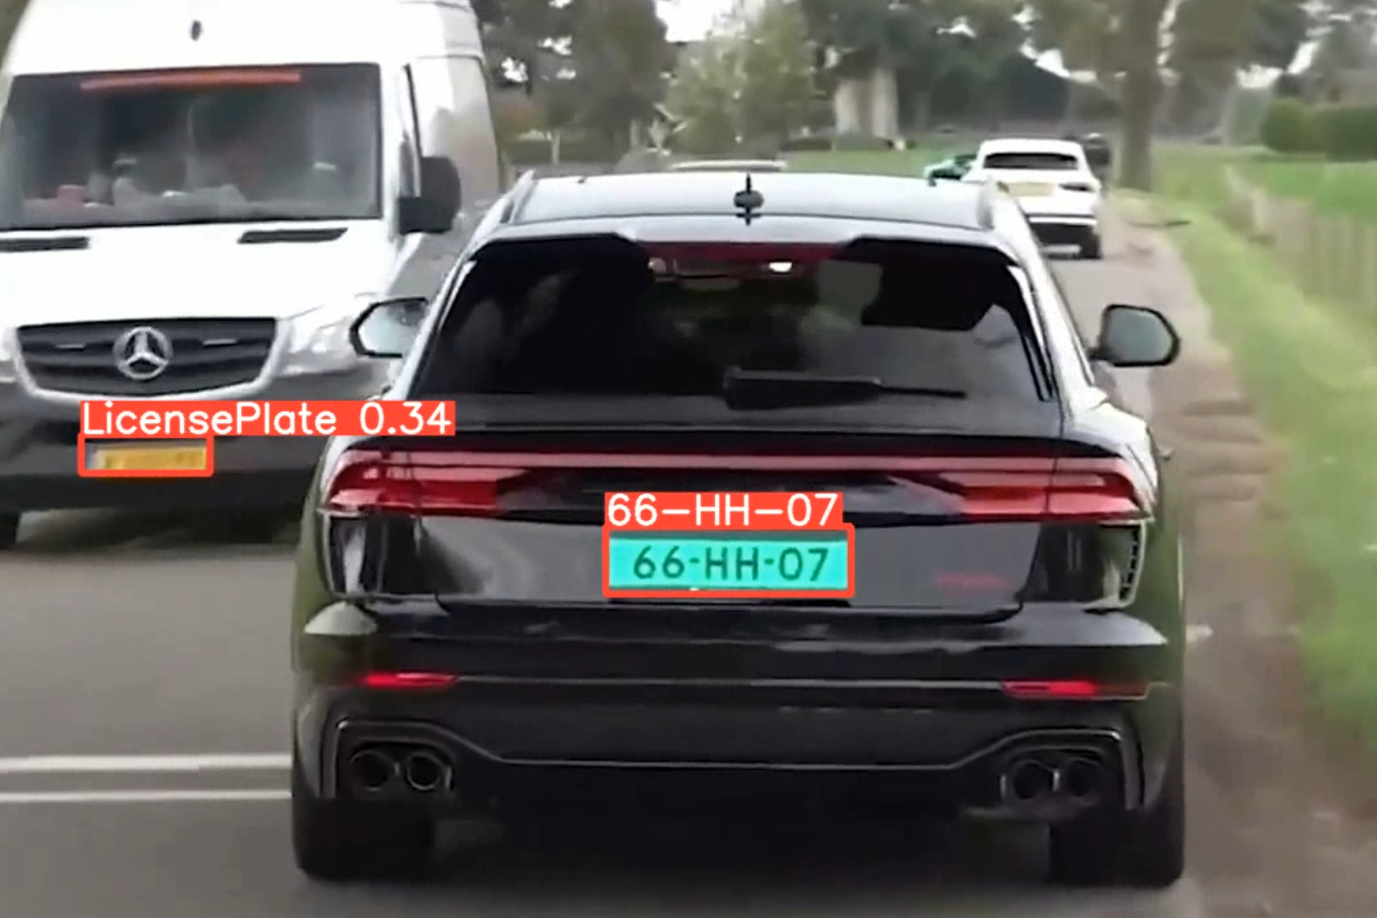
RESULT AND RESULT ANALYSIS

Slide 18
PROJECT SCHEDULE
Tasks | May | June |  |  | July |  | Aug | Sept
Requirement Analysis
Designing
Test Cases
Coding with unit testing
Testing
Documentation

Slide 19
CONCLUSION
The combination of YOLO and Deep SORT has emerged as a powerful and versatile tool for vehicle detection and tracking. Their ability to operate in real-time, handle challenging conditions, and adapt to different environments makes them suitable for a wide range of applications. As research in these areas continues, we can expect further improvements in accuracy, efficiency, and robustness, further enhancing the capabilities of vehicle detection and tracking systems.

Slide 20
FUTURE ENHANCEMENT
Enhanced Accuracy
Real-Time Optimization
Multi-Object Tracking
Adaptive Learning
Deployment and Integration
Privacy and Ethical Considerations

Slide 21
REFERENCES
[1] Anthony Lim, “Vehicles Registrations in Malaysia - 31.2 mil as of 2019,” Paultan.org, Apr. 02, 2020.
[2] T. Afrin and N. Yodo, “A survey of road traffic congestion measures towards a sustainable and resilient transportation system,” Sustain., vol. 12, no. 11, pp. 1–23, 2020, doi: 10.3390/su12114660.
[3] M. D. Chow, “Alibaba and Sena to develop smart traffic solution to ease congestion,” May24,2019 12:02 AM.
[4] J. Redmon, S. Divvala, R. Girshick, and A. Farhadi, “You only look once: Unified, real-time object detection,” Proc. IEEE Comput. Soc. Conf. Comput. Vis. Pattern Recognit., vol. 2016-Decem, pp. 779– 788, 2016, doi: 10.1109/CVPR.2016.91. A. Bochkovskiy, C. Y. Wang, and H. Y. M. Liao, “YOLOv4: Optimal Speed and Accuracy of Object Detection,” arXiv, 2020. [6] J. Xiong, W. Cui, W. Zhang, and X. Zhang, “YOLOv3-Darknet with Adaptive Clustering Anchor Box for Intelligent Dry and Wet Garbage Identification and Classification,” Proc. - 2019 11th Int. Conf. Intell. Human-Machine Syst. Cybern. IHMSC 2019, vol. 2, no. 99, pp. 80–84, 2019, doi: 10.1109/IHMSC.2019.10114.

Slide 22
QUERIES?

Slide 23
THANK YOU

