Slide 1

Carpal Tunnel Syndrome Night Mitten
Innovative solution for CTS

Slide 2

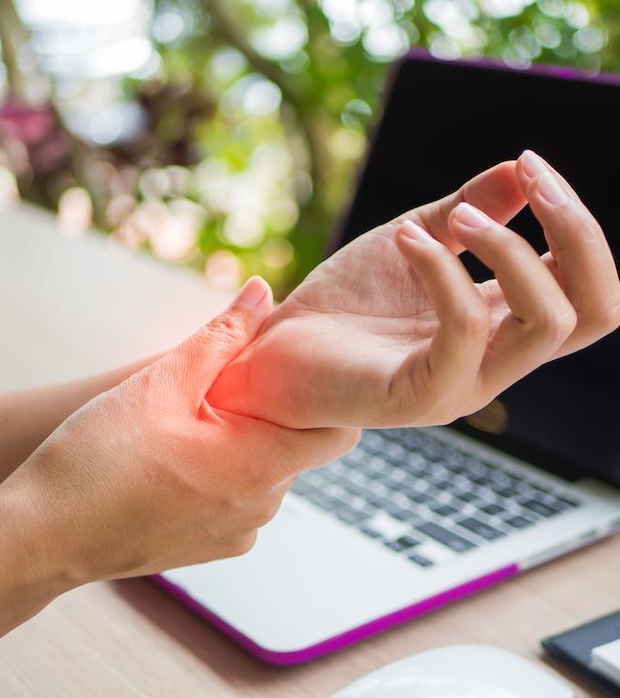

Market Need
CTS affects millions worldwide (10% of adults may experience CTS).
Traditional splints often fail to provide the desired effect.
Patients seek non-invasive, comfortable solutions.
Orthopedic shops need innovative products to expand their portfolio.

Slide 3
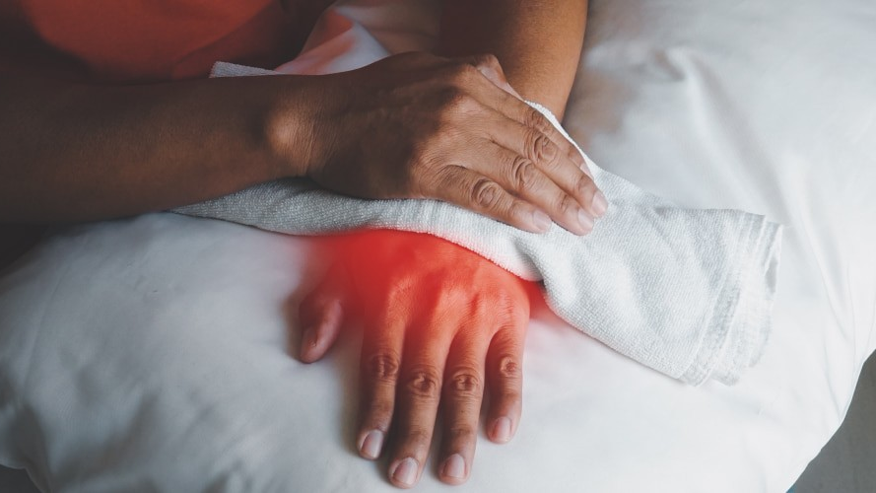
Night symptoms
PAIN
TINGLING
NUMBLESS
FREQUENT WAKE-UPS

Slide 4
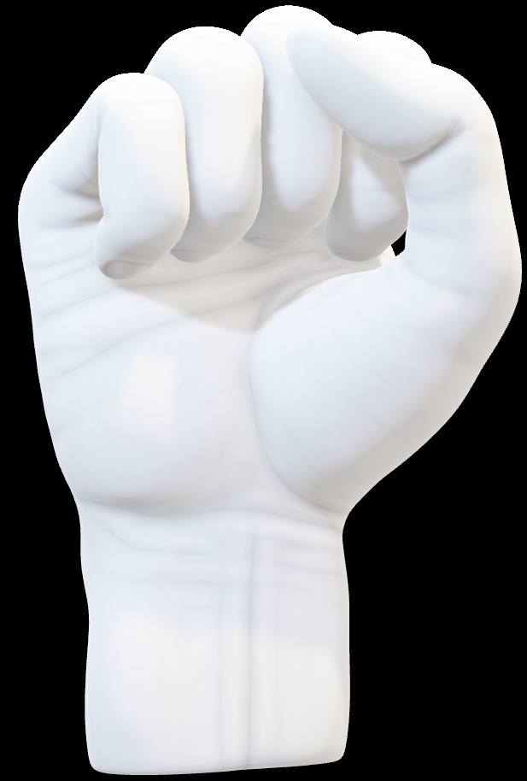
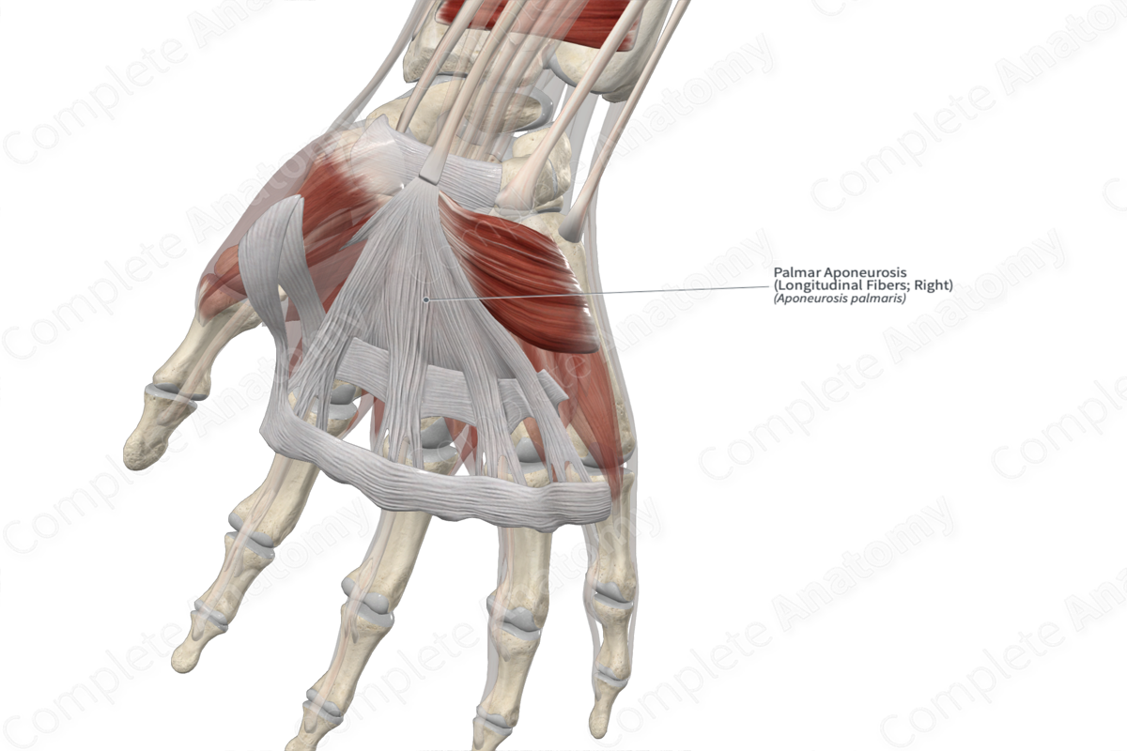
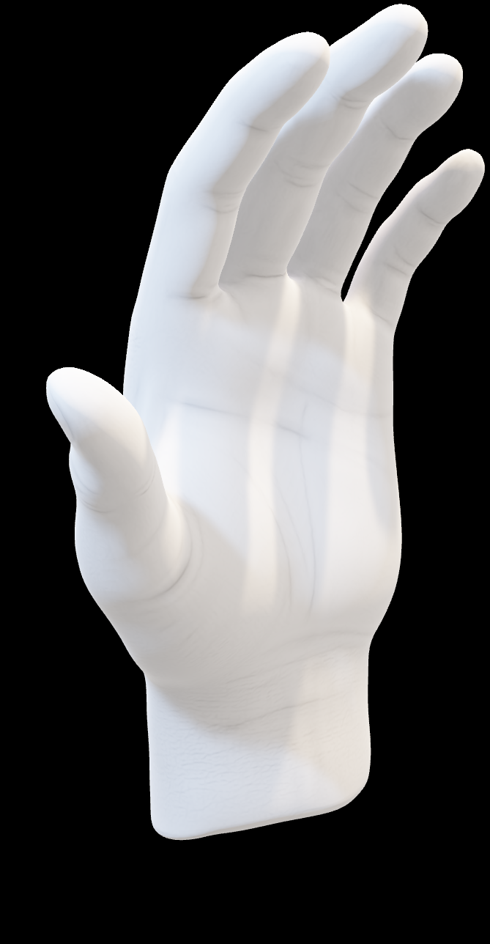
Finger flexion
Simple move
Powerful relief
CTS Relief Revolution
Reduce tendon bulk in tunnel
By flexing the fingers, the median nerve is slackened, tendon bulk is reduced, and space within the tunnel is optimized — relieving CTS pressure at its source.
Slacken the median nerve
Optimize space in tunnel

Slide 5
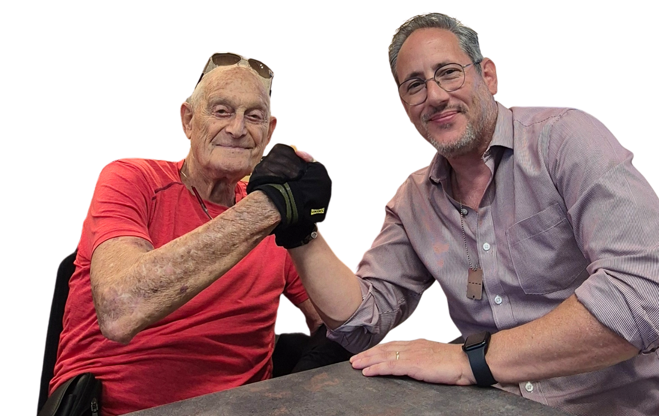
Collaboration That Transformed CTS Care
Born from orthopedic expertise and URIEL’s innovation, this partnership turned a simple idea — inspired by an oven mitten — into a medical device.
Together, we redefined how CTS can be managed: conservative, non-invasive, and effective.
Prof.Daniel Reis Orthopedic Surgeon and President Emeritus
of the Israeli Orthopedic Association
Shachar Hirsh CEO URIEL Meditex Group LTD.

Slide 6
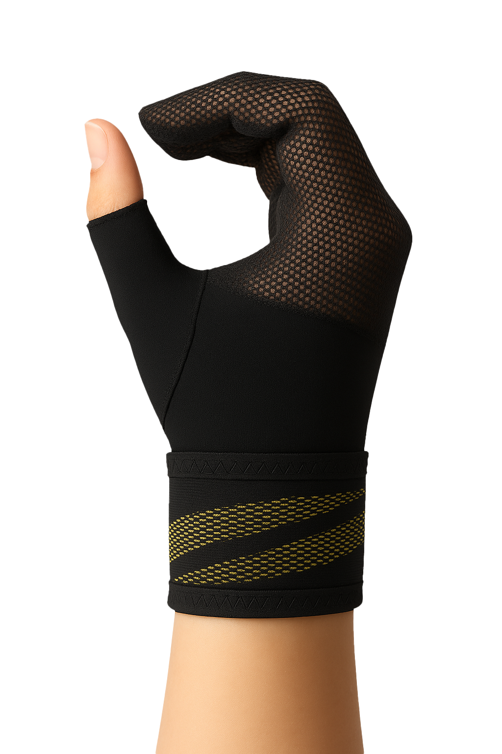
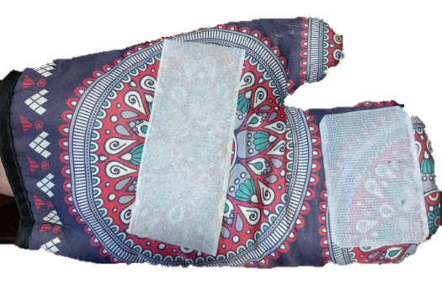
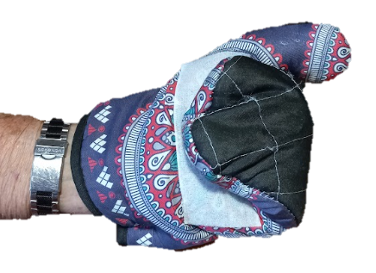
Innovation often begins with simplicity an oven mitten that became a medical breakthrough
Velcro attachment open
Velcro attachment closed

Slide 7
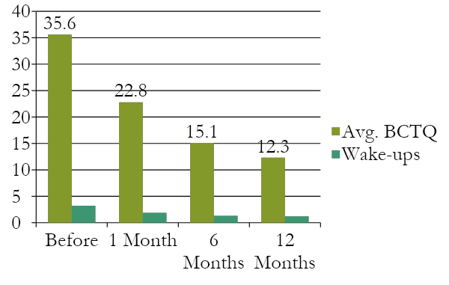
Clinical Evidence
1-Month Pilot Study with CTS-patients in one or two hands
Boston Carpal Tunnel Questionnaire (BCTQ) results:
Most patients improved after first month
Only 11% required further surgical consideration
Patients reported better sleep, fewer wake-ups, and pain relief

Slide 8
CTS Night Mitten - Nighttime Pain Relief Support
Supports finger flexion position for nerve decompression
Lightweight breathable mitten design with Velcro fastening
Comfortable fit throughout the night
Three sizes for perfect fit
Washable, durable, consumer-friendly

Slide 9
Why It Stands Out
Unique differentiator vs. standard wrist splints
Conservative, non-invasive option for early CTS management
Expands offering into nighttime therapy solutions
High potential for retail pharmacies, orthopedics, online sales

Slide 10

SHIELD SERIES
Innovative orthopedic support

Slide 11
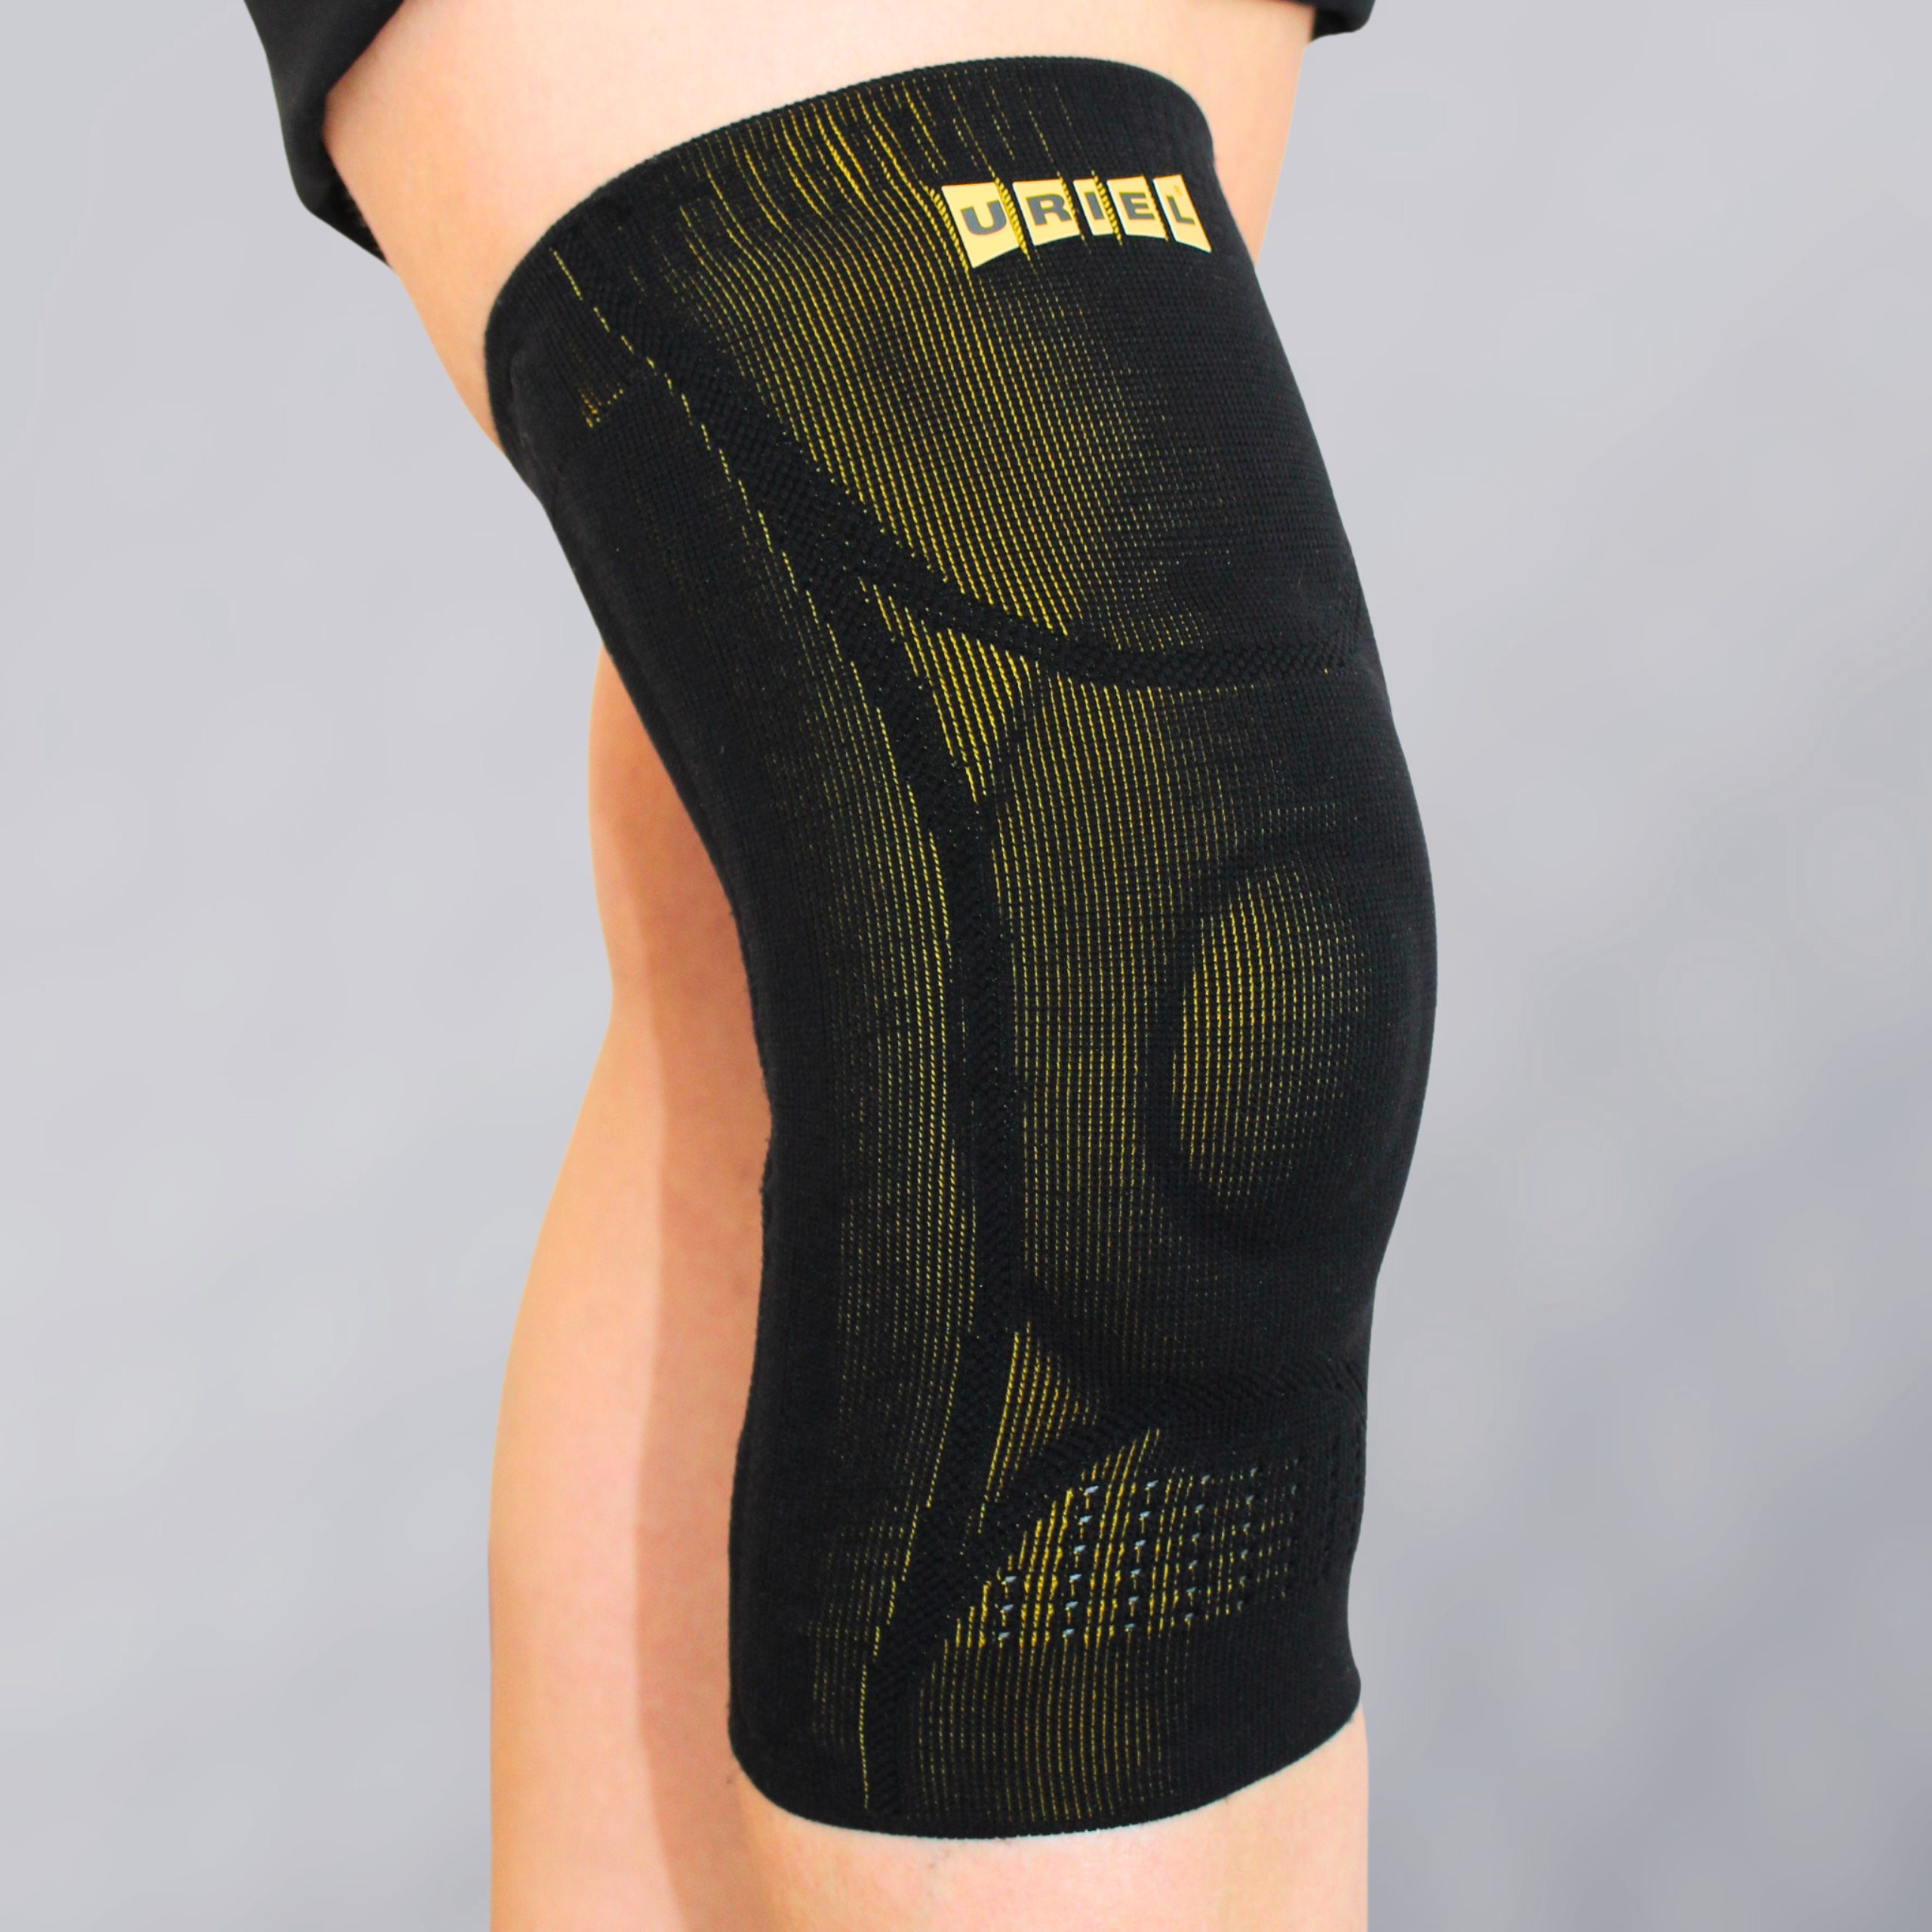
GenuShield Knee Support
With flexible stays & gel pad
Advanced support for stability, pain relief & swelling reduction.

Slide 12
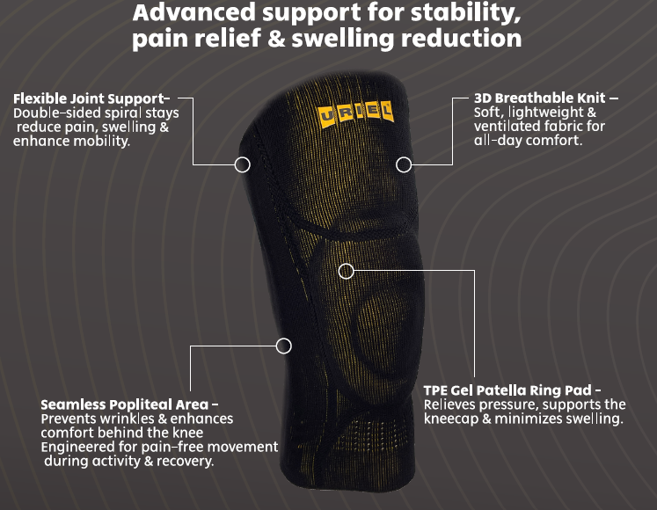

Slide 13
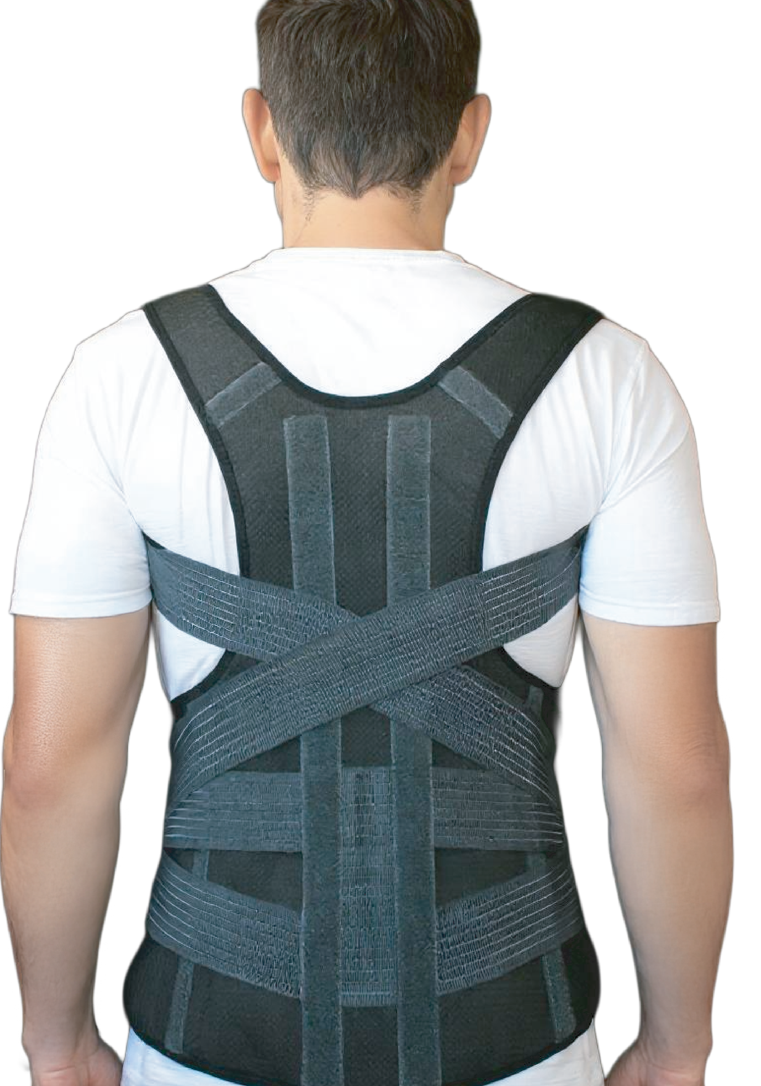
SpinaShield Posture Corrector Belt
Advanced and lightweight posture corrector
designed to improve spinal alignment and reduce
upper back and shoulder pain. Featuring comfortable, adjustable straps, it supports upright posture, relieves muscle tension, and encourages natural movement.
Ideal for those who sit for long hours, suffer from poor posture, or seek pain relief in daily life.
-Supports natural spinal alignment.
-Helps relieve neck and upper back pain.
-Discreet, slim, and comfortable for everyday use.
for Spine and Shoulders

Slide 14
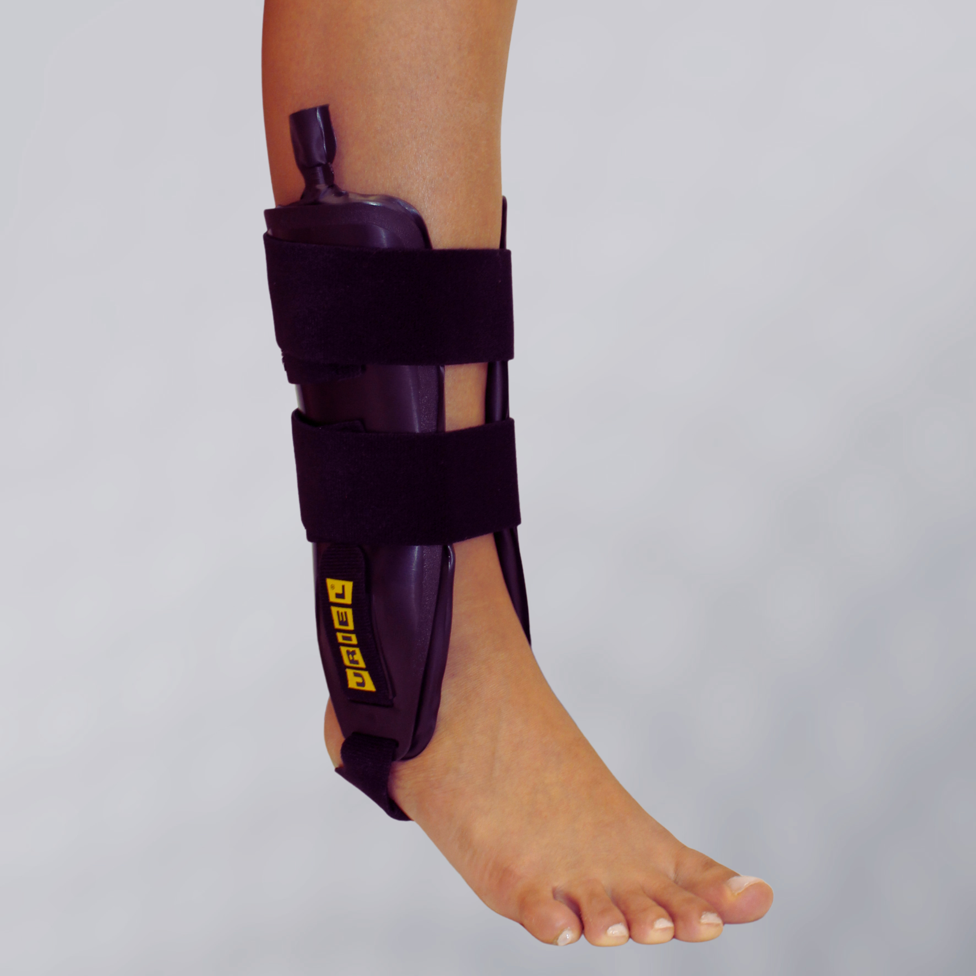
TaluAir Shield Ankle Stabilizer
TaluAir Shield Ankle Stabilizer is a rigid ankle brace that restricts side-to-side movement and delivers strong lateral stabilization after acute sprains, ligament injuries, or instability.
The inflatable cushions allow a customized fit and help reduce swelling during the critical first days of recovery.
Dual-sided Ankle Brace with Air Cushions
Medical Indications:
Acute ankle sprains, Chronic instability, Lateral ligament injuries, Post-trauma stabilization, Early rehabilitation phase.

Slide 15
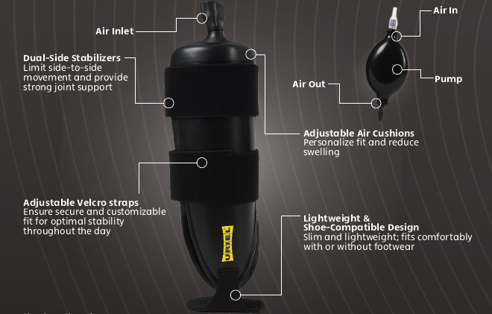

Slide 16
Thanks!

