Slide 1


DESIGN TO PERFORM
A global orthotics & footcare manufacturer
COMPANY PROFILE

Slide 2

A GLOBAL ORTHOTICS &
FOOTCARE MANUFACTURER
"At URIEL, we develop, manufacture, and market the most exceptional medical devices and services for a variety of different purposes.
Our products combine updated and state-of-the-art design, impact driven, high quality and innovative technologies all to provide the most efficient solutions, from injury prevention to rehabilitation, with a high level of performance, based on more than 50 years of practical experience and research.
Our mission is to inspire and motivate people, at any age, to live a more fulfilling and active life."
OUR VISION & MISSION

Slide 3
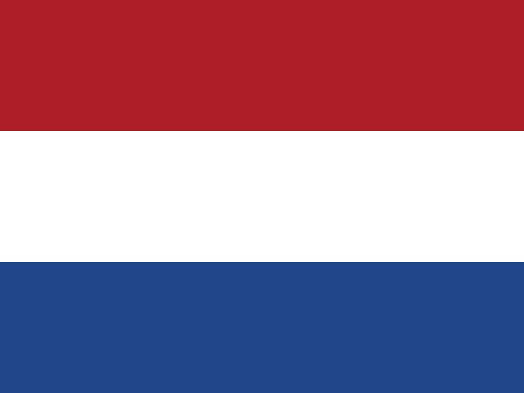



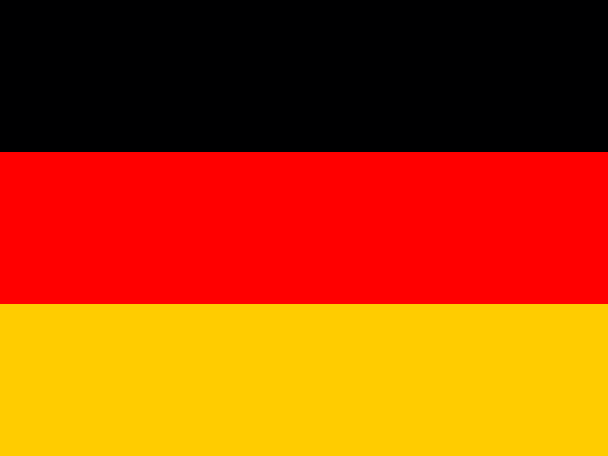







WORKING
WITH THE
LEADING
HOSPITALS
Netherlands
Switzerland
Austria
Israel
Germany

Slide 4


WHY URIEL?
50
✓
50 years of outstanding reputation
YEARS OF
REPUTATION
650+
✓
Premium materials
Innovative products designed by doctors and physiotherapists
PRODUCT
SKUs
✓
20+
✓
Over 650 SKUs
COUNTRIES
WORLDWIDE
✓
Global brand, sold in 20+ countries
FDA, CE - regulation approved
FDA · CE APPROVED
✓

Slide 5

SOLUTIONS FOR THE
WHOLE BODY
Uriel's product line covers the full range of possible needs from neck to toe and comes in a full range of sizes to accommodate all body types

Slide 6





URIEL LEADERSHIP TEAM
The people driving 50 years of orthotics & footcare excellence
SHACHAR HIRSH
AMIR KATZ
RACHEL HIRSH
TAL ZOLOTOV
ISSA NEIMA
EYAL SADOT
CEO
VP R&D
CFO & COS
IMPORT & EXPORT MANAGER
SALES DIRECTOR
VP SALES

Slide 7





WORKING WITH EXPERTS
EXTERNAL ADVISORY BOARD
PROF. REIS
BOAZ LAZAR
EYAL ZUR
URIA MORAN
Orthopedic specialist
Former president of the Israeli Association for Orthopedics
Textile product expert
Wearable & Innovative Smart Textile consultant
Physiotherapist, BPT, MSc
Former IDF head of physiotherapy
CLINICAL INPUT
MEDICAL & ORTHOPEDIC EXPERTISE
Grounded in clinical & biomechanical research

Slide 8

EMPOWERING MOVEMENT
ACROSS 20 COUNTRIES

Slide 9
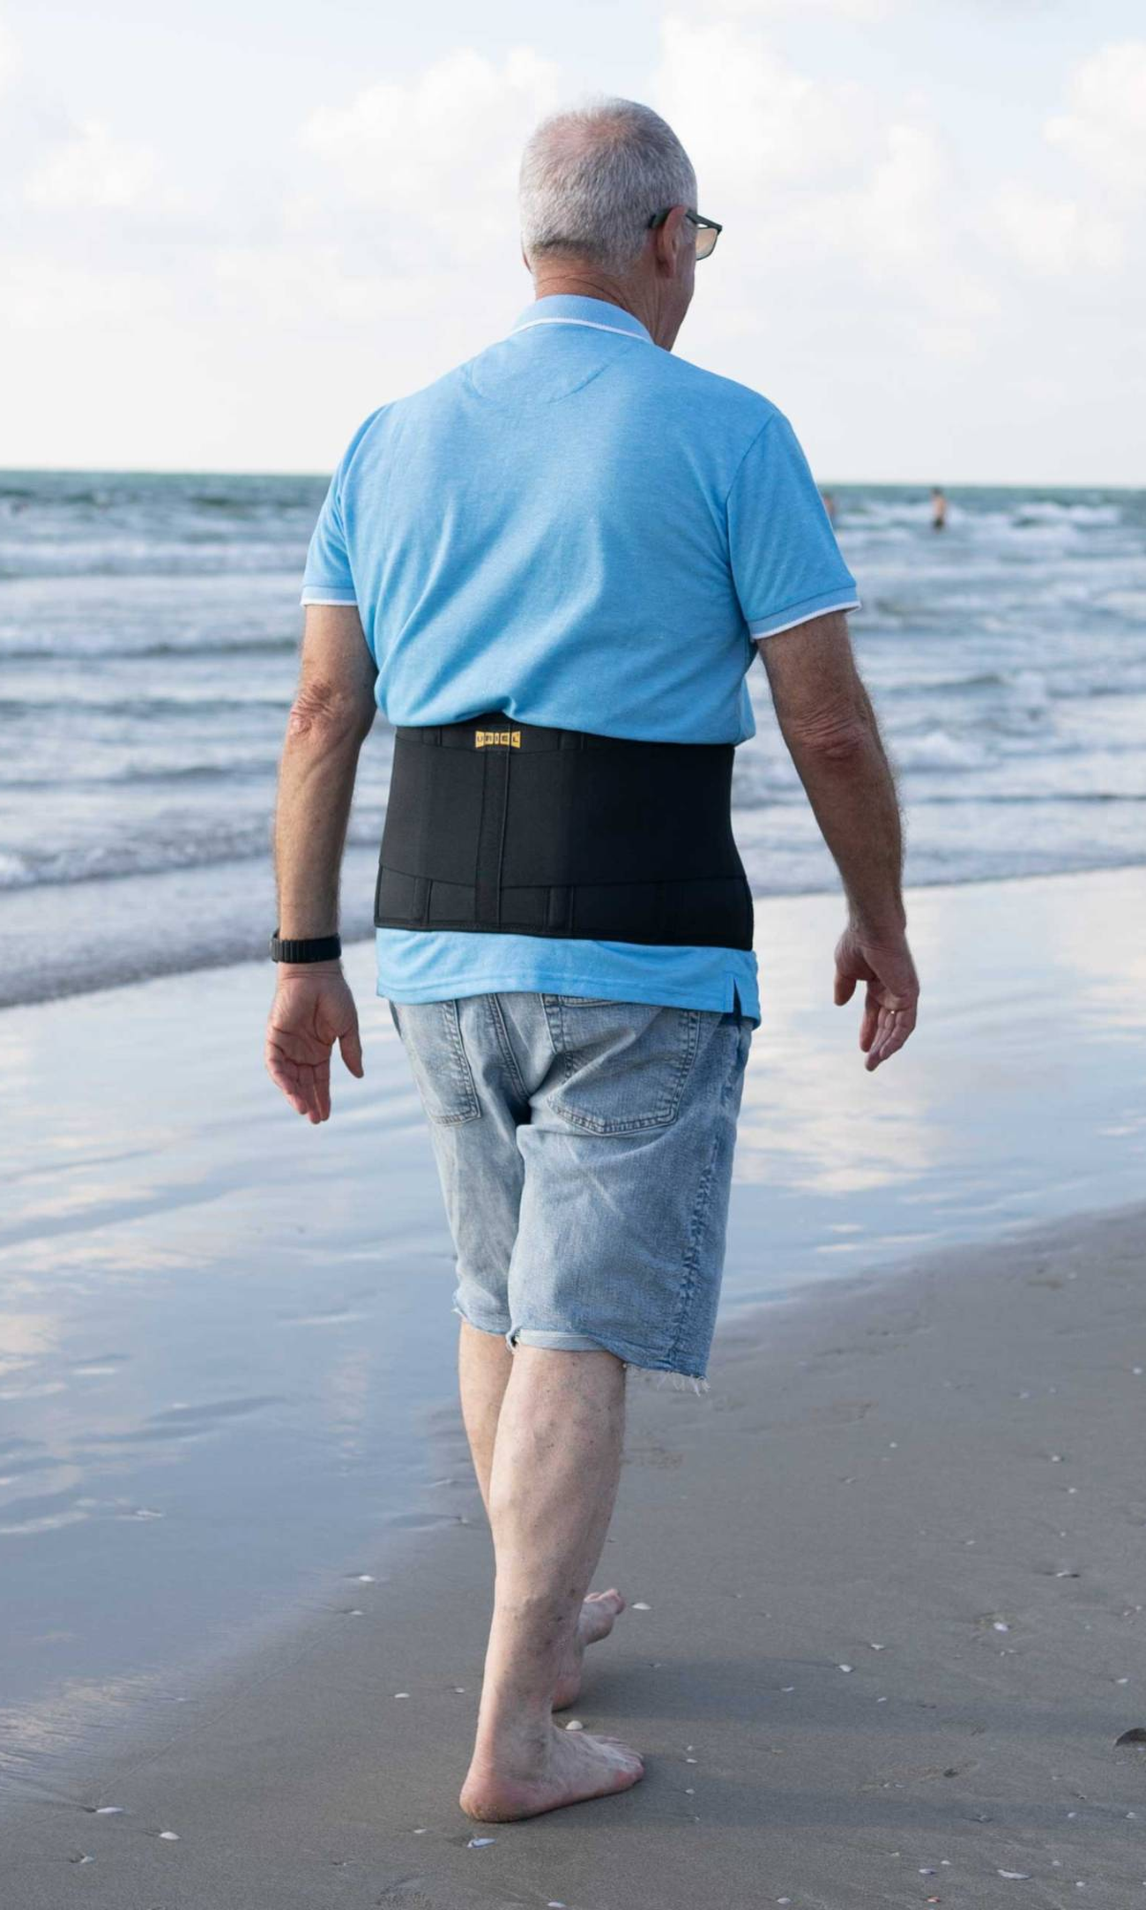
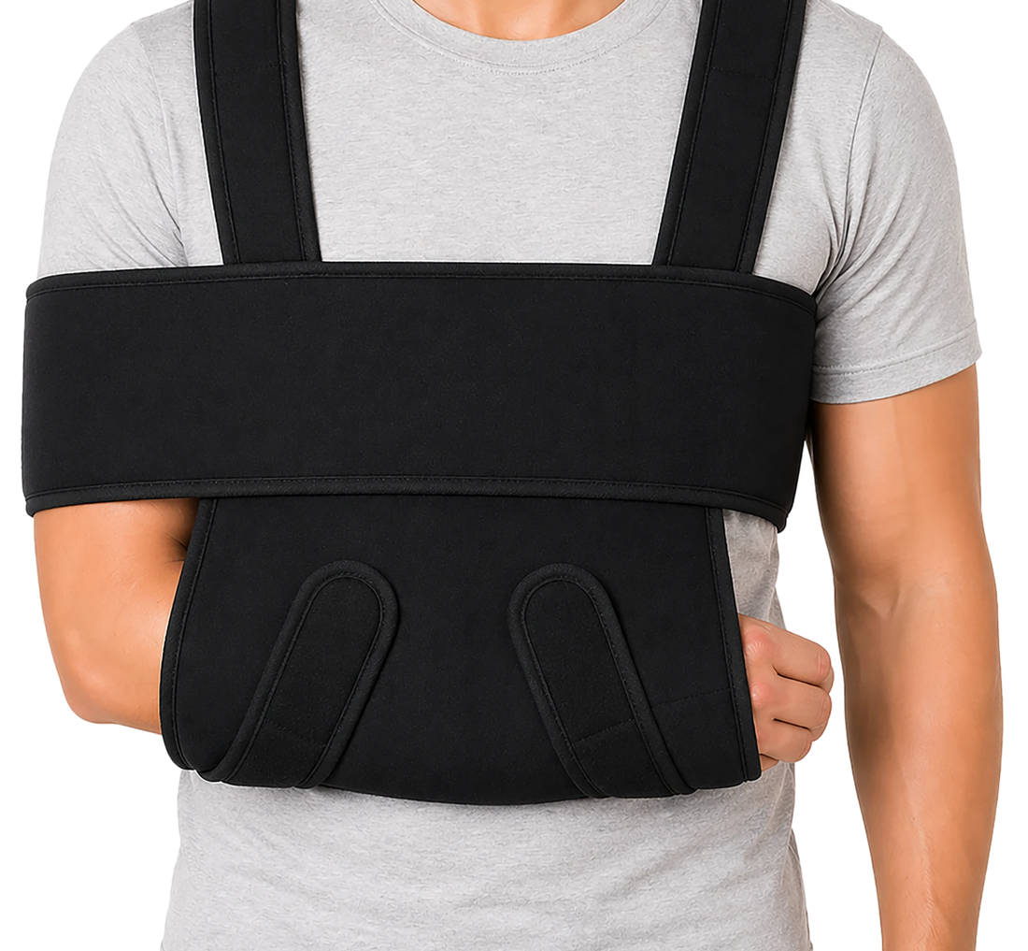
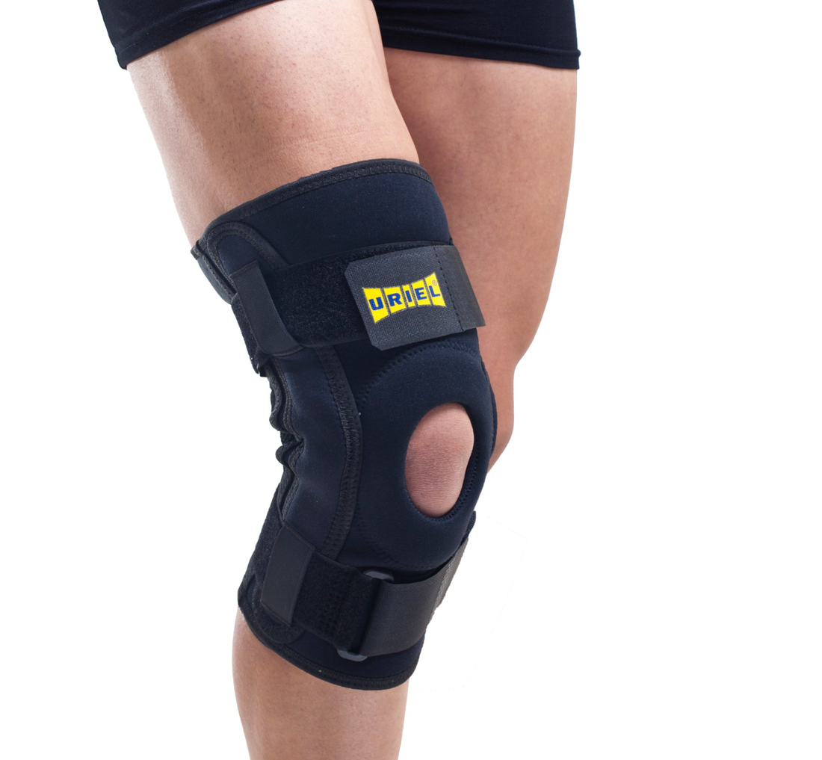
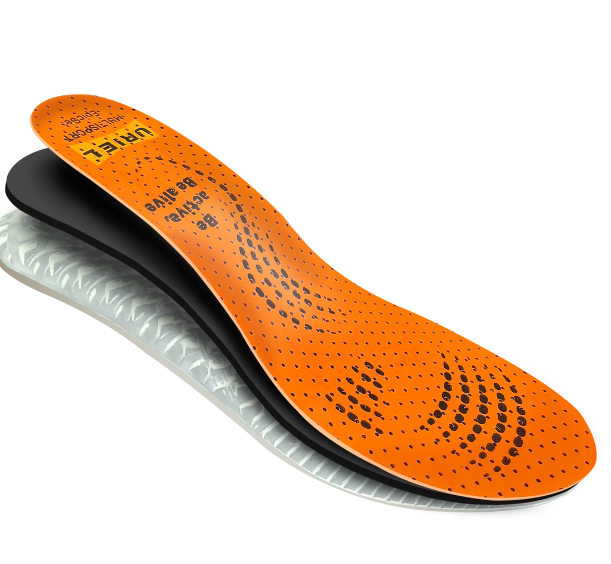
URIEL
CATEGORIES
Over 650 SKUs

Slide 10
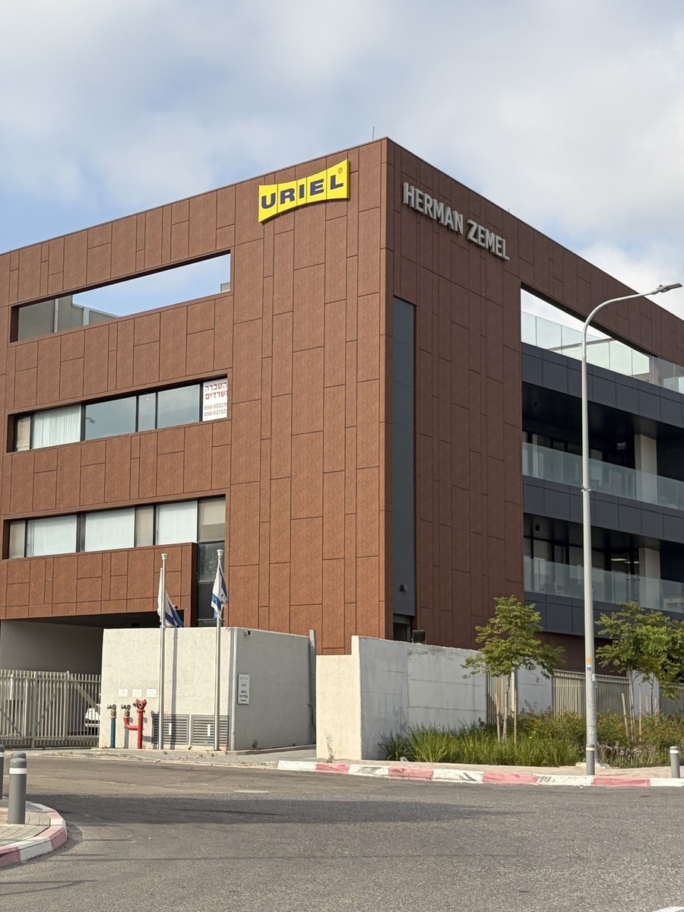



URIEL HEADQUARTERS AND WAREHOUSE

