Slide 1


SHIELD SERIES
Innovative orthopedic support

Slide 2

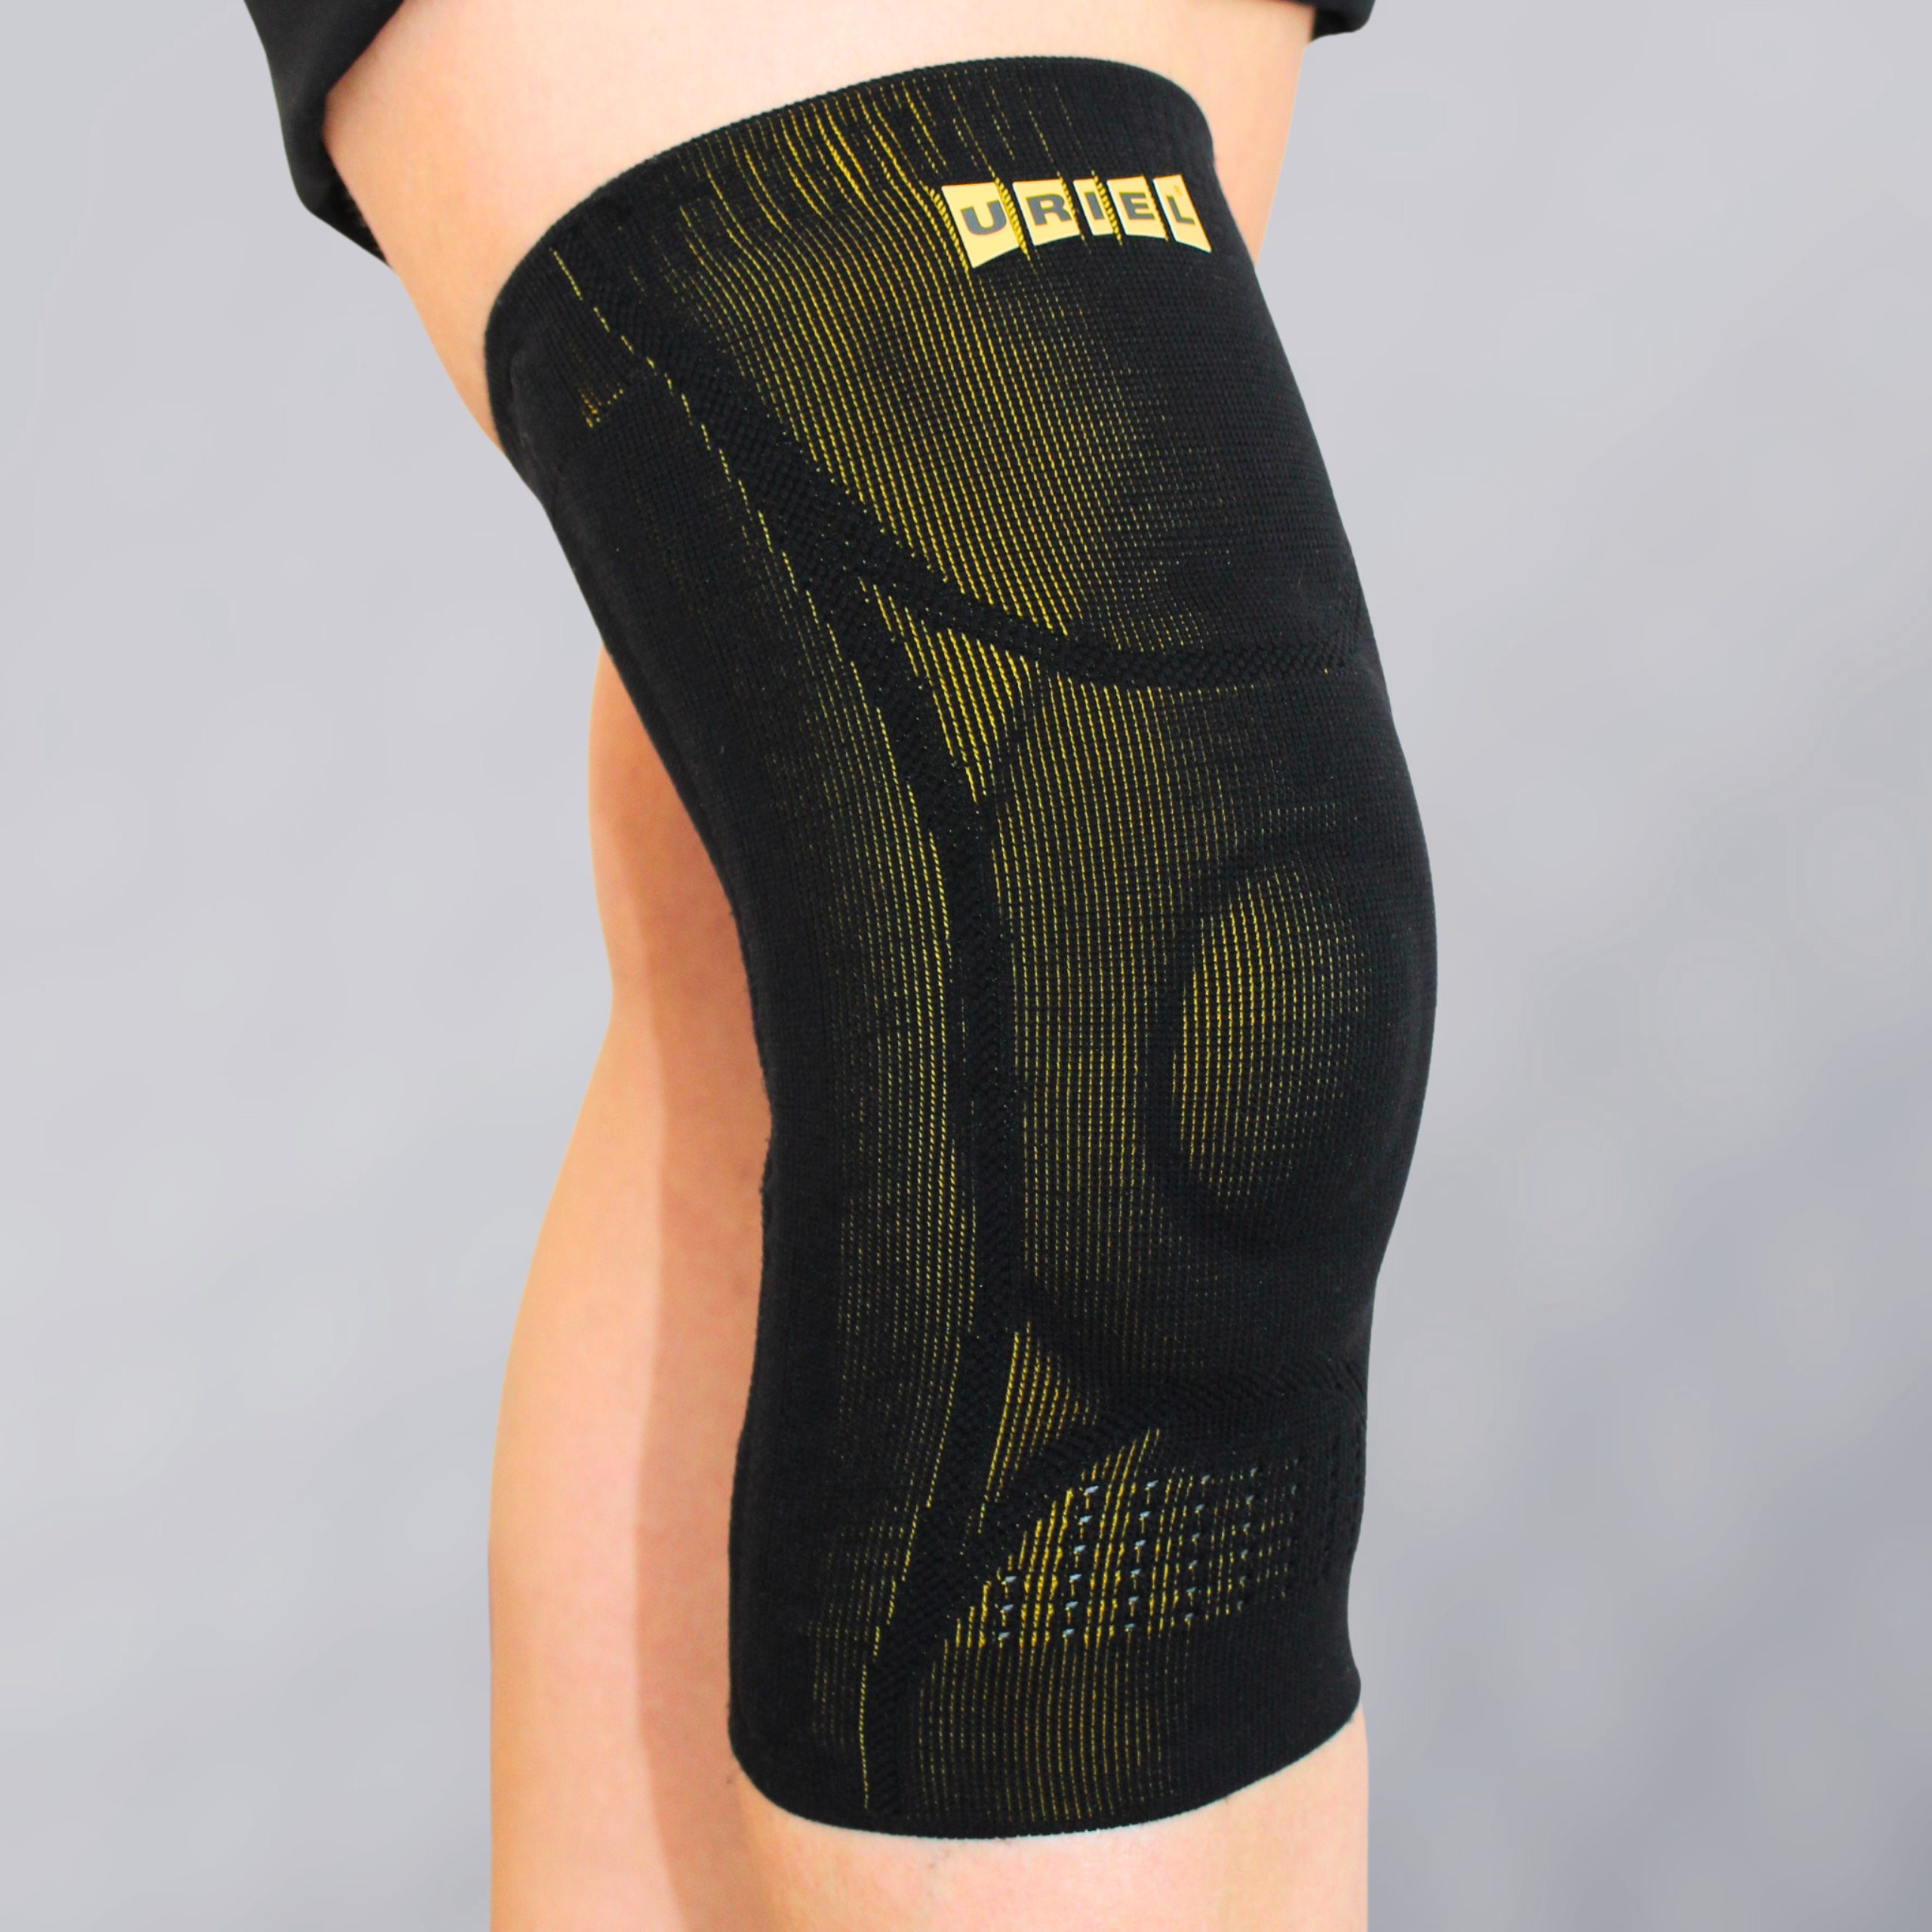

GenuShield Knee Support
With flexible stays & gel pad
Advanced support for stability, pain relief & swelling reduction.

Slide 3
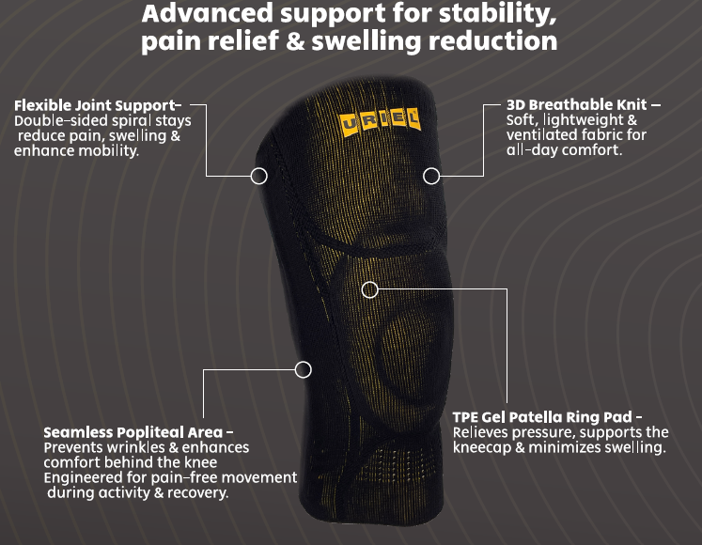

Slide 4
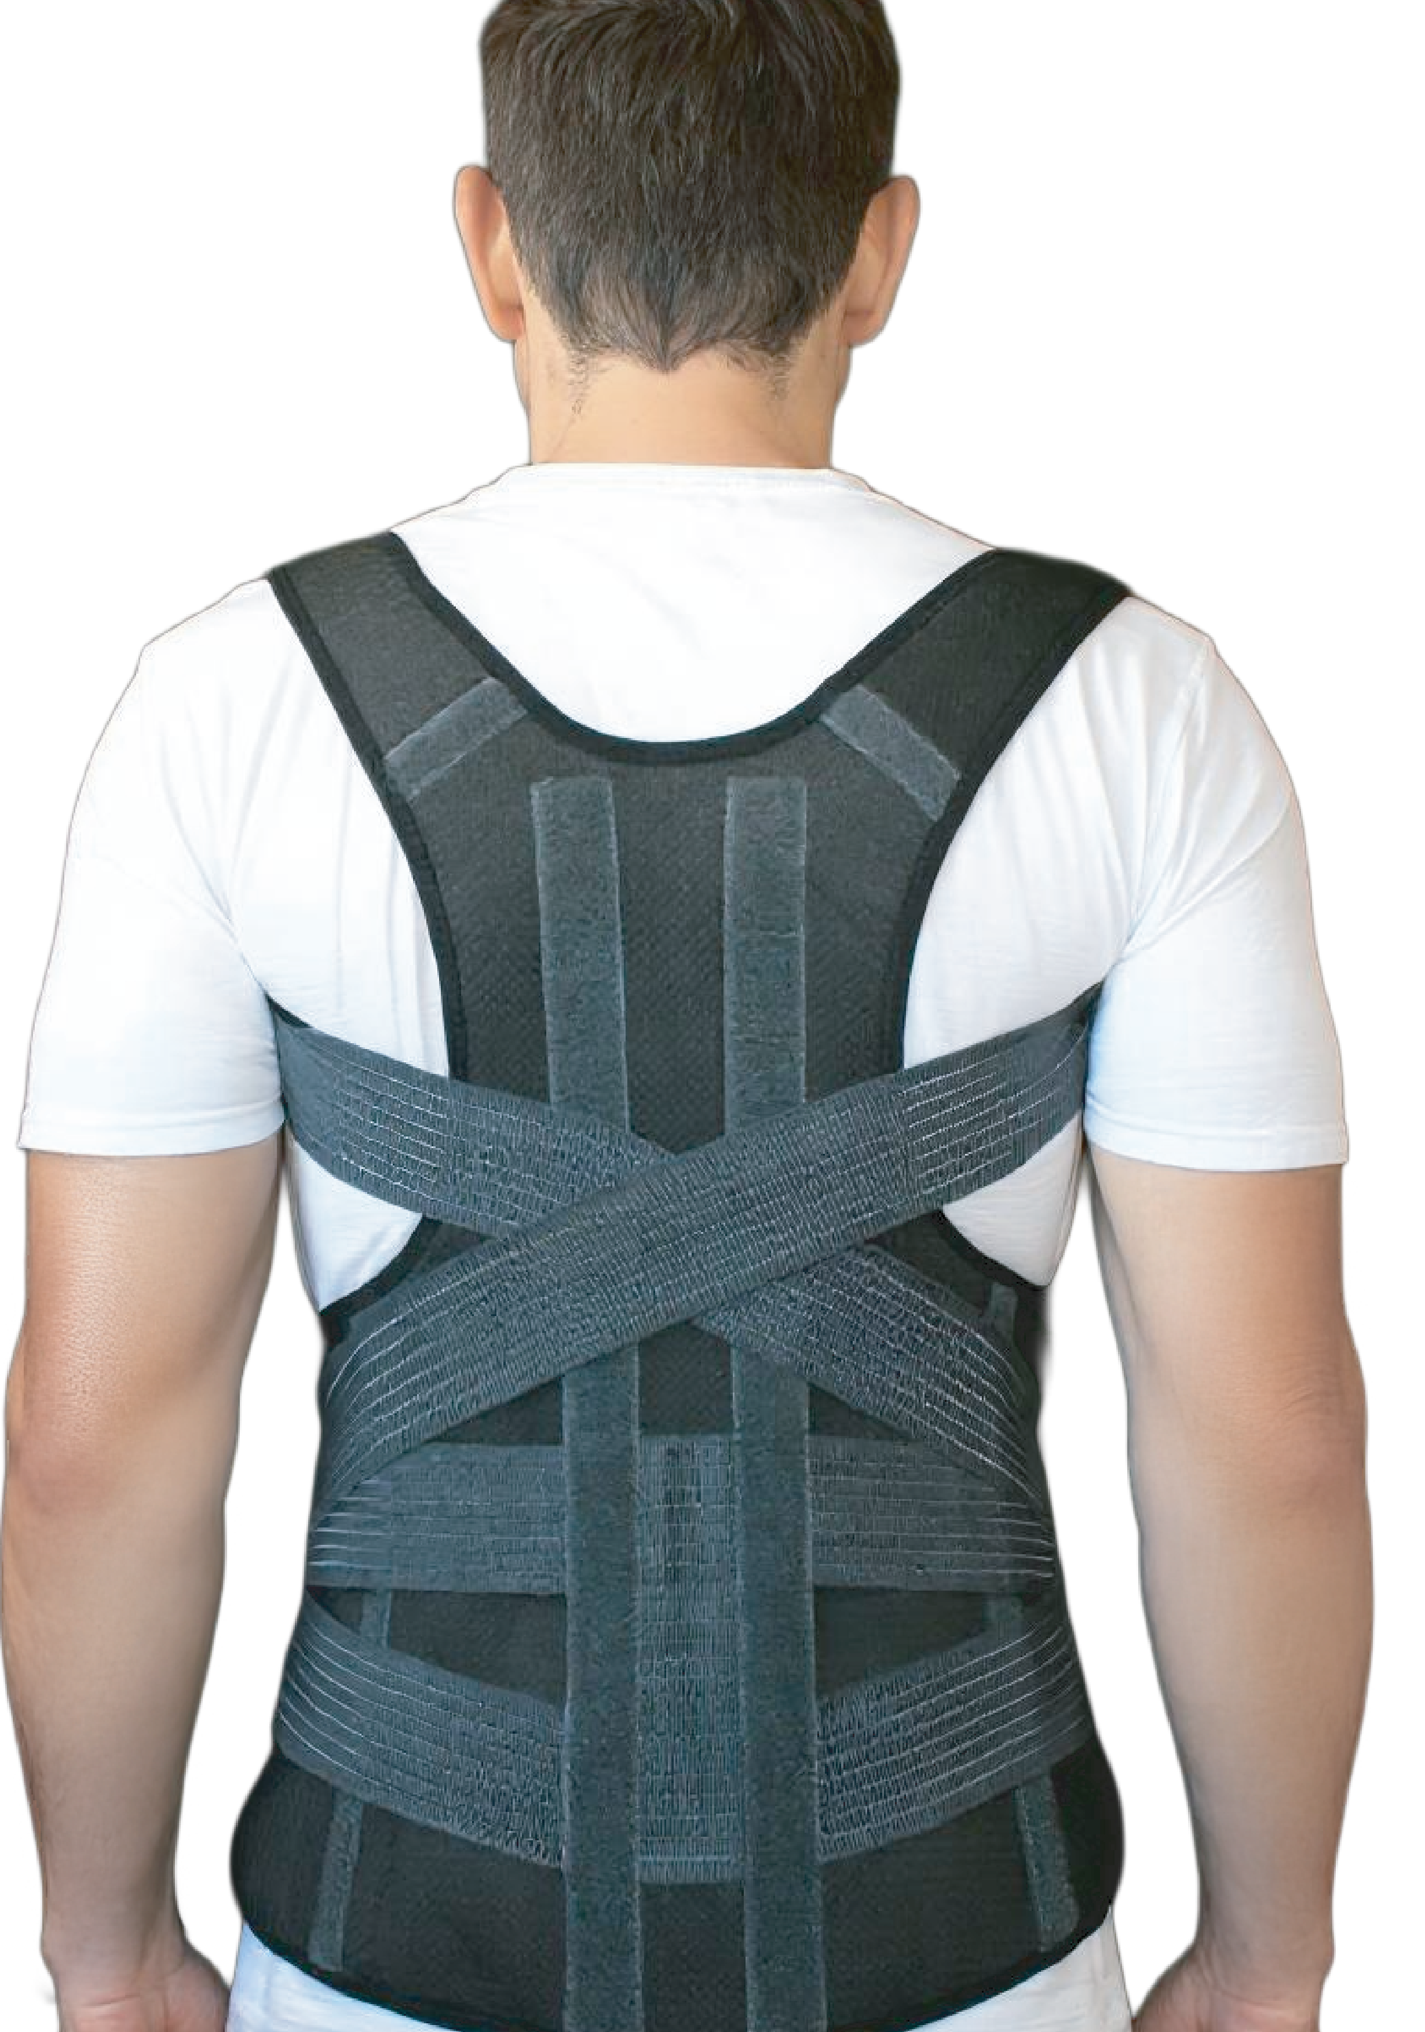
SpinaShield Posture Corrector Belt
Advanced and lightweight posture corrector
designed to improve spinal alignment and reduce
upper back and shoulder pain. Featuring comfortable, adjustable straps, it supports upright posture, relieves muscle tension, and encourages natural movement.
Ideal for those who sit for long hours, suffer from poor posture, or seek pain relief in daily life.
-Supports natural spinal alignment.
-Helps relieve neck and upper back pain.
-Discreet, slim, and comfortable for everyday use.
for Spine and Shoulders

Slide 5
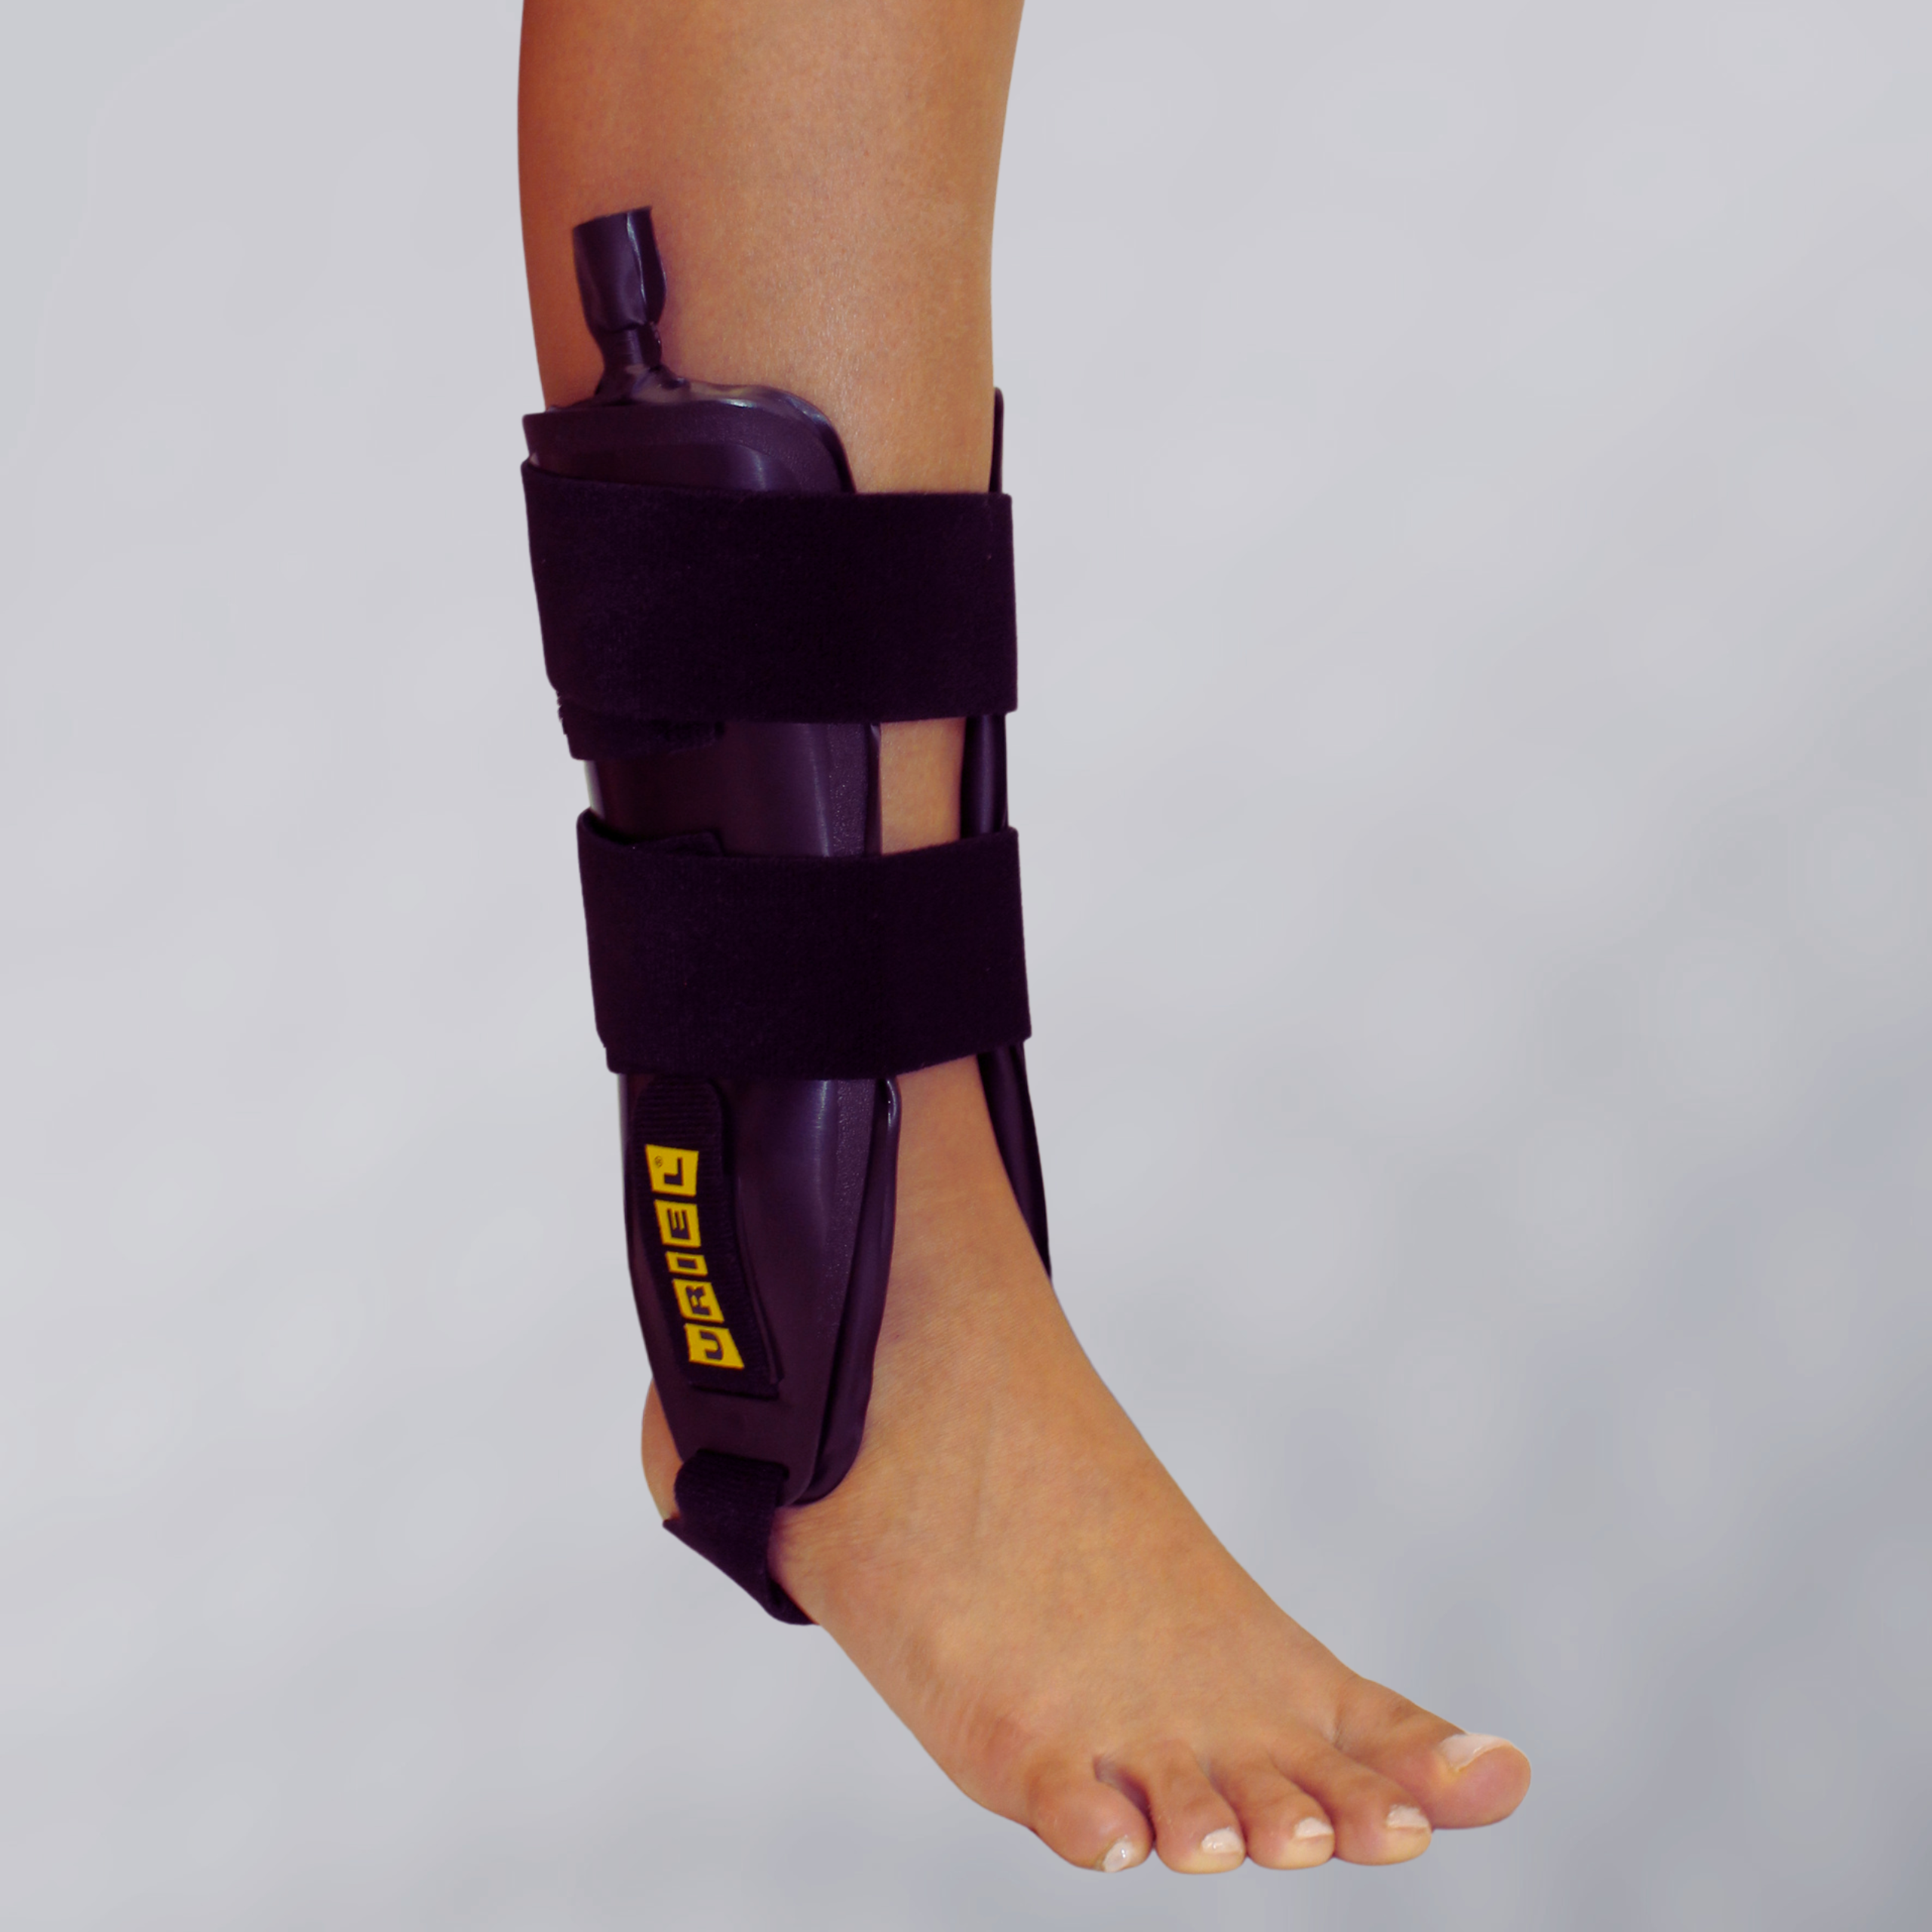
TaluAir Shield Ankle Stabilizer
TaluAir Shield Ankle Stabilizer is a rigid ankle brace that restricts side-to-side movement and delivers strong lateral stabilization after acute sprains, ligament injuries, or instability.
The inflatable cushions allow a customized fit and help reduce swelling during the critical first days of recovery.
Dual-sided Ankle Brace with Air Cushions
Medical Indications:
Acute ankle sprains, Chronic instability, Lateral ligament injuries, Post-trauma stabilization, Early rehabilitation phase.

