Slide 1
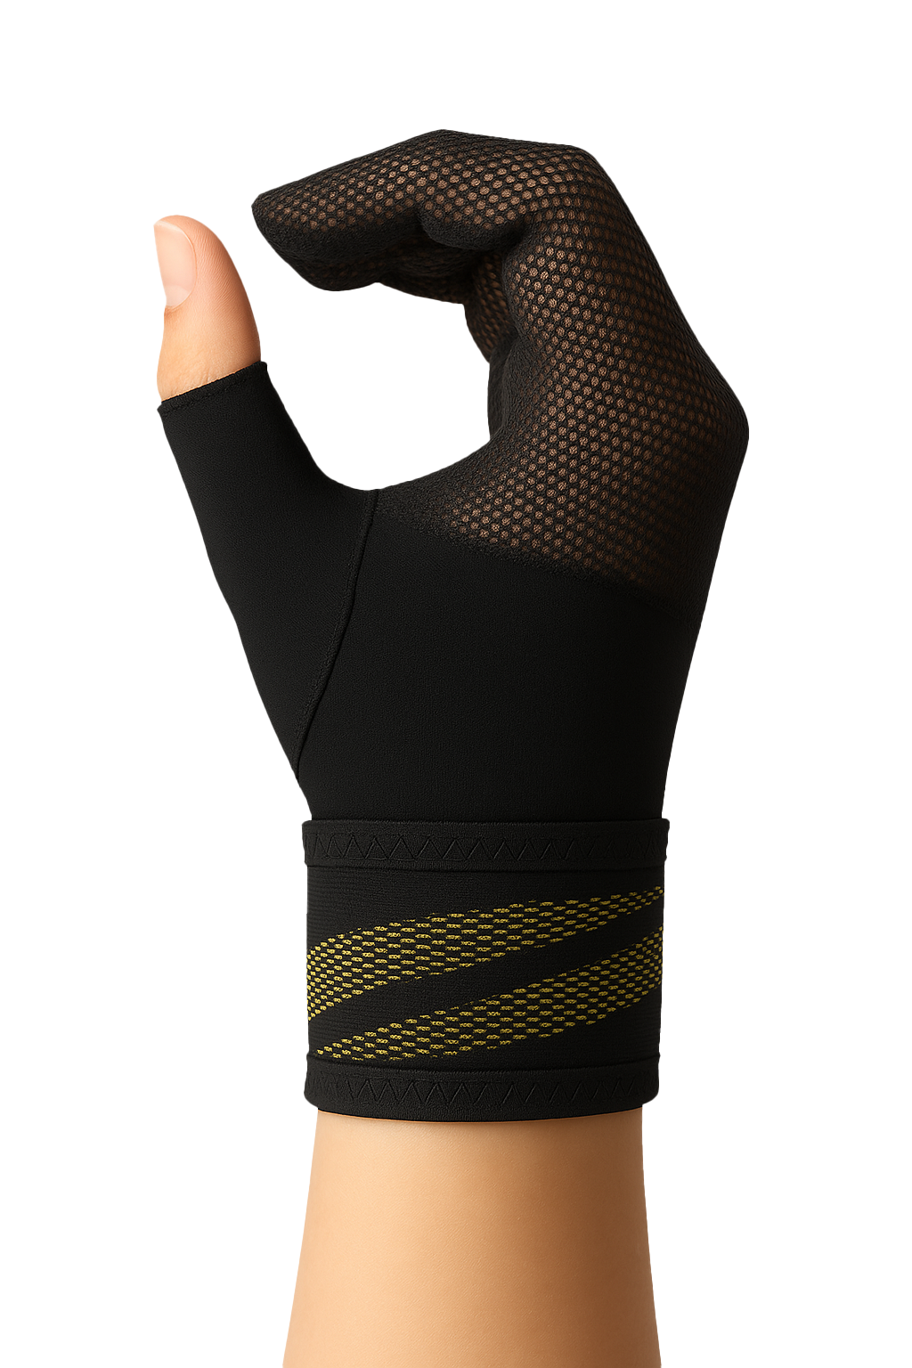
WRIST CARE
CTS Night Mitten
Nighttime Pain Relief Support
Lightweight breathable mitten design with Velcro fastening.
Comfortable fit throughout the night.
Supports finger flexion position for nerve decompression.
Three sizes for perfect fit.
Washable, durable, consumer-friendly.

