Slide 1

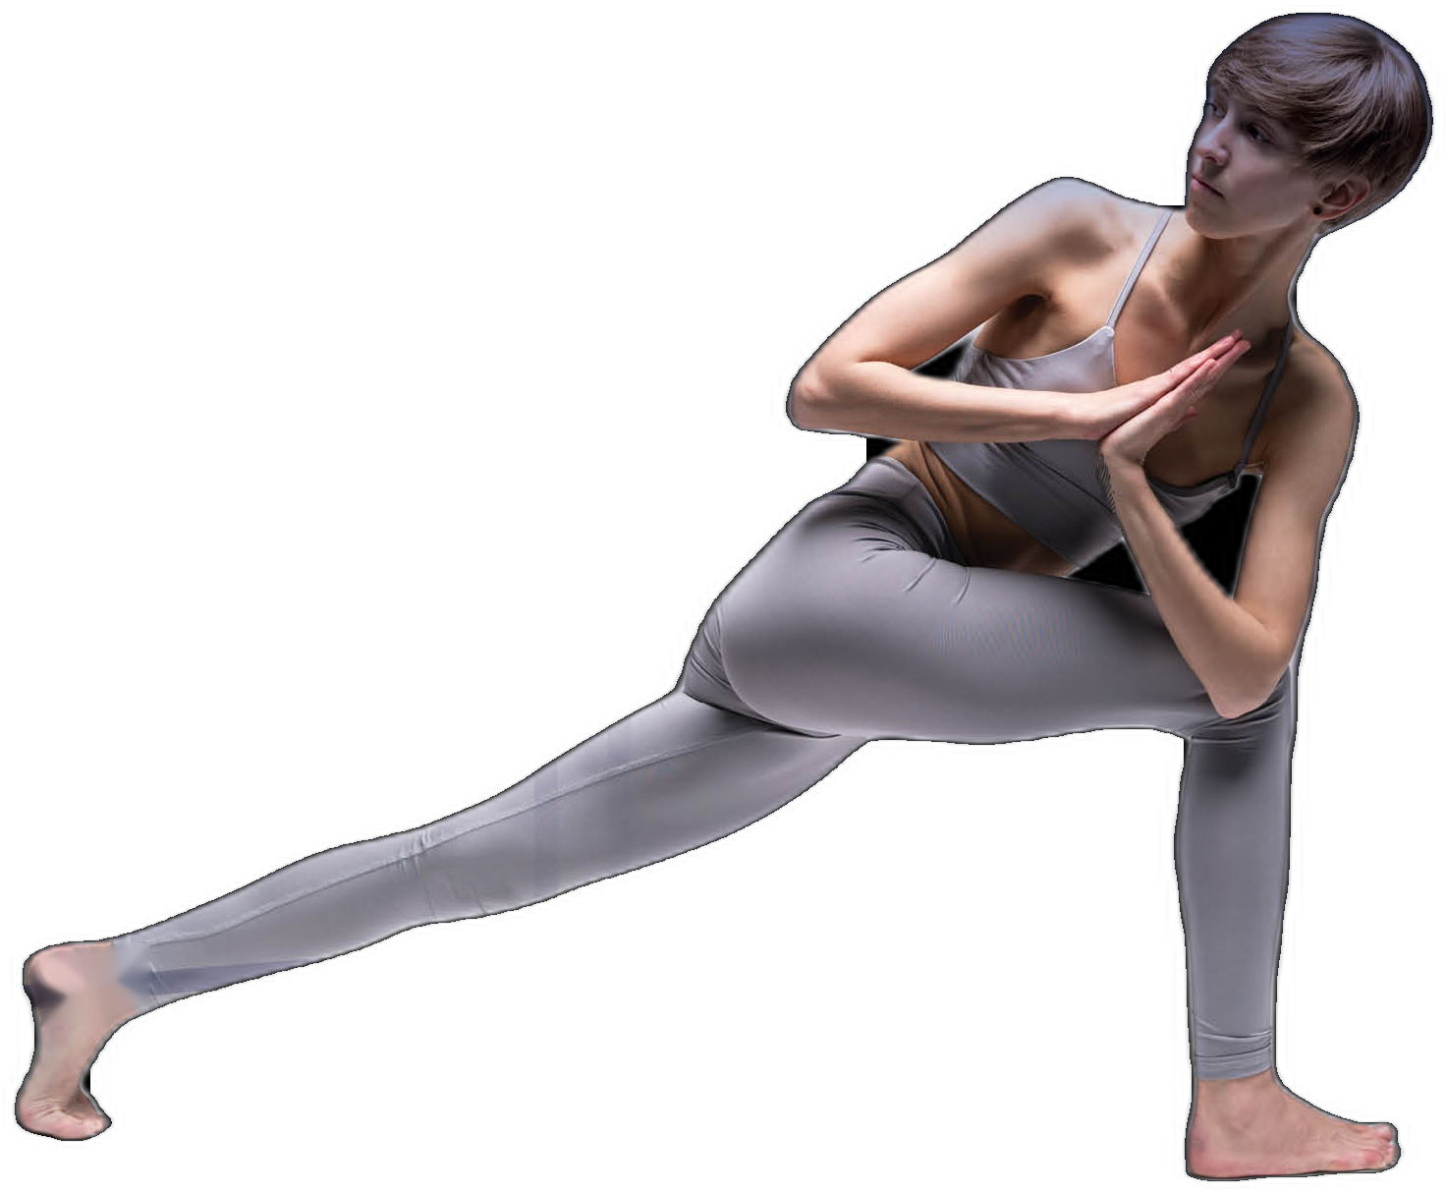
DESIGN TO PERFORM
A GLOBAL ORTHOPEDICS & FOOTCARE MANUFACTURER
COMPANY PROFILE

