Slide 1
URIEL
PRODUCT LINE DETAILS
COMPANY PRODUCT CATALOG

Slide 2
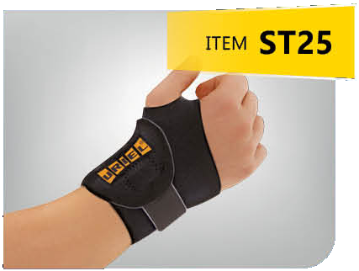
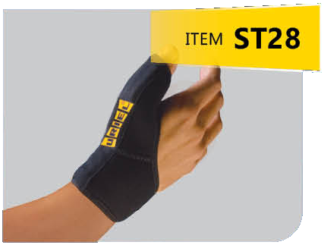
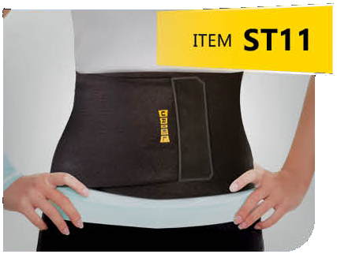
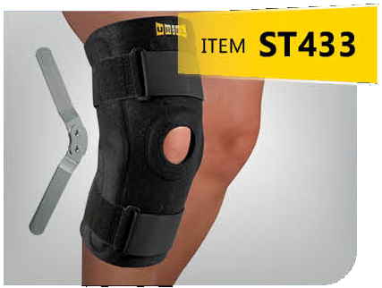
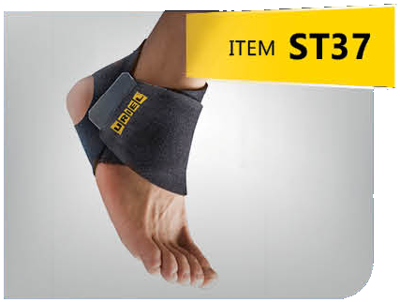
ORTHOPEDIC SUPPORT
ST-CORE EVERYDAY SERIES
Elevate your comfort with our one-size series of orthopedic products, expertly fashioned from soft, premium neoprene. Designed for all body parts, experience comfort & support throughout your day.
WRIST SUPPORT
THUMB SUPPORT
ABDOMINAL BELT
+8
PRODUCTS
KNEE SUPPORT
ANKLE BANDAGE

Slide 3
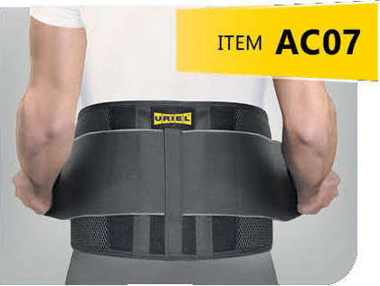
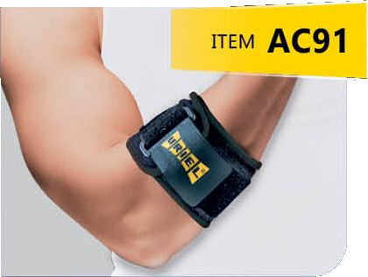
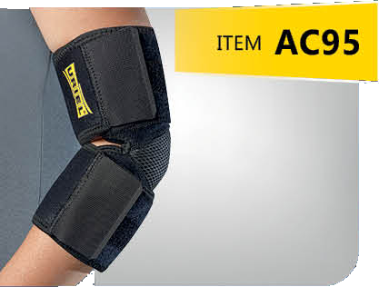
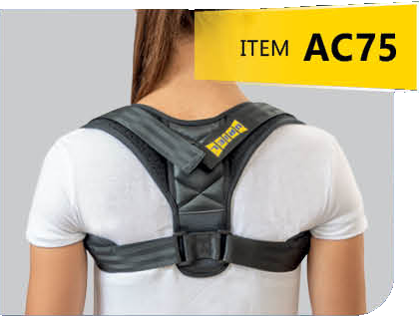
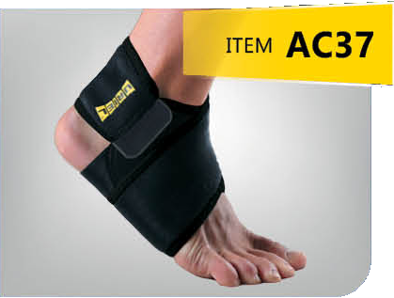
ORTHOPEDIC SUPPORT
AC-ACTIVE SERIES
Crafted with care, our one-size orthopedic series combines breathable mesh and neoprene for unparalleled comfort in every movement, tailored to meet all your needs.
LUMBO BELT
TENNIS BANDAGE
UNIVERSAL ELBOW BANDAGE
+7
PRODUCTS
POSTURE CORRECTOR
ANKLE BANDAGE

Slide 4
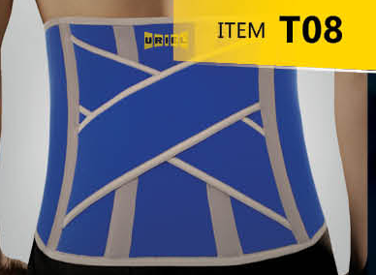
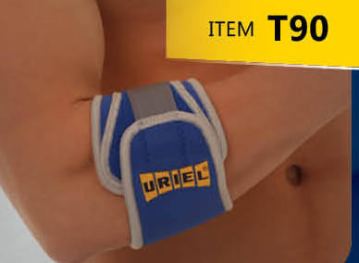
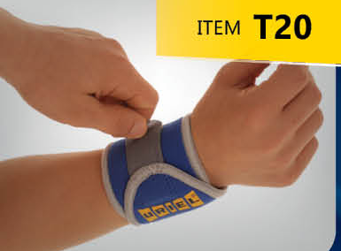
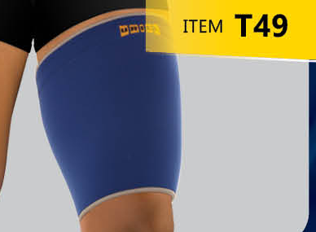
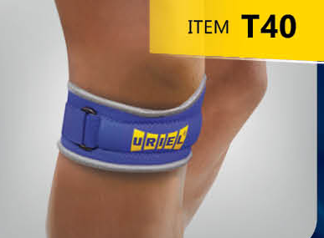
ORTHOPEDIC SUPPORT
THERMAL SERIES
Heat retaining neoprene combined with 100% cotton towel lining provides premium comfort support with thermal benefits to promote faster healing.
CRISS CROSS BELT
TENNIS BANDAGE
WRIST BANDAGE
+35
PRODUCTS
THIGH SUPPORT
PATELLA STRAP

Slide 5
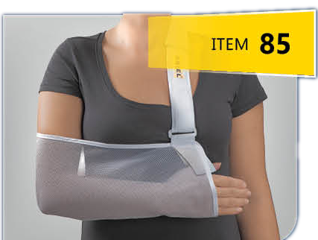
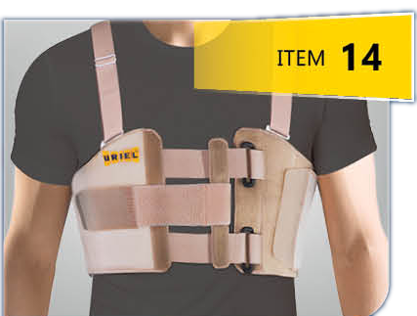
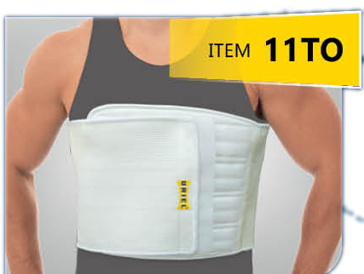
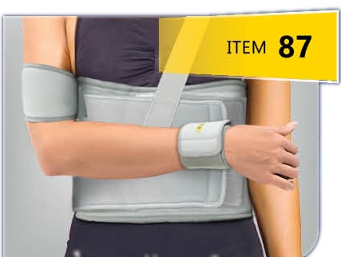
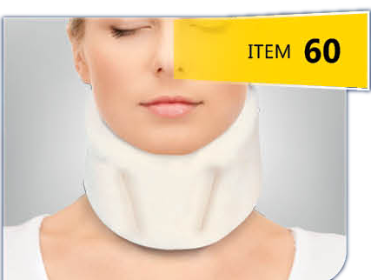
ORTHOPEDIC SUPPORT
POST SURGERY & SUPPORT
From neck to ankle, find all-in-one support in our Post Surgery & Support collection. With tailored belts, braces, and splints, we're here for your complete recovery journey.
ARM SLING POUCH
POST SURGICAL STERNUM BELT
POST SURGICAL BELT
+100
PRODUCTS
ARM & SHOULDER IMMOBILIZER
SOFT CERVICAL COLLAR

Slide 6
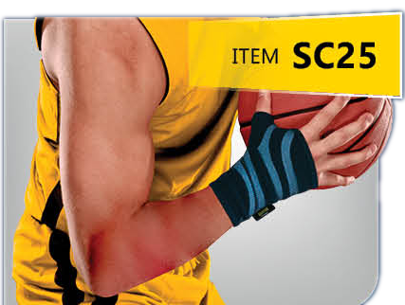
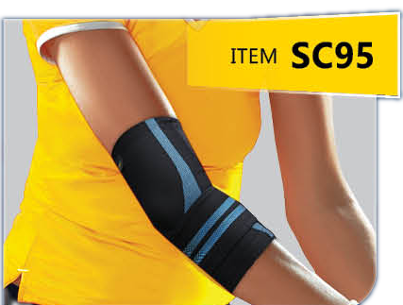
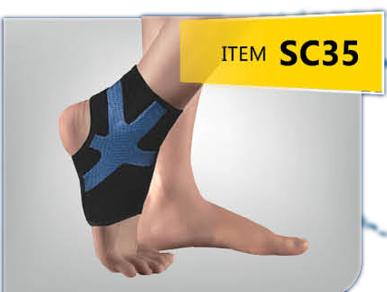
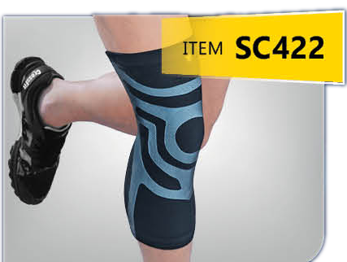
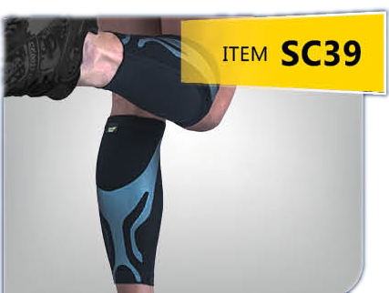
SPORT CATEGORY
THE SPORT SERIES
Reach Your Athletic Peak with Comfortable Ease
WRIST COMPRESSION SLEEVE
ELBOW COMPRESSION SLEEVE
ANKLE COMPRESSION SLEEVE R/L
✓ TRIPLE-LAYERED 3D CUTTING TECHNOLOGY
✓ INJECTED SILICONE PROVIDES TARGETED SUPPORT FOR JOINTS AND MUSCLES WHILE REDUCING VIBRATION
✓ SPORT-READY LIGHTWEIGHT BREATHABILITY
✓ UPF 50+ PROTECTED
KNEE COMPRESSION SLEEVE
SHIN COMPRESSION SLEEVE

Slide 7
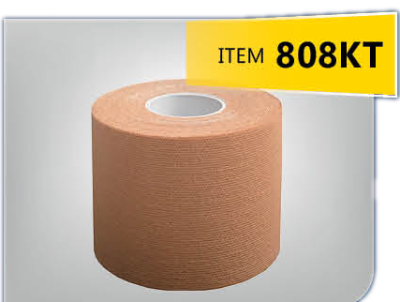
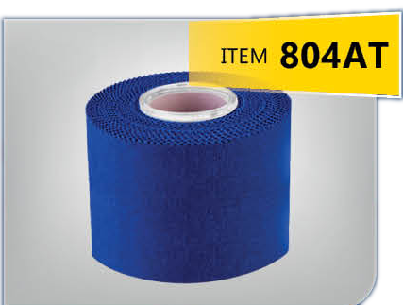
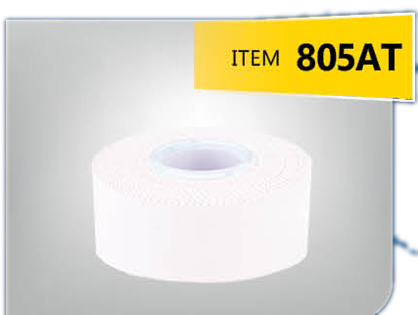
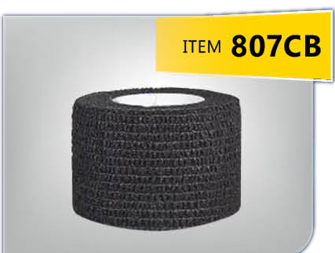
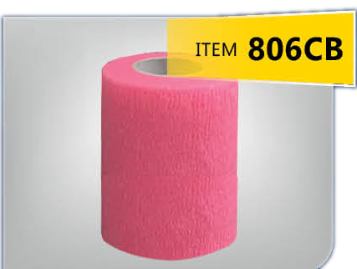
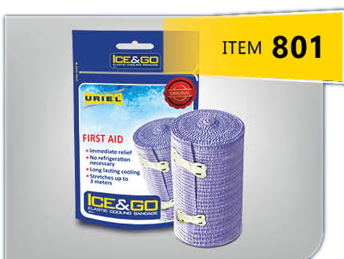
SPORT CATEGORY
TAPES & WRAPS
Step up your game with our Tapes & Wraps collection. From sport adhesive tapes to cohesive wraps and Cooling Bandages collection, we've got you covered for every activity. Stay supported, stay unstoppable.
PROFESSIONAL KINESIOLOGY TAPE
PROFESSIONAL SPORTS ADHESIVE TAPE
PROFESSIONAL SPORTS ADHESIVE TAPE
PROFESSIONAL COHESIVE BANDAGE
PROFESSIONAL COHESIVE BANDAGE
ELASTIC COOLING BANDAGE

Slide 8
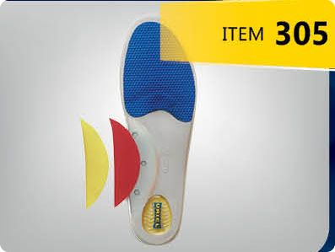
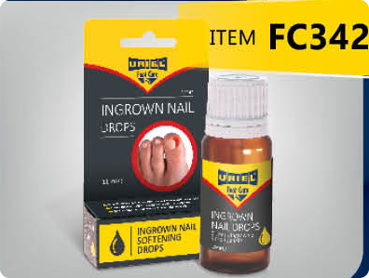
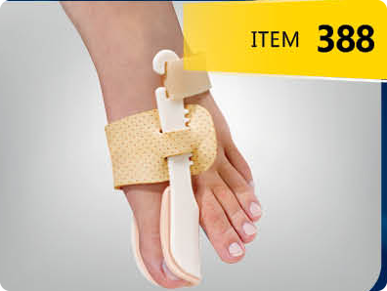
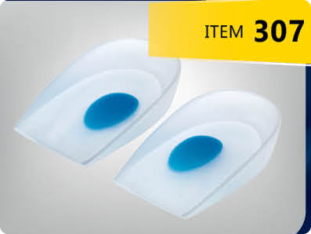
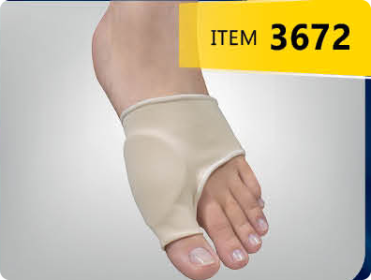
FOOT-CARE CATEGORY
FOOT CARE
Discover complete foot care solutions - your one-stop solution for all your foot needs with our range of insoles, inserts, health socks, and silicone products. We've got you covered from heel to toe. Experience comfort, support, and relief tailored to your unique foot requirements. Step into wellness today.
ADJUSTABLE ARCH SUPPORT KIT
INGROWN NAIL DROPS
HALLUX VALGUS NIGHT SPLINT
+50
PRODUCTS
SILICONE HEEL SUPPORT CUSHION
PROFESSIONAL COHESIVE BANDAGE

Slide 9
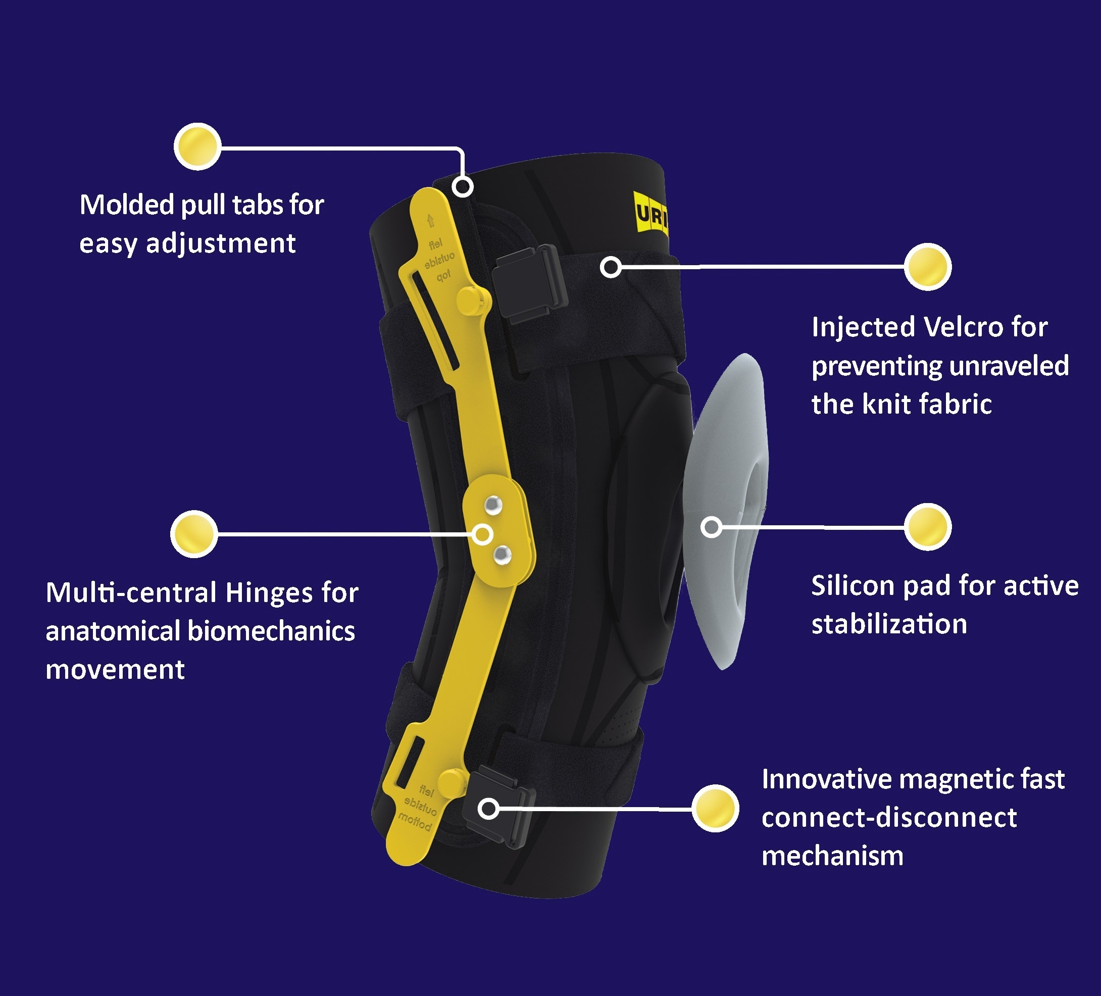
GENU-SHIELD STABILIZER
PROVIDES JOINT STABILIZATION WHILE REDUCING PAIN AND SWELLING

