Slide 1
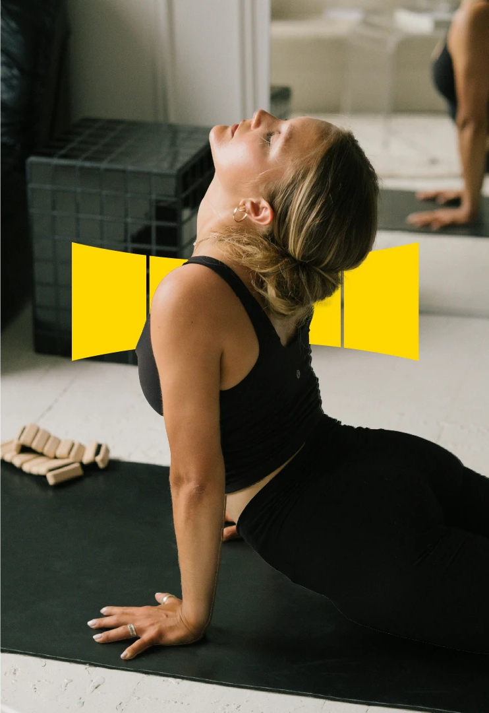

DESIGN TO PERFORM
A GLOBAL ORTHOPEDICS & FOOTCARE MANUFACTURER
COMPANY PROFILE

Slide 2
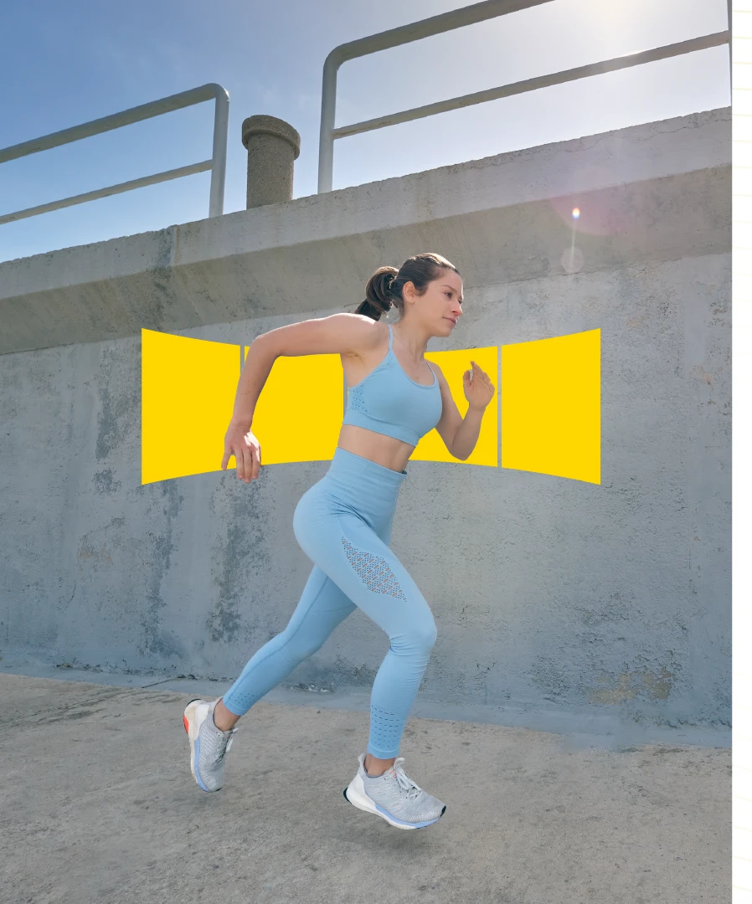
DESIGN TO PERFORM
A GLOBAL ORTHOPEDICS & FOOTCARE MANUFACTURER
COMPANY PROFILE

Slide 3

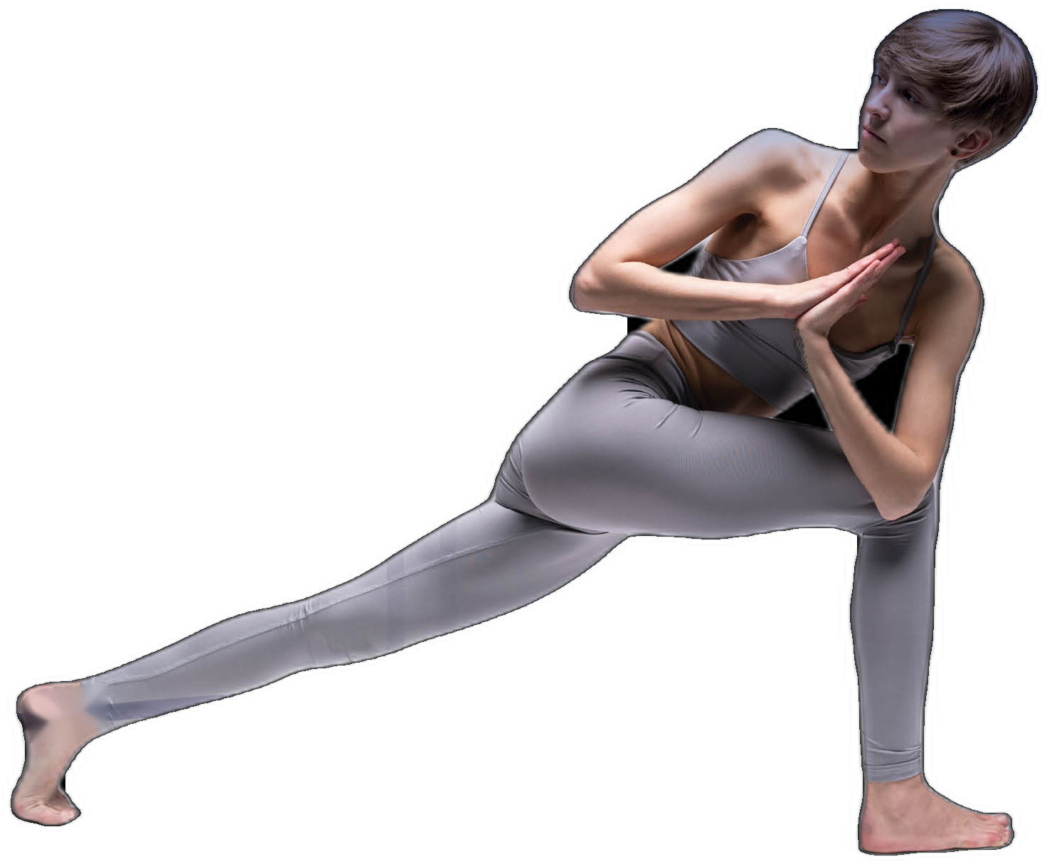
DESIGN TO PERFORM
A GLOBAL ORTHOPEDICS & FOOTCARE MANUFACTURER
COMPANY PROFILE

Slide 4

A GLOBAL ORTHOPEDICS &
FOOTCARE MANUFACTURER
OUR VISION & MISSION
"At URIEL, we develop, manufacture, and market the most exceptional medical devices and services for a variety of different purposes.
Our products combine updated and state-of-the-art design, impact driven, high quality and innovative technologies all to provide the most efficient solutions, from injury prevention to rehabilitation, with a high level of performance, based on more than 50 years of practical experience and research.
Our mission is to inspire and motivate people, at any age, to live a more fulfilling and active life."

Slide 5
OUR JOURNEY
URIEL ESTABLISHED BY MR. URIEL ROZEN
ENTRANCE TO THE ORTHOPEDIC WORLD
GOING WORLDWIDE,
SERVING OVER 20 COUNTRIES
OPENING
URIEL.CO.IL
1970
1982
2008
2012
2020
2021
2024
2026
MEDITEX GROUP LTD,
INDUSTRY MARKET LEADER
BECOMING OFFICIAL SUPPLIER OF HOSPITALS
NEW OWNERSHIP
ACQUISITIONS AND JV'S

Slide 6

EMPOWERING BETTER
MOVEMENT ACROSS +20 COUNTRIES

Slide 7
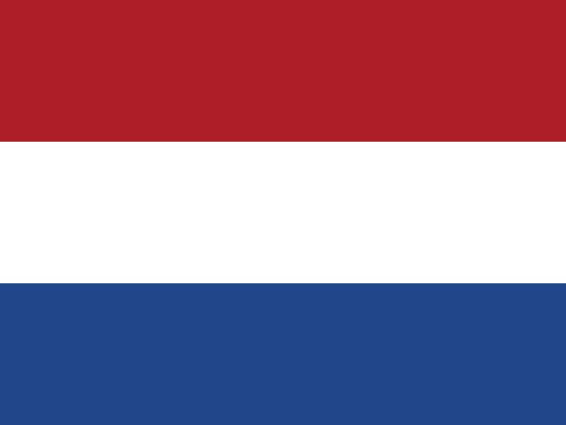











PARTNERING WITH LEADING HOSPITALS WORLDWIDE
Netherlands
Switzerland
Austria
Israel
Germany

Slide 8




REGULATION
AROUND THE WORLD
URIEL MEETS THE HIGHEST STANDARDS OF THE AUTHORITIES IN ISRAEL AND AROUND THE WORLD

Slide 9
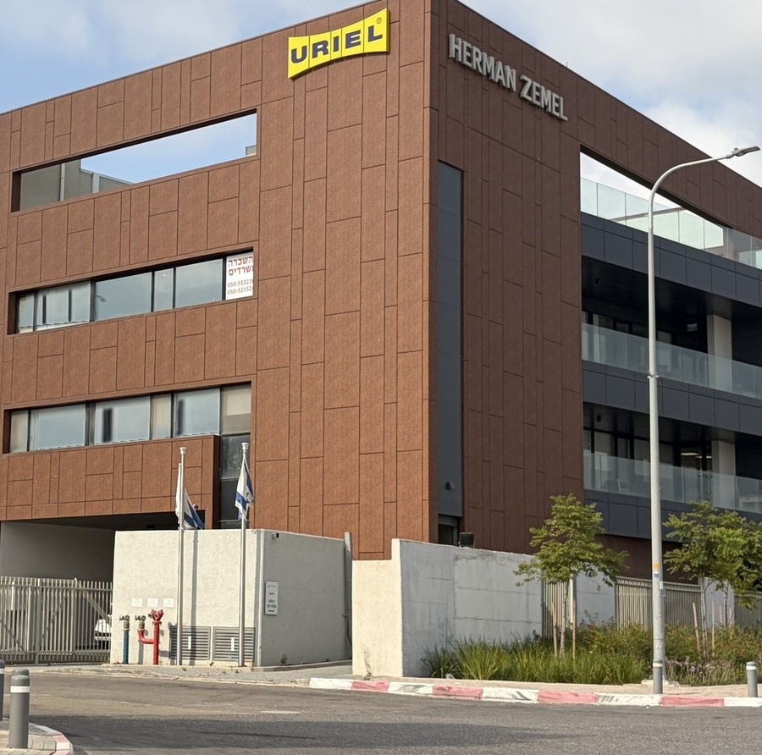



URIEL HEADQUARTERS AND WAREHOUSE

Slide 10





WORKING WITH EXPERTS
EXTERNAL ADVISORY BOARD
PROF. REIS
BOAZ LAZAR
EYAL ZUR
URIA MORAN
Orthopedic specialist
Former president of the Israeli Association for Orthopedics
Textile product expert
Wearable & Innovative Smart Textile consultant
Physiotherapist, BPT, MSc
Former IDF head of physiotherapy
CLINICAL INPUT
MEDICAL & ORTHOPEDIC EXPERTISE
Grounded in clinical & biomechanical research

Slide 11





URIEL LEADERSHIP TEAM
The people driving 50 years of orthotics & footcare excellence
SHACHAR HIRSH
AMIR KATZ
RACHEL HIRSH
TAL ZOLOTOV
ISSA NEIMA
EYAL SADOT
CEO
VP R&D
CFO & COS
IMPORT & EXPORT MANAGER
SALES DIRECTOR
VP SALES

Slide 12

WHY URIEL?
50
YEARS OF
REPUTATION
✓
50 years of outstanding reputation
650+
✓
Premium materials
PRODUCT
SKUs
✓
Innovative products designed by doctors and physiotherapists
20+
✓
Over 650 SKUs
COUNTRIES
WORLDWIDE
✓
Global brand, sold in 20+ countries
FDA · CE APPROVED
✓
FDA, CE - regulation approved

Slide 13
OUR GROWTH ENGINES
1
2
3
Global Expansion
E-commerce Revolution
Strategic Acquisitions
Connecting with the world, expanding the distributor network worldwide.
Marketplaces reshape shopping while our website drives direct sales, both essential for growth.
Building a stronger portfolio through smart partnerships.

Slide 14



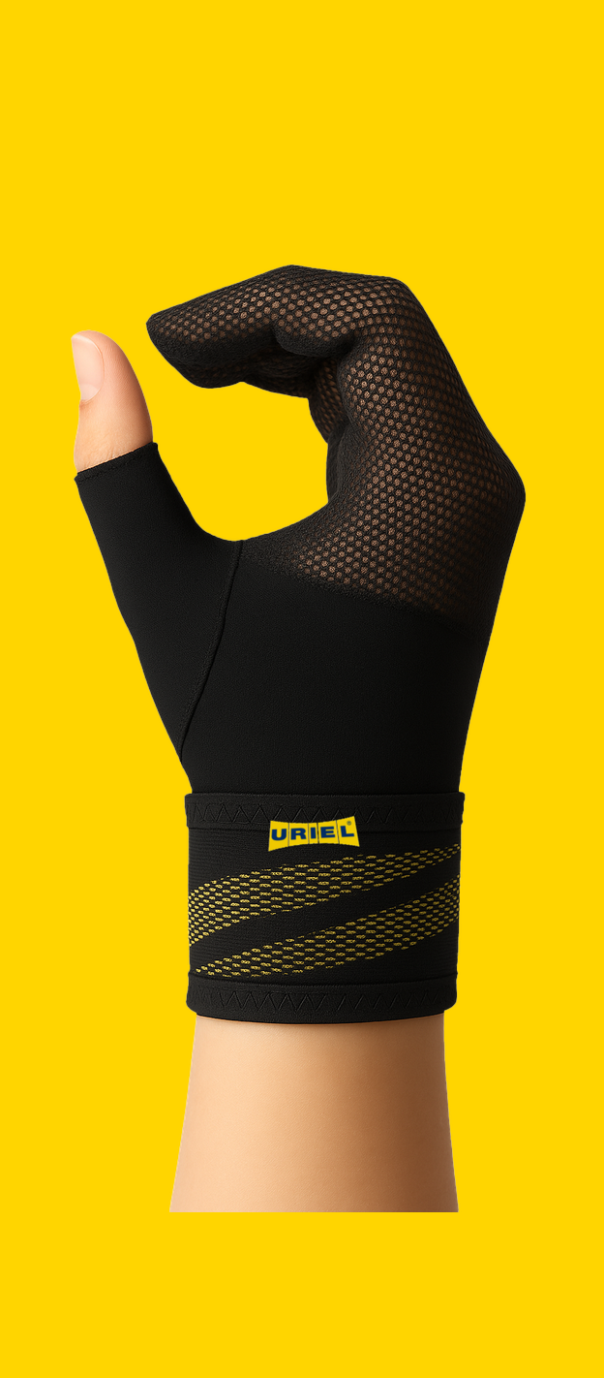

URIEL
CATEGORIES
Over 650 SKUs

Slide 15

SOLUTIONS FOR THE
WHOLE BODY
Uriel's product line covers the full range of possible needs from neck to toe and comes in a full range of sizes to accommodate all body types

Slide 16















NAVIGATING A COMPETITIVE LANDSCAPE
Diverse Competition
Focused Solutions
The market is filled with many players who hold geographic dominance, but lack comprehensive expertise across all categories.
While others focus on volume, we prioritize tailored solutions that empower movement and enhance well-being.
Orthopedic Braces
Footcare Support
Kinesio Tapes

Slide 17
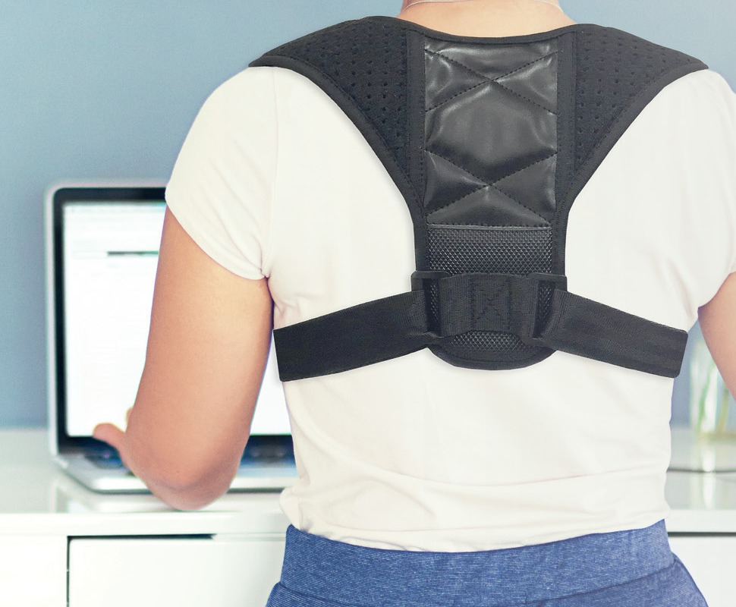
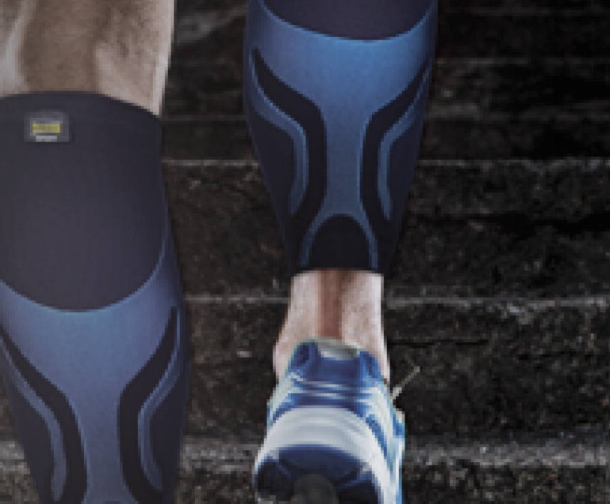
URIEL, FROM MEDICAL CARE TO ACTIVE LIFESTYLE
MEDICAL
LIFESTYLE
+

Slide 18
DRIVING GROWTH POTENTIAL
IN ORTHOPEDIC CATEGORY
✓
Aging with Confidence
Longer life spans mean more need for lasting support.
✓
Active Lifestyles, Active Demand
Health-conscious consumers are seeking solutions for better mobility.
✓
Prevent Today, Perform Tomorrow
Injury prevention is key to staying active and strong.

Slide 19
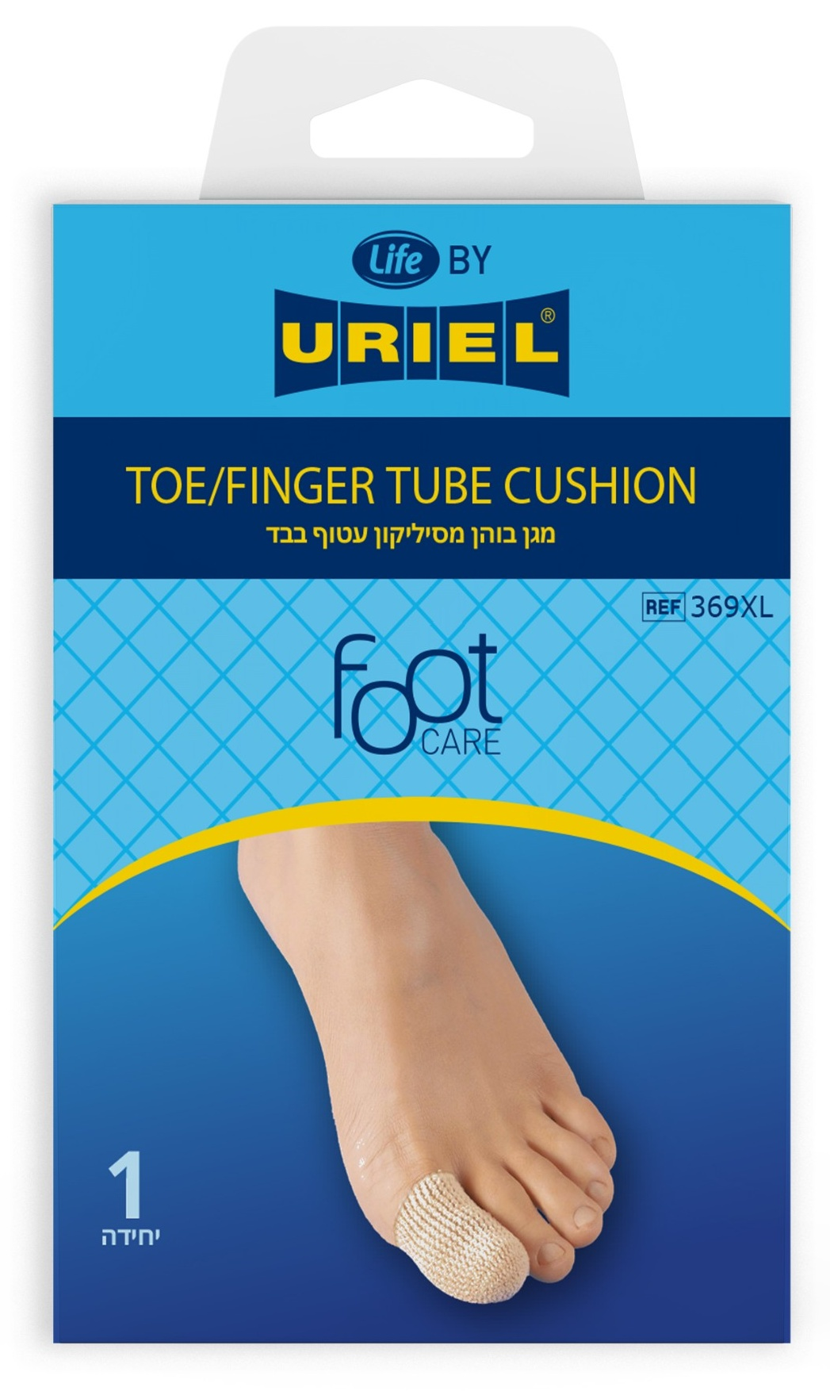
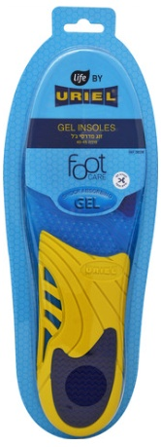
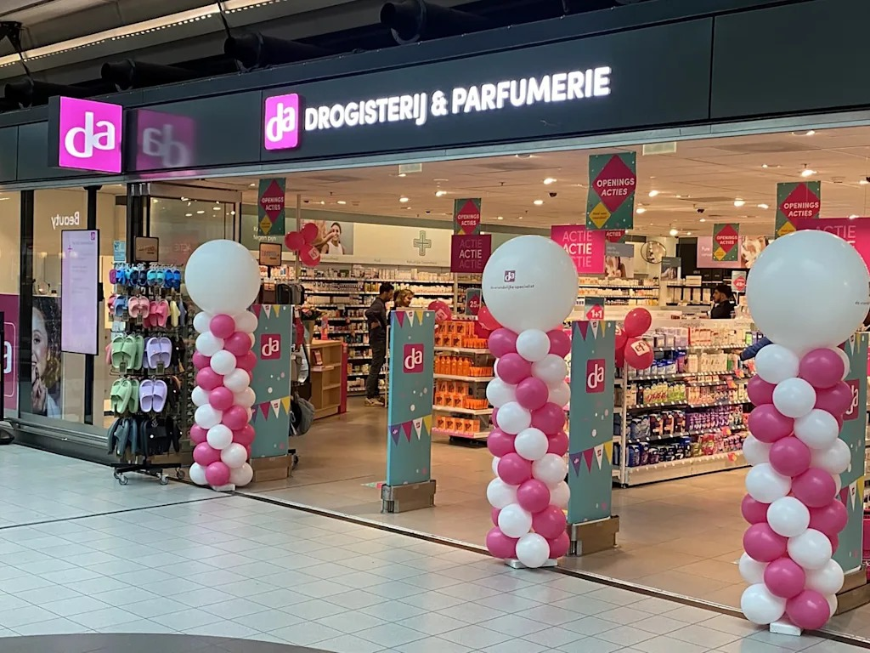
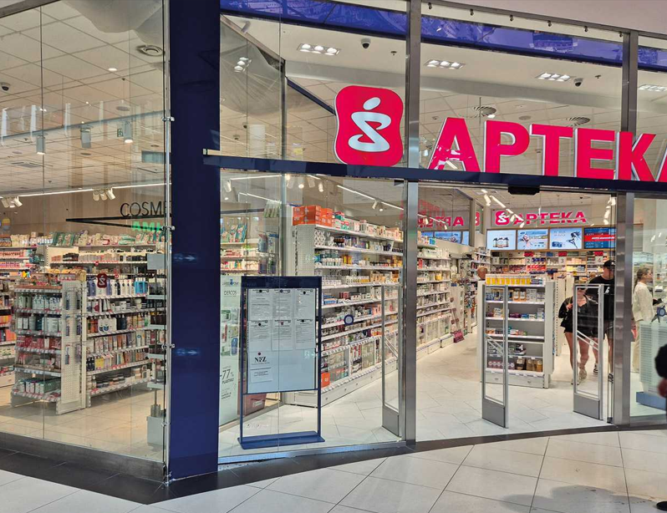
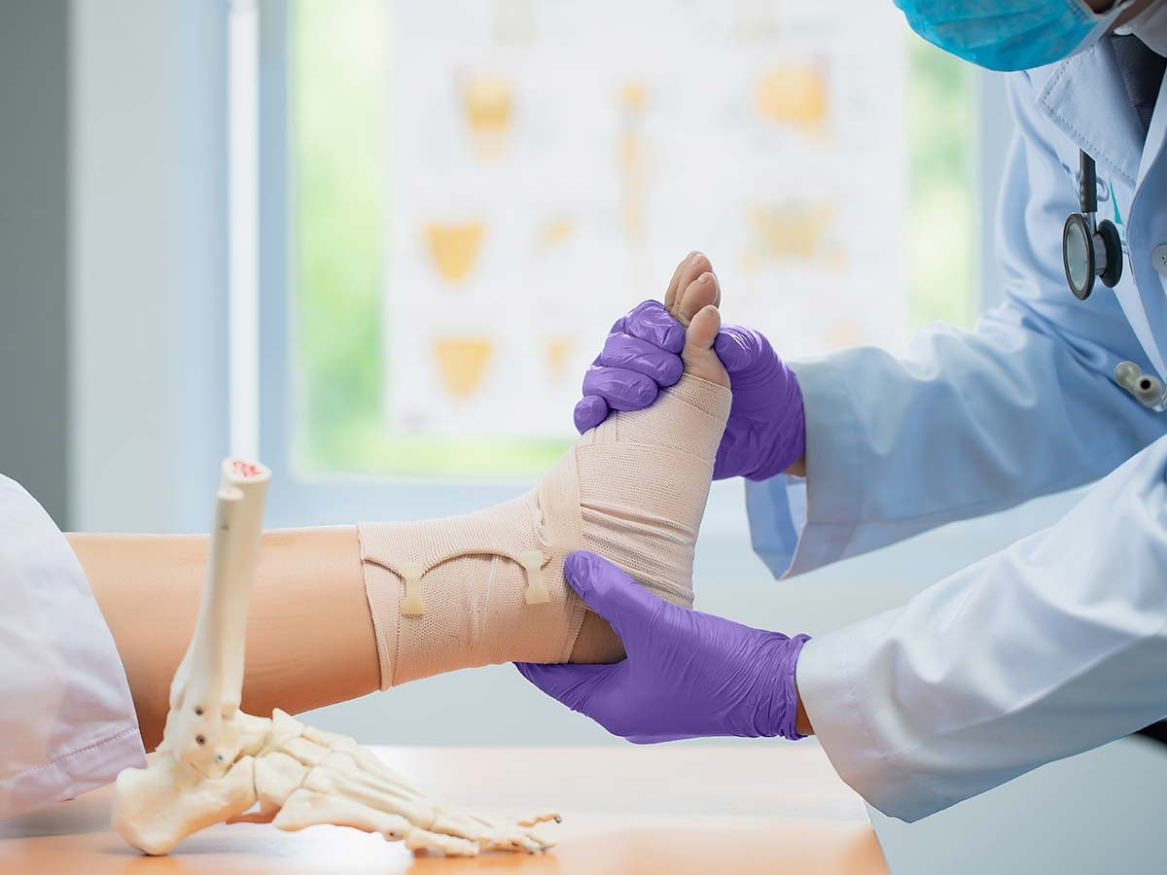
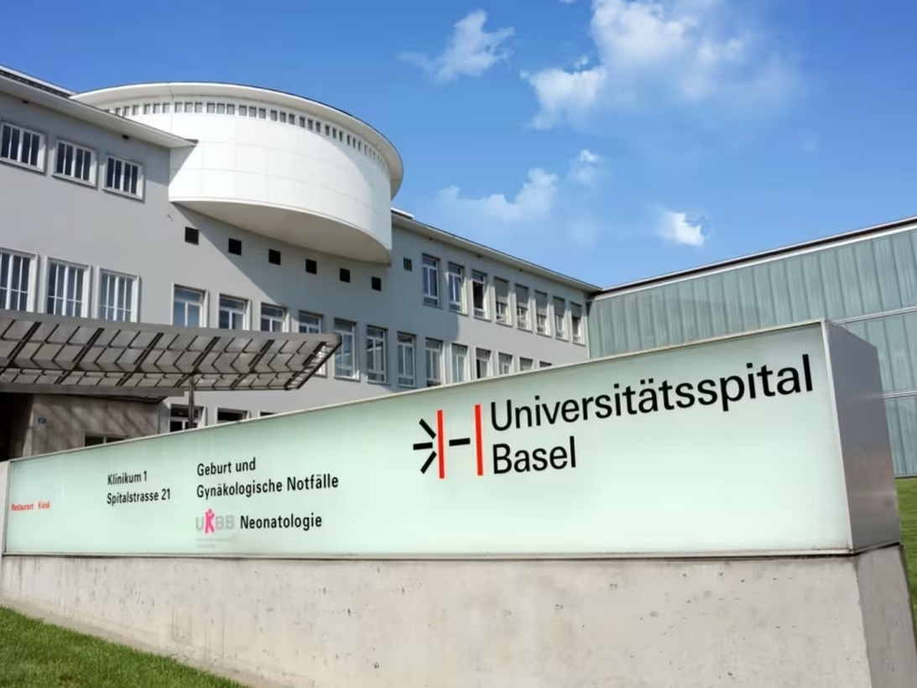


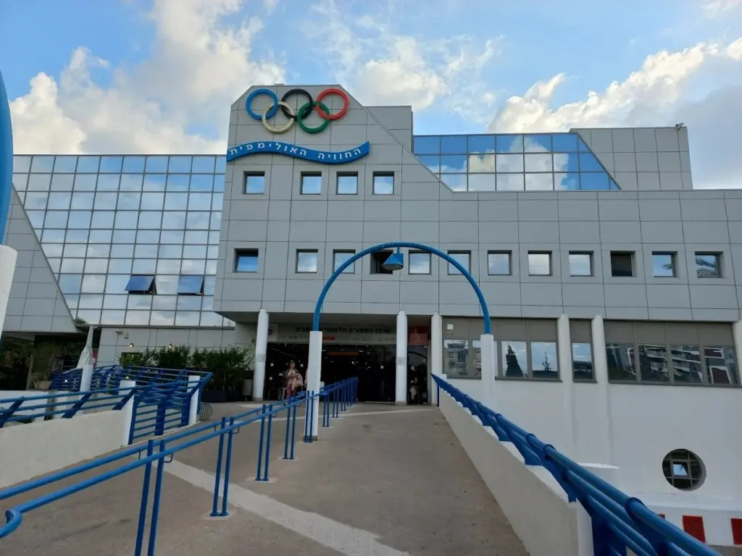
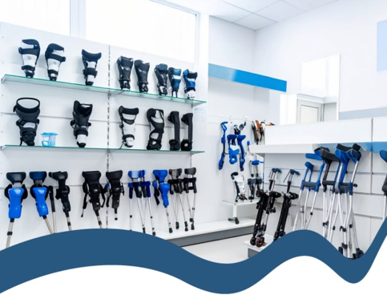
SALES CHANNELS
THE PILLARS
1
2
3
4
5
Pharmacies & Drug Stores
Hospitals
Digital
Orthopedic And Physiotherapy Institutes
Private Labels

