Slide 1
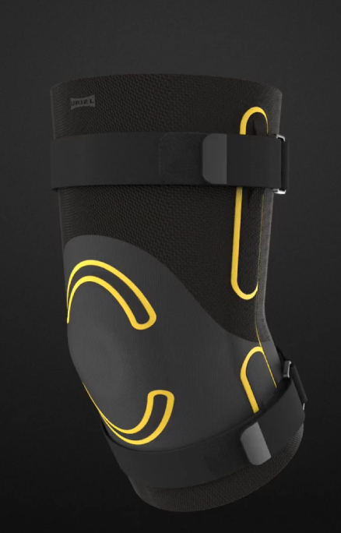
URIEL
R&D STRATEGY
✓
Innovation technology: wearables
✓
Innovative, functional & design
✓
Innovative design update

Slide 2
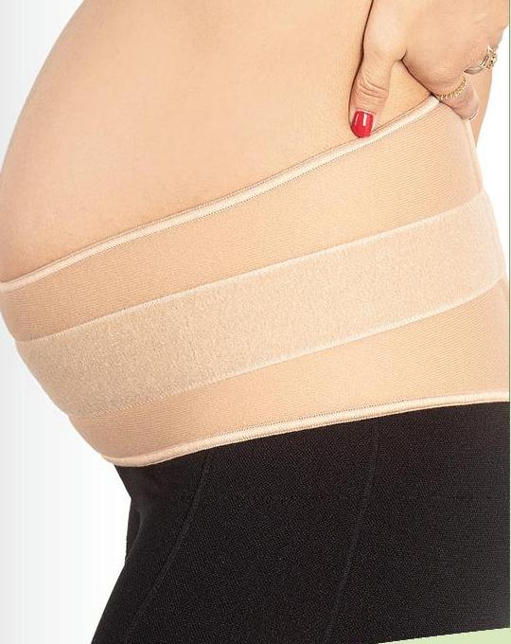
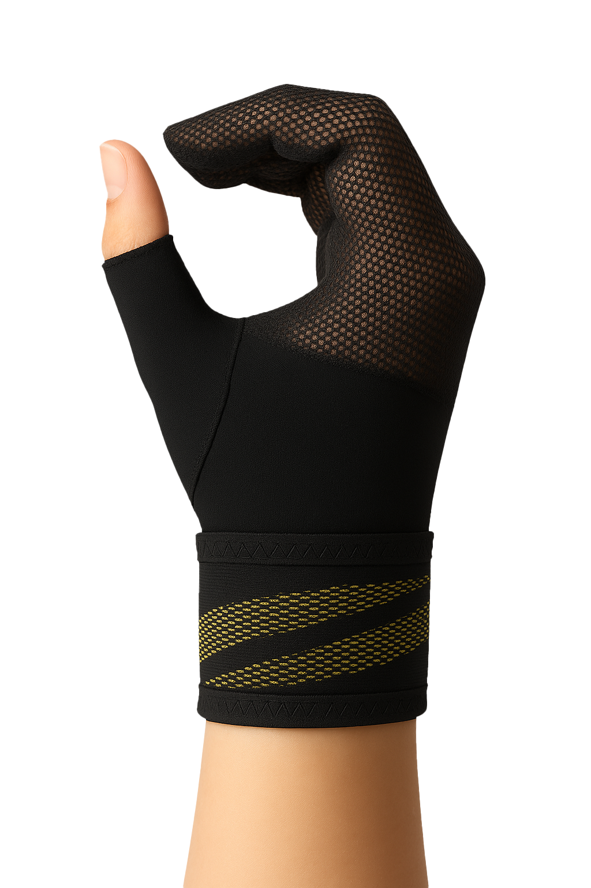
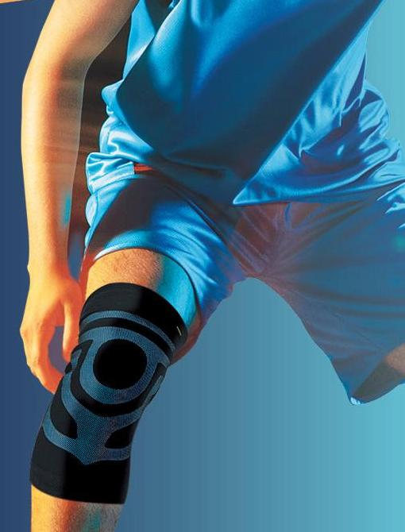
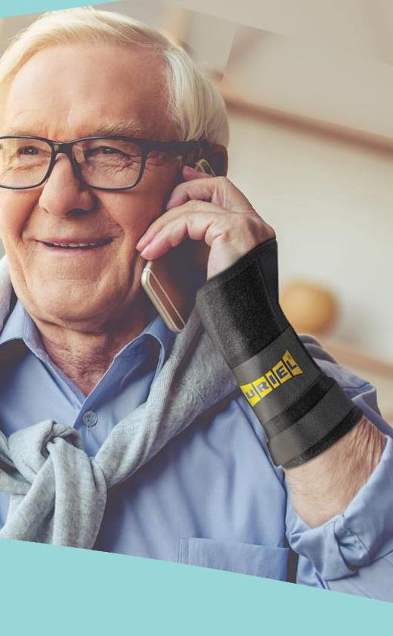
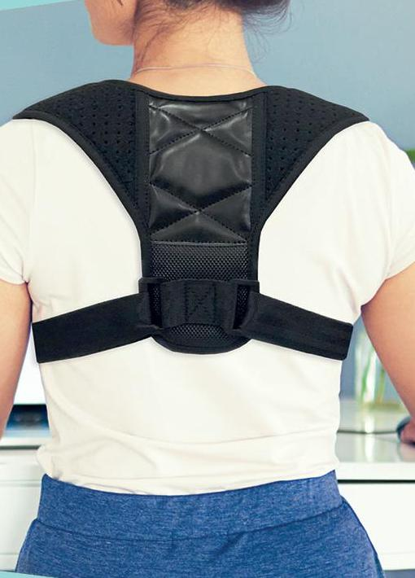
TO ALL PEOPLE,
AT ANY AGE

Slide 3
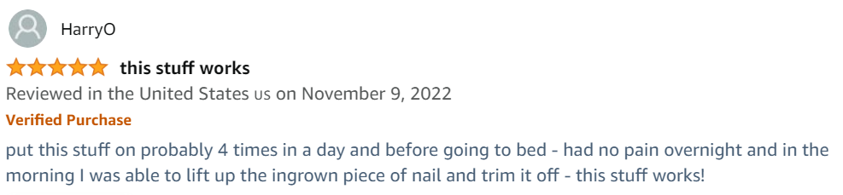
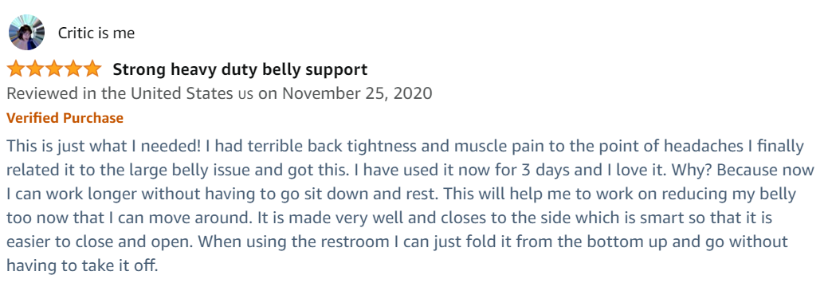
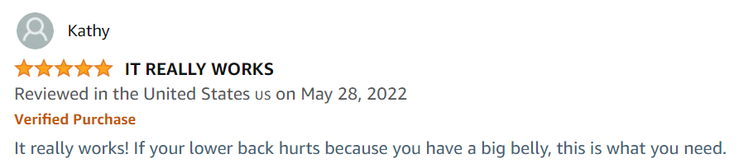
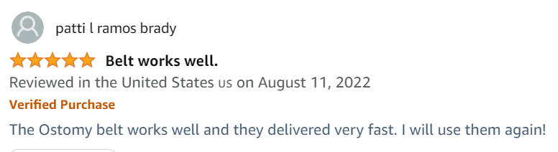
CONSUMERS LOVE URIEL!
8000+
REVIEWS
& VIDEOS
URIEL consumers are URIEL’s best ambassadors, with 8,000+ reviews and videos.

Slide 4
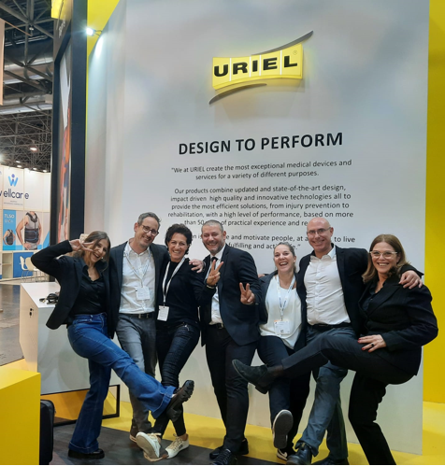
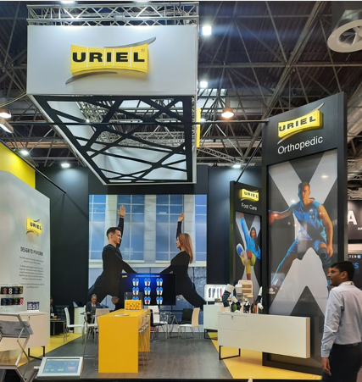
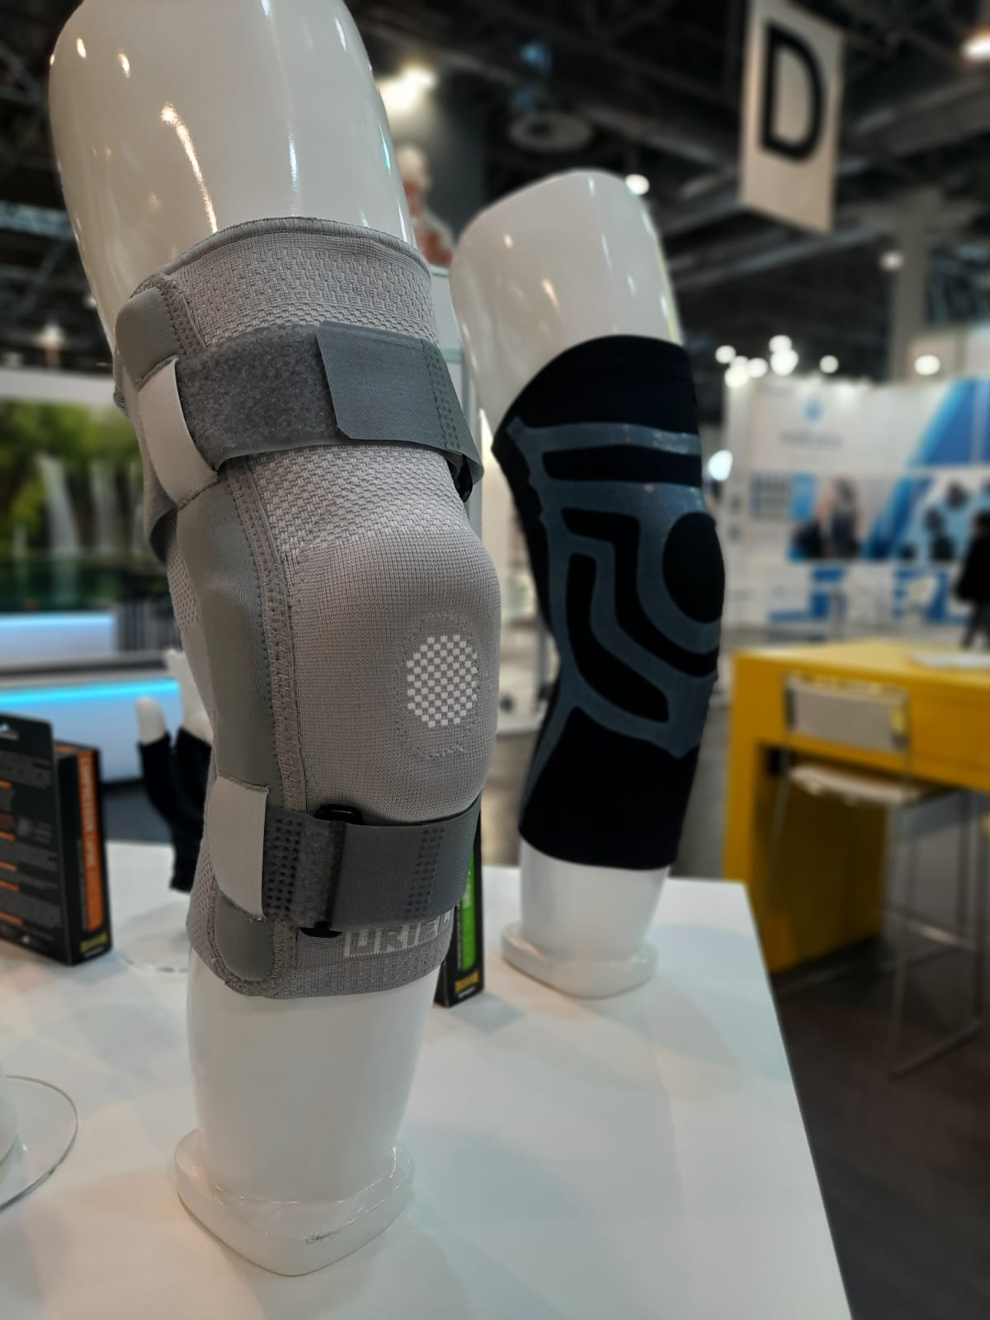
WE LOVE INNOVATION

Slide 5
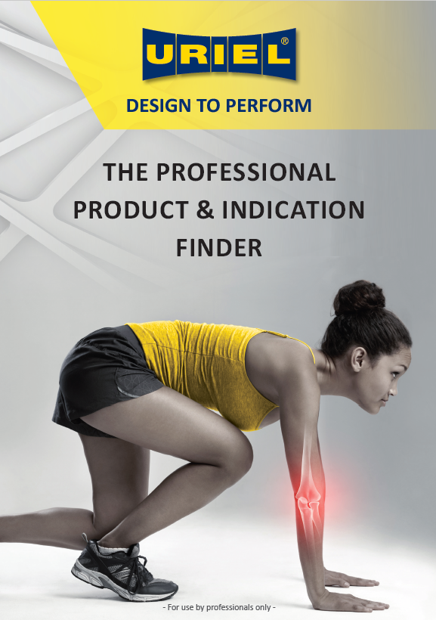
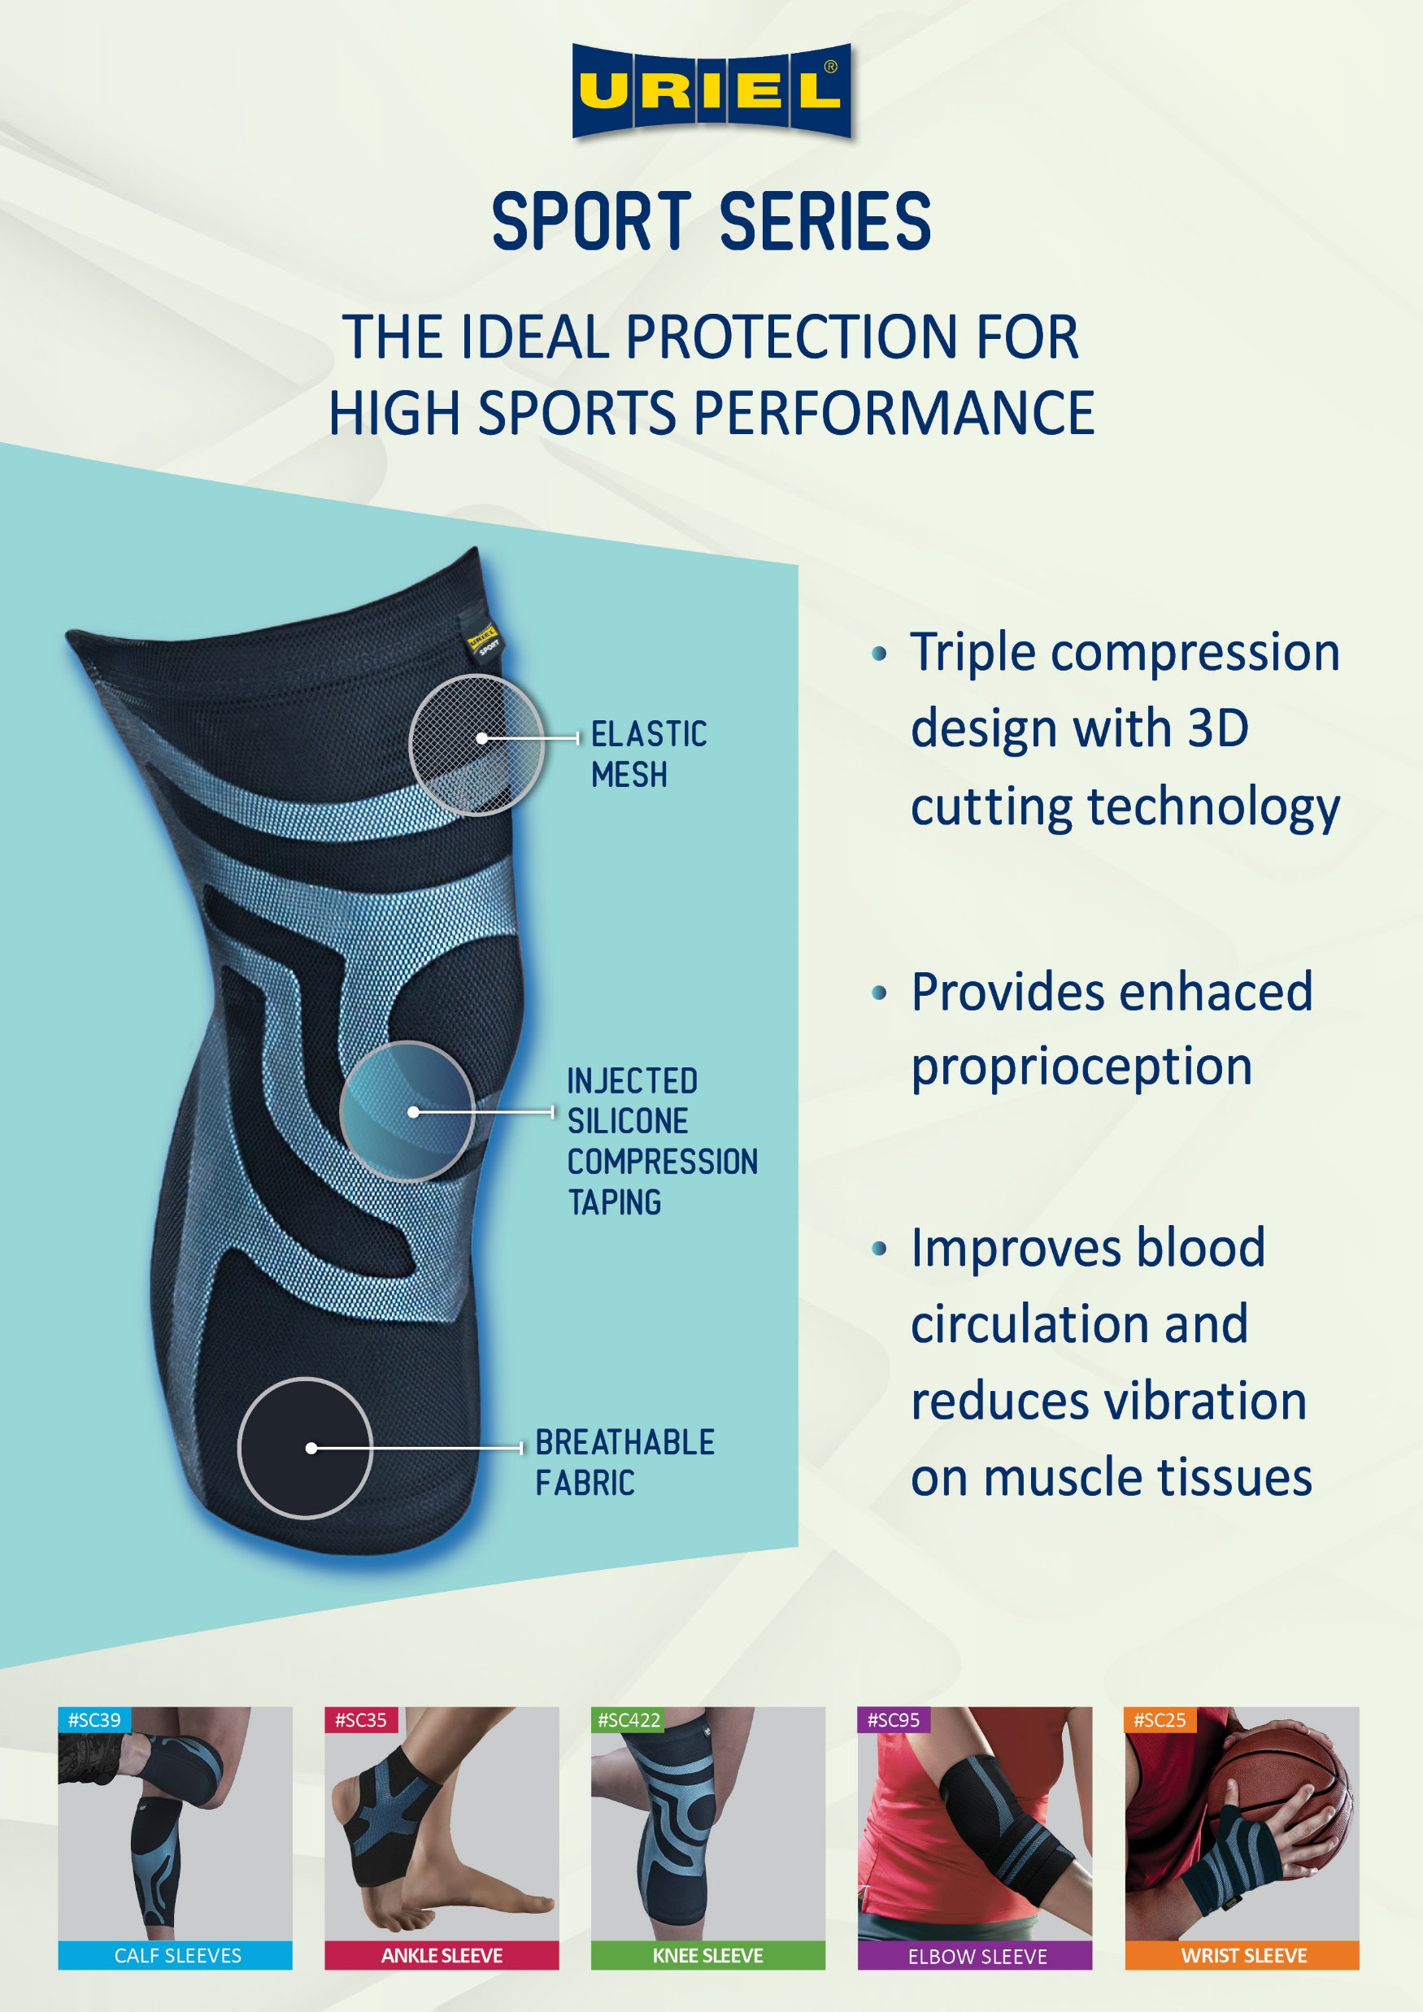
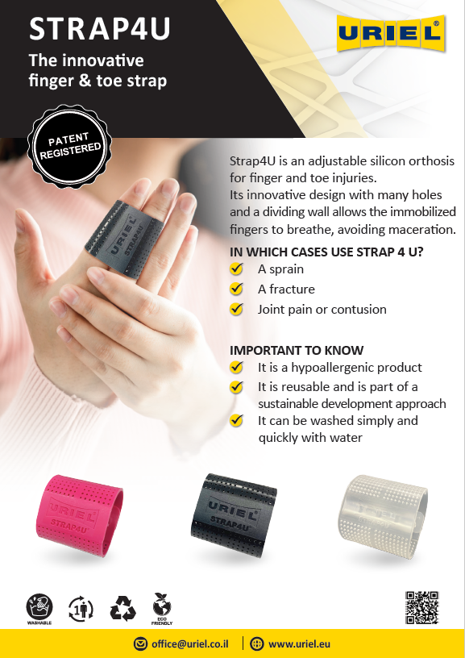
JUST FOR YOU

Slide 6
AZERBAIJAN: AN EMERGING
MARKET OPPORTUNITY
Azerbaijan's medical devices market — including orthopedics as a sub-segment — is projected to grow from $520M (2025) to $790M by 2031, a 9.2% CAGR.
A dedicated market report for braces & supports in Azerbaijan doesn't exist yet — here's what the data does show.
AZERBAIJAN MEDICAL DEVICES MARKET
IMPORT ACTIVITY (HS 9021)
GLOBAL CONTEXT
$520M → $790M
South Korea — $3.56M (2024)
(reference only — not Azerbaijan-specific)
Switzerland — $2.61M (2025)
$4.67B → $7.01B
2025 → 2031 · incl. orthopedics as a sub-segment
9.2% CAGR
India — $1.55M (2025)
Orthopedic braces & supports, global, 2024→2030, CAGR 7.3%
Growth drivers: aging population, healthcare-infrastructure investment, medical tourism.
Braces, splints, casts & fracture appliances — a steady multi-country import flow shows an active market.
MEA region: $369.2M by 2030
Azerbaijan is not reported separately in these global/regional studies.
Source: 6wresearch, 2025
Source: Trading Economics / UN Comtrade
Source: Grand View Research, 2024
Note: Azerbaijan has no standalone braces & supports market report yet — figures above combine the broader medical devices market, import data, and global context as the closest available proxies.
Sources: 6wresearch, Azerbaijan Medical Devices Market (2020–2026, forecast to 2031); Grand View Research, Orthopedic Braces & Supports Market (2024); Trading Economics / UN Comtrade import data (2024–2025). Accessed Aug 2026.

Slide 7
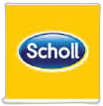


DOMINATING THE LOCAL MARKET
IN ISRAEL
✓
High Brand Awareness: Our brand is widely recognized as a trusted choice in Israel's orthopedic market.
✓
Strong Customer Preference: Many consumers prefer our products, showcasing their confidence in our quality.
✓
Robust Reputation: We maintain a strong reputation for reliability and innovation in the local market.
BRAND AWARENESS & PREFERENCE — ISRAEL ORTHOPEDIC MARKET
60%
59%
57%
7%
6%
4%
2%
2%
1%
1%
1%
7%
0.5%
Scholl
Life
URIEL
Medi
Mueller
Slim Fit
Orliman
Sport On
Bauerfeind
Genutrain
Bort
AKS
None of the
above
**Survey of 500 consumers, 2023.

Slide 8
THE GLOBAL ORTHOPEDIC
BRACES & SUPPORTS MARKET
URIEL's core global market — orthopedic braces & supports — was valued at $4.67B in 2024 and is projected to reach $7.01B by 2030, a 7.3% CAGR.
Independent analysts confirm consistent growth — knee braces and e-commerce/DTC lead the expansion.
GLOBAL MARKET SIZE
MARKET BY BODY REGION
US$ billions — Grand View Research, 2024–2030
% of total market — MarketsandMarkets, 2025
*2030 figure is a forecast (CAGR 7.3%)
Knee braces alone are the largest sub-segment — 34–46% of total demand, and the fastest-growing.
Note: Market-size estimates vary by source ($3.8–4.9B for 2024/2025) depending on category definition (e.g., inclusion of pain-management products). Grand View Research is used as the primary estimate here; data was gathered via search snippets, not a direct source fetch.
Sources: Grand View Research, Orthopedic Braces & Supports Market (2025); MarketsandMarkets (2025); Precedence Research (2025); Mordor Intelligence (2025); Future Market Insights (2025). Accessed Aug 2026.

