Slide 1
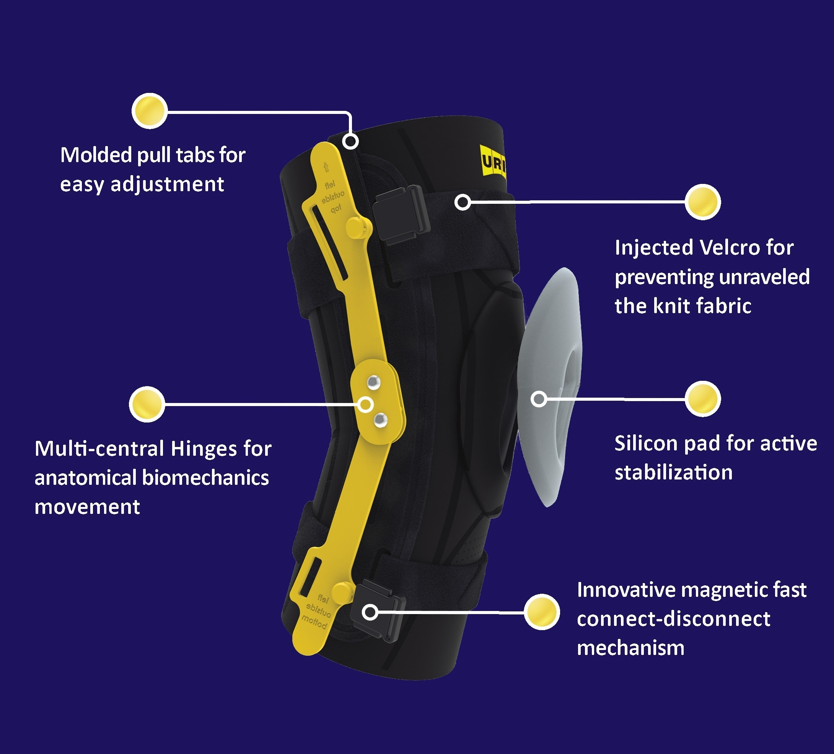
GENU-SHIELD STABILIZER
PROVIDES JOINT STABILIZATION WHILE REDUCING PAIN AND SWELLING

