Slide 1

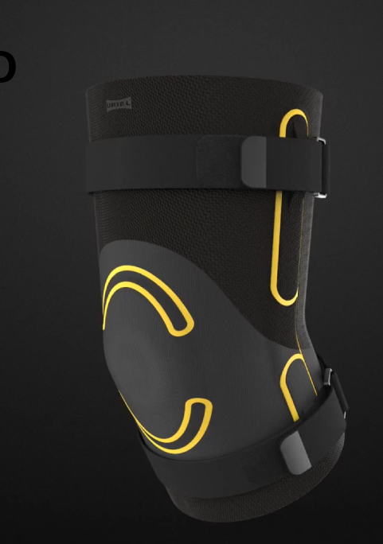
Innovation technology: wearables
Innovative, functional & design
innovative design update
URIEL R&D
STRATEGY

Slide 2


Slide 3



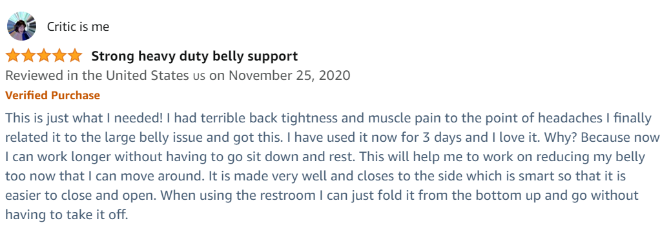

Consumers LOVE URIEL!
URIEL consumers are URIEL’s best ambassadors,
with 8000+ REVIEWS AND VIDEOS.

Slide 4

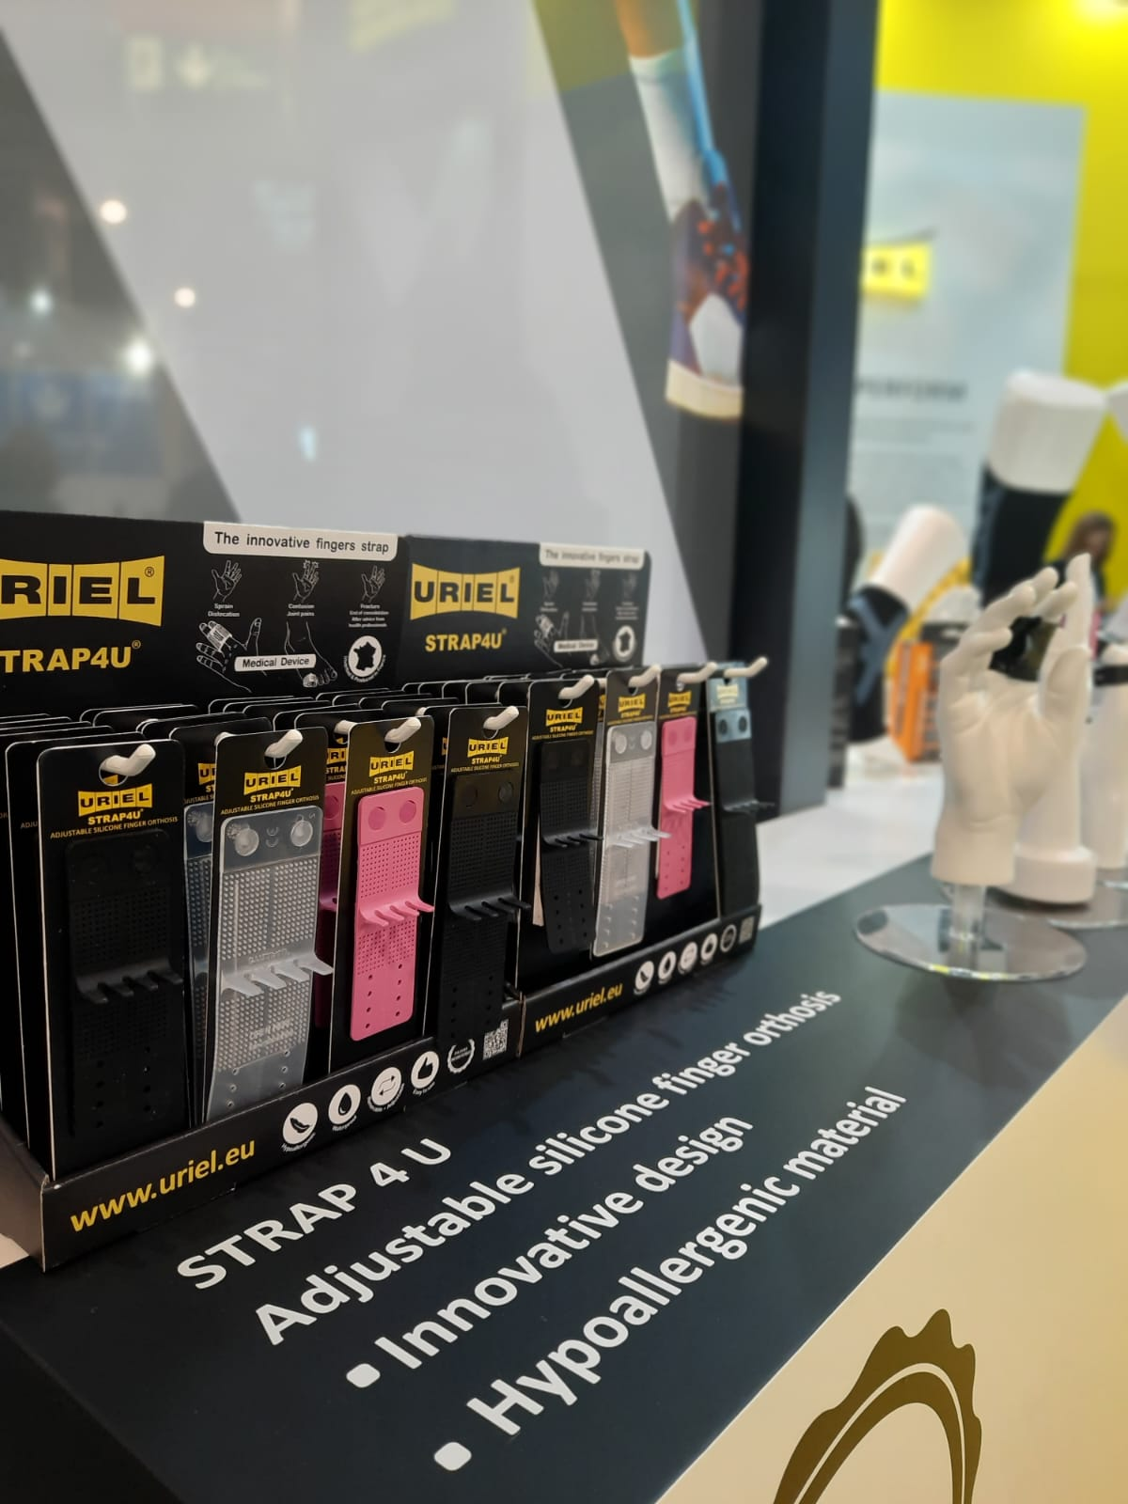
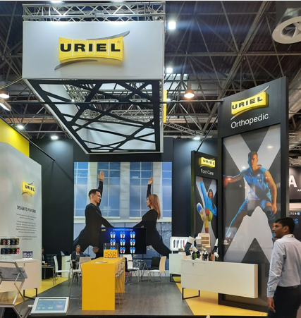
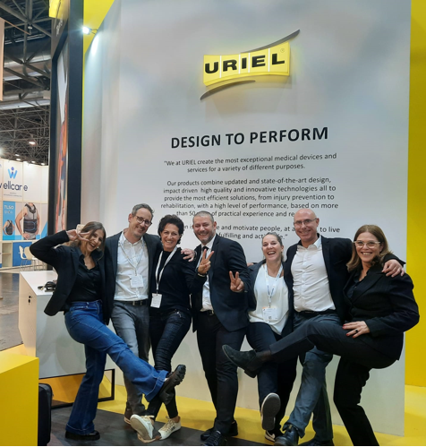
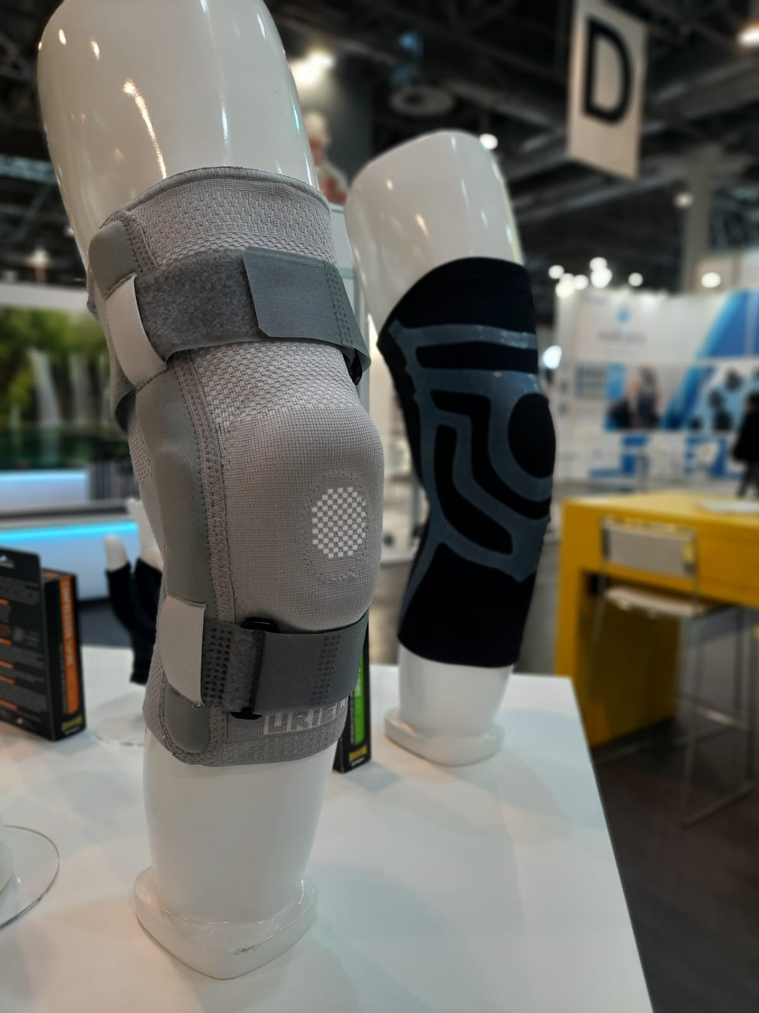

WE LOVE
INNOVATION

Slide 5

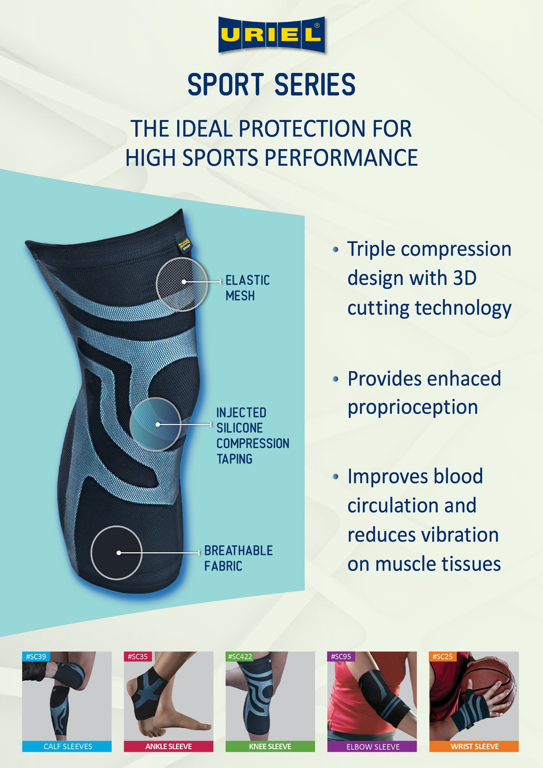
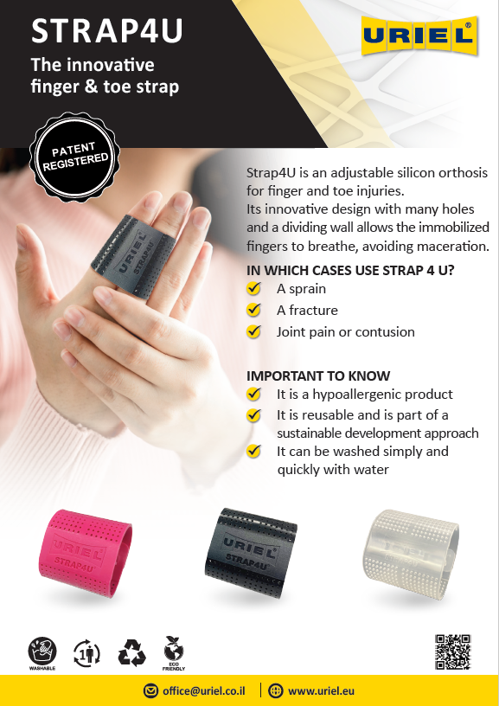
JUST FOR
YOU

