Slide 1
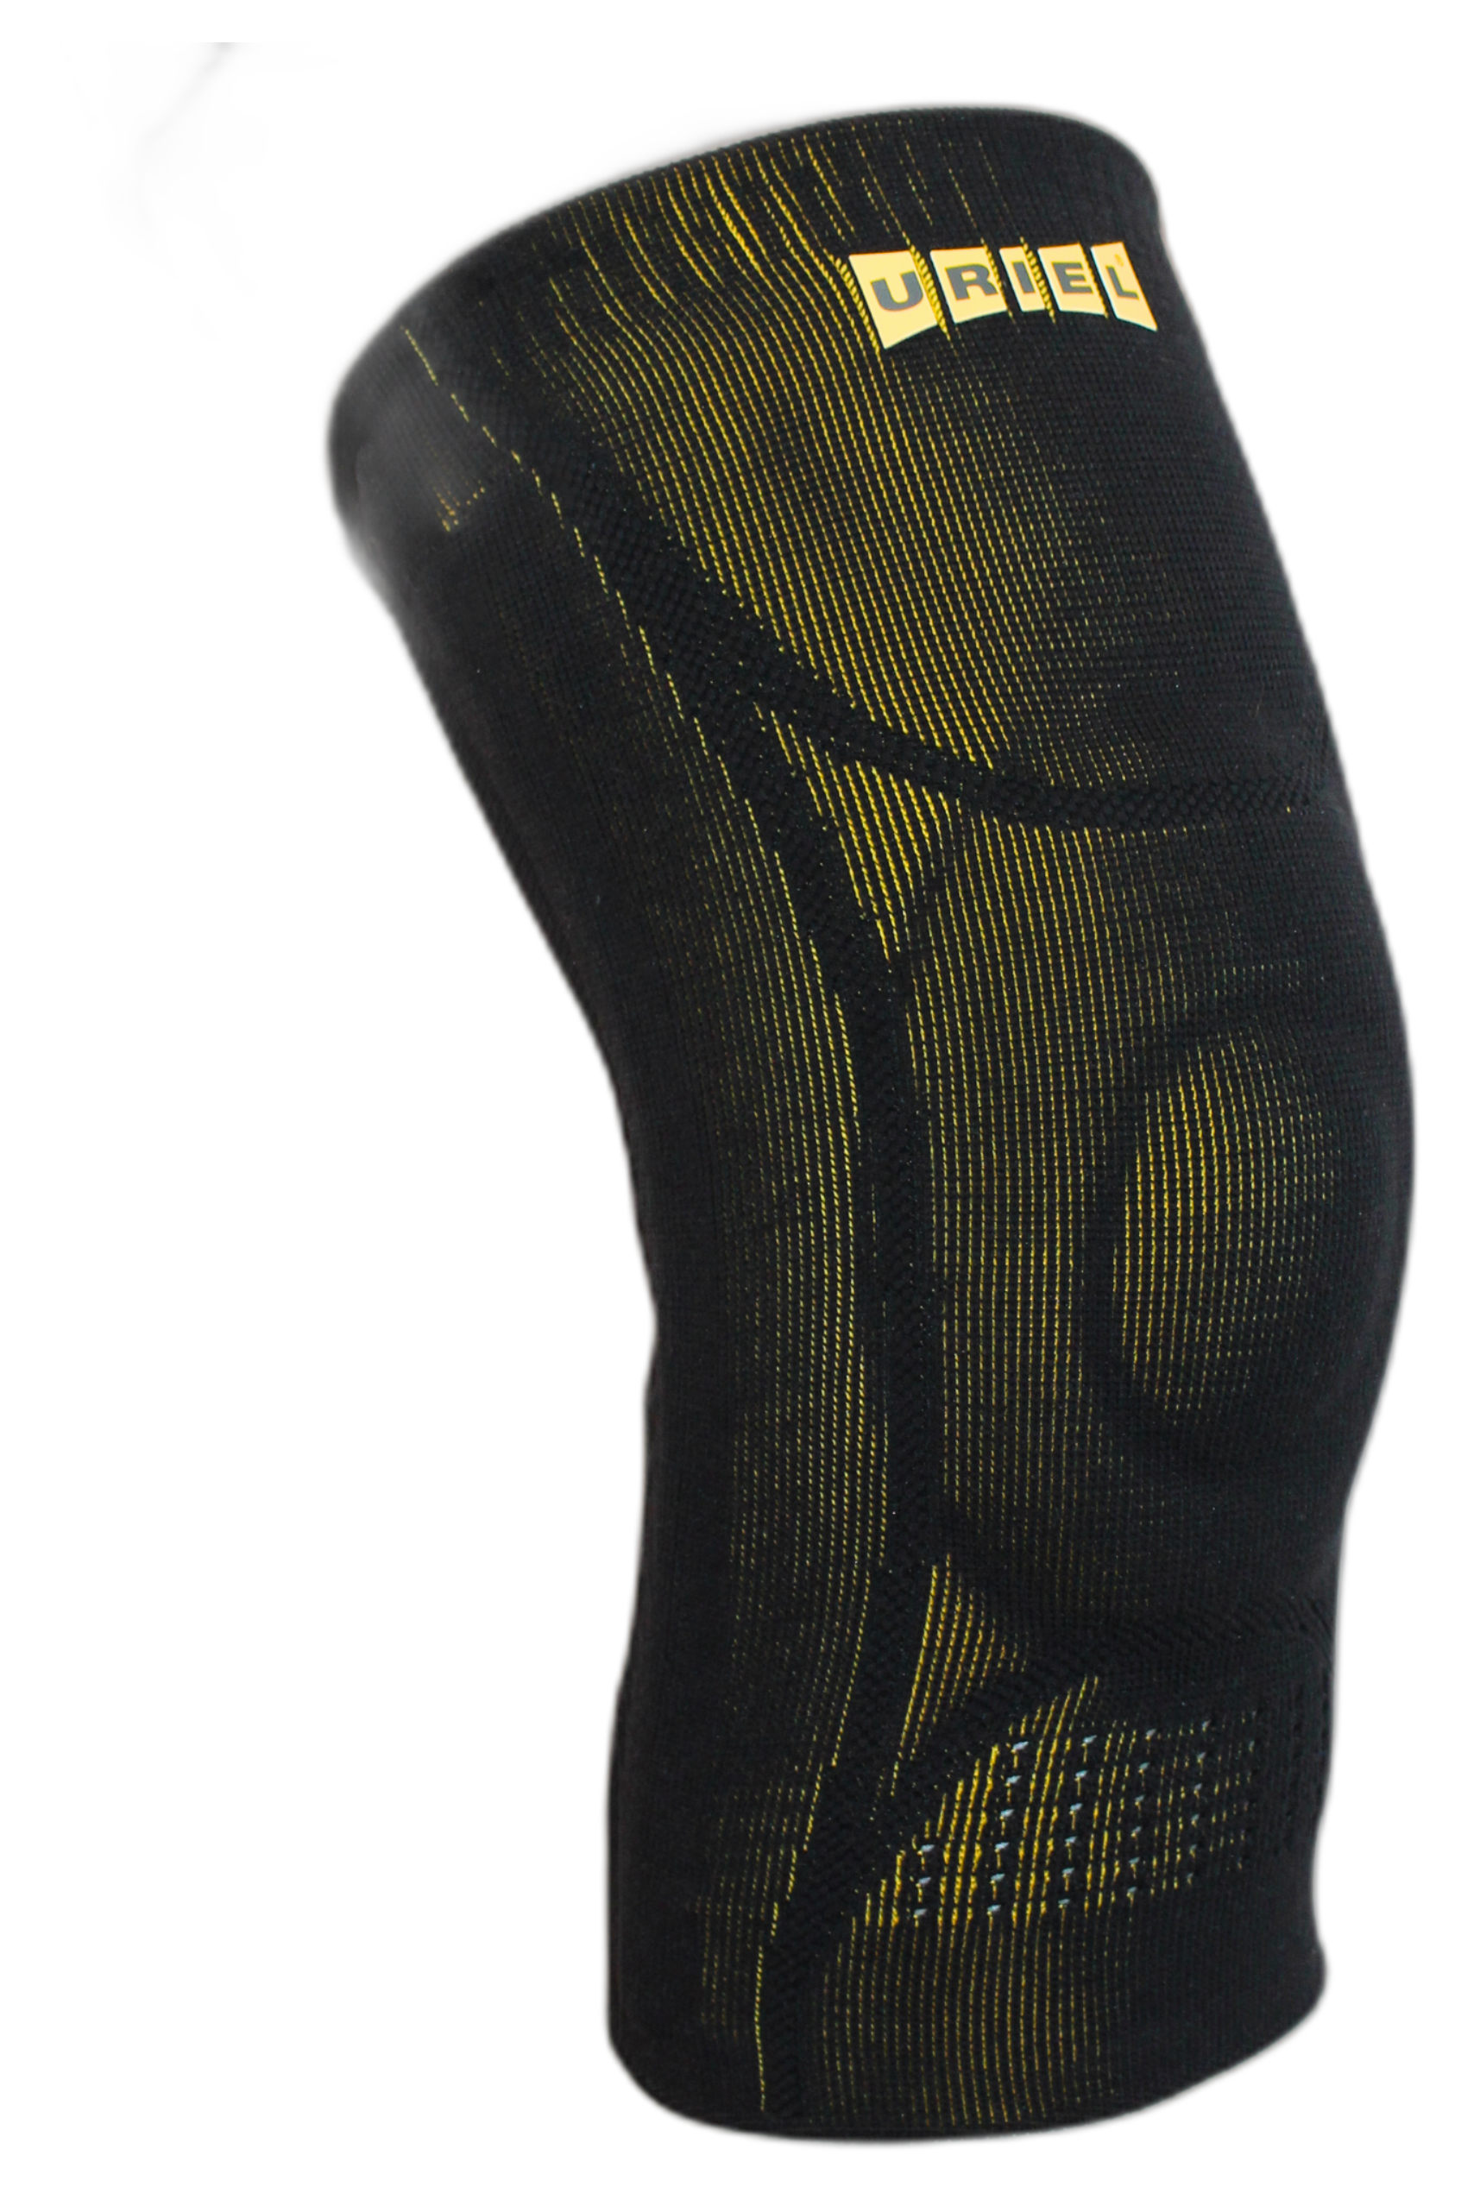
GenuShield Knee Support
3D Breathable Knit
Soft, lightweight & ventilated fabric for all-day comfort.
Flexible Joint Support
Double-sided spiral stays reduce pain, swelling & enhance mobility.
ADVANCED SUPPORT FOR STABILITY, PAIN RELIEF & SWELLING REDUCTION
TPE Gel Patella Ring Pad
Relieves pressure, supports the kneecap & minimizes swelling.
With flexible stays & gel pad
Seamless Popliteal Area
Prevents wrinkles & enhances comfort behind the knee.

