Slide 1
Driving Growth Potential in Orthopedic Categoty
Aging with Confidence Longer life spans mean more need for lasting support.
Active Lifestyles, Active Demand Health-conscious consumers are seeking solutions for better mobility.
Prevent Today, Perform Tomorrow Injury prevention is key to staying active and strong.

Slide 2
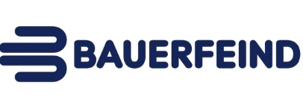




Navigating a Competitive Landscape
Diverse Competition: The market is filled with many players who hold geographic dominance, but lack comprehensive expertise across all categories.
Focused Solutions: While others focus on volume, we prioritize tailored solutions that empower movement and enhance well-being.

Slide 3
Our Growth Engines
Global Expansion Connecting with the world, Expanding the distributor network worldwide
E-commerce Revolution
Marketplaces reshape shopping while our website drives direct sales, both essential for growth.
Strategic Acquisitions Building a stronger portfolio through smart partnerships.

Slide 4

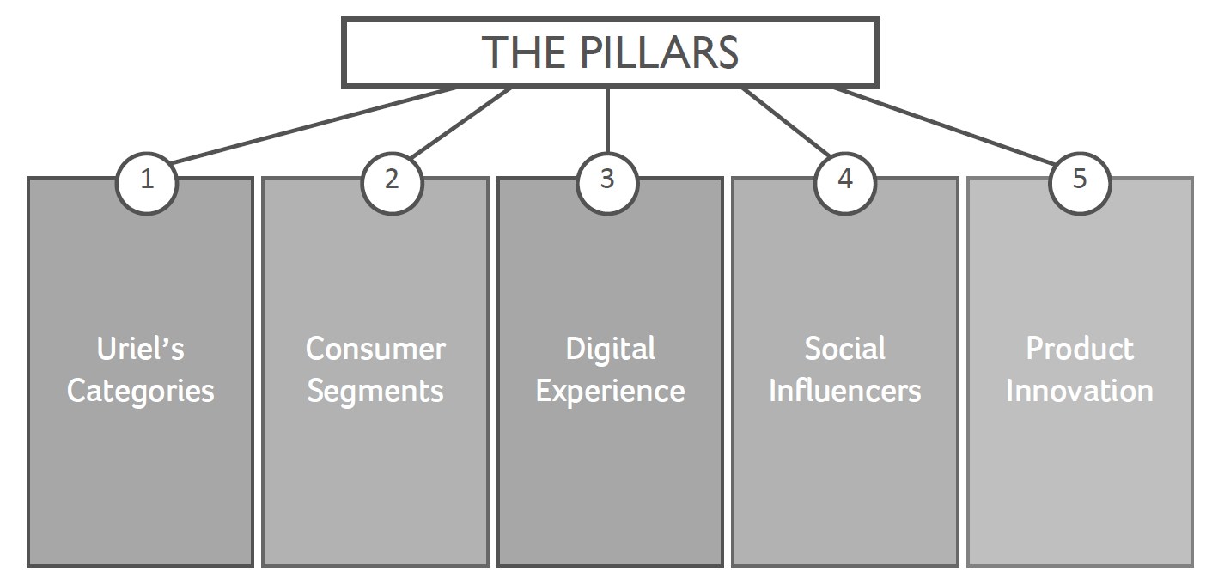
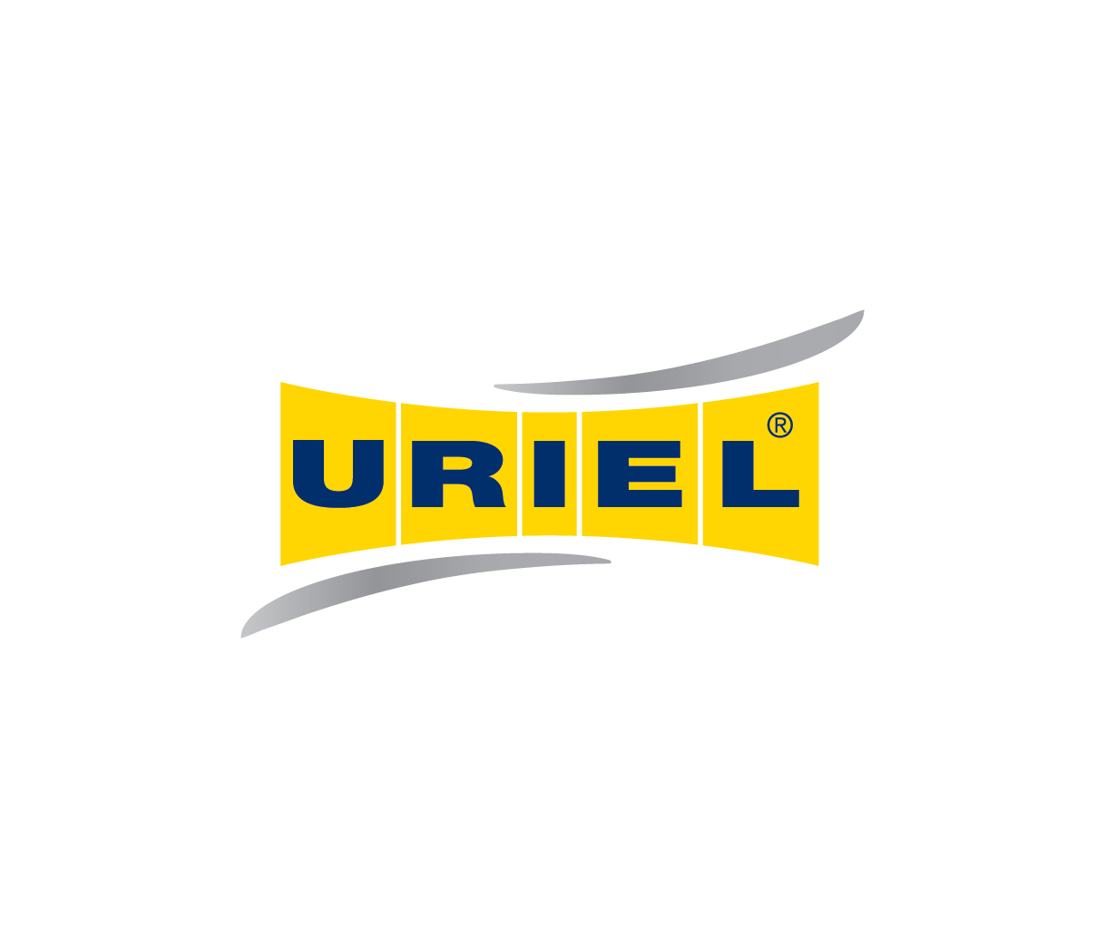
Sales Channels
pharmacies & Drug stores
Private labels
Hospitals
digital
Orthopedic and physiotherapy institutes

Slide 5






REGULATION
AROUND THE
WORLD
URIEL meets the highest standards of the authorities in Israel and around the world

Slide 6
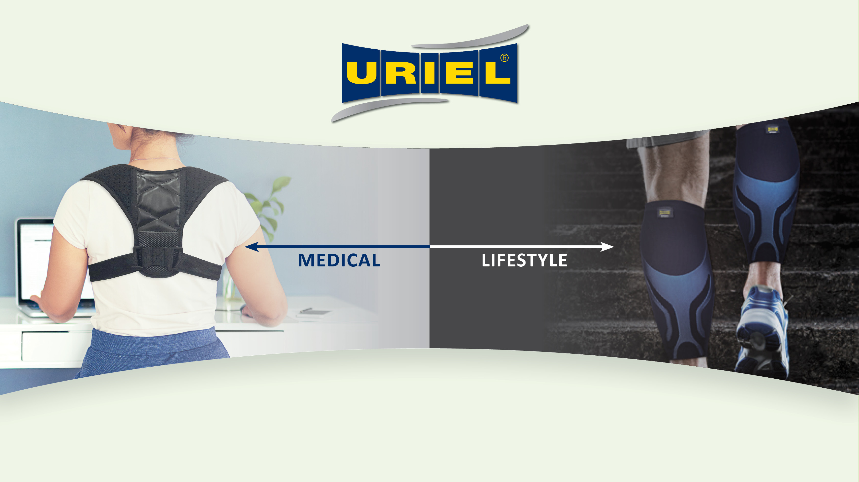
לשלב קומפוזיציית מוצרים רפואיים
לשלב קומפוזיציית מוצרי ספורט, טיפוח כף רגל
Medical
LifeStyle

