Slide 1

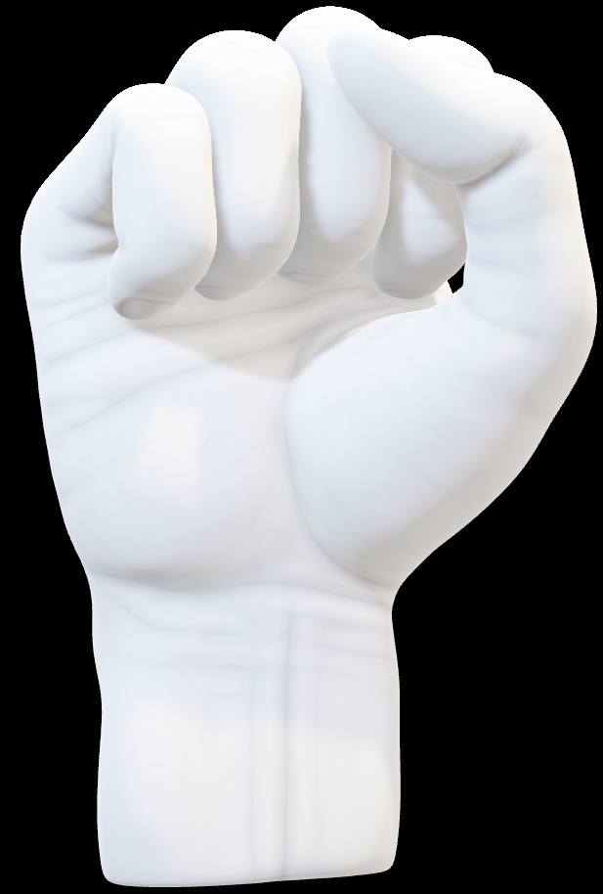
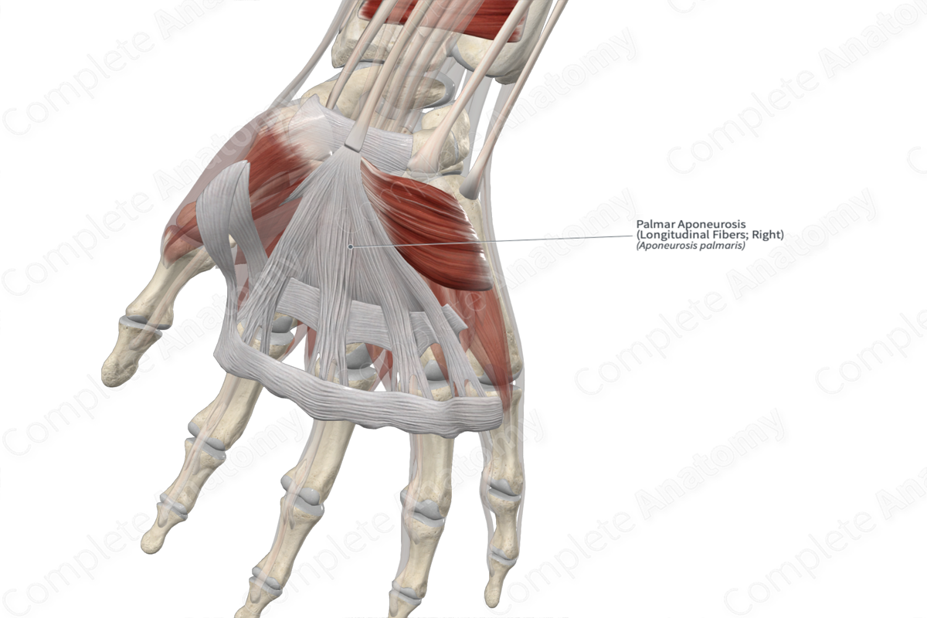
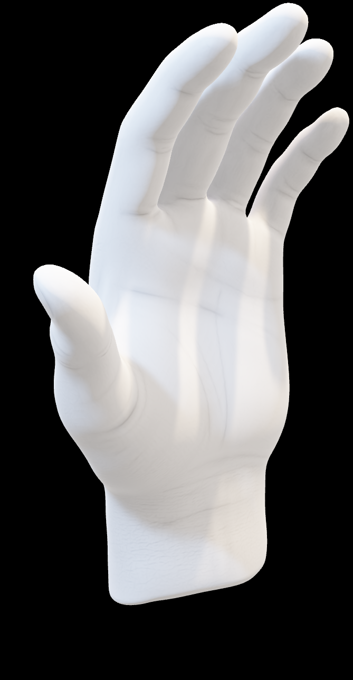

MARKET NEED
CTS affects millions worldwide (10% of adults may experience CTS).
Traditional splints often fail to provide the desired effect.
Patients seek non-invasive, comfortable solutions.
Orthopedic shops need innovative products to expand their portfolio.
Reduce tendon bulk in tunnel
Slacken the median nerve
Optimize space in tunnel

Slide 2
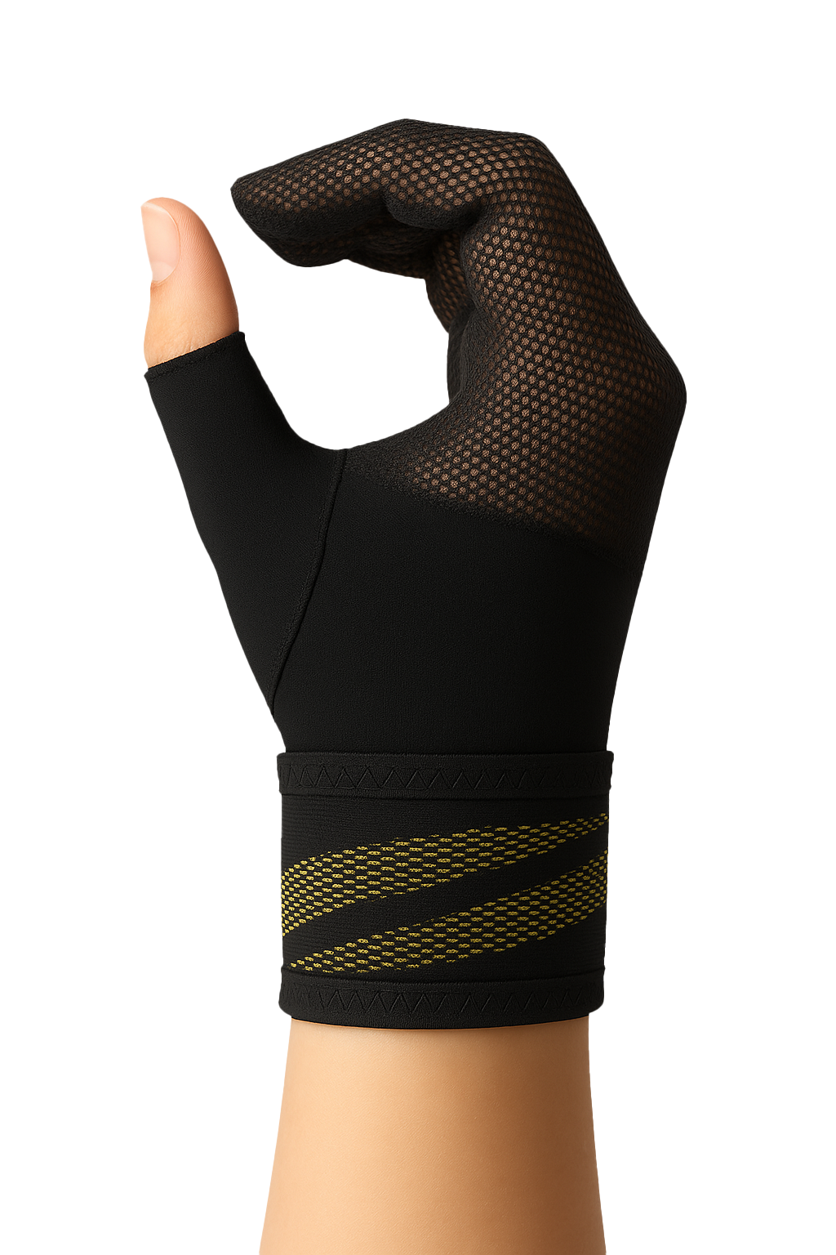
CTS NIGHT MITTEN NIGHTTIME PAIN RELIEF SUPPORT
Supports finger flexion position for nerve decompression
Lightweight breathable mitten design with Velcro fastening
Comfortable fit throughout the night
Three sizes for perfect fit
Washable, durable, consumer-friendly

Slide 3
THE SPORT SERIES
Reach Your Athletic Peak with Comfortable Ease
✓ TRIPLE-LAYERED 3D CUTTING TECHNOLOGY
✓ INJECTED SILICONE PROVIDES TARGETED SUPPORT FOR JOINTS AND MUSCLES WHILE REDUCING VIBRATION
✓ SPORT-READY LIGHTWEIGHT BREATHABILITY
✓ UPF 50+ PROTECTED

