Slide 1
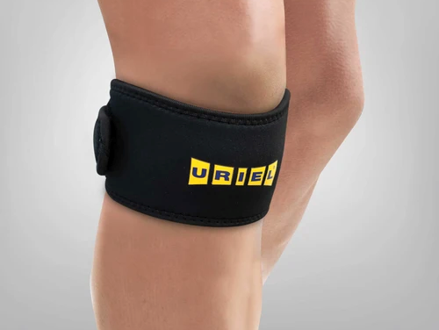
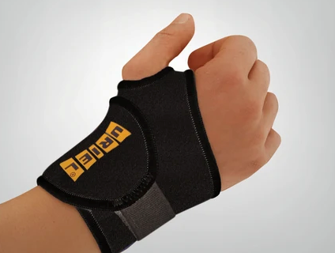
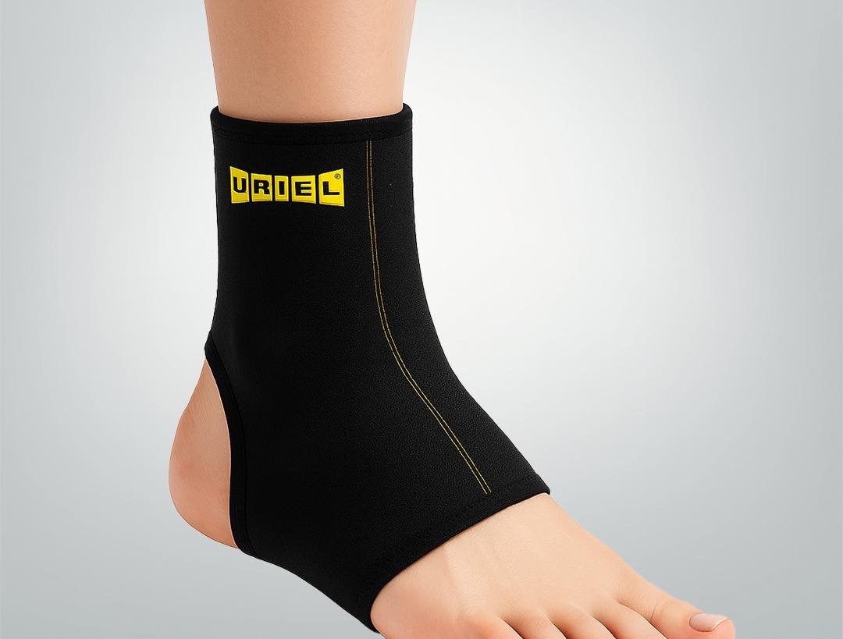
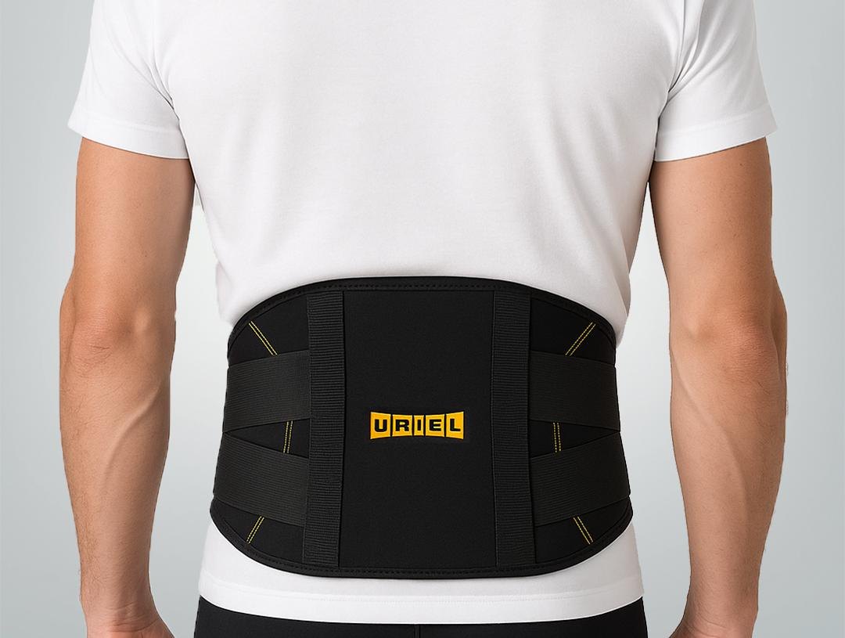
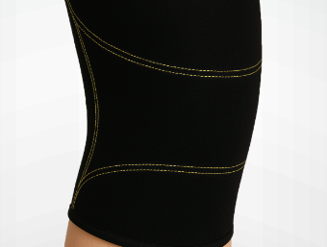
ORTHOPEDIC SUPPORT
ITEM —
ITEM T91
ITEM T20
THERMAL SERIES
Heat retaining neoprene combined with 100% cotton towel lining provides premium comfort support with thermal benefits to promote faster healing.
CRISS CROSS BELT
TENNIS BANDAGE
WRIST BANDAGE
ITEM 49
ITEM T40
+35
PRODUCTS
THIGH SUPPORT
PATELLA STRAP

Slide 2
