Slide 1

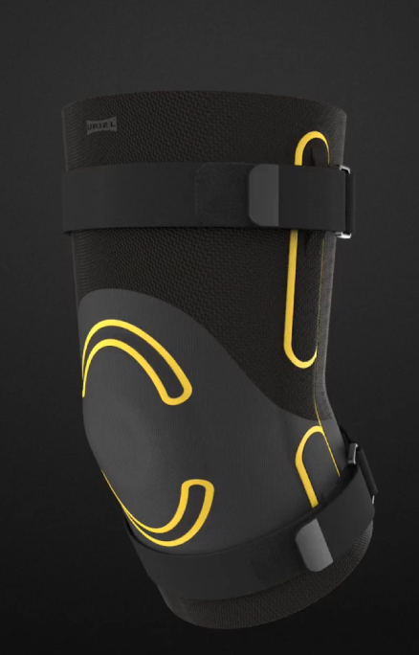
URIEL
R&D STRATEGY
✓
Innovation technology: wearables
✓
Innovative, functional & design
✓
Innovative design update

