Slide 1
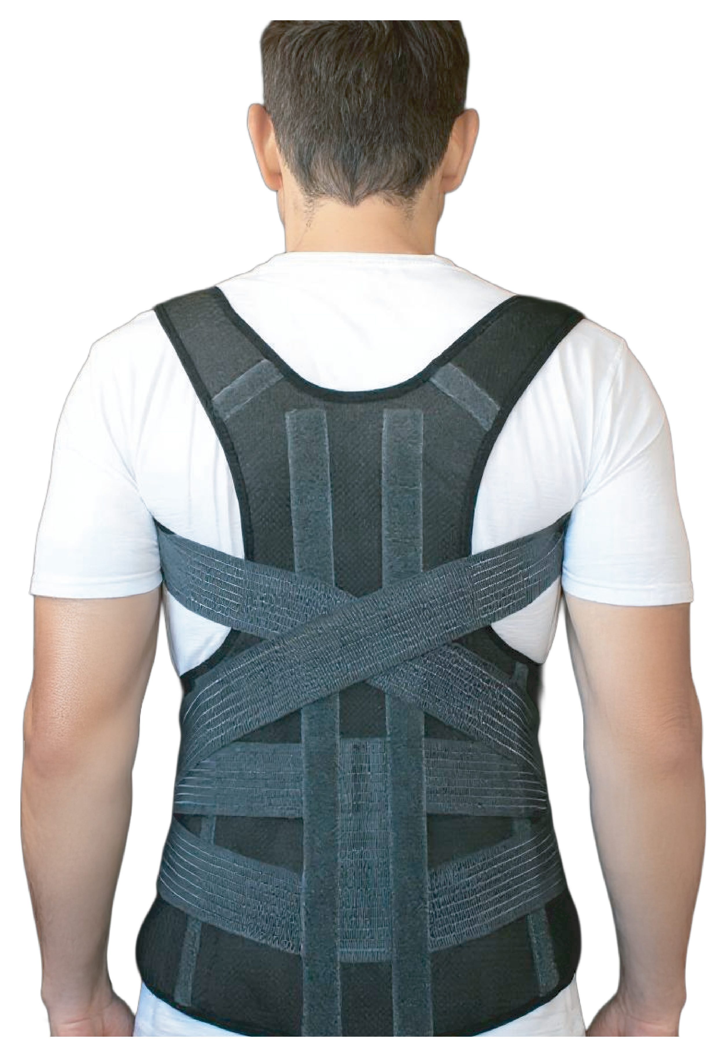
POSTURE CARE
SpinaShield
Posture Corrector Belt
FOR SPINE AND SHOULDERS
Advanced and lightweight posture corrector designed to improve spinal alignment and reduce upper back and shoulder pain. Featuring comfortable, adjustable straps, it supports upright posture, relieves muscle tension, and encourages natural movement.
Supports natural spinal alignment.
Helps relieve neck and upper back pain.
Discreet, slim, and comfortable for everyday use.

