Slide 1
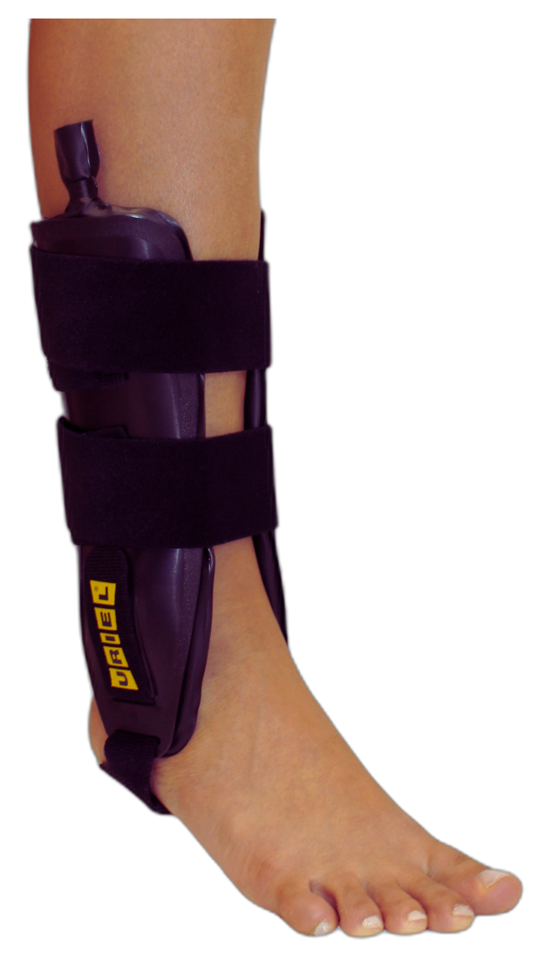
ANKLE SUPPORT
TaluAir Shield
Ankle Stabilizer
DUAL-SIDED ANKLE BRACE WITH AIR CUSHIONS
TaluAir Shield Ankle Stabilizer is a rigid ankle brace that restricts side-to-side movement and delivers strong lateral stabilization after acute sprains, ligament injuries, or instability. The inflatable cushions allow a customized fit and help reduce swelling during the critical first days of recovery.
Medical Indications: Acute ankle sprains, chronic instability, lateral ligament injuries, post-trauma stabilization, early rehabilitation phase.

