Slide 1

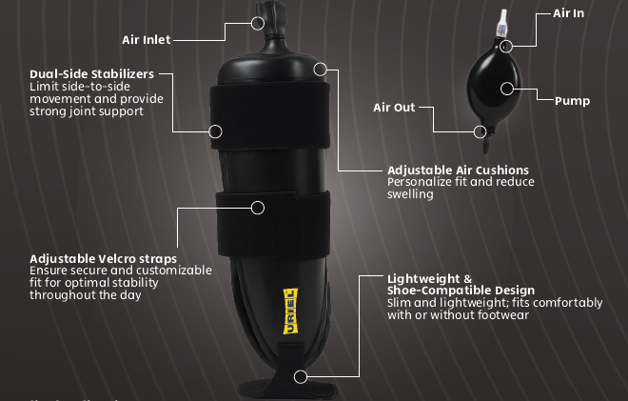

Slide 2
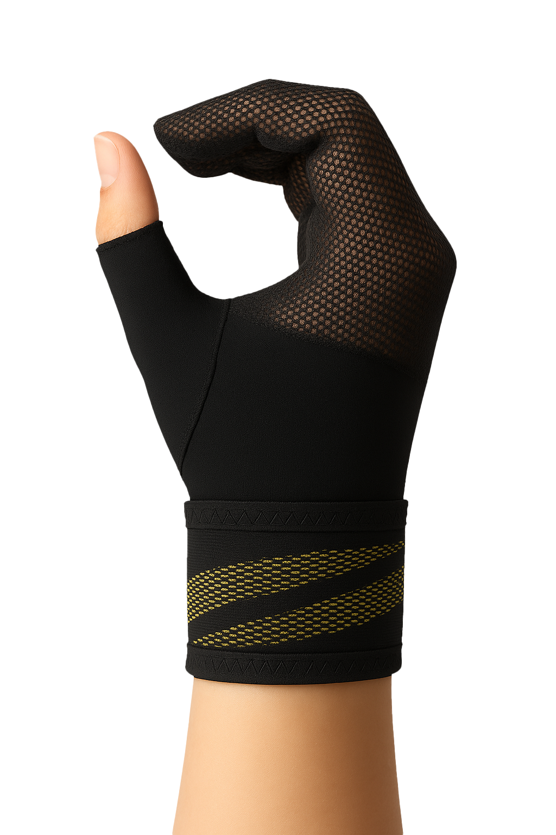

CTS Night Mitten - Nighttime Pain Relief Support
Supports finger flexion position for nerve decompression
Lightweight breathable mitten design with Velcro fastening
Comfortable fit throughout the night
Three sizes for perfect fit
Washable, durable, consumer-friendly

