Slide 1
URIEL
SHIELD SERIES
INNOVATIVE ORTHOPEDIC SUPPORT

Slide 2
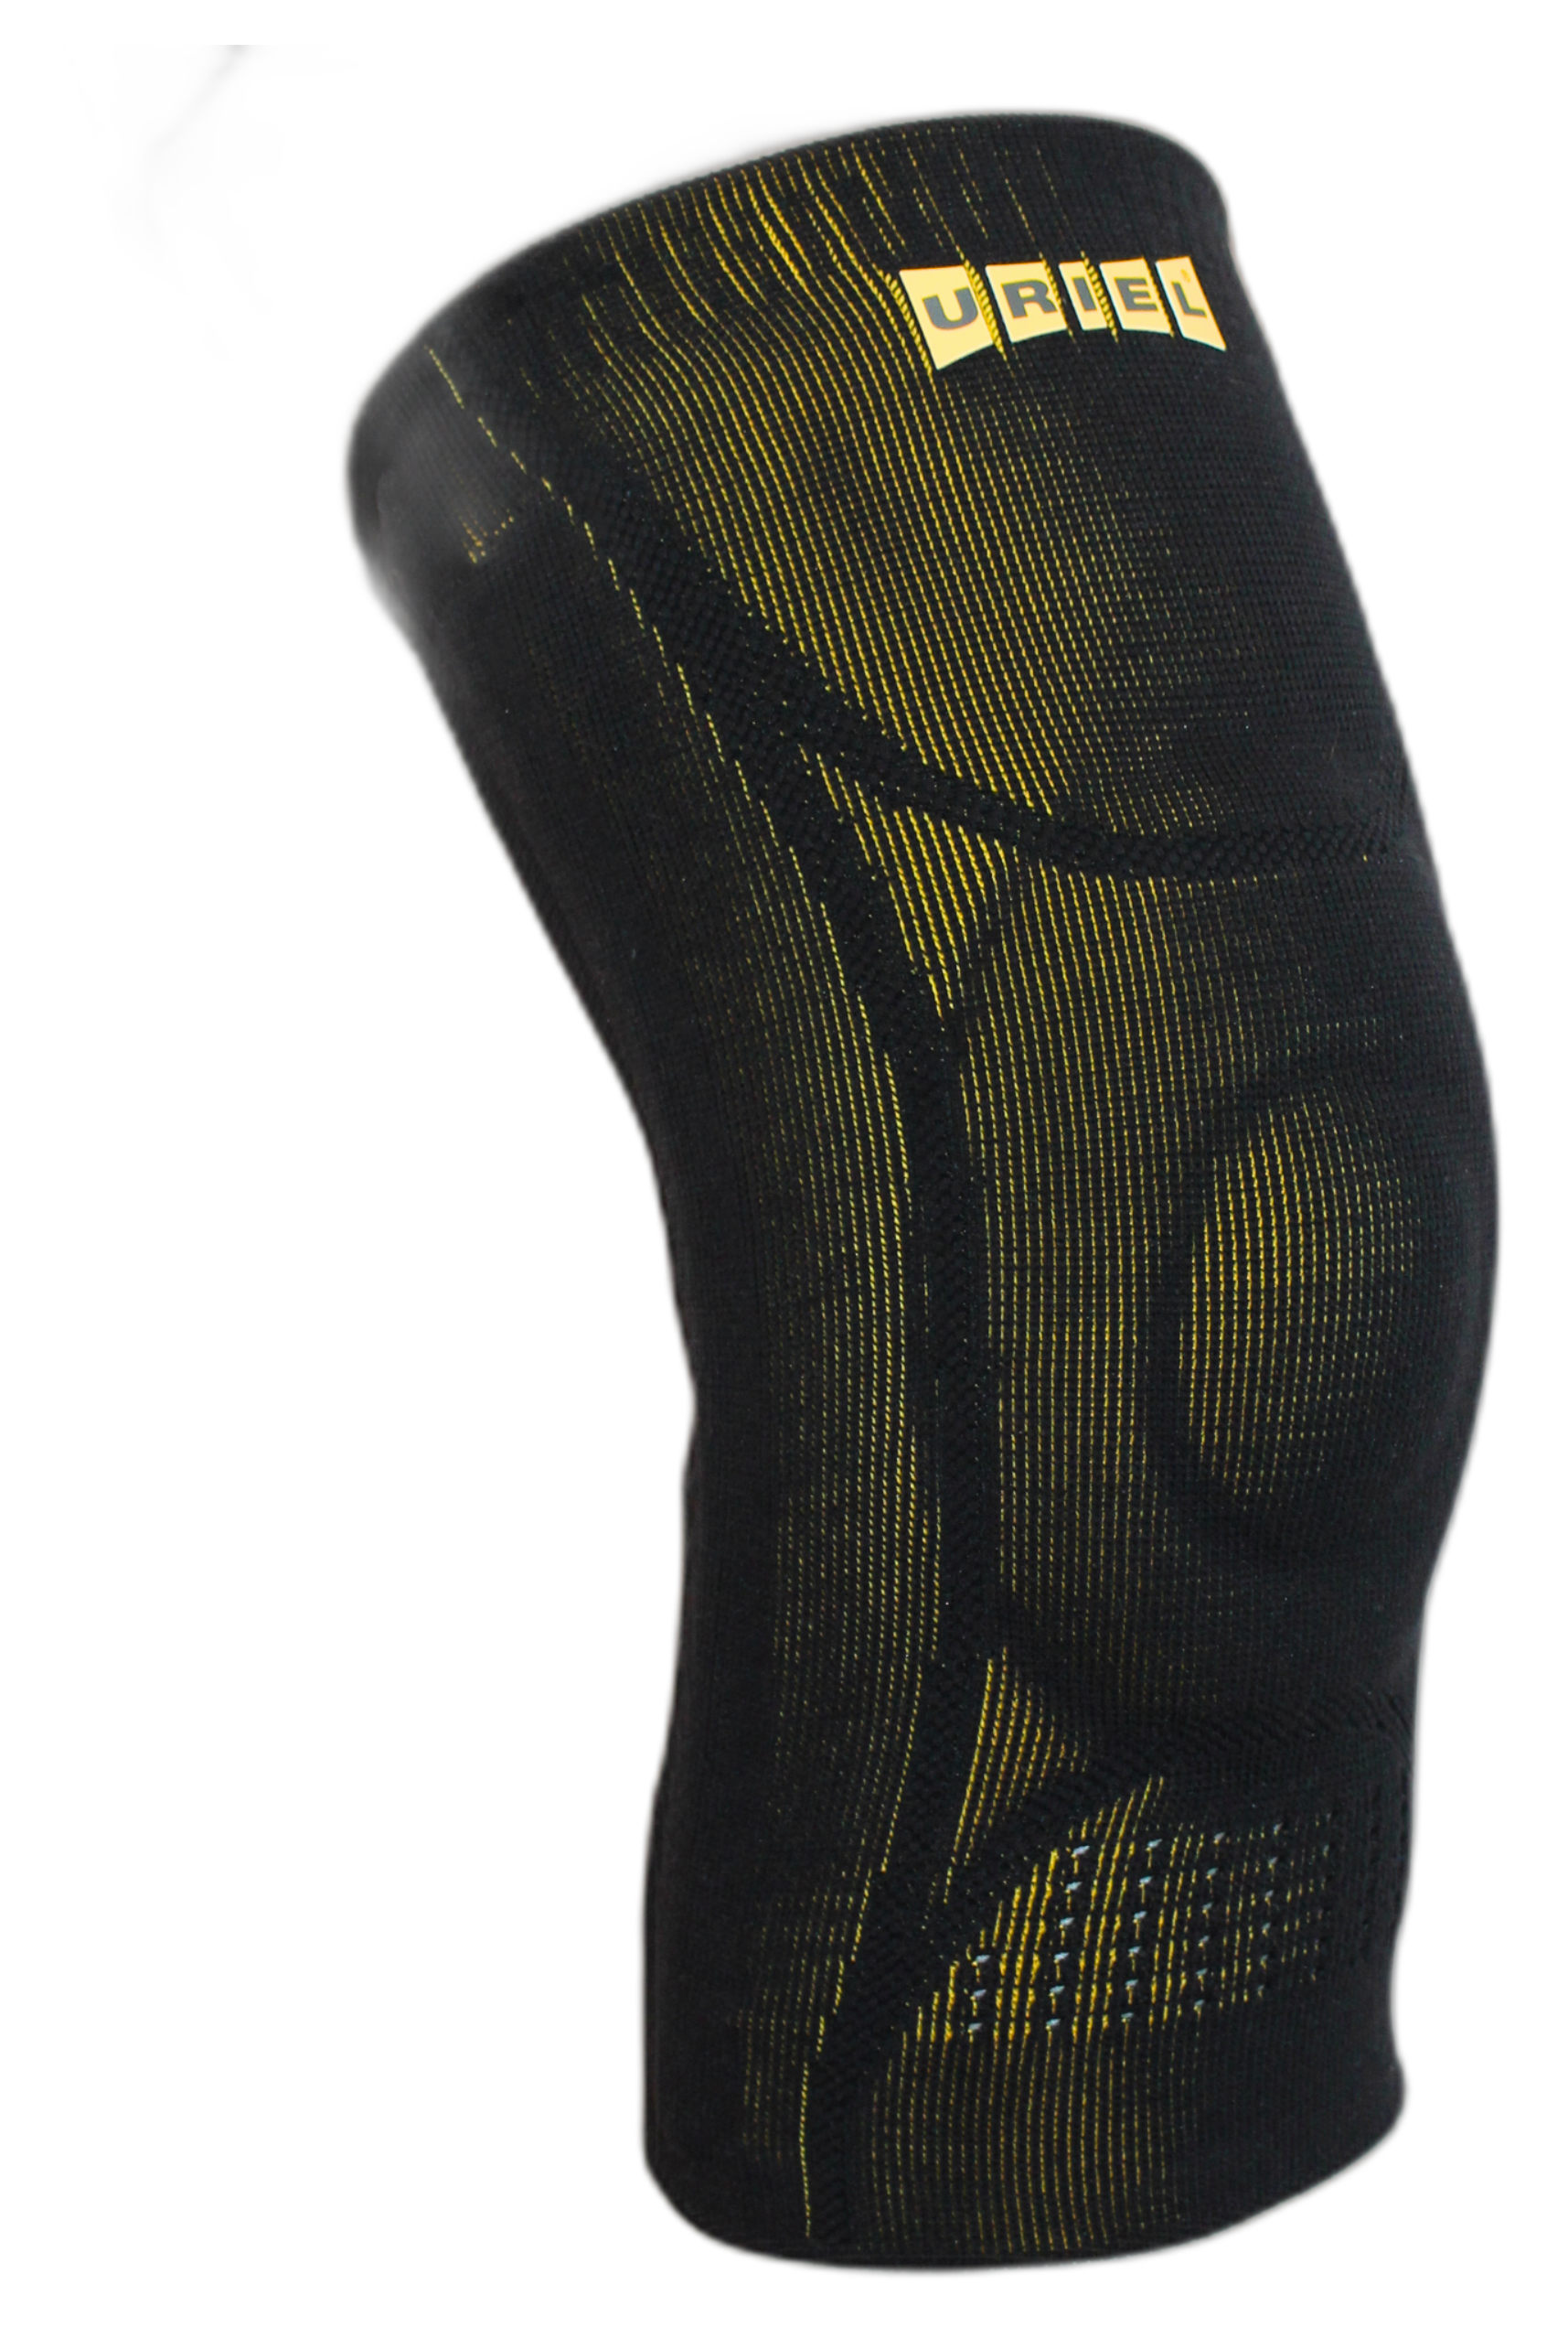
GenuShield Knee Support
3D Breathable Knit
Soft, lightweight & ventilated fabric for all-day comfort.
Flexible Joint Support
Double-sided spiral stays reduce pain, swelling & enhance mobility.
ADVANCED SUPPORT FOR STABILITY, PAIN RELIEF & SWELLING REDUCTION
TPE Gel Patella Ring Pad
Relieves pressure, supports the kneecap & minimizes swelling.
With flexible stays & gel pad
Seamless Popliteal Area
Prevents wrinkles & enhances comfort behind the knee.

Slide 3
GENUSHIELD KNEE SUPPORT
URIEL
3D Breathable Knit
Soft, lightweight & ventilated fabric for all-day comfort.
Flexible Joint Support
Double-sided spiral stays reduce pain, swelling & enhance mobility.
TPE Gel Patella Ring Pad
Relieves pressure, supports the kneecap & minimizes swelling.
Seamless Popliteal Area
Prevents wrinkles & enhances comfort behind the knee; engineered for pain-free movement during activity & recovery.

Slide 4
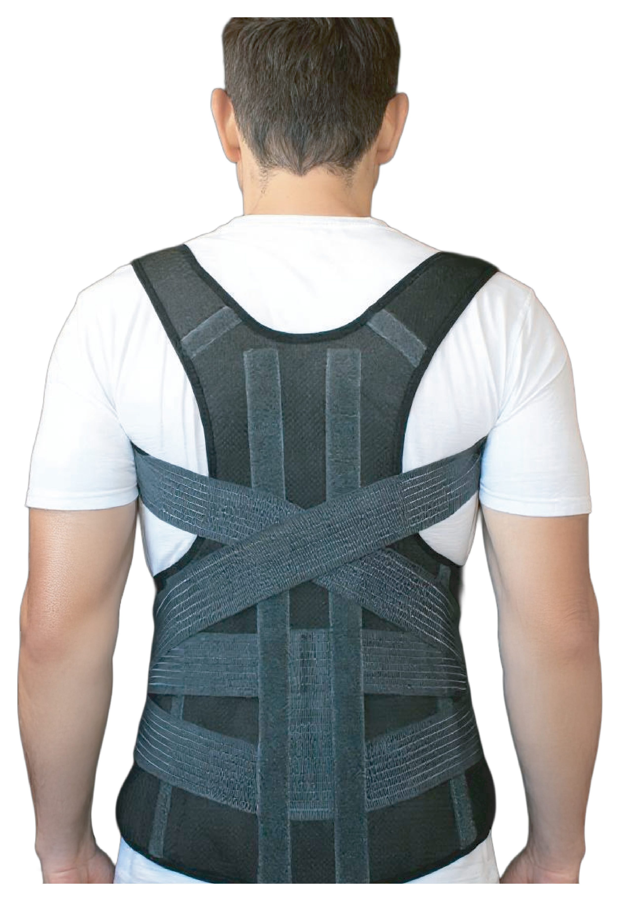
POSTURE CARE
SpinaShield
Posture Corrector Belt
FOR SPINE AND SHOULDERS
Advanced and lightweight posture corrector designed to improve spinal alignment and reduce upper back and shoulder pain. Featuring comfortable, adjustable straps, it supports upright posture, relieves muscle tension, and encourages natural movement.
Supports natural spinal alignment.
Helps relieve neck and upper back pain.
Discreet, slim, and comfortable for everyday use.

Slide 5
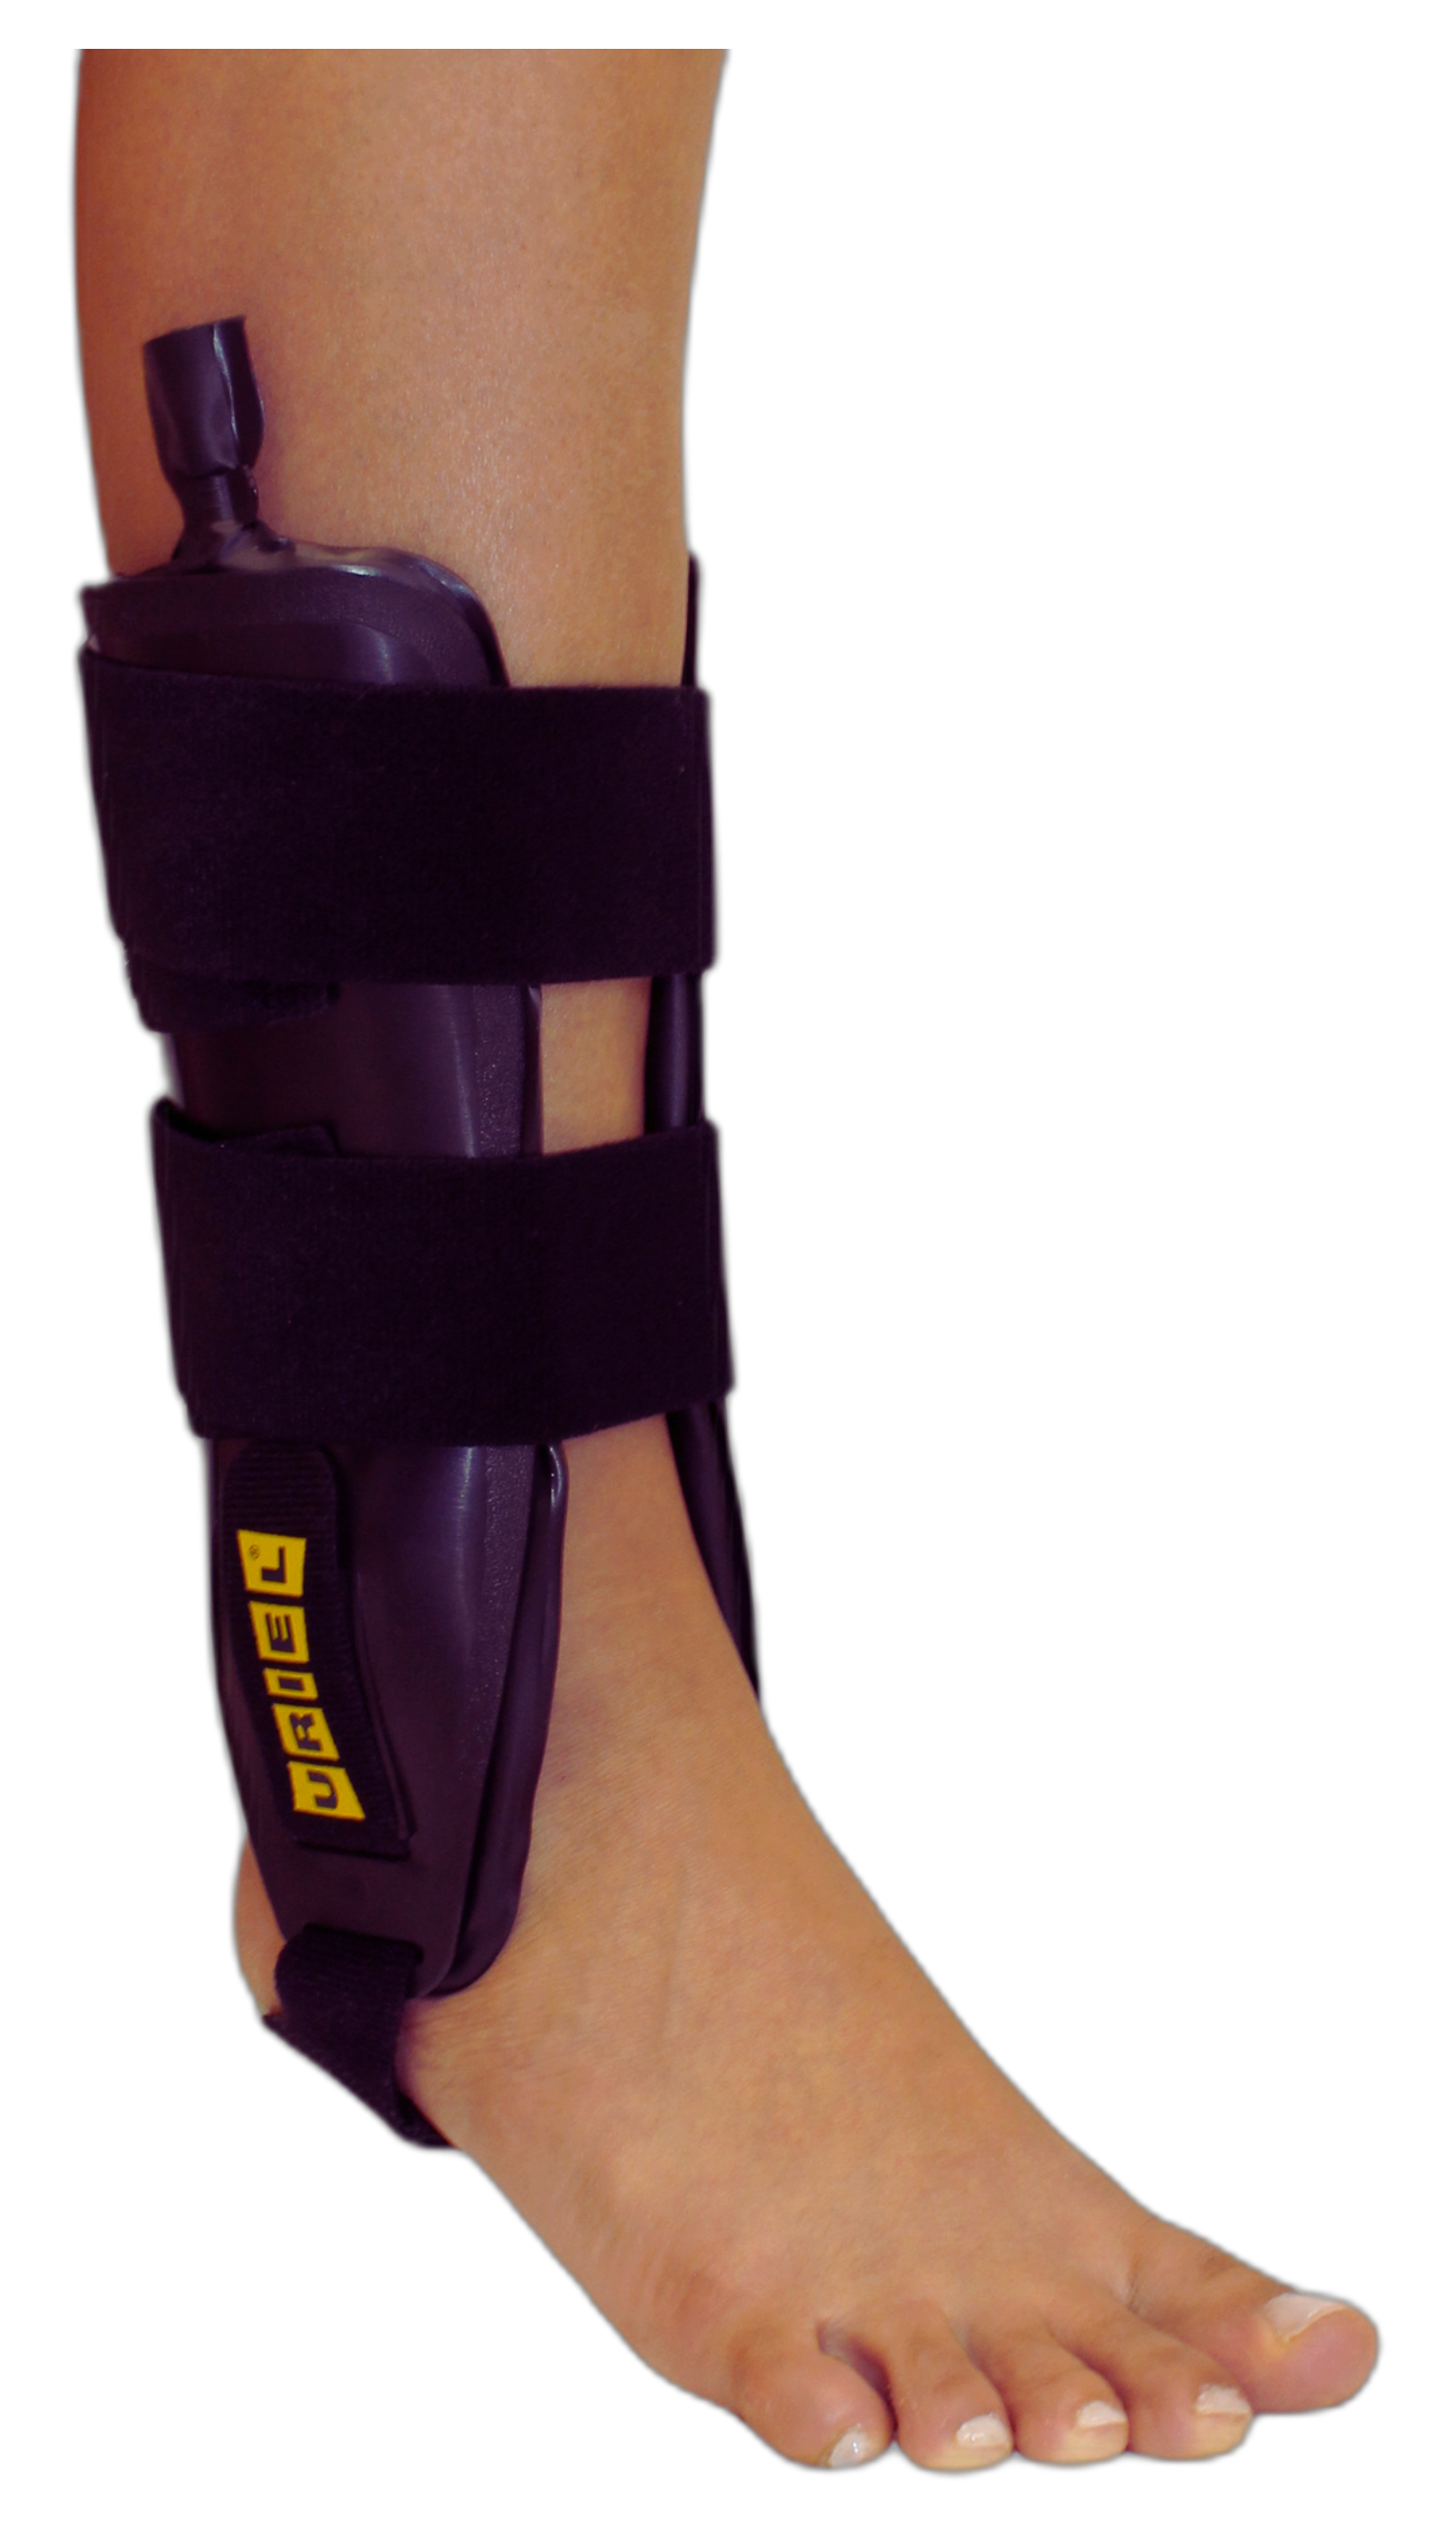
ANKLE SUPPORT
TaluAir Shield
Ankle Stabilizer
DUAL-SIDED ANKLE BRACE WITH AIR CUSHIONS
TaluAir Shield Ankle Stabilizer is a rigid ankle brace that restricts side-to-side movement and delivers strong lateral stabilization after acute sprains, ligament injuries, or instability. The inflatable cushions allow a customized fit and help reduce swelling during the critical first days of recovery.
Medical Indications: Acute ankle sprains, chronic instability, lateral ligament injuries, post-trauma stabilization, early rehabilitation phase.

