Slide 1

Carpal Tunnel Syndrome Night Mitten
Innovative solution for CTS

Slide 2


Night symptoms
PAIN
TINGLING
NUMBLESS
FREQUENT WAKE-UPS

Slide 3


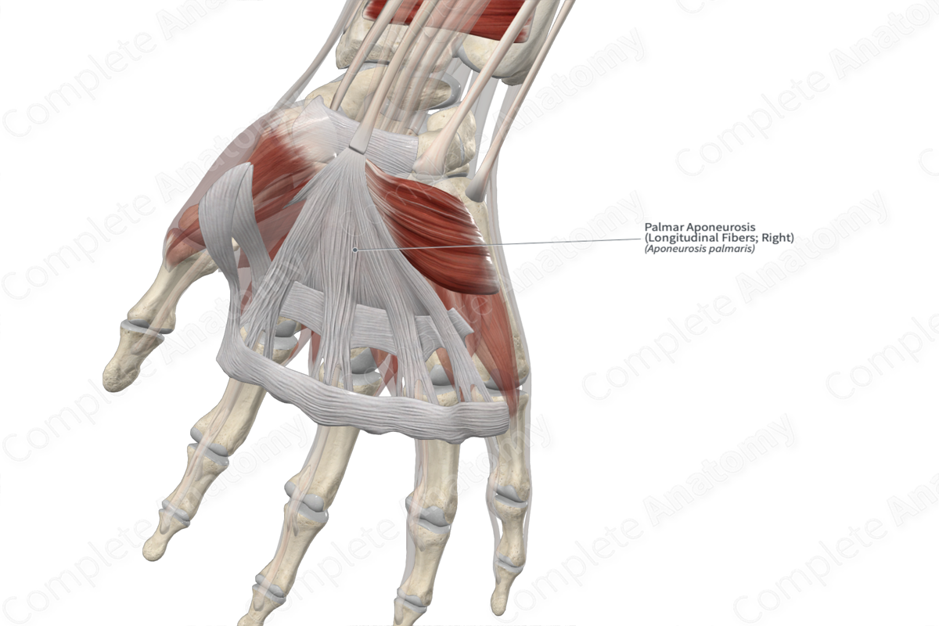
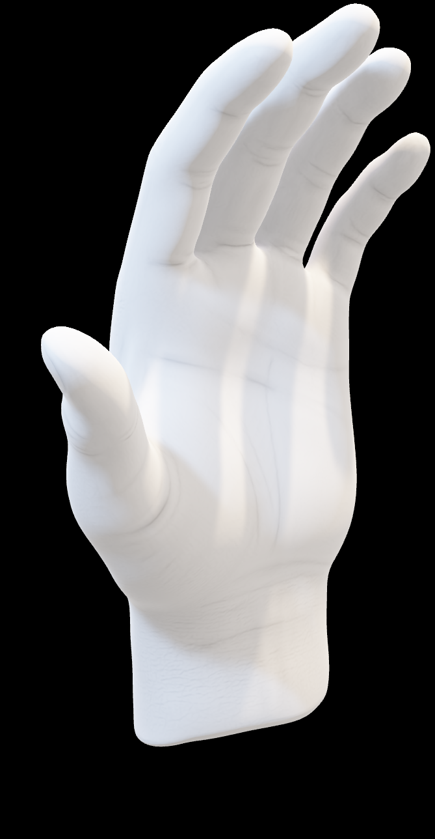
Market Need
CTS affects millions worldwide (10% of adults may experience CTS).
Traditional splints often fail to provide the desired effect.
Patients seek non-invasive, comfortable solutions.
Orthopedic shops need innovative products to expand their portfolio.
Reduce tendon bulk in tunnel
Slacken the median nerve
Optimize space in tunnel

Slide 4
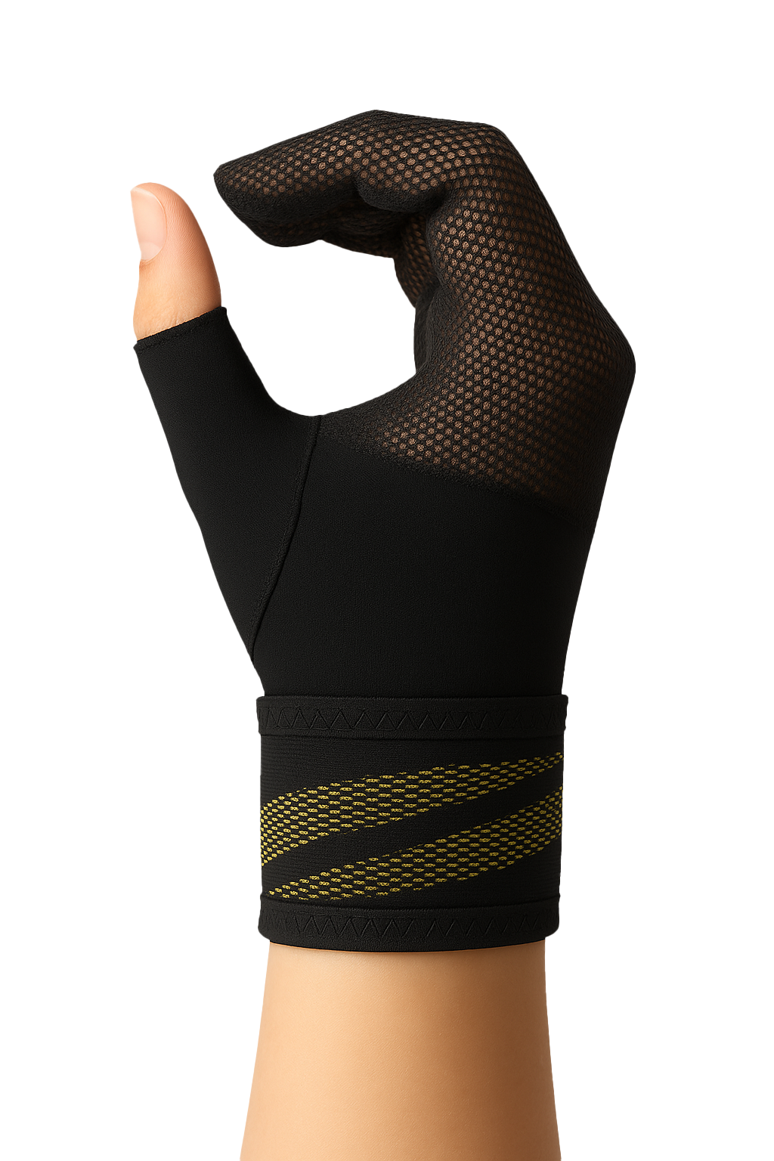
CTS NIGHT MITTEN NIGHTTIME PAIN RELIEF SUPPORT
Supports finger flexion position for nerve decompression
Lightweight breathable mitten design with Velcro fastening
Comfortable fit throughout the night
Three sizes for perfect fit
Washable, durable, consumer-friendly

