Slide 1
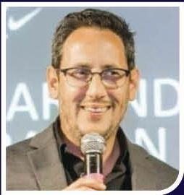
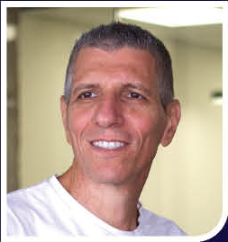
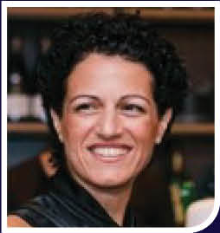
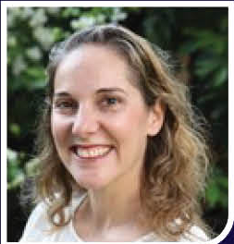
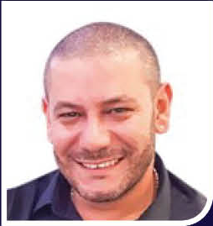
URIEL LEADERSHIP TEAM
The people driving 50 years of orthotics & footcare excellence
SHACHAR HIRSH
AMIR KATZ
RACHEL HIRSH
TAL ZOLOTOV
ISSA NEIMA
EYAL SADOT
CEO
VP R&D
CFO & COS
IMPORT & EXPORT MANAGER
SALES DIRECTOR
VP SALES

