Slide 1
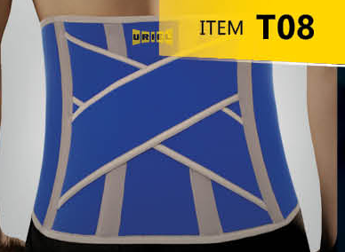
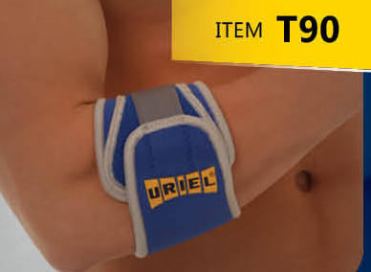
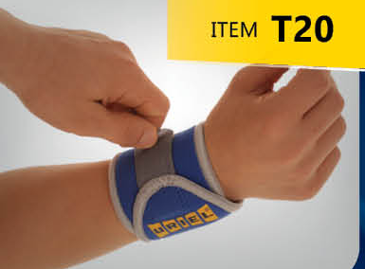
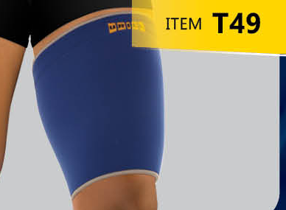
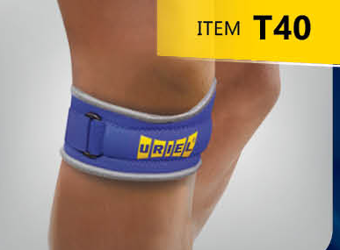
ORTHOPEDIC SUPPORT
THERMAL SERIES
Heat retaining neoprene combined with 100% cotton towel lining provides premium comfort support with thermal benefits to promote faster healing.
CRISS CROSS BELT
TENNIS BANDAGE
WRIST BANDAGE
+35
PRODUCTS
THIGH SUPPORT
PATELLA STRAP

Slide 2
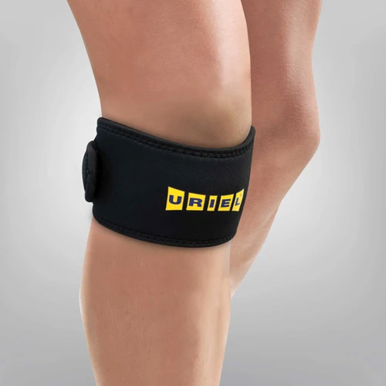
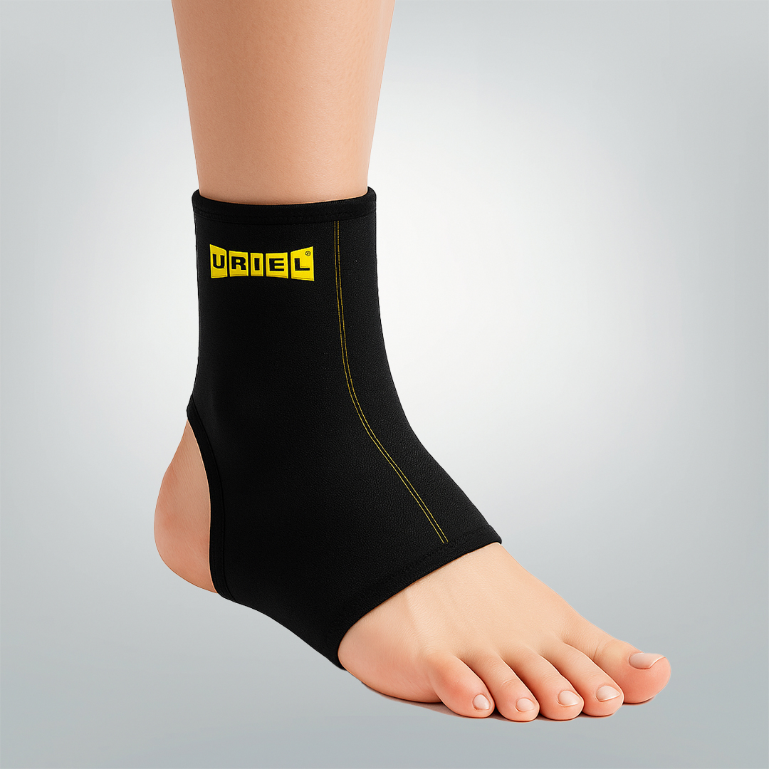
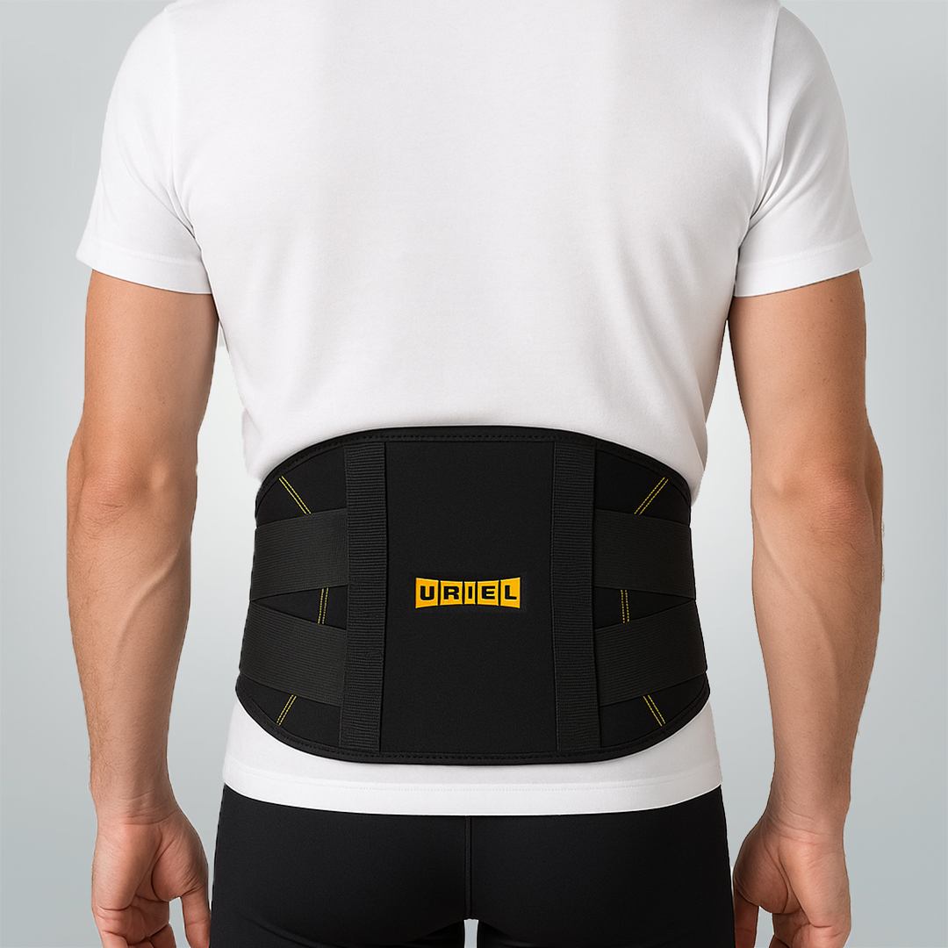
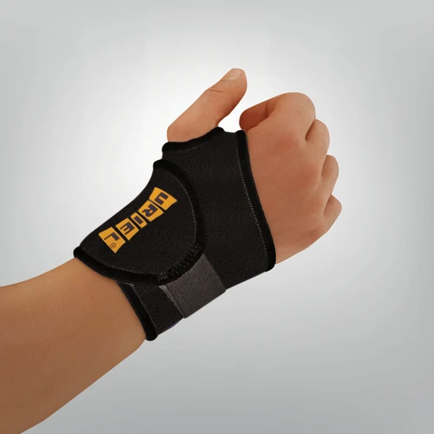
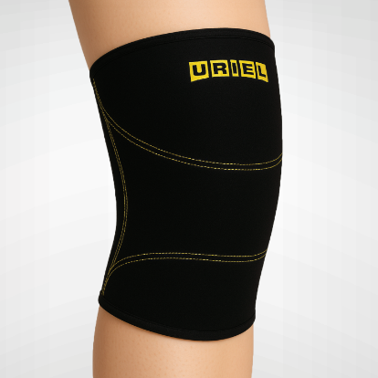
ORTHOPEDIC SUPPORT
ITEM T40B
ITEM T36B
ITEM T066B
THERMAL SERIES
Heat retaining neoprene combined with 100% cotton towel lining provides premium comfort support with thermal benefits to promote faster healing.
ITEM T25B
ITEM T46B
+35
PRODUCTS

Slide 3
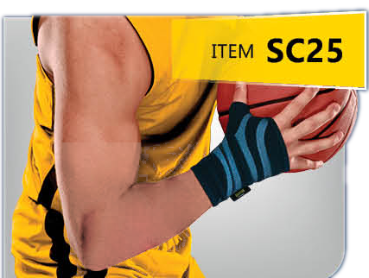
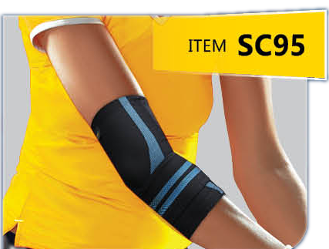
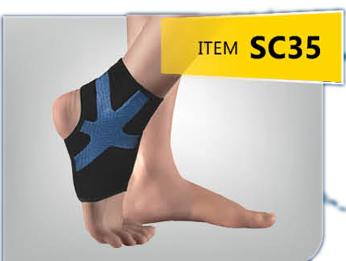
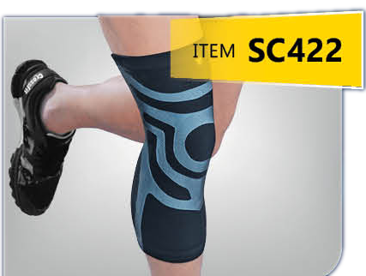
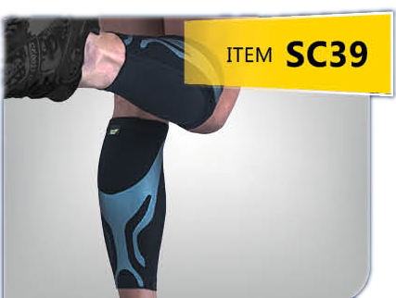
SPORT CATEGORY
THE SPORT SERIES
Reach Your Athletic Peak with Comfortable Ease
WRIST COMPRESSION SLEEVE
ELBOW COMPRESSION SLEEVE
ANKLE COMPRESSION SLEEVE R/L
✓ TRIPLE-LAYERED 3D CUTTING TECHNOLOGY
✓ INJECTED SILICONE PROVIDES TARGETED SUPPORT FOR JOINTS AND MUSCLES WHILE REDUCING VIBRATION
✓ SPORT-READY LIGHTWEIGHT BREATHABILITY
✓ UPF 50+ PROTECTED
KNEE COMPRESSION SLEEVE
SHIN COMPRESSION SLEEVE

Slide 4
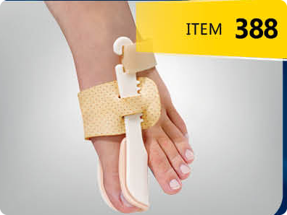
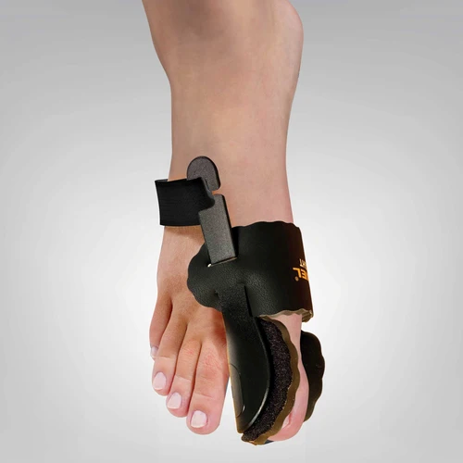

Slide 5
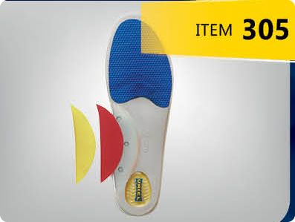
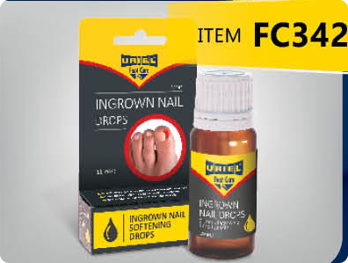
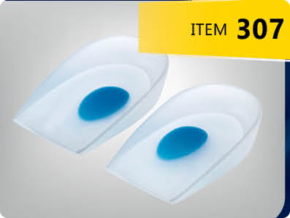
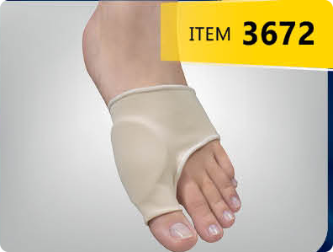
FOOT-CARE CATEGORY
FOOT CARE
Discover complete foot care solutions - your one-stop solution for all your foot needs with our range of insoles, inserts, health socks, and silicone products. We've got you covered from heel to toe. Experience comfort, support, and relief tailored to your unique foot requirements. Step into wellness today.
ADJUSTABLE ARCH SUPPORT KIT
INGROWN NAIL DROPS
HALLUX VALGUS NIGHT SPLINT
+50
PRODUCTS
SILICONE HEEL SUPPORT CUSHION
PROFESSIONAL COHESIVE BANDAGE

