Slide 1

Carpal Tunnel Syndrome Night Mitten
Innovative solution for CTS

Slide 2

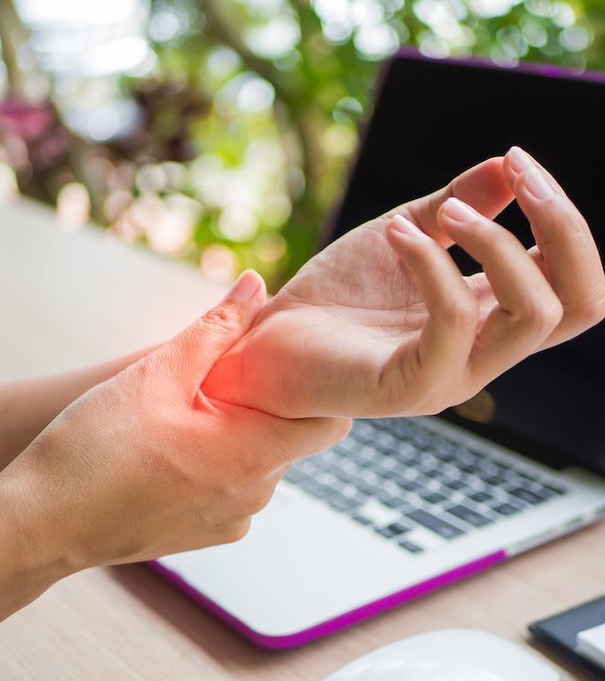

The Problem
CTS affects millions worldwide — up to 10% of adults may experience it.
Traditional splints often fail to provide the desired effect.
Patients want non-invasive comfort; orthopedic shops want innovative new products.
Night symptoms:
PAIN
TINGLING
NUMBNESS
FREQUENT WAKE-UPS

Slide 3
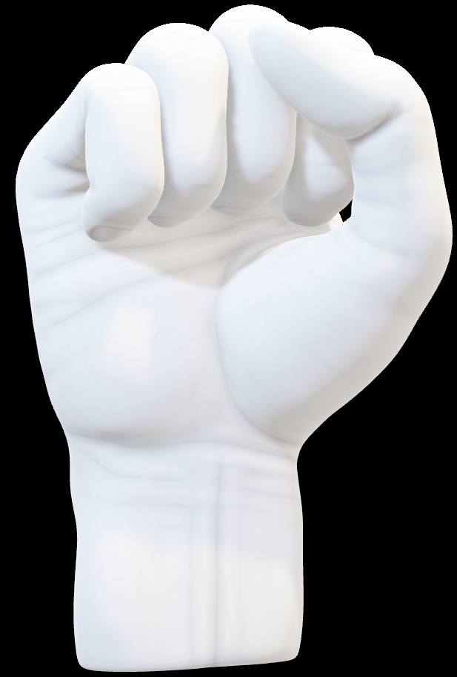
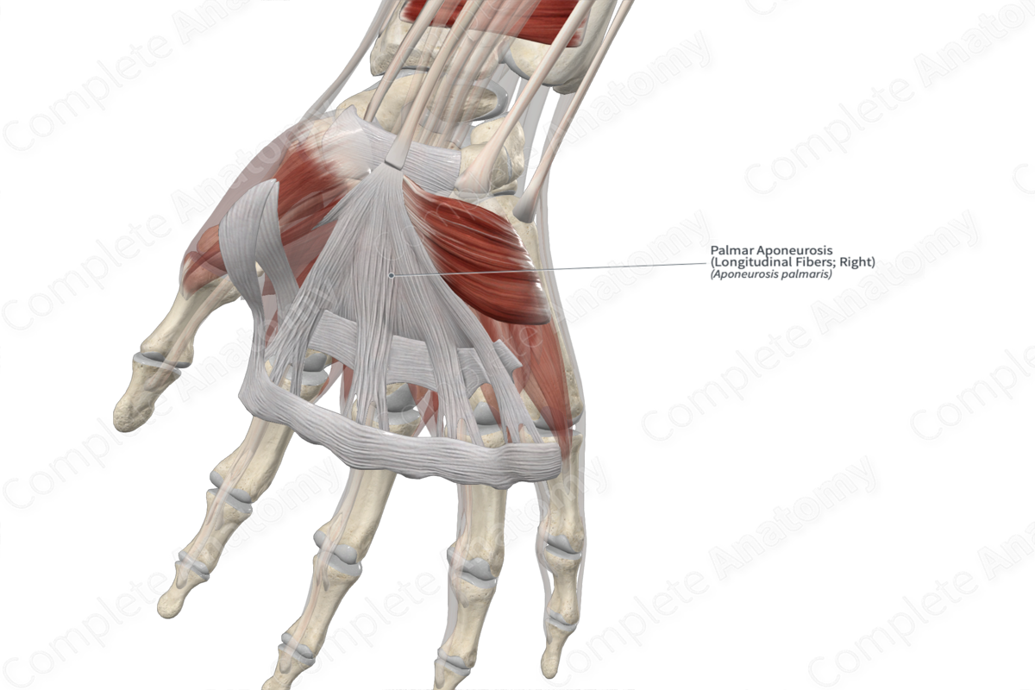
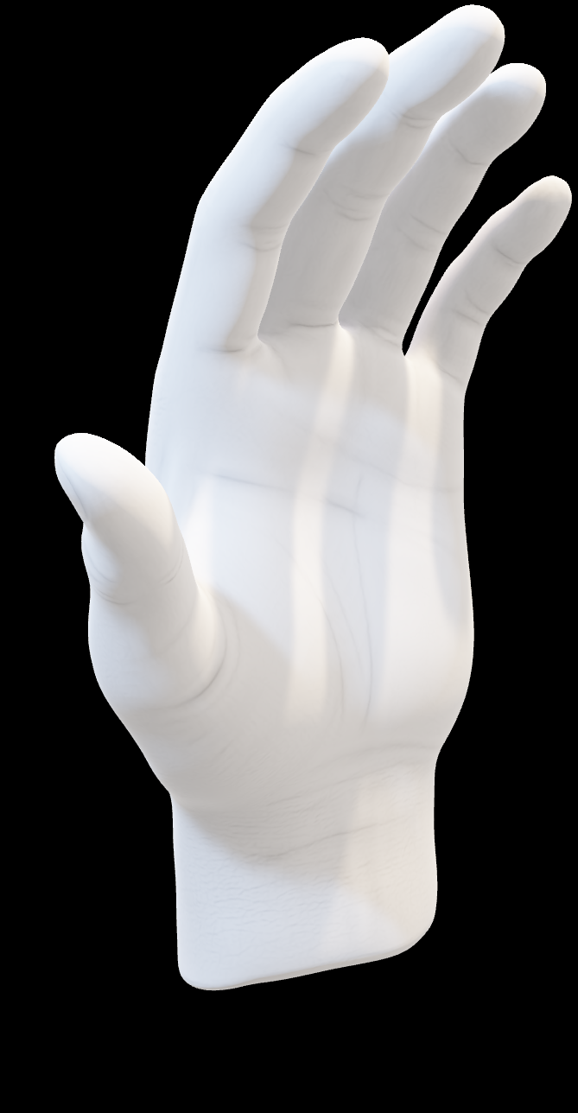
Finger flexion
Simple move
Powerful relief
CTS Relief Revolution
Reduce tendon bulk in tunnel
By flexing the fingers, the median nerve is slackened, tendon bulk is reduced, and space within the tunnel is optimized — relieving CTS pressure at its source.
Slacken the median nerve
Optimize space in tunnel

Slide 4
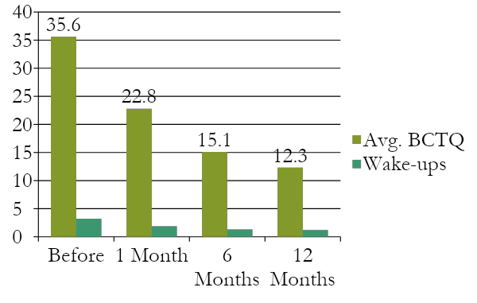
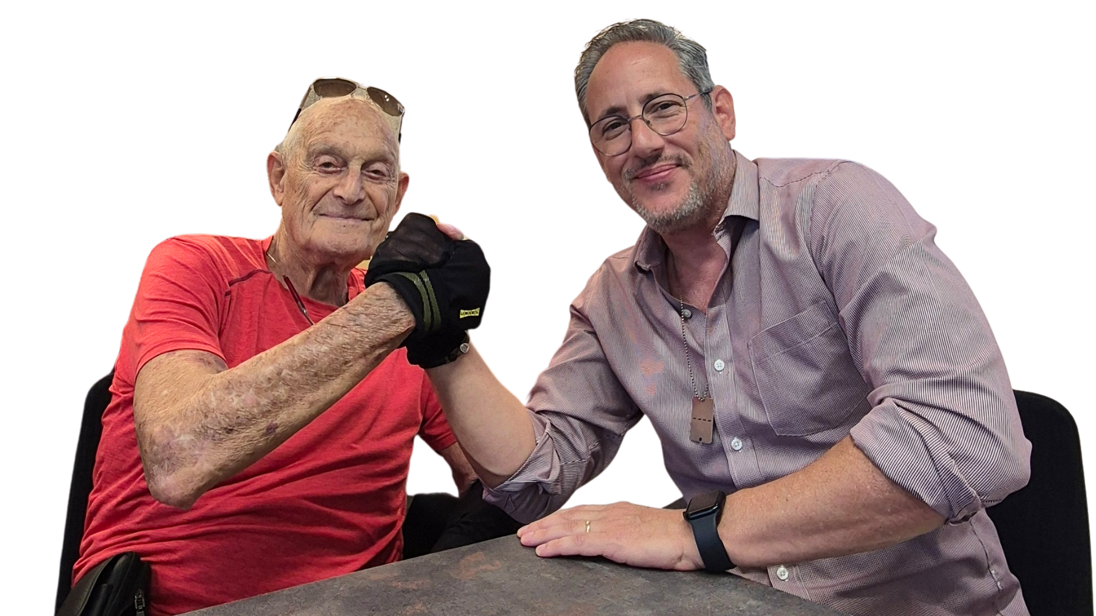
The Story Behind It — Proven by Results
Born from orthopedic expertise and URIEL’s innovation, a simple idea — inspired by an oven mitten — became a clinical-grade medical device. Together, we redefined CTS care: conservative, non-invasive, and effective.
Clinical Evidence — 1-Month Pilot Study
Boston Carpal Tunnel Questionnaire (BCTQ) results:
Prof. Daniel Reis — Orthopedic Surgeon, Israeli Orthopedic Assoc.
Shachar Hirsh — CEO, URIEL Meditex Group
Only 11% required further surgical consideration — patients reported better sleep, fewer wake-ups, and pain relief.

Slide 5
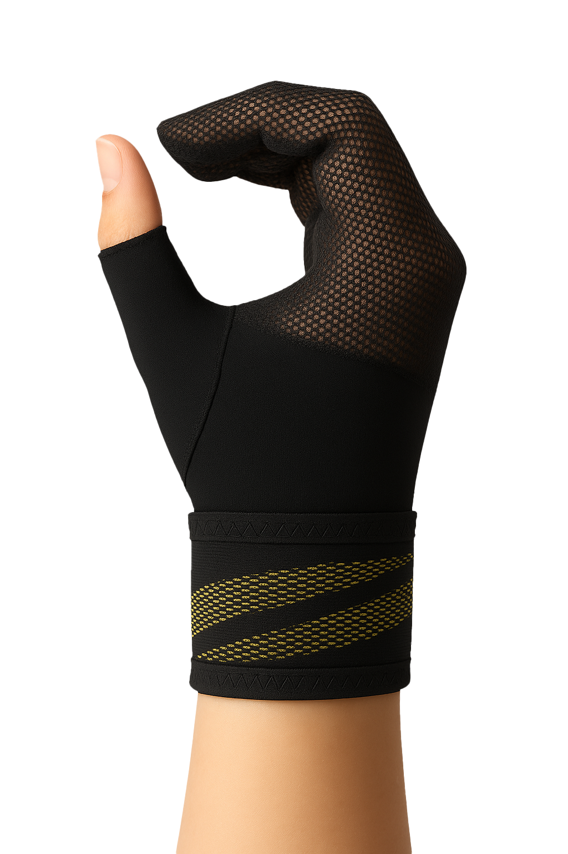
The Product & Its Advantage
Product Features
Why It Stands Out
Supports finger-flexion positioning for nerve decompression
Lightweight, breathable design with Velcro fastening — three sizes for a perfect fit
Comfortable, washable, and durable — built for nightly use
Unique, conservative alternative to standard wrist splints — non-invasive for early CTS management
Expands offering into nighttime therapy — high potential for pharmacies, orthopedics, and online sales

Slide 6

SHIELD SERIES
Innovative orthopedic support

Slide 7
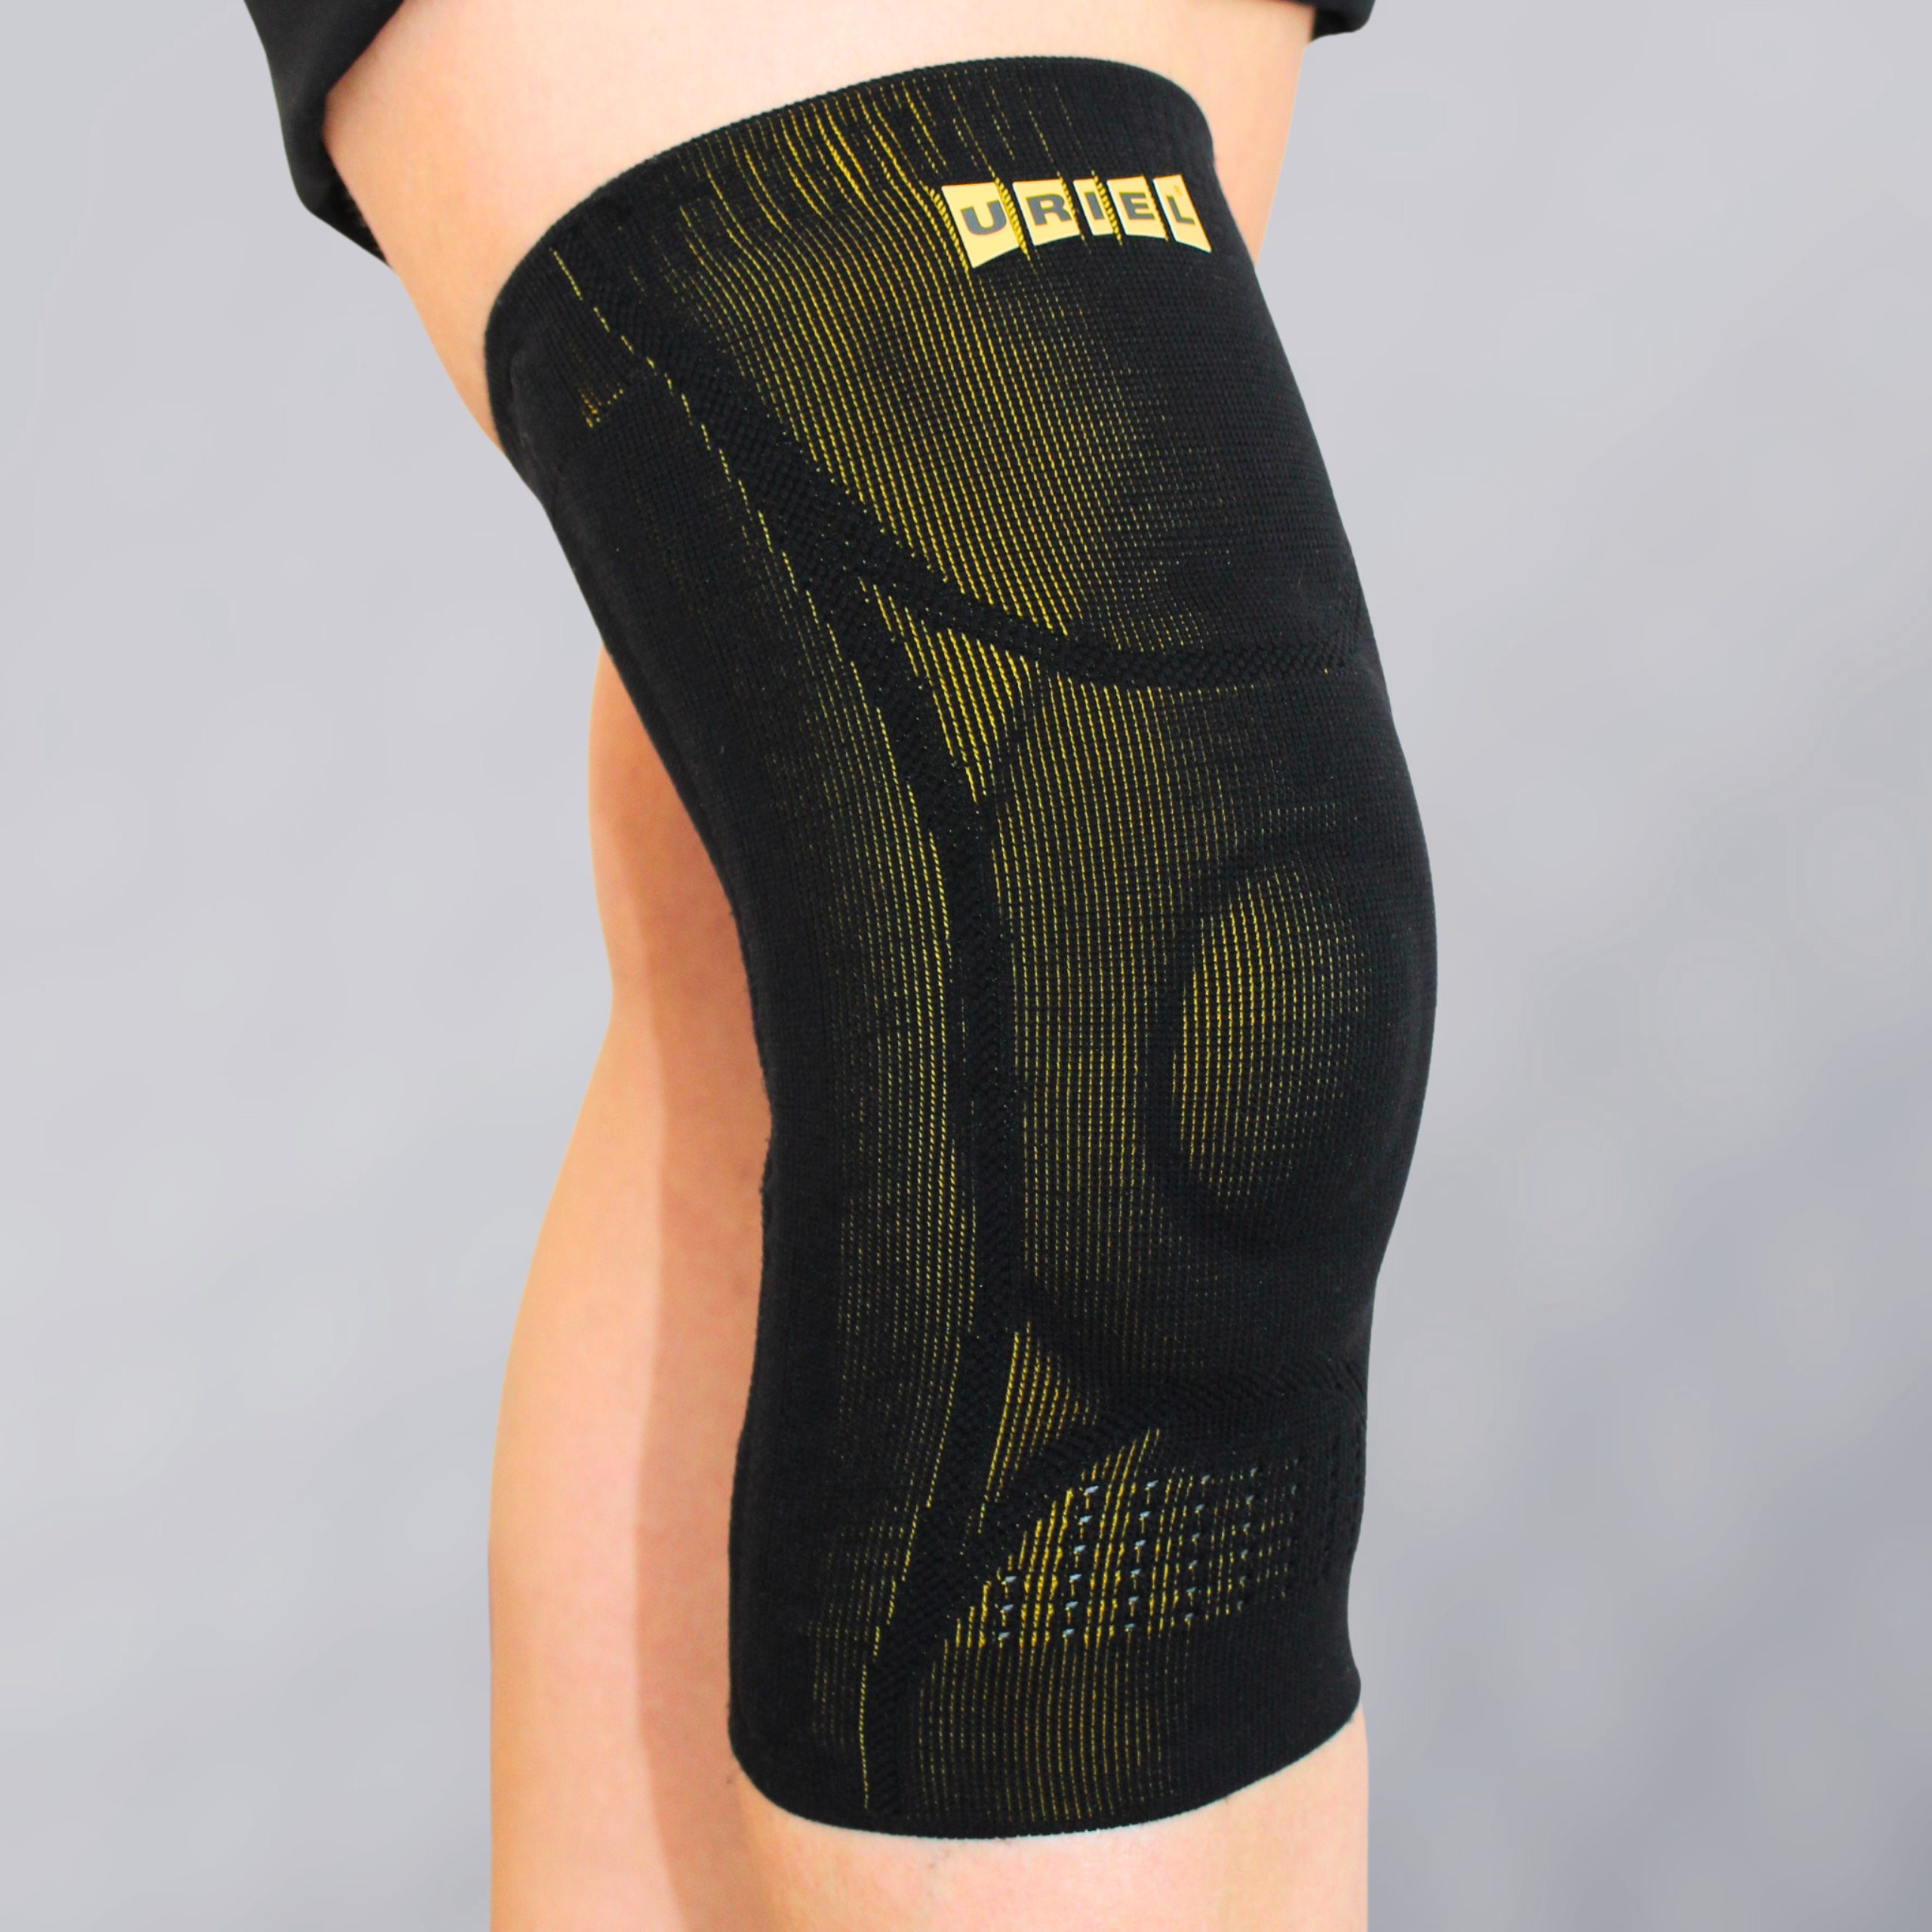
GenuShield Knee Support
With flexible stays & gel pad
Advanced support for stability, pain relief & swelling reduction.

Slide 8
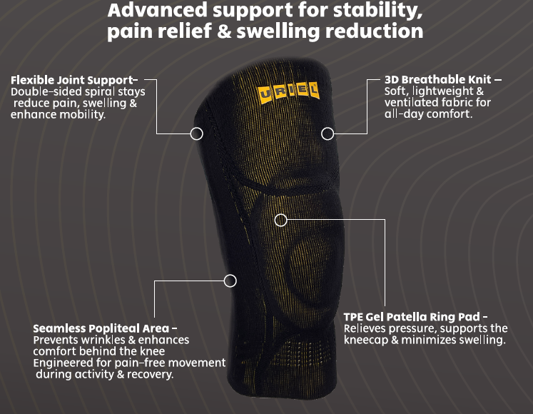

Slide 9
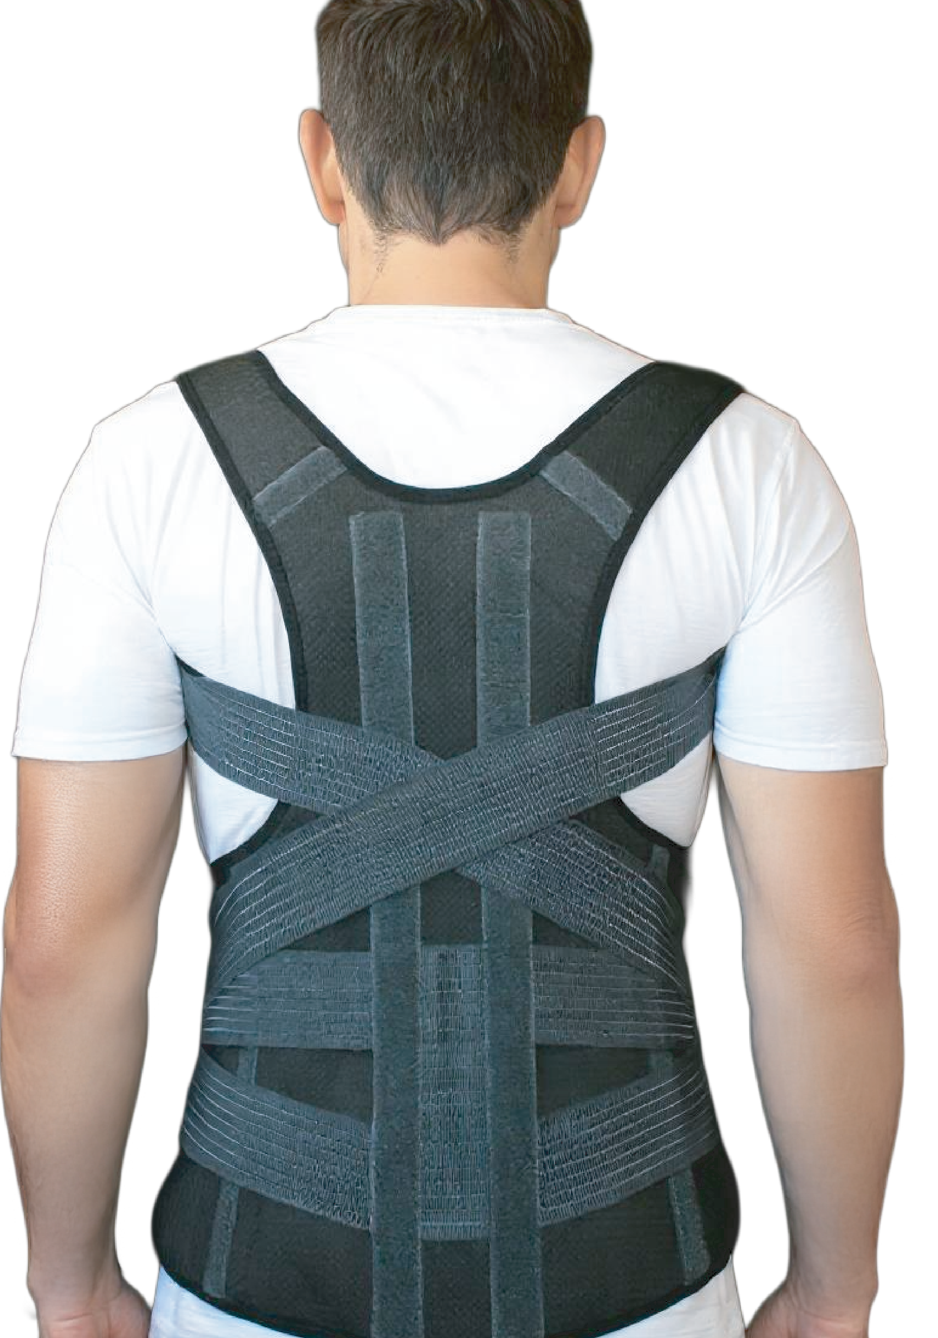
SpinaShield Posture Corrector Belt
Advanced and lightweight posture corrector
designed to improve spinal alignment and reduce
upper back and shoulder pain. Featuring comfortable, adjustable straps, it supports upright posture, relieves muscle tension, and encourages natural movement.
Ideal for those who sit for long hours, suffer from poor posture, or seek pain relief in daily life.
-Supports natural spinal alignment.
-Helps relieve neck and upper back pain.
-Discreet, slim, and comfortable for everyday use.
for Spine and Shoulders

Slide 10
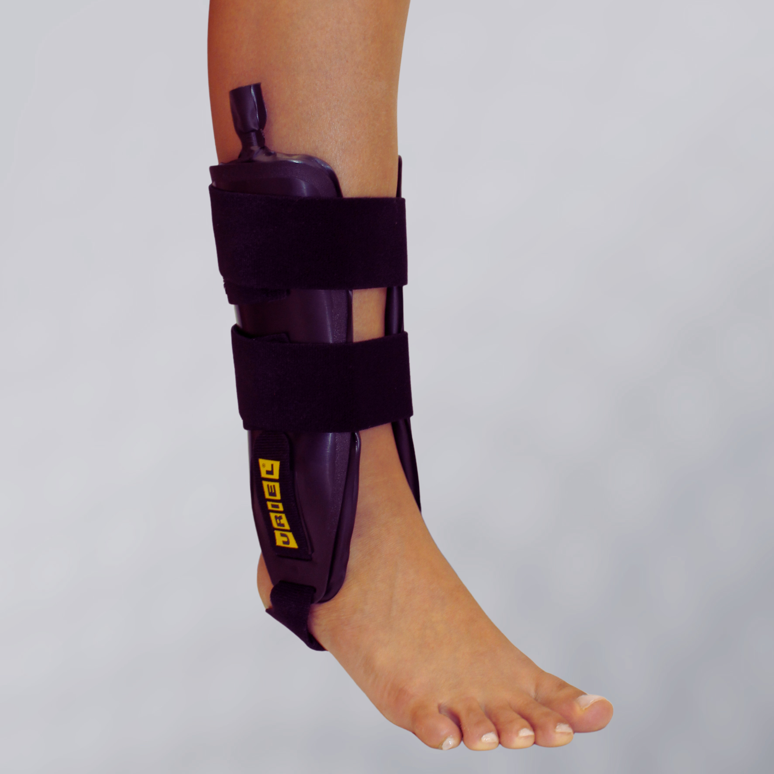
TaluAir Shield Ankle Stabilizer
TaluAir Shield Ankle Stabilizer is a rigid ankle brace that restricts side-to-side movement and delivers strong lateral stabilization after acute sprains, ligament injuries, or instability.
The inflatable cushions allow a customized fit and help reduce swelling during the critical first days of recovery.
Dual-sided Ankle Brace with Air Cushions
Medical Indications:
Acute ankle sprains, Chronic instability, Lateral ligament injuries, Post-trauma stabilization, Early rehabilitation phase.

Slide 11
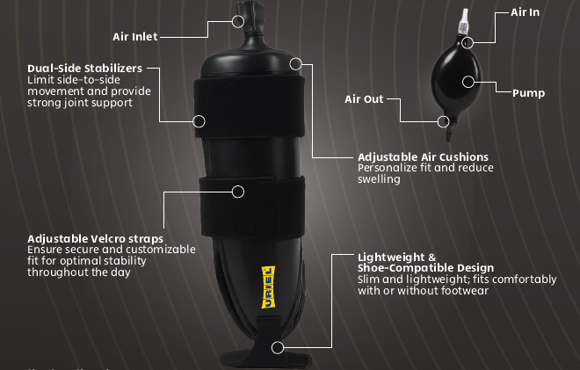

Slide 12
Thanks!

