Slide 1
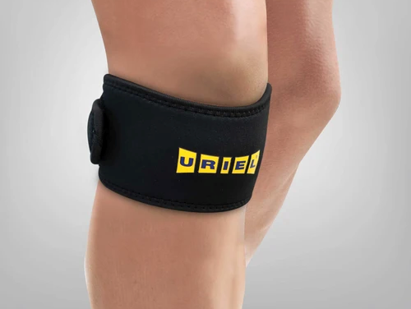
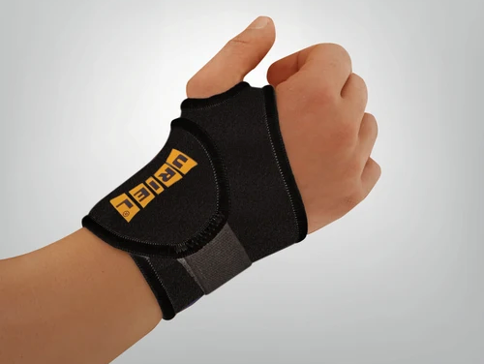
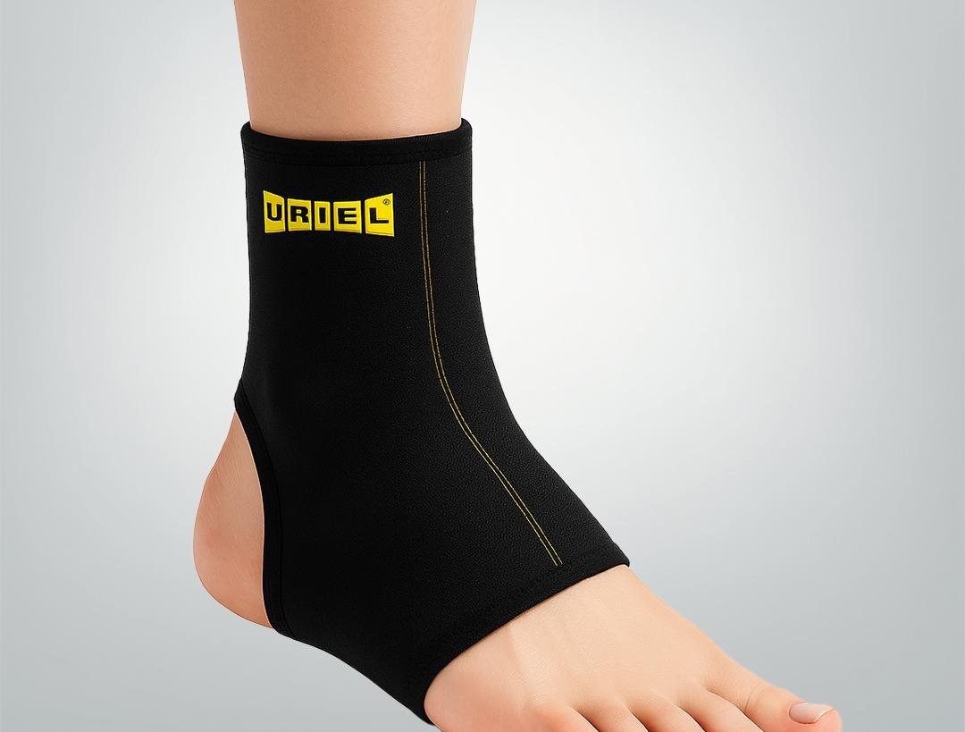
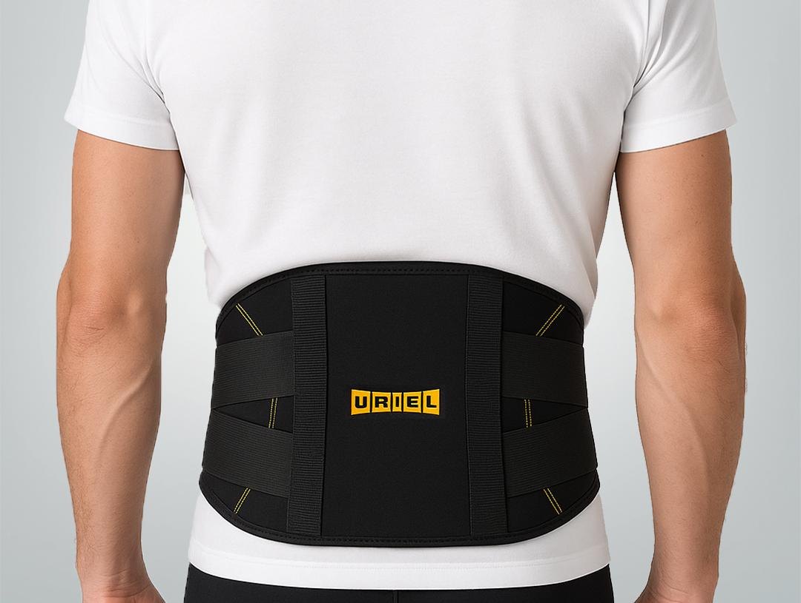
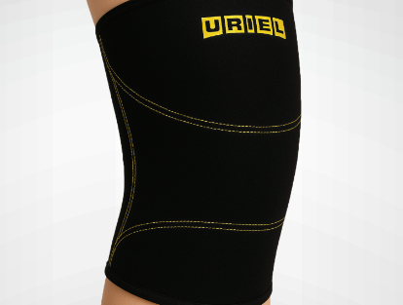
ORTHOPEDIC SUPPORT
THERMAL SERIES
Heat retaining neoprene combined with 100% cotton towel lining provides premium comfort support with thermal benefits to promote faster healing.
CRISS CROSS BELT
TENNIS BANDAGE
WRIST BANDAGE
+35
PRODUCTS
THIGH SUPPORT
PATELLA STRAP

Slide 2
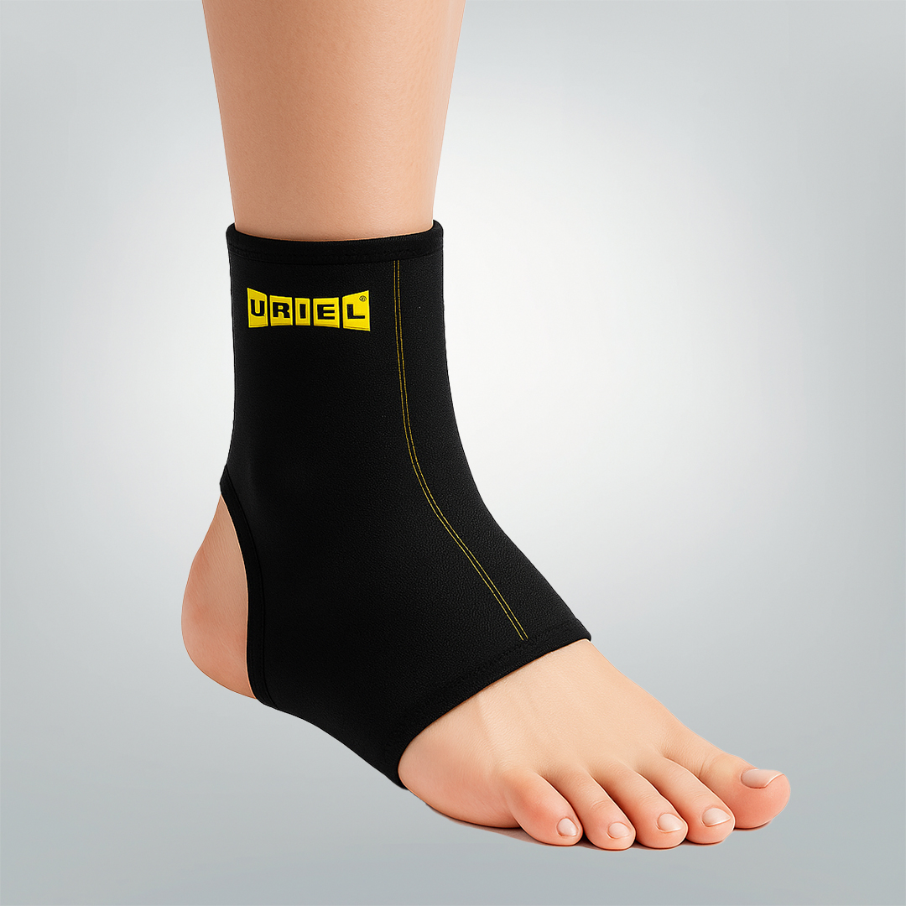
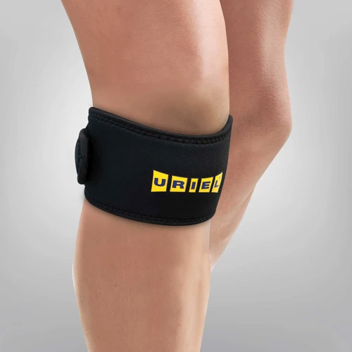
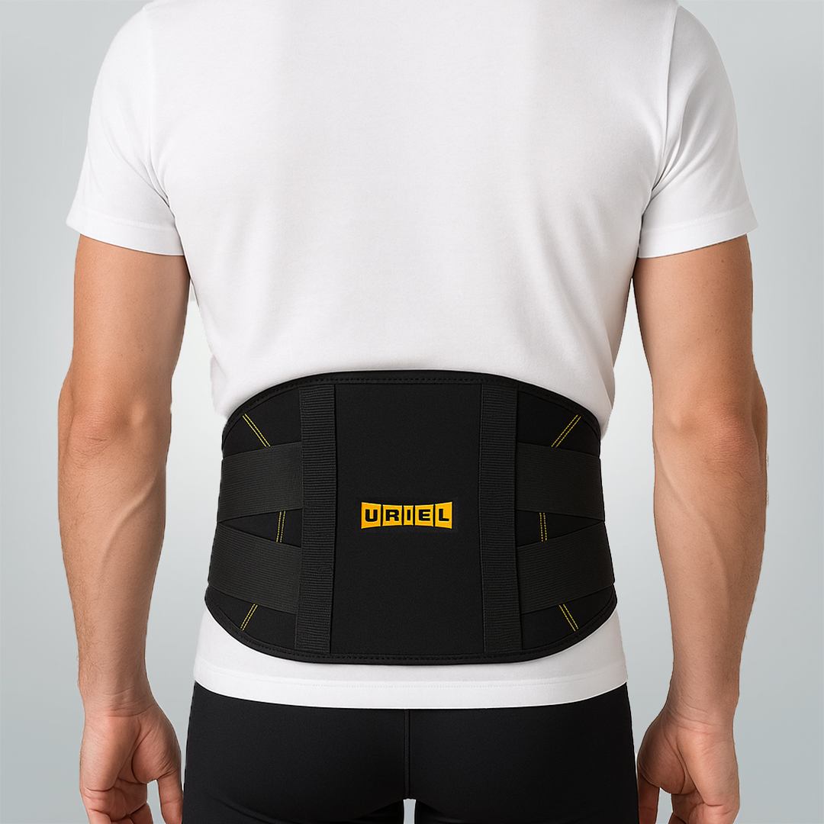
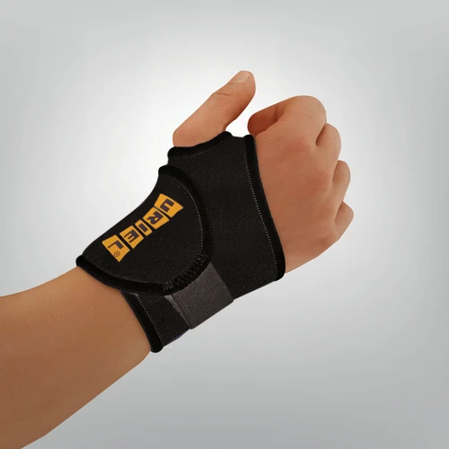
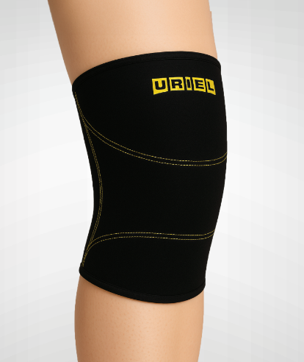

Slide 3
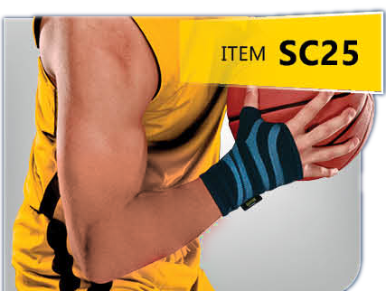
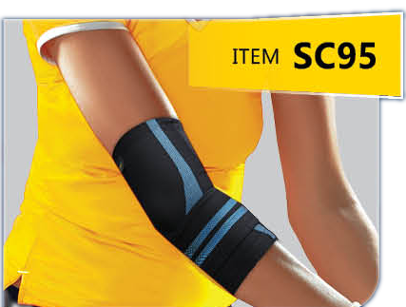
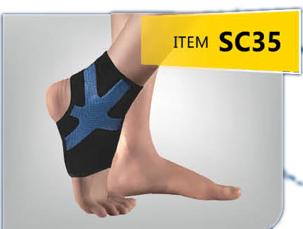
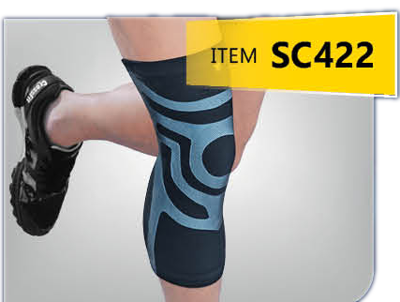
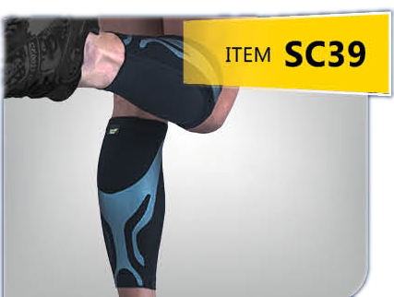
SPORT CATEGORY
THE SPORT SERIES
Reach Your Athletic Peak with Comfortable Ease
WRIST COMPRESSION SLEEVE
ELBOW COMPRESSION SLEEVE
ANKLE COMPRESSION SLEEVE R/L
✓ TRIPLE-LAYERED 3D CUTTING TECHNOLOGY
✓ INJECTED SILICONE PROVIDES TARGETED SUPPORT FOR JOINTS AND MUSCLES WHILE REDUCING VIBRATION
✓ SPORT-READY LIGHTWEIGHT BREATHABILITY
✓ UPF 50+ PROTECTED
KNEE COMPRESSION SLEEVE
SHIN COMPRESSION SLEEVE

Slide 4
