Slide 1
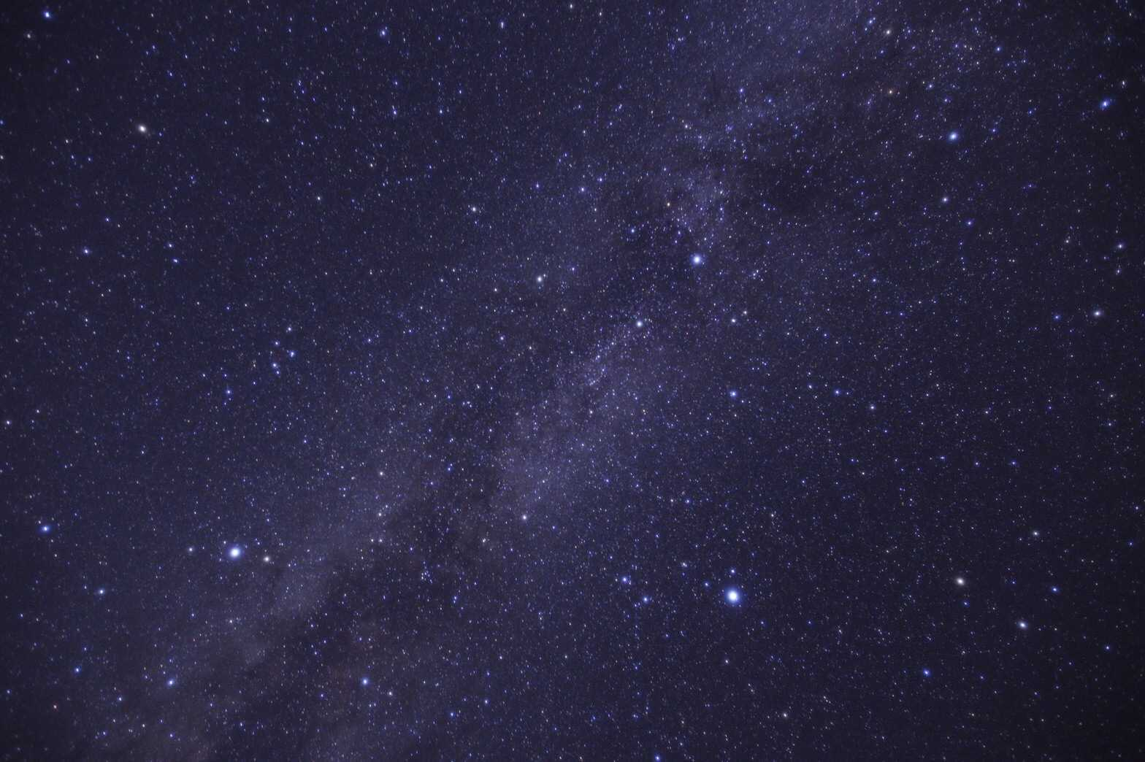
Proposal of a Constellation Identification Method Using Point Set Data
Graduate School of Engineering, Osaka Prefecture University
Sayaka Nadamoto, Naoki Mori, Makoto Okada
Notes:
Hello everyone, my name is Sayaka Nadamoto and I’m a student at the Graduate School of Engineering, Osaka Prefecture University.
It is a great honor to be able to speak to you today.
Today, I'm going to talk about a proposal of a constellation identification method using point set data. This presentation will expand the possibilities of image recognition.

Slide 2

Agenda
Research Background
Related Studies
Experiment
Conclusion
Notes:
Here is the agenda of this presentation. First, I would like to give you some background about constellation identification. Next, I’m going to talk about related studies used in this study, and then I will move on to detailed description of the experiment. Finally, I would like to conclude this study.

Slide 3
Agenda
Research Background
Related Studies
Experiment
Conclusion
Notes:
Then, let's start with the research background.

Slide 4
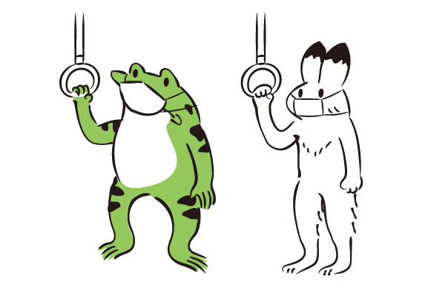

Research Background
- In recent years, the rapid development of machine learning has made it possible to recognize images with high accuracy for a wide range of tasks.
Frog ? or Rabbit ?
Frog
Rabbit

Slide 5
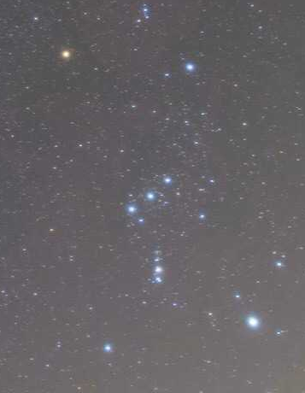
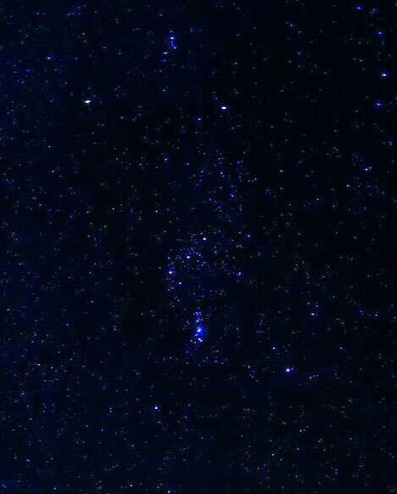
Research Background
- In recent years, the rapid development of machine learning has made it possible to recognize images with high accuracy for a wide range of tasks.
Constellation Identification
Small data sets
Wide variety of the appearances of stars
Orion
Orion
Notes:
However, constellation identification is a challenge task for two reasons. First, there are small data sets on constellations, so it is difficult to make the AI learn the characteristics of each constellation. Second, there is a wide variety of the appearances of stars depending on the photographer and the equipment. Even in photos of the same constellation, the stars appear in different ways. So it is very difficult to identify constellations in astrophotography,and there has been very few studies.

Slide 6
Research Background
- In recent years, the rapid development of machine learning has made it possible to recognize images with high accuracy for a wide range of tasks.
Constellation Identification
Small data sets
Wide variety of the appearances of stars
Orion
Orion
Addressed in unique ways
Notes:
Therefore, we took on the challenge of constellation identification by addressing these issues in unique ways.

Slide 7
Agenda
Research Background
Related Studies
Experiment
Conclusion
Notes:
Next, I will introduce the related studies used in this study. Here, I will introduce two identification networks.

Slide 8
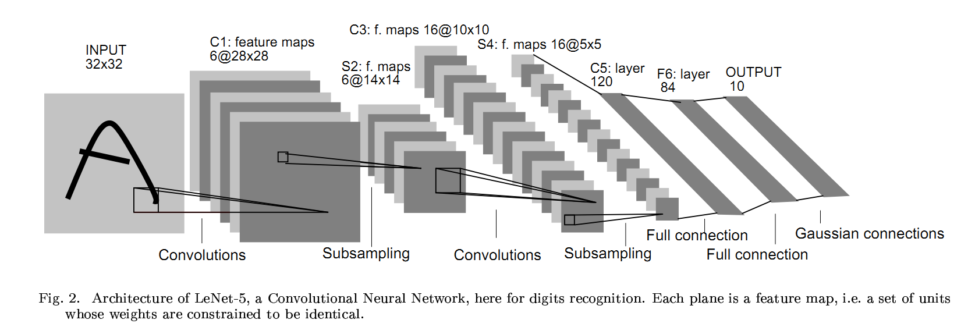
Related Studies
Convolutional Neural Network: CNN
A type of artificial neural network model, which is a mathematical model that imitates the visual properties of the brain
[referenced]
Yann LeCun, Patrick Haffner, Léon Bottou, and Yoshua Bengio. 1999. Object Recognition with Gradient-Based Learning. In Shape, Contour and
Grouping in Computer Vision. Springer-Verlag, Berlin, Heidelberg, 319.
Notes:
Convolutional Neural Network, also known as CNN, is ~. In this study, we used VGG19, which is a one type of CNN, for constellation identification.

Slide 9
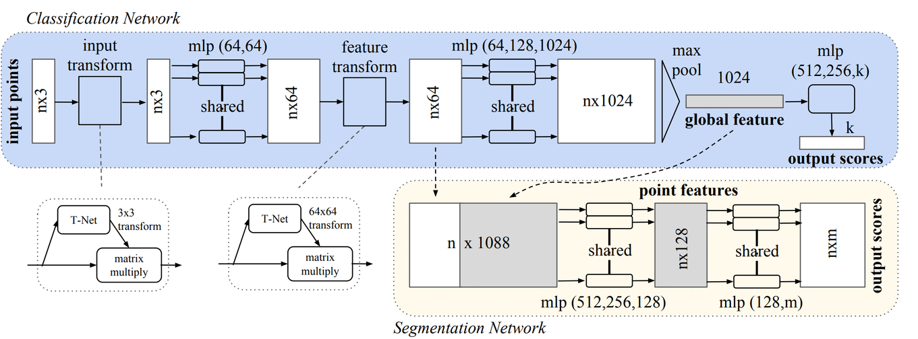
Related Studies
PointNet
A deep learning framework for classifying and segmenting point clouds that is a set of points
[referenced]
C. R. Qi, H. Su, K. Mo, and L. J. Guibas. “Pointnet: Deep learning on point sets for 3d classification and segmentation.”, CoRR,
Vol. abs/1612.00593, 2016.

Slide 10
Related Studies
PointNet
Order invariance
same result
Movement invariance
same result
Notes:
PointNet guarantees the order invariance and movement invariance. We also tried to identify constellations using these properties of PointNet.

Slide 11
Agenda
Research Background
Related Studies
Experiment
Conclusion
Notes:
The following is a description of the experiments conducted in this study.

Slide 12
Experiment
Objective
Identify constellations in astrophotography.
Proposed method
・A method for creating data sets
・A method for identifying constellations
Notes:
These are two methods we propose for this objective.

Slide 13
Experiment
Objective
Identify constellations in astrophotography.
Proposed method
・A method for creating data sets
・A method for identifying constellations
Notes:
First, I will explain a method for creating data sets.

Slide 14
Experiment
A method for creating data sets
… Create constellation images as data sets that allow an AI to learn
the characteristics of the constellations
Example of the Hipparcos Catalogue
name | ra | dec | spect_type | vmag
HIP 27989 | 88.79287161 | 7.40703634 | M2lb | 0.45
Coordinate
Color
Magnitude
[referenced]
M. Perryman, L. Lindegren, J. Kovalevsky, E. Hoeg, U. Bastian, P. Bernacca, M. Crez´ e, F. Donati, M. Grenon, M. Grewing,
F. van Leeuwen, H. Marel, F. Mignard, C. A. Murray, R. Le Poole, H. Schrijver, C. Turon, F. Arenou, M. Froeschle, and C. Petersen.
“The Hipparcos Catalogue.”, Astronomy and Astrophysics, 323. L49-L52, 1997.
Notes:
~ using the Hipparcos Catalogue. The Hippa’rcos Catalogue is compiled and published based on observations by the European Space Agency’s Hipparcos satellite. It contains information on the star's coordinates, color, and magnitude. Here is the example of the Hipparcos Catalogue.

Slide 15
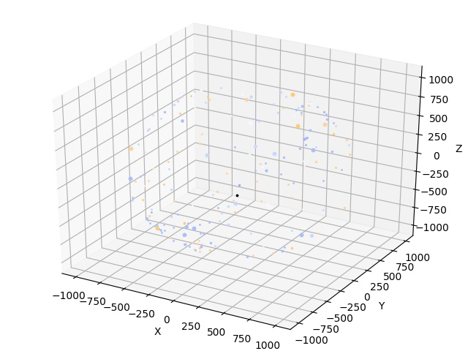
Experiment
A method for creating data sets
… Create constellation images as data sets that allow an AI to learn
the characteristics of the constellations
Notes:
Then here is a reproduction of each star in three-dimensional space based on this information.

Slide 16
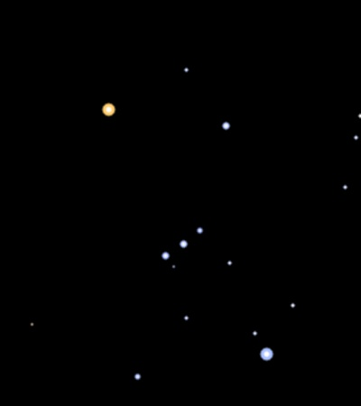
Experiment
A method for creating data sets
… Create constellation images as data sets that allow an AI to learn
the characteristics of the constellations
Cut out
Star map
(Constellation image)
Notes:
A constellation image is created by cutting out a part of this three-dimensional space. We call the created constellation image star map.

Slide 17
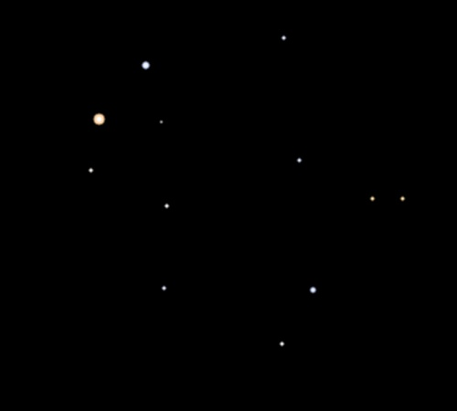
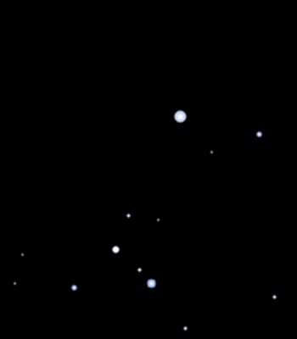
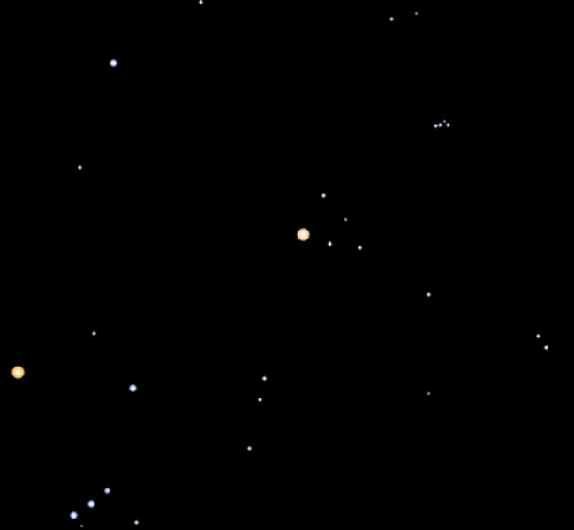
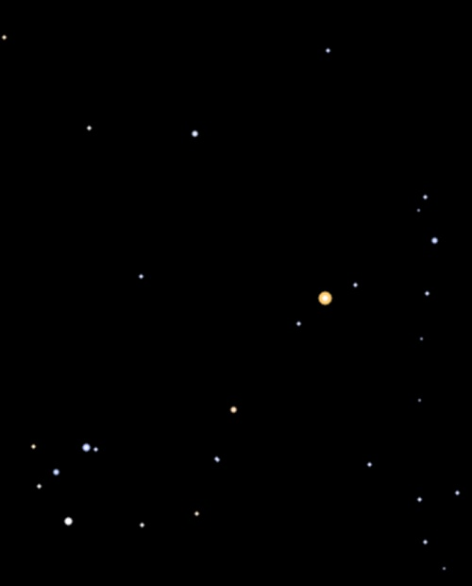
Experiment
A method for creating data sets
… Create constellation images as data sets that allow an AI to learn
the characteristics of the constellations
Extract bright stars
Gemini Canis Major Orion Taurus Scorpius
Astrophotography
Constellations to be identified
Extract bright stars
Notes:
In this study, these five constellations were selected for identification., and we created star maps for these constellations.

Slide 18
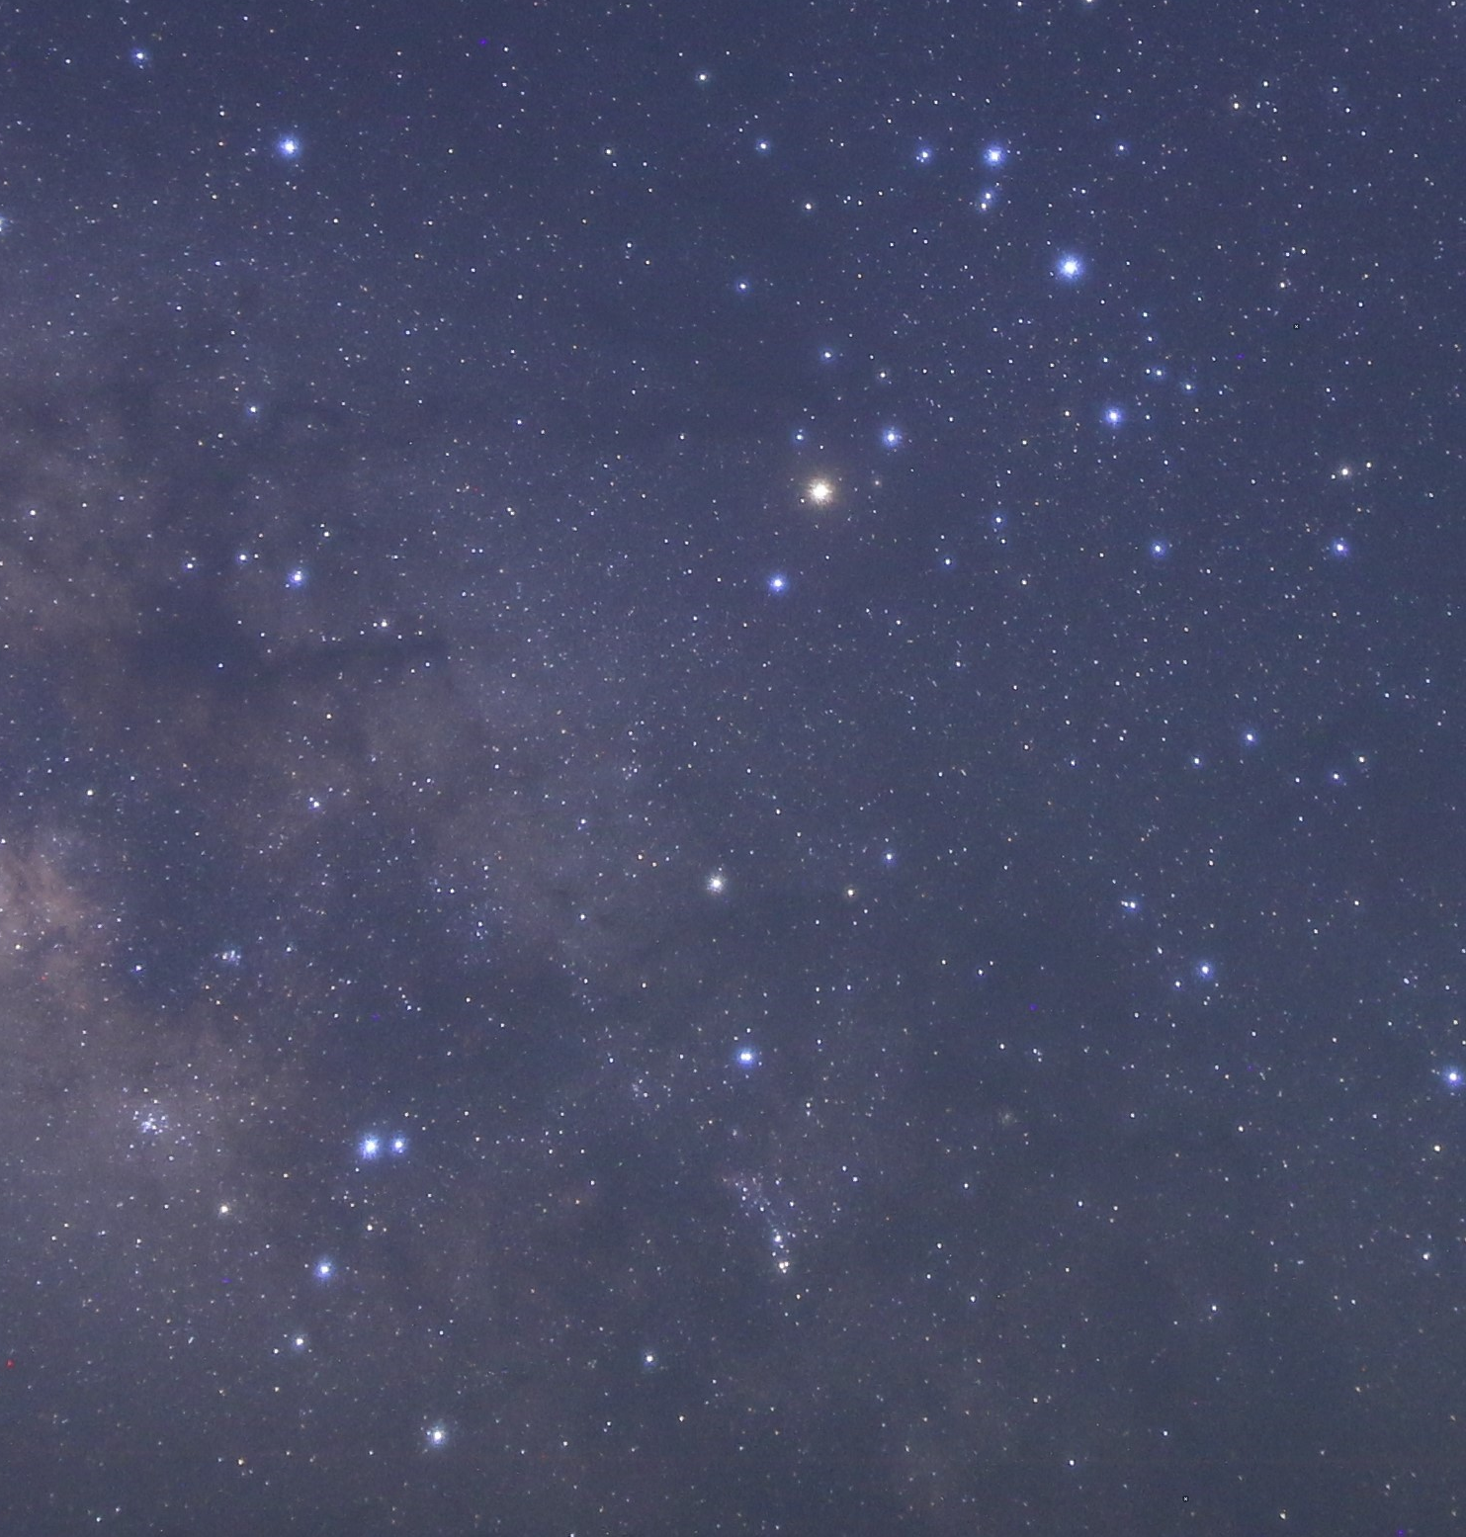

Experiment
A method for creating data sets
… Create constellation images as data sets that allow an AI to learn
the characteristics of the constellations
Star map
(Constellation image)
Astrophotography
Orion
Scorpius
Orion
Scorpius
Gemini
Gemini
Notes:
This is the example of the star map and this is the example of the astrophotography. By comparing these images, it can be seen that we were able to create constellation images that reproduce the actual sequence of the stars. Now, we can create data sets.

Slide 19
Experiment
Objective
Identify constellations in astrophotography.
Proposed method
・A method for creating data sets
・A method for identifying constellations
Notes:
Next, I will explain a method for identifying constellations.

Slide 20

Experiment
A method for identifying constellations
… Identify constellations by treating a constellation as a set of points
Star map
Astrophotography
Learn the characteristics of constellations
Identify constellations
AI
trained AI
Notes:
We identify constellations using the created star maps by ~. Here is the flow of the experiment. Use star maps to make AI learn the characteristics of constellations, and use trained AI to identify constellations in astrophotography.

Slide 21
Experiment
A method for identifying constellations
… Identify constellations by treating a constellation as a set of points
Star map
Astrophotography
Learn the characteristics of constellations
Identify constellations
AI
trained AI
Notes:
In this learn and identification, we use the idea of a constellation as a set of points.

Slide 22
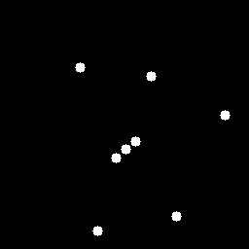
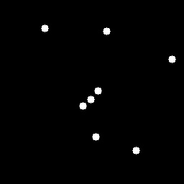
Experiment
A method for identifying constellations
… Identify constellations by treating a constellation as a set of points
Star map
Extract bright stars
Astrophotography
Extract bright stars
Notes:
Originally, a constellation is a region bounded by a certain boundary line, however, in this study, we treat a constellation as a set of points by extracting bright stars. In these experiments, the number of stars to be extracted was set to 8, considering the number of stars that make up the constellation to be identified.

Slide 23
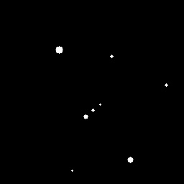
Experiment
A method for identifying constellations
… Identify constellations by treating a constellation as a set of points
・Applying to a CNN (Experiment 1)
・Applying to a CNN (Experiment 2)
・Applying to PointNet (Experiment 3)
Notes:
Under these conditions, three types of experiments were conducted. Experiment 1 is ~.

Slide 24
Experiment
A method for identifying constellations
… Identify constellations by treating a constellation as a set of points
・Applying to a CNN (Experiment 1)
・Applying to a CNN (Experiment 2)
・Applying to PointNet (Experiment 3)
←All stars are represented with the same size.
←The star size is changed according to the magnitude of the star.
Notes:
The difference between the images used in Experiment 1 and Experiment 2 is that in Experiment 1~

Slide 25
Experiment
A method for identifying constellations
… Identify constellations by treating a constellation as a set of points
・Applying to a CNN (Experiment 1)
・Applying to a CNN (Experiment 2)
・Applying to PointNet (Experiment 3)
Input coordinate information
Notes:
In Experiment 3, we used the coordinate information of each star as input for PointNet.

Slide 26
Experiment
Result
Results of the accuracy of the astrophotography in each experiment
(Mean and standard deviation of 5 trials)
 |  | Accuracy
 |  | Mean | Standard deviation
Comparison experiment | Adam | 0.42 | 0.04
Experiments Using The proposed method | Experiment 1 | 0.56 | 0.03
Loss function | Experiment 2 | 0.51 | 0.05
Number of epochs | Experiment 3 | 0.59 | 0.03
Notes:
In the comparison experiment, we trained and identified with CNN without extracting bright stars.
Since there is no famous dataset in astrophotography for constellation identification, there is also no index of accuracy. In the first place, there is almost no previous study on constellation identification. Even in some studies, the data used varies. In this study, too, I used my own collected data, which includes some that are difficult for AI to identify, and the problem is considered to be highly challenging.

Slide 27
Experiment
Result
Results of the accuracy of the astrophotography in each experiment
(Mean and standard deviation of 5 trials)
 |  | Accuracy
 |  | Mean | Standard deviation
Comparison experiment | Adam | 0.42 | 0.04
Experiments Using The proposed method | Experiment 1 | 0.56 | 0.03
Loss function | Experiment 2 | 0.51 | 0.05
Number of epochs | Experiment 3 | 0.59 | 0.03
Notes:
The results show that the proposed method, which considers a constellation as a set of points, increases the accuracy. This confirmed the effectiveness of the proposed method.

Slide 28
Experiment
Result
Results of the accuracy of the astrophotography in each experiment
(Mean and standard deviation of 5 trials)
 |  | Accuracy
 |  | Mean | Standard deviation
Comparison experiment | Adam | 0.42 | 0.04
Experiments Using The proposed method | Experiment 1 | 0.56 | 0.03
Loss function | Experiment 2 | 0.51 | 0.05
Number of epochs | Experiment 3 | 0.59 | 0.03
Notes:
The accuracy of Experiment 1 and 3 is higher the accuracy of Experiment 2, so we found that if we use star map data sets, the accuracy is higher when all stars are represented with the same size.

Slide 29
Experiment
A method for identifying constellations
… Identify constellations by treating a constellation as a set of points
・Applying to a CNN (Experiment 1)
・Applying to a CNN (Experiment 2)
・Applying to PointNet (Experiment 3)
Notes:
This is probably due to the fact that the magnitude relationships of stars in astrophotography vary from image to image.

Slide 30
Agenda
Research Background
Related Studies
Experiment
Conclusion
Notes:
Finally, I will conclude this study.

Slide 31
Conclusion
We propose a method for creating data sets that will allow an AI to learn the characteristics of constellations.
We propose a method for identifying constellations by treating a constellation as a set of points.
The effectiveness of the proposed method was confirmed by numerical experiments.
If use star map data sets, the accuracy is higher when all stars are represented with the same size.

Slide 32
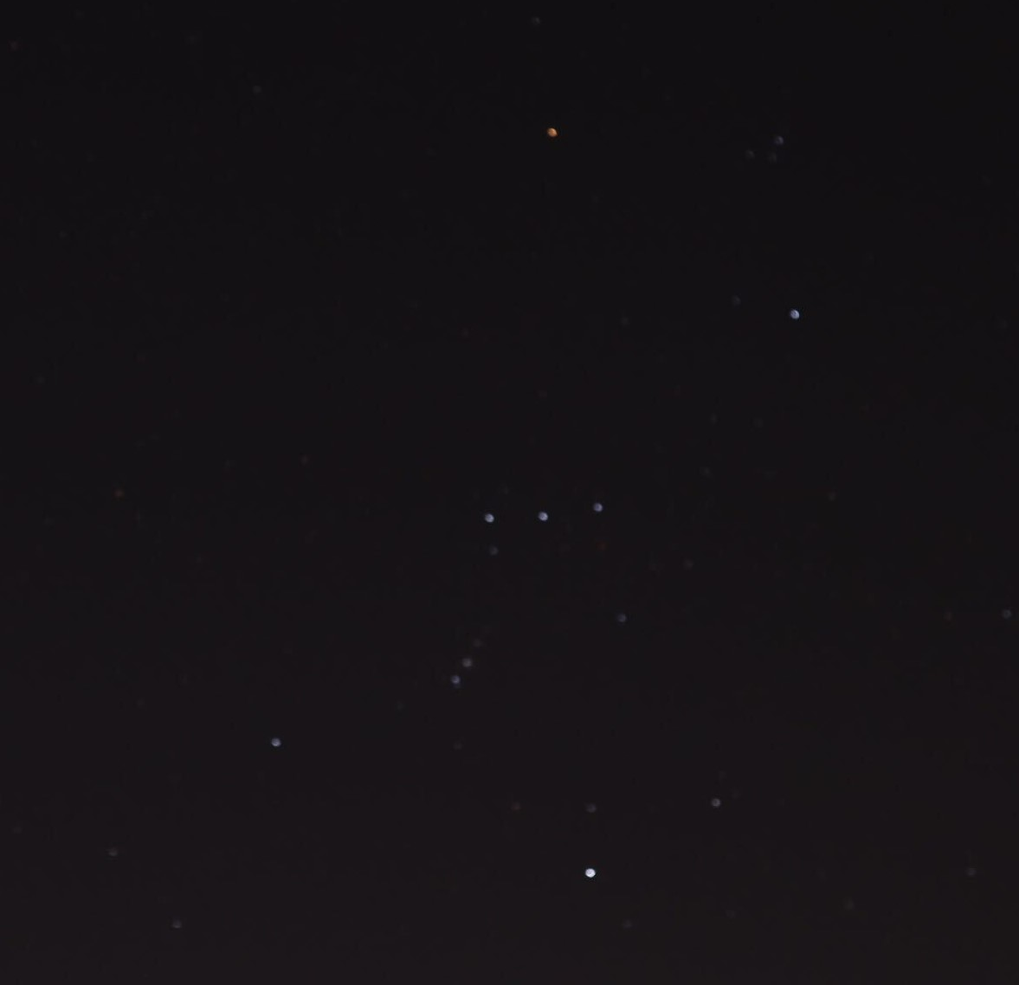
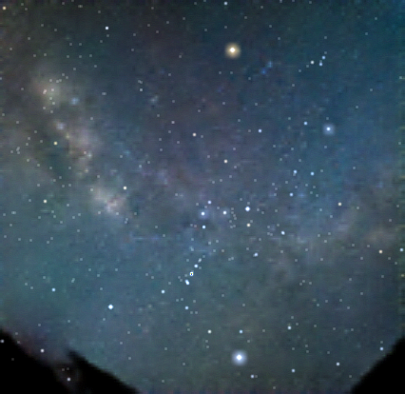
Feature Works
Experiment with increasing the number of identified constellations
Experiment to identify astrophotography with multiple constellations
Before editing
After editing
Identified as "Orion"
Notes:
Eventually, we are considering devising such an automatic editing method for astrophotography.

Slide 33

Thank you very much for your attention.
Notes:
I would like to conclude my presentation.

Slide 34
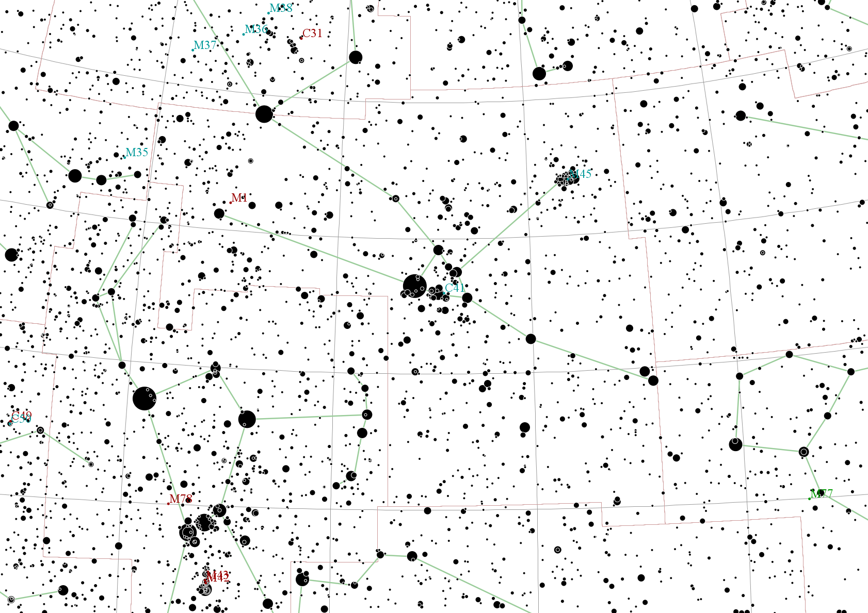
Research Background
Fewer data
Only some of the constellations are in the images.
Star chart
[referenced] Astro Commons
(http://astronomy.webcrow.jp/chart/nl.html)
Notes:
There are several such star charts available on the Internet. In some cases, the necessary constellations are not in the images.

Slide 35
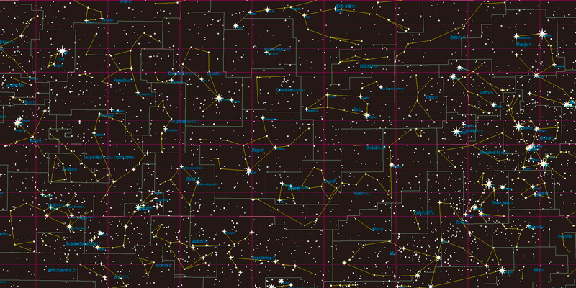
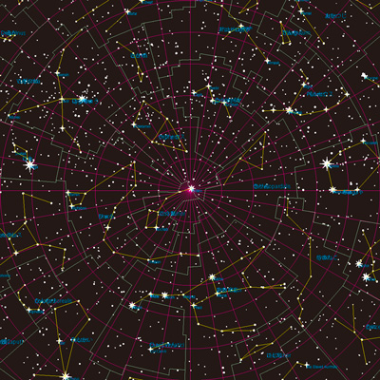

▲ Mid-latitudes (declination: -60$°$～60$°$)
▲
Northern sky (declination: 0$°$～90$°$)
[referenced] http://hokori.net/archives/170
Notes:
Although there is a way to create star charts from star table data, it is difficult to specify the range to be cut out arbitrarily with the conventional method. On the other hand, in this study, it is possible to create a star map of any range.

Slide 36
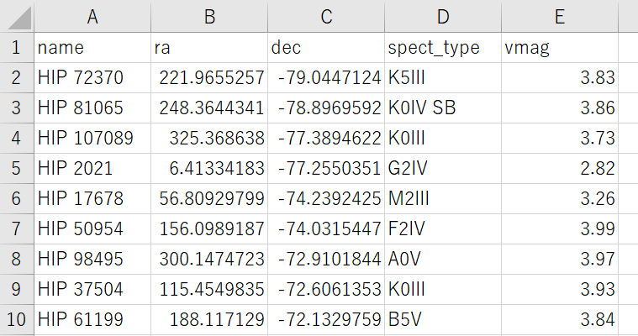
Experiment
Example of the Hipparcos Catalogue
Equatorial coordinates
Equatorial coordinates:
Coordinates based on the rotation of the earth, used to express the absolute position of a star.
(RA: Right Ascension, DEC: Declination)
Notes:
From the equatorial coordinate system,

Slide 37

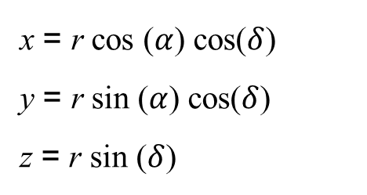

Experiment
Example of the Hipparcos Catalogue
x = r cos ($α$) cos($δ$)
y = r sin ($α$) cos($δ$)
z = r sin ($δ$)
x-axis direction: direction of vernal equinox
z-axis direction: direction of the celestial north pole
r: radius of the projected celestial sphere
(Set at 1000 in this study)
$α$ = $\frac{ra × π}{180}$
$δ$ = $\frac{dec × π}{180}$
Notes:
Calculate the x, y, and z coordinates of each star in this way.

Slide 38
Experiment
Example of the Hipparcos Catalogue
First letter | Color
O | Blue
B | Blue and white
A | White
F | Yellow and white
G | Yellow
K | Orange
M | Orange red
Color
Notes:
The spectral types are classiﬁed into seven categories according to the ﬁrst letter of the alphabet as color information.

Slide 39
Experiment
Example of the Hipparcos Catalogue
Visual magnitude
Size of the star’s diameter = 15 / (Visual magnitude)
(radius of the projected celestial sphere = 1000)
Notes:
The magnitude of the star’s diameter was set to 15 divided by the visual magnitude.

Slide 40
Experiment

Slide 41
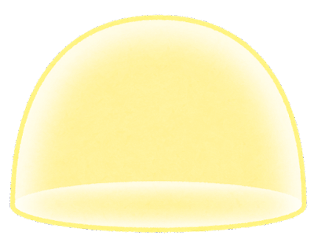


Experiment
Notes:
It is easy to understand if you imagine a planetarium with a full-sky sphere instead of a hemisphere.

Slide 42
Experiment
Notes:
I'm going to cut out a part of this planetarium.

Slide 43
Experiment
Notes:
As an example, cut out the Orion in the area circled in red.

Slide 44
Experiment
(-100, 200, 250)
(-100, 200, -200)
(300, 200, -200)
Notes:
Determine the coordinates of the area to be cut out.

Slide 45
Experiment
Two-dimensions
三次元
二次元
Three-dimensions
Notes:
Project the stars on the three-dimensional space onto the two-dimensional plane.

Slide 46


Experiment
$$𝒳$$
(-100, 200, 250)
$$𝒴$$
Projection plane
Notes:
This is what it looks like from above.

Slide 47
Experiment
$$𝒳$$
Origin
(0, 0)
$$𝒴$$
Origin
(0, 0)
x
y
Notes:
Using this as the origin, draw a star on the plane.

Slide 48
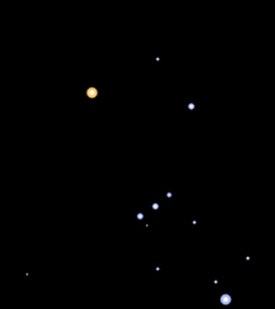
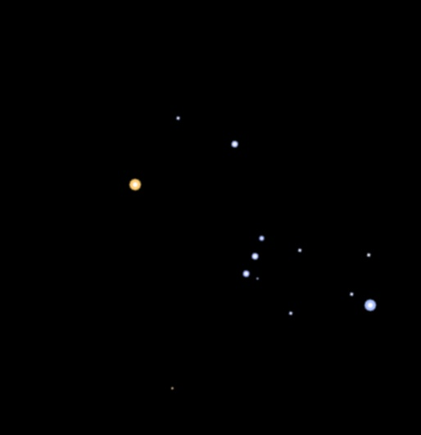
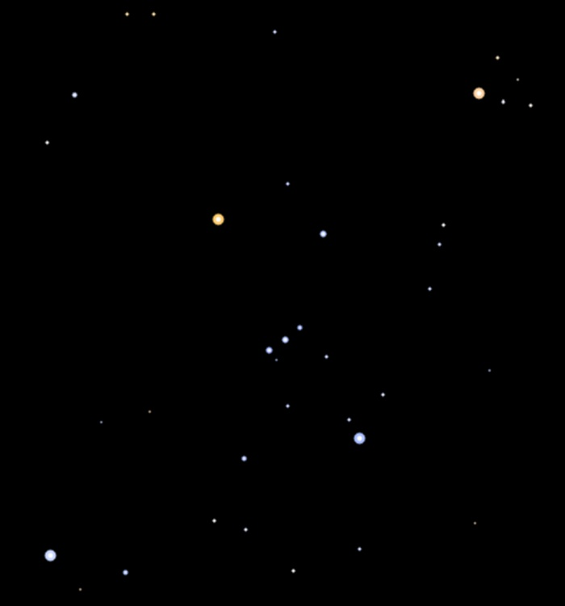
Experiment
Number of training and test Images
Training images (sheets) | Test images (sheets)
1200 | 50
Original image
Pixel translation
Rotation
Resize (reduce)
Notes:
The training images were subjected to data augmentation such as pixel translation, rotation, and resizing. The test images were obtained by scraping 10 images from each constellation, and although the images were basically chosen for their lack of gorgeous editing, some constellations may contain some gorgeous images due to the small amount of data.

Slide 49
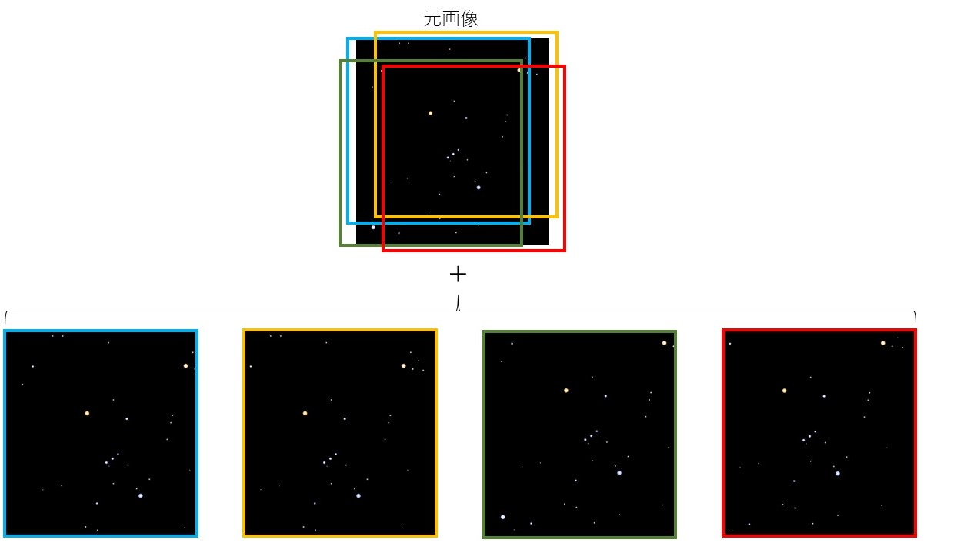
Experiment
Pixel translation
Notes:
In pixel translation, four ways of cropping were performed for a single image in this way.

Slide 50
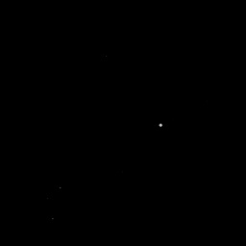
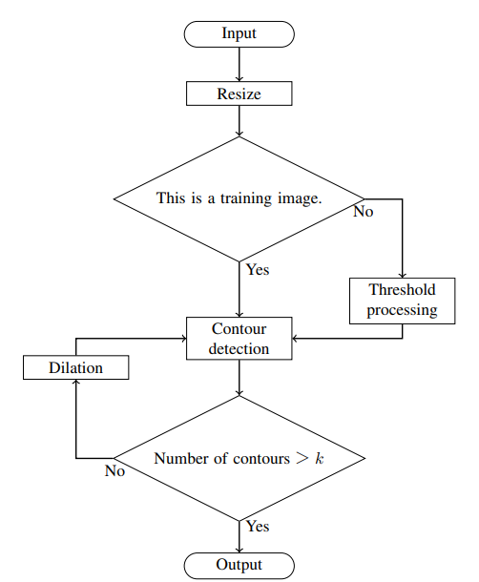
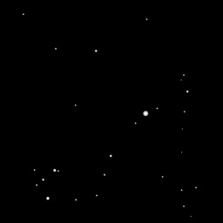
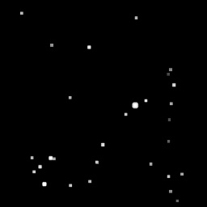
Experiment
Dilation
Dilation
Notes:
This is a flowchart of bright star extraction. In the red circle, the dilation process is repeatedly applied to the image until the specified number of stars is found.

Slide 51
Experiment
PointNet
Input
x | y
82 | 69
181 | 222
119 | 162
129 | 153
155 | 78
231 | 118
139 | 145
100 | 237
Origin
(0, 0)
x
y
Input the coordinates of the star
Notes:
In PointNet, the input is a set of coordinates of bright stars in the image.

Slide 52
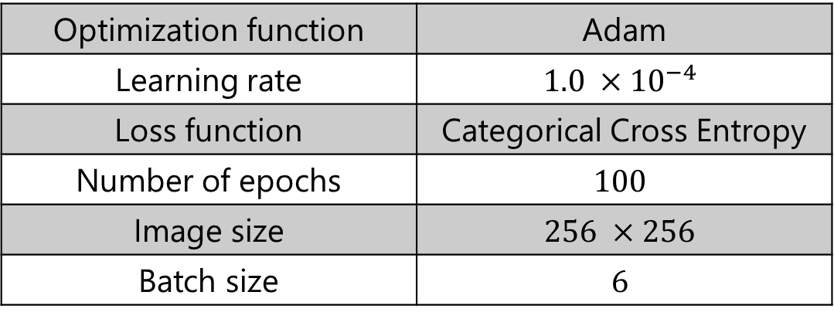
Experiment
A method for identifying constellations
Experiment parameters (CNN) for Experiment 1 and 2
Optimization function | Adam
Learning rate | $$1.0 ×{10}^{−4}$$
Loss function | Categorical Cross Entropy
Number of epochs | $$100$$
Image size | $$256 ×256$$
Batch size | $$6$$

Slide 53
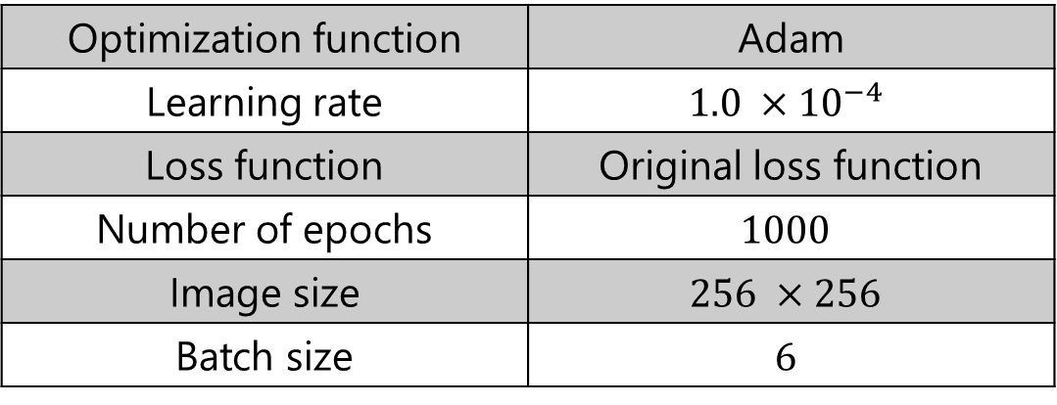




Experiment
A method for identifying constellations
Experiment parameters (PointNet) for Experiment 3
Optimization function | Adam
Learning rate | $$1.0 ×{10}^{−4}$$
Loss function | Original loss function
Number of epochs | $$1000$$
Image size | $$256 ×256$$
Batch size | $$6$$
Original loss function:
Cross Entropy Loss
$$L_{H}:$$
$L$ = $L_{H}+ L_{reg}$
$L_{reg}$ = ${\left\|I−AA^{T}\right\|}_{F}^{2}$
$$A:$$
Feature matrix output by T-Net
Notes:
It has been reported that PointNet improves accuracy by using this original loss function.

Slide 54
Experiment
CNN
Train
Test
[引用] https://jp.mathworks.com/help/deeplearning/ug/layers-of-a-convolutional-neural-network.html
One difference in the extracted points can make a big difference in the image.
Notes:
As CNNs learn features in their neighborhoods,

Slide 55
Experiment
PointNet
Train
Test
x | y
82 | 69
181 | 222
119 | 162
129 | 153
155 | 78
231 | 118
139 | 145
100 | 237
x | y
82 | 69
181 | 222
119 | 162
129 | 153
40 | 25
231 | 118
139 | 145
100 | 237
Even if one difference in the extracted points has little effect on the properties of the set.
Notes:
As PointNet learns the features of a set,

Slide 56
Experiment
Result
Results of the average number of identiﬁcations for each constellation.
(Mean and standard deviation of 5 trials)
 | accuracy
 | Gemini | Canis Major | Orion | Taurus | Scorpius
Comparison Experiment | 6.4 | 5.6 | 3.6 | 3.0 | 2.2
Experiment 1 | 5.0 | 5.4 | 9.8 | 5.4 | 2.6
Experiment 2 | 6.4 | 3.4 | 7.4 | 4.2 | 2.2
Experiment 3 | 6.2 | 5.8 | 10.0 | 4.0 | 4.0
Notes:
It tended to be misidentified when the number of stars in the image was large. Constellations where the extracted stars tended to be clustered tended to be misidentified as such, and those where they were scattered tended to be misidentified as such.

Slide 57
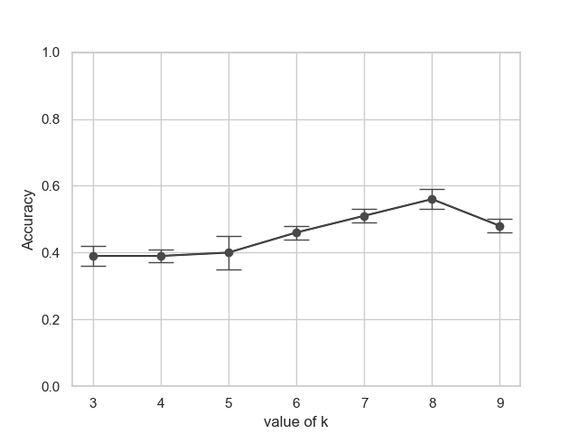
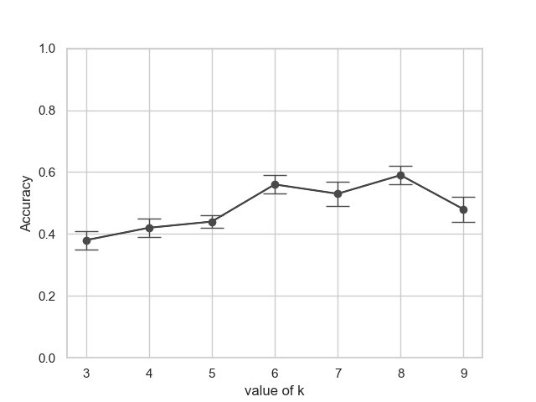
Experiment
CNN
PointNet
Notes:
Here is a graph showing the change in the accuracy when the number of stars to be extracted is changed. The horizontal axis shows the number of stars to be extracted and the vertical axis shows the accuracy. As a result, the first value we set was the best result.

