Slide 1

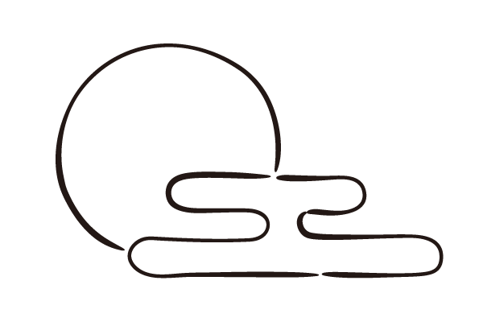
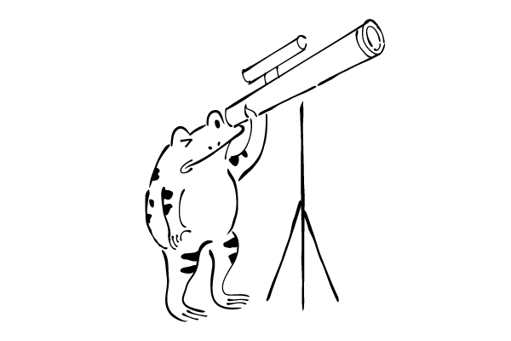
A Proposal of Constellation Identification Method Based on Star Map Data by Machine Learning
B4 Sayaka Nadamoto
Notes:
Today, I will talk about ~

Slide 2
Agenda
・ Research Background
・ The Proposed Method
・ Future Plans
Notes:
Here is the Agenda of my presentation.

Slide 3
Agenda
・ Research Background
・ The Proposed Method
・ Future Plans
Notes:
First, I will introduce the research background.

Slide 4
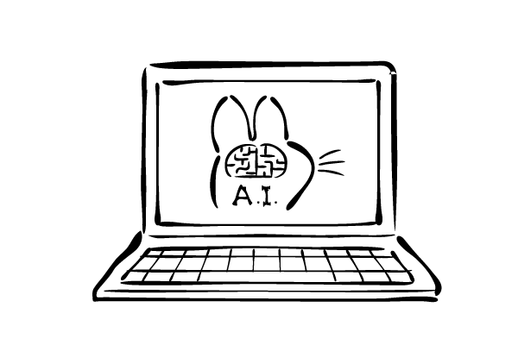

Research Background
- In recent years, research on image recognition using artificial intelligence has attracted attention.
An apple
Notes:
In recent~
With the advent of neural networks, artificial intelligence can identify with high accuracy if it is simple. Like this.

Slide 5
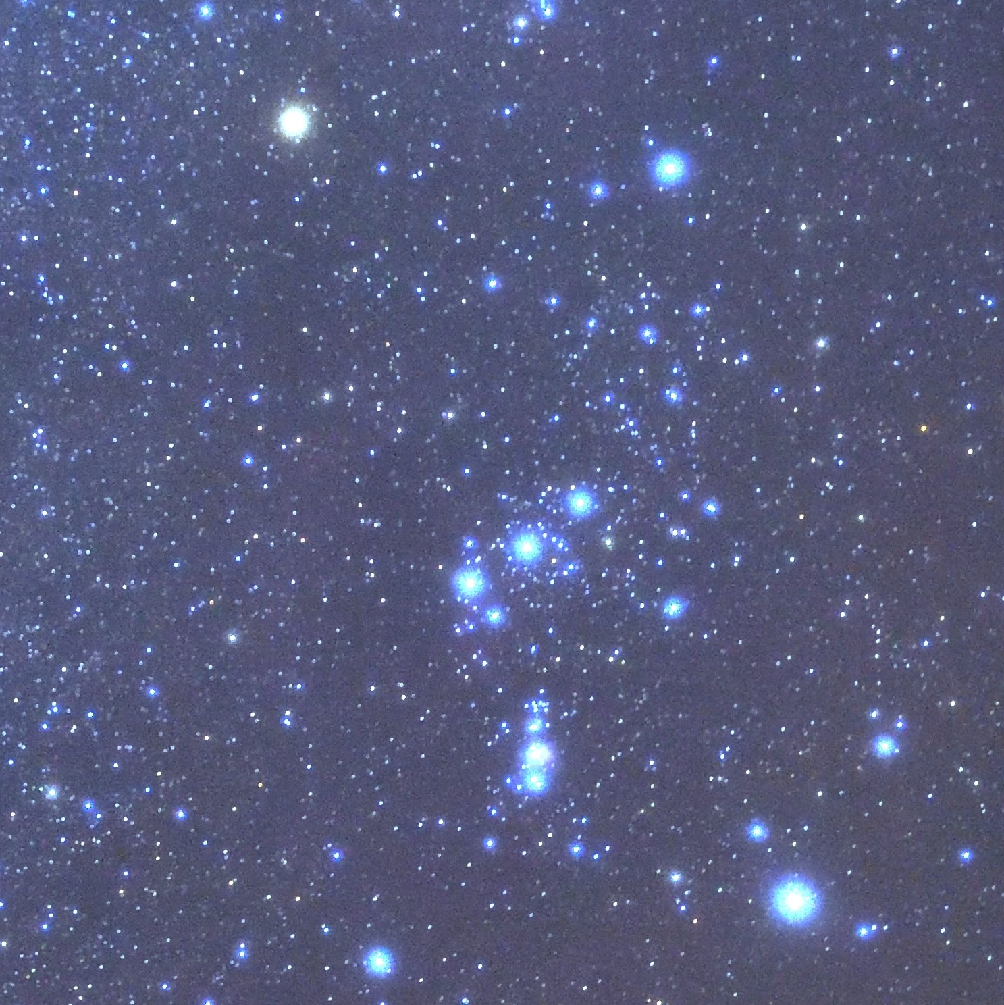
Research Background
- Astrophotography identification is a very difficult task, even with artificial intelligence.
？
Notes:
However, astrophotography doesn’t work out well like that. In fact, astrophotography identification is~

Slide 6
Research Background
- Astrophotography identification is a very difficult task, even with artificial intelligence.
Difficult to draw a line between
the target and the background
Wide variety of ways to
take and edit photos
Small dataset
Notes:
There are mainly three reasons why it is difficult for artificial intelligence to identify astrophotography well.

Slide 7
Research Background
- Astrophotography identification is a very difficult task, even with artificial intelligence.
Difficult to draw a line between
the target and the background
Wide variety of ways to
take and edit photos
Small dataset
Notes:
First, it is difficult ~
Too small stars can interfere with identification.

Slide 8
Research Background
- Astrophotography identification is a very difficult task, even with artificial intelligence.
Difficult to draw a line between
the target and the background
Wide variety of ways to
take and edit photos
Small dataset
Notes:
Second, there is a wide variety~
It depends on the photographer and the equipment.

Slide 9
Research Background
- Astrophotography identification is a very difficult task, even with artificial intelligence.
Difficult to draw a line between
the target and the background
Wide variety of ways to
take and edit photos
Small dataset
Notes:
Third, the number of astrophotography datasets is small.
So I have to prepare a large dataset myself.
I try to identify astrophotography by inventing my own solution to these problems.

Slide 10
Agenda
・ Research Background
・ The Proposed Method
・ Future Plans
Notes:
Next, I will talk about the proposed method.

Slide 11
The Proposed Method
- The goal of my research is to create artificial intelligence that understands celestial bodies like humans.
Orion
Notes:
The goal of ~

Slide 12
The Proposed Method
- In the research, I try to identify a constellation in the astrophotography.
Select from candidates
？
Notes:
As a preliminary step, in the research, ~ from multiple candidates.

Slide 13
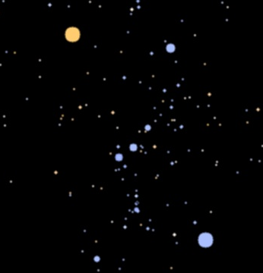
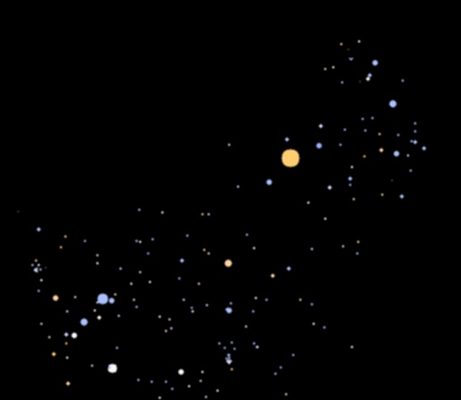
The Proposed Method
- First, create star maps based on the data in the star catalog.
Orion
Scorpio
Notes:
Here, I will explain the procedure of the research. First ~
Use these star maps as datasets, and this allows to expand datasets.
I devise to resolve the small datasets problems by this method.
(rotate and filter the star maps)

Slide 14
The Proposed Method
- Then, artificial intelligence learns the star maps and it will identifies unknown photos.
Orion
Learn star maps
？
+ filter
Notes:
Then~
At this time, filter the astrophotography to make it easier to identify constellations.
(Filtering that leaves only stars with high brightness values)
This method will solve the first and second problems of the astrophotography identification.
In this way, I proposed the method to identify the constellation in the astrophotography from multiple candidates.

Slide 15
Agenda
・ Research Background
・ The Proposed Method
・ Future Plans
Notes:
Finally, I will talk about future plans.

Slide 16
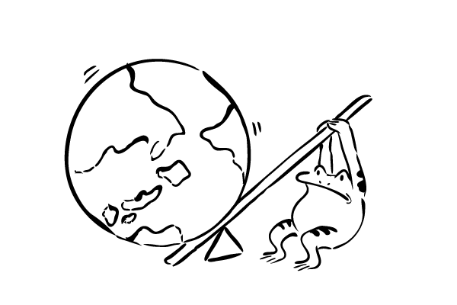
Future Plans
- Try to identify astrophotography taken in various compositions.
- Try to identify both astrophotography with many stars and with few stars.
Notes:
These are the two future plans. I will try to ~
(add rotate images to datasets)
(change the filtering method according to the number of stars in the astrophotography)
I would like to conclude my talk. Thank you for your listening.

