Slide 1
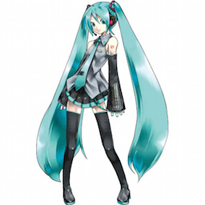
PyTorch 移植版
Original (caffemodel)
{'general’:
[('thighhighs', 0.99),
('1girl', 0.98),
('twintails', 0.98),
('solo', 0.96),
('aqua hair', 0.91),
('long hair', 0.88),
('very long hair', 0.83), ('detached sleeves', 0.74), ('skirt', 0.67),
('necktie', 0.56),
('aqua eyes', 0.55)], 'character’:
[('hatsune miku', 0.99)], 'copyright’:
[('vocaloid', 0.99)],
'rating’:
[('safe', 0.97), ('questionable', 0.02), ('explicit', 0.00)]}
{'general’:
[('thighhighs', 0.99), ('twintails', 0.98),
('1girl', 0.98),
('solo', 0.96),
('aqua hair', 0.91),
('long hair', 0.89),
('very long hair', 0.83), ('detached sleeves', 0.72), ('skirt', 0.72),
('necktie', 0.67),
('aqua eyes', 0.65),
('boots', 0.58),
('thigh boots', 0.56)], 'character’:
[('hatsune miku', 0.99)], 'copyright’:
[('vocaloid', 0.99)],
'rating’:
[('safe', 0.98), ('questionable', 0.01), ('explicit', 0.00)]}
Input Image

