Slide 1
A Method of Emotional Estimation and An Investigation of Multimodalization about Four-Scene Comics Based on Deep Learning
B4 Yusei Takayama
Notes:
Hello, everyone. I'm Yusei Takayama.
Today, I`d like to talk about “A Method of Emotional Estimation & An Investigation of Multimodalization about Four-Scene Comics Based on Deep Learning”.
-------------
「深層学習に基づく4 コマ漫画の感情推定とマルチモーダル化への検討」と題しまして,
ソフトウェアシステム研究グループの高山が発表いたします.

Slide 2
Outline
Introduction
Dataset
Procedure
Future Research Plan
Notes:
Here is the outline of my presentation.
------------------
発表の流れはこのようになっております.

Slide 3
Outline
Introduction
Dataset
Procedure
Future Research Plan
Notes:
First, I’d talk about Introduction.
------------------
まず, はじめに

Slide 4





Introduction
Notes:
Recently, because of the development of artificial intelligence,
understanding of human’s creative works has been attracting many researchers’ attention such as music and novels and so on…
But it is still considered to be a difficult task.
-----------------------
近年, 人工知能の発展を受けて, 音楽や小説などの創作物理解が注目されていますが, これらは未だに難しいタスクであると考えられています．

Slide 5
Introduction
Comic Computing
Notes:
In my research, I especially interested in “Comic Computing” for understanding the contents of comics.
---------------------
本研究ではその中でも,
マンガの内容理解, コミック工学に注目しました.

Slide 6
Introduction
Comic Computing
[Texts]
ex) dialog, onomatopoeia
[Images]
ex) character, background
Notes:
Generally, Comics have multimodal data consisting of Texts and images.
In the field of Comic Computing,
Many researches on image processing have been reported,
But there are few researches on natural language processing.
-------------
漫画というのは自然言語と画像から構成されるマルチモーダルなデータを持っています.
画像処理に関する研究は数多く報告されていますが,
自然言語処理による研究は少ないのが現状です.

Slide 7
Introduction
Comic Computing
[Texts]
ex) dialog, onomatopoeia
[Images]
ex) character, background
Notes:
From this background, I mainly deal with text data with using natural language processing.
----------------
こうした背景から
よって本研究では, 主に自然言語処理を扱います.

Slide 8
Introduction
Comic Computing
[Texts]
ex) dialog, onomatopoeia
＋
[Images]
ex) character, background
||
[Multimodalization]
Notes:
In addition, considering information of images,
I investigate Multimodalization to understand the contents of Comics.
---------------------
そして, 画像情報も加味したマルチモーダルな
漫画の内容理解についての検討をしていきます.

Slide 9
Introduction
[Purpose]
Understanding Japanese comics
[Task]
Emotional estimation of dialogs
in four-scene comics
Notes:
So, The purpose of my research is “Understanding Japanese Comics”,
But, likewise this is very difficult problem too, so
As preparation for it, I set up “Emotional Estimation of Dialogs in Four-Scene Comics” as a task in my research.
------------------
研究目的をmangaの内容理解とし, この問題は難しいので
そのためのタスクとして4 コマ漫画のセリフの感情推定を設定しました.

Slide 10
Outline
Introduction
Dataset
Procedure
Future Research Plan
Notes:
Next, I’d talk about Data Set.
-----------------
次にデータセットについて説明します.

Slide 11
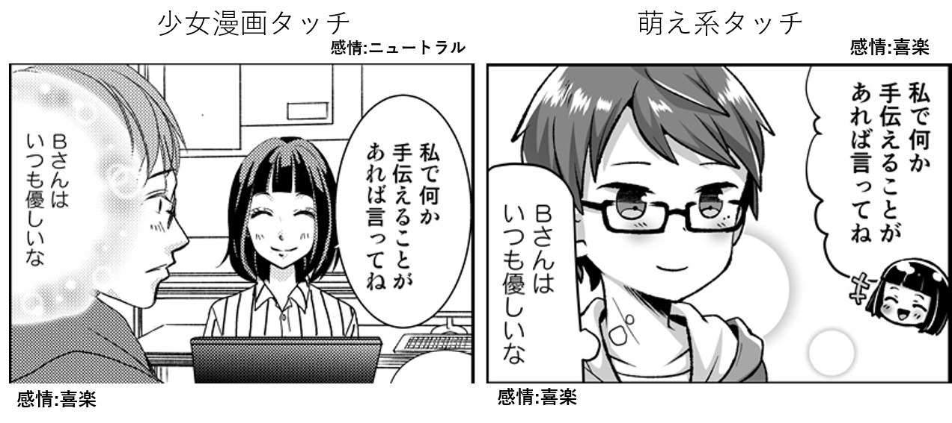
Four-Scene Comic Story Dataset
“Shoujo Manga” Touch
“Moe” Touch
Label : neutral
Label : happiness
© Drawn by Rina Takashina, Scenario written by
Saki Harimura and at Spoma Inc.
© Drawn by Umeko Muneta, Scenario written by
Saki Harimura and at Spoma Inc.
and Miki Ueno at Toyohashi University of Technology
and Miki Ueno at Toyohashi University of Technology
Five artists drew the same plot
Emotional annotation by the authors
Four-Scene Comic story dataset for softwares on creative process.
In New Trends in Intelligent Software Methodologies,
Tools and Techniques , Miki Ueno
Notes:
the dataset used in my research is "Four-Scene Manga Story Dataset".
This dataset was created by 5 artists under the same plot, and divided into 5 touches.
Touch means style of drawing.
The main feature is the emotional annotation by the authors.
As shown in the figure, the right side is set to “happiness" and the left side is set to "neutral" for the women's speech.
So you can see that even with the same plot, the way to assign the emotion label is depending on their sensibilities.
---------------
よって本研究で用いるデータセットがこの「4コマ漫画ストーリーデータセット」です.
このデータセットは複数の漫画家が同一プロットの下, 作成しており, いくつかのタッチに分かれています.
そして作者による感情アノテーションがされていることが大きな特徴です.
図の通り, 女性の発言に対して, 右側は”喜楽”, 左側は”ニュートラル”と設定しており,
同一プロットであっても作者の感性によって感情ラベルのつけ方が異なることが分かります.

Slide 12
・Emotion Label (7 Types)
・Touch (5 Types)
“Gyagu”, “Shoujo Manga”, “Shounen Manga”,
“Seinen Manga”, “Moe”
“Neutral”, “Happiness”, “Surprise”,
“Fear”, “Sadness”, “Anger”, “Disgust”
Notes:
This dataset has these five touches. And, these seven emotion labels.
----------------
このデータセットはこれらの５つのタッチがあり, それぞれ10話まで存在します.
そして感情ラベルとしては, ニュートラル, 喜楽, 驚愕, 恐怖, 悲哀, 憤怒, 嫌悪の７種類存在します.

Slide 13
Outline
Introduction
Dataset
Procedure
Future Research Plan
Notes:
Next, I’d talk about procedure of my research.
-----------------
次に実験手順について説明します

Slide 14
Procedure
2 class classification problem
Positive Class : Happiness
Negative Class : The Others
Notes:
because of the size of dataset and the difficulty of the analysis,
I deal with 2 class classification problem which
Positive class is only Hapinness label and
Negative class is the others.
------------
本実験ではデータ数と解析の難しさの問題から, 喜楽のみを正例クラス, その他をすべて負例クラスとした2クラスのセリフの感情推定
を行います.

Slide 15
Procedure
2 class classification problem
Input
Output
Tied
Dialog
Label
Happiness
or
The Others
Notes:
More specifically,
As mentioned above, each dialog is assigned a single emotion label by the authors.
So, I can say that this is a classification problem with dialog as input and label as output.
-----------------
データセット内の各セリフには 1 つの感情ラベルが付与されています.
つまり、これはdialogを入力、labelを出力とする分類問題であるといえます。

Slide 16
Procedure
2 class multimodal classification problem
Input
Output
Dialog
Label
＋
Tied
Happiness
or
The Others
Scene
Notes:
In addition, multimodal classification problem can be performed by
adding the image information of the scene tied with each dialogue to the input.
----------------------
また、各セリフに対応するコマの画像情報を入力に加えることで、マルチモーダルな分類問題が実行可能です。

Slide 17
Procedure
2 class multimodal classification problem
Input
Doc2Vec, BERT, …
Output
Dialog
Text
Embedding
+
Classfier
Label
Scene
Image
Embedding
illustration2vec, VGG16, …
Notes:
In fact, distributed representations obtained by each the embedding method is used
as input to the classifier.
and predict the labels.

Slide 18
Outline
Introduction
Dataset
Procedure
Future Research Plan
Notes:
Finally, I’d talk about Future research plan.
-----------------
最後に研究計画について説明します

Slide 19
Future Research Plan
Expand the dataset
Emotional estimation with
more meta information
Explore more rational
distributed representation
Notes:
There are three things I hope to accomplish as my future research plan.
First, I want to expand the dataset for “comic computing”.
Currently, the size of data set is a small and it is a bottleneck for improving generalization performance.
Second is Emotional Estimation with More Meta Information such as information of speakers.
Third, I want to explore a more rational Distributed Representation of dialogs and images.
----------------------
卒業論文の計画として私が達成したいことは次の３つがあります。
まず、データセットの拡張です。現状、データ数の少なさがモデルの汎化性能を上げることに対する大きなボトルネックになっています。
次に、メタ情報をさらに加えてのセリフの感情推定です。
最後は、より合理的なベクトル化手法の考案です。

Slide 20
Notes:
Thank you for listening.
改善の余地あり = There's room for improvement

Slide 21
Notes:
Thank you for listening.

Slide 22
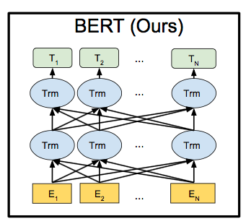
BERT
Bidirectional Encoder Representations from Transformer
A generalized language model
based on multiple bi-directional transformers
Easy to transfer pre-trained models to other tasks
Devlin, Jacob and Chang, Ming-Wei and Lee, Kenton and Toutanova, Kristina.
BERT: Pre-training of Deep Bidirectional Transformers for Language Understanding. 2018.
Notes:
まずBERTについて説明します. BERT とは ～ の略称で
その名の通り複数の双方向Transformer に基づく汎用言語モデルで
入力された文および，含まれる各単語に対応する分散表現を出力します.
また,事前学習済みモデルを他のタスクに転移学習することが容易で
様々な自然言語タスクにおいて State of the art を獲得しています.

Slide 23
Illustrarion2Vec
A vectorization method for images proposed by
Masaki Saito and Yusuke Matsui et al.
A model based on VGG
Tackle the difficulties of image recognition for illustrations such as cartoon drawings and cartoons
Masaki Saito, Yusuke Matsui,
Illustration2Vec: A Semantic Vector Representation of Illustrations, 2015
Notes:
illustration2vec\citeは, Masaki Saito と Yusuke Matsui らが提案した画像のベクトル化手法で, VGG をベースとしたモデルとなっている.
既存の画像認識モデルのほとんどが ImageNet などの実画像を評価対象にしており,
アニメ絵や漫画といったイラストに対して評価を行っていなかったため, イラストのより合理的なベクトル化が期待できる手法である.

Slide 24
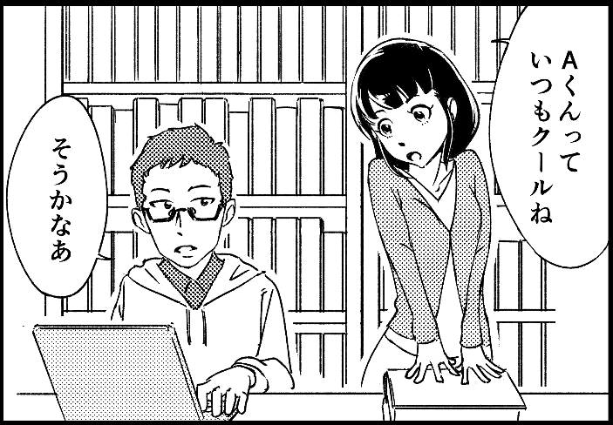
Input Relationship
Tied
Dialog
Scene
A くんって
いつもクールね
Notes:
For example,
Scene input tied with this dialog is
The image of the scene containing this dialog.

Slide 25
Future Research Plan
Expand the dataset
How to expand ?
- Thesaurus of Japanese
- AutoAugment for NLP task

Slide 26
Future Research Plan
Emotional estimation with
more meta information
Why ?
- Many of dialogs are from the main characters
- Focusing them is efficiently for my research
Notes:
Generally,
Many of dialogs are from the main characters, so
by focusing on them, I expect to understand the contents more efficiently.

Slide 27
Next Step of My Research
[Purpose]
Understanding Japanese comics
[Next Purpose]
Automatic generation of comics
Notes:
Generally,
Many of dialogs are from the main characters, so
by focusing on them, I expect to understand the contents more efficiently.

Slide 28
Procedure
2 class multimodal classification problem
Input
Doc2Vec, BERT, …
Output
Dialog
Text
Embedding
+
Classfier
Label
Scene
Image
Embedding
illustration2vec, VGG16, …
Notes:
Because There are many different embedding methods,
Comparison of the accuracy of each embedding method is an issue for the future.

