Slide 1
End to end testing with golang
By Adrian Witas

Slide 2
What is end to end testing
End-to-end testing is a methodology that:
Test the entire application in an environment that exactly imitates production with all network communication, datastore and other dependencies interaction.
Verify the desired output on the basis of the input provided.
Focuses on verifying the end to end testing process flow.

Slide 3
EXTRACT TRANSFORM AND LOAD I/O
INPUT
Data in database/datastore
Data/logs in local or remote file system
Transformation rules and configuration
OUTPUT
Transformed data in database
Transformed data in files system
Application logs

Slide 4
Web App/services I/O
INPUT
HTTP Request (URL, Method, Headers, Payload)
Settings and configuration
Business model and performance data
Output
HTTP Response(Code, Header, Content)
Business transaction and application logs
Updated business model data

Slide 5
UI Application I/O
INPUT
User interface and user interaction (click, touch, typing)
Settings and configuration
User, meta and performance data
Output
Updated user interface
Business transaction/application logs
User and meta data
Updated performance data

Slide 6
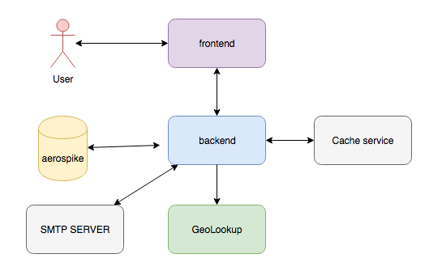
Single Sign On application USE CASE
REST API

Slide 7
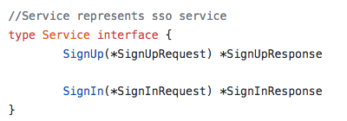
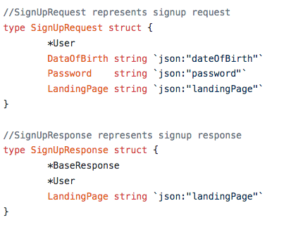
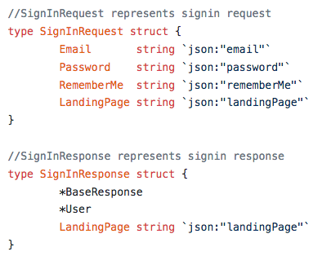
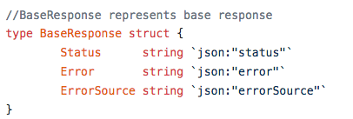
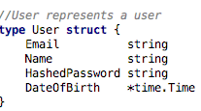
SSO application USE CASE MODEL
https://github.com/viant/endly/tree/master/example/ui/sso

Slide 8
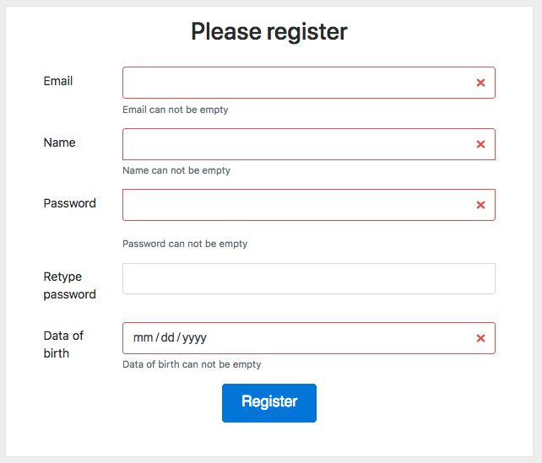
Register user process flow
empty fields use case
invalid email use case
password does not use case
email has been already registered
user IP’s is from whitelisted geo location
register user
sending activation/verification email

Slide 9
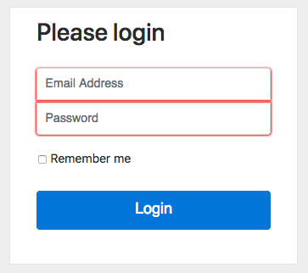
Login process flow
empty credentials use case
login non existing user use case
invalid credentials use case
sign in valid user use case

Slide 10
End to end testing workflows
Application environment
Datastore/database
Caching services
Geo location service
Datastore
Loading schema
Pre-seeding static data
App
Build and deployment
Regression
Initial application state setup
Test plan
Data setup
Test execution
Output verification

Slide 11
What is endly Endly ?
https://github.com/viant/endly/
Engineer centric automation and end to end functional testing open source framework written in go.
Extendable (pluggable services)
Flexible (easy task orchestration)
Language agnostic
Declarative

Slide 12
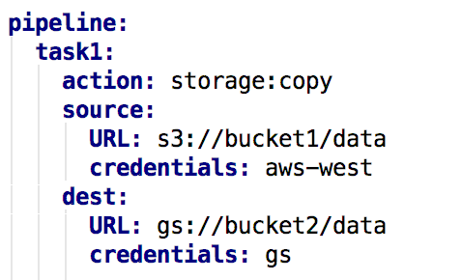
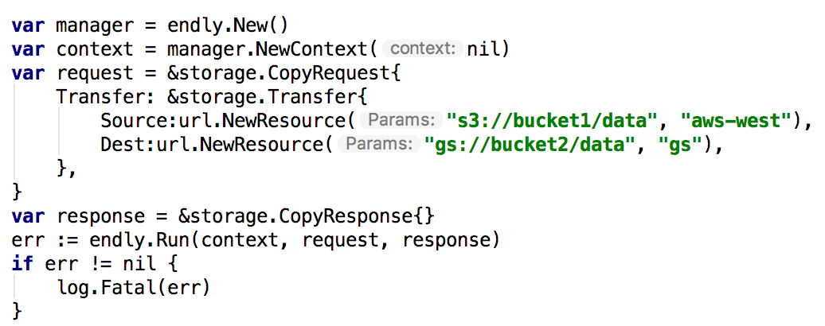
Declarative vs Imperative
Transferring data from AWS go GS task

Slide 13
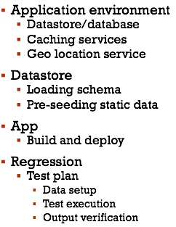
Endly testing workflows
System – application environment setup
Datastore – create & load database schema
App – build and app deployment
Regression – test plan

Slide 14
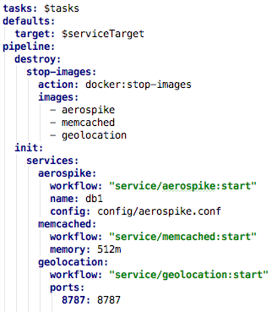
application environment workflow
Datastore/database
Caching services
Geo location service

Slide 15
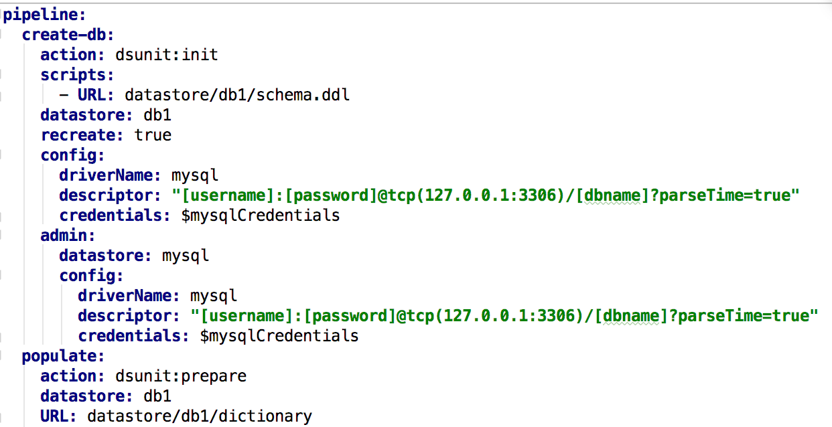
Database setup
Datastore registration with driver
Database Creation
Database schema loading
Uploading static data

Slide 16
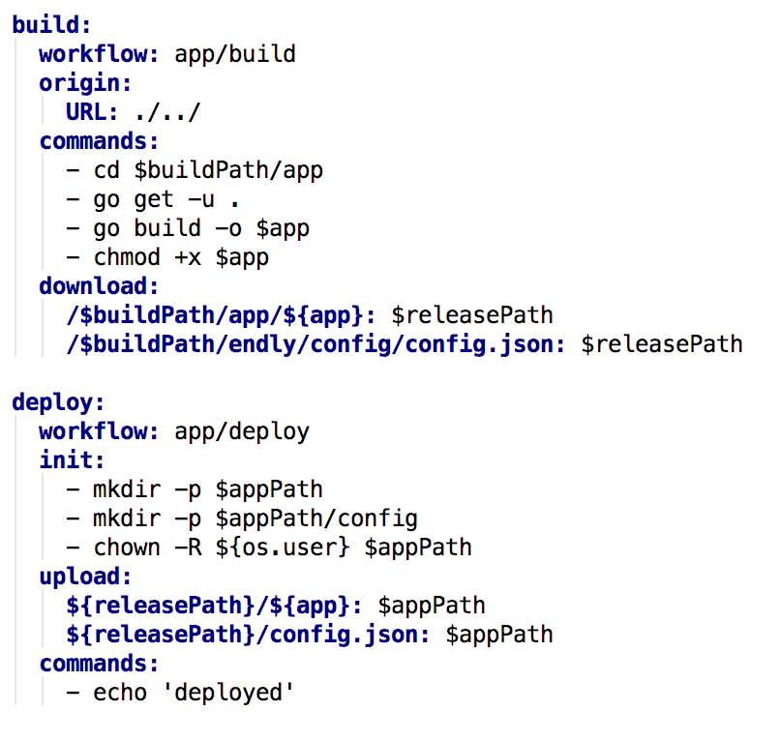
Application build and deployment
Code checkout
Application build
Application deployment

Slide 17
Regression workflow
Setting initial application state
Setting up log listeners
Starting application
Test plan execution
Setting up initial use case state
Selenium/HTTP/Rest runner
Output verification per use case
Post tests execution bulk output verification

Slide 18
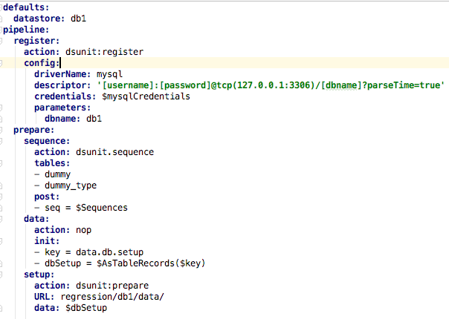
Initial application state
Load static data
Load use case data
Reading sequences
updating use case data with SEQ/UUID
Bulk load or per use case

Slide 19
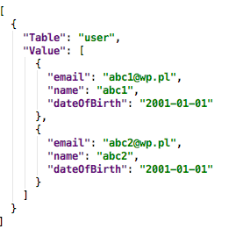
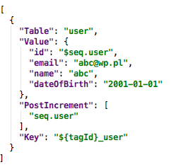
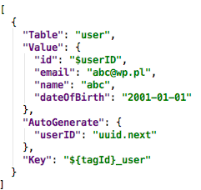
Initial Use case state

Slide 20
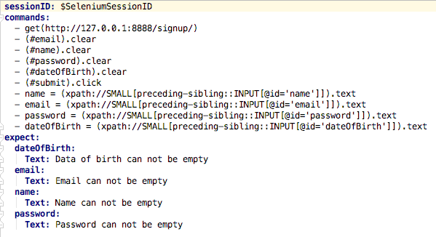
Regression testing - selenium

Slide 21
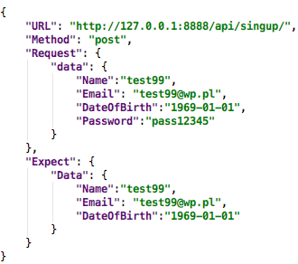
Regression testing – REST runner

Slide 22
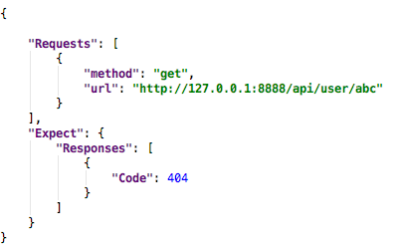
Regression testing – HTTP runner

Slide 23
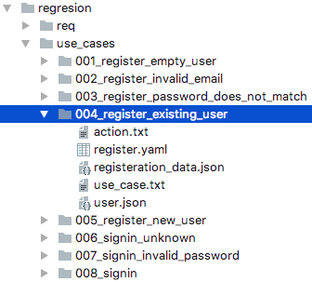
Regression test cohesion

Slide 24
Testing Workflows complexity & automation
System – application environment setup
Datastore – create & load database schema
App – build and deploy an app
Regression – test plan and execution

Slide 25
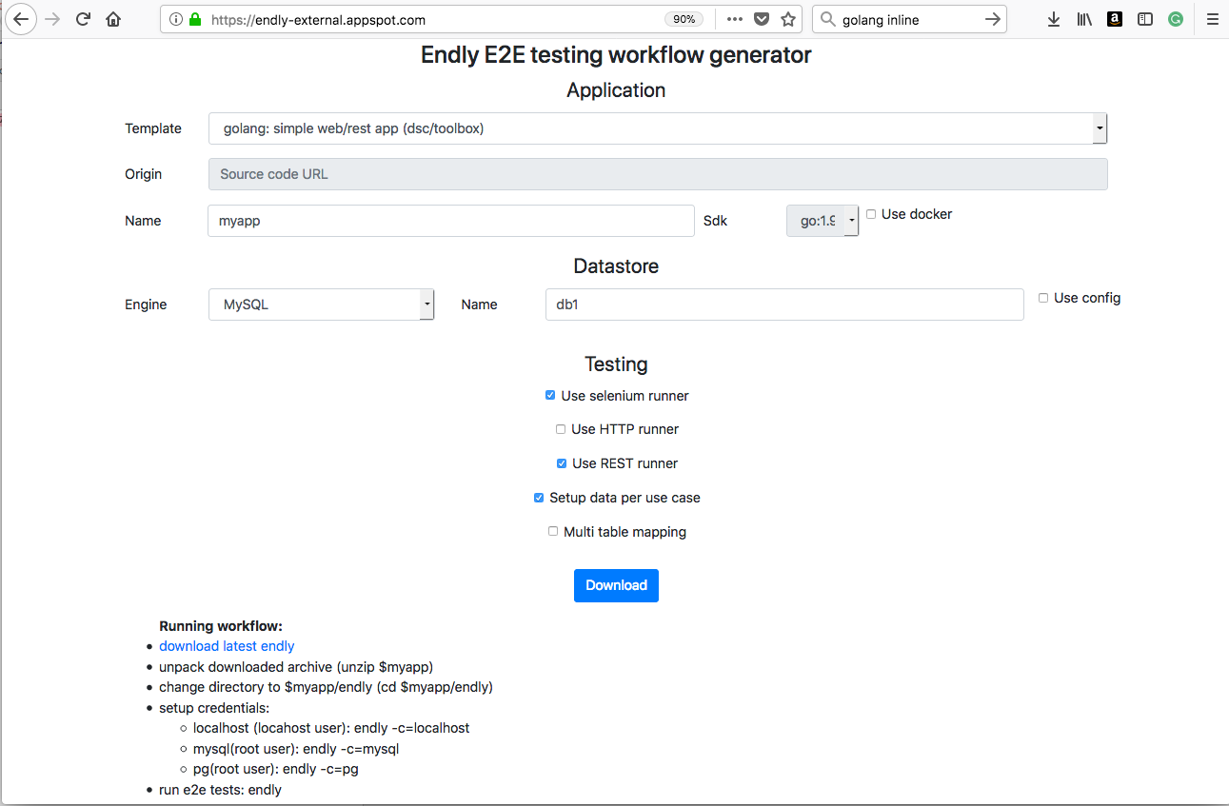
Workflow generator
http://endly-external.appspot.com/

Slide 26
Beyond e2e testing
ability to run complex system on engineer laptop or cloud
focus on deliverable’s input and output
development environment setup automation
staging system setup automation
auto generating use cases for production raised defect
debugging and troubleshooting simplification
simplifies learning complex systems with many dependencies
QA team / testing engineer integration

Slide 27
Q & a

