Slide 1
End to end testing with golang
By Adrian Witas

Slide 2
What is end to end testing
End-to-end testing is a methodology that:
Test the entire application in an environment that exactly imitates production with all network communication, datastores and other dependencies interaction.
Focuses on verifying the end to end testing process flow.
Verify the desired output on the basis of the input provided.

Slide 3
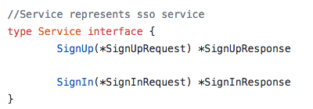
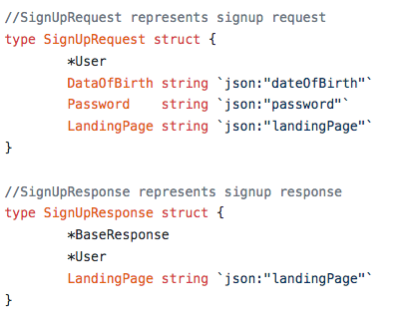
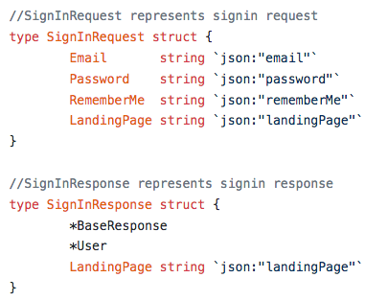
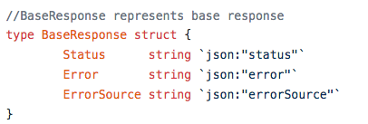
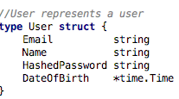
SSO application e2e use case
https://github.com/viant/endly/tree/master/example/ui/sso

Slide 4
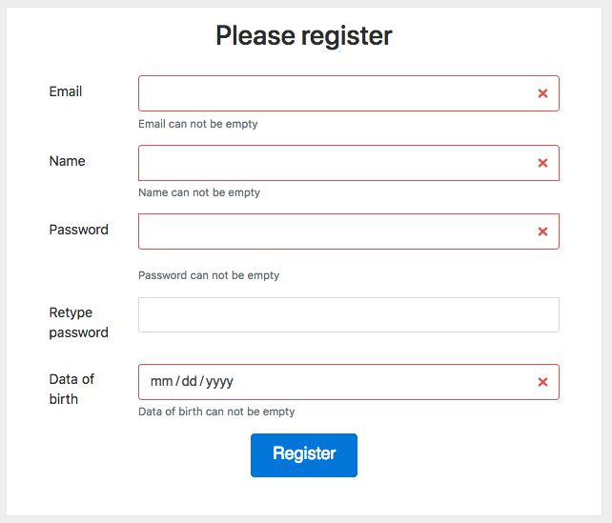
Signup process flow
empty fields use case
invalid email use case
password does not use case
email has been already registered
register user
sending activation/verification email

Slide 5
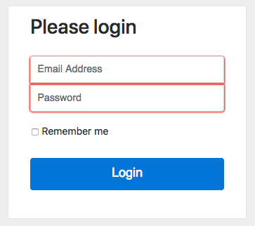
Sign-in process flow
empty credentials use case
login non existing user use case
invalid credentials use case
sing in valid user use case

Slide 6
Endly e2e testing framework
https://github.com/viant/endly/
Endly is engineer centric language agnostic automation and end to end functional testing framework written in go addressing most of the aspects of testing automation.

Slide 7
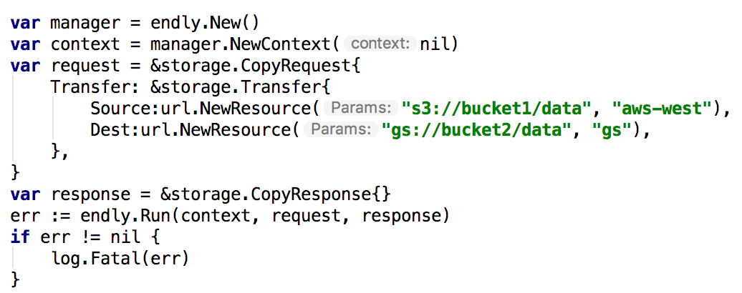
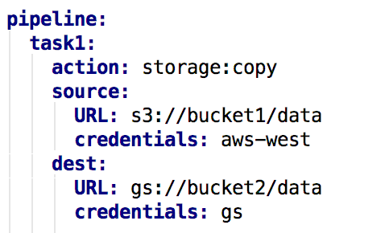
Imperative vs Declarative

Slide 8
End to end testing breakdown
Application environment
Datastore/database
Caching services
Geo location service
Datastore
Loading schema
Pre-seeding static data
Regression
Test plan
Data setup
Test execution
Output verification

Slide 9
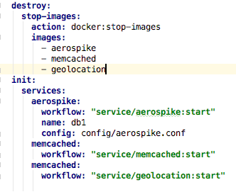
application environment
Datastore/database
Caching services
Geo location service

Slide 10
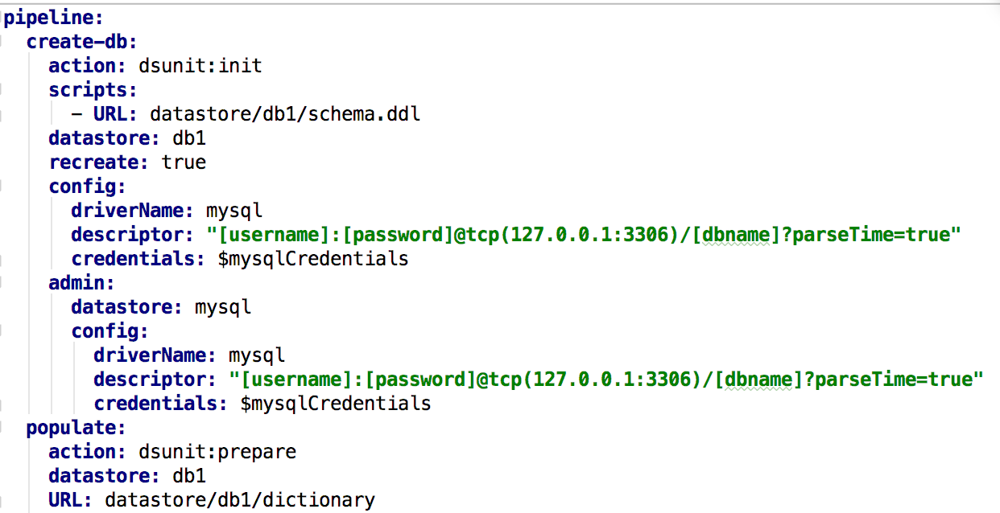
Database setup
Datastore registration with driver
Database Creation
Database schema loading
Uploading static data

Slide 11
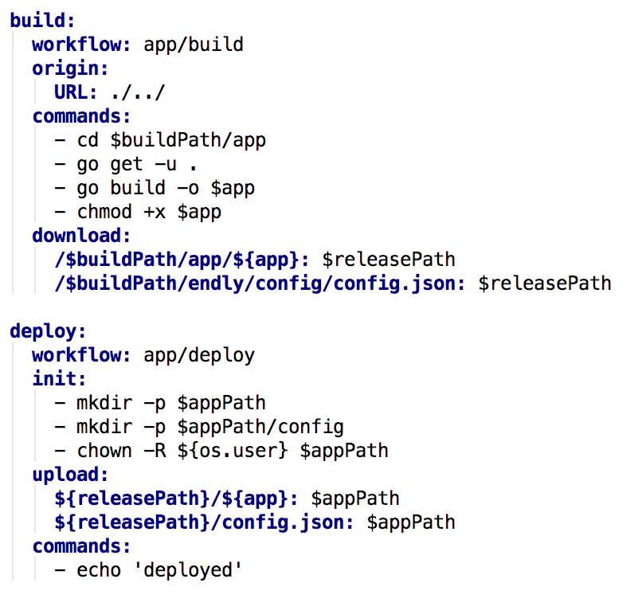
Application build and deployment
Code checkout
Application build
Application deployment

Slide 12
regression

Slide 13
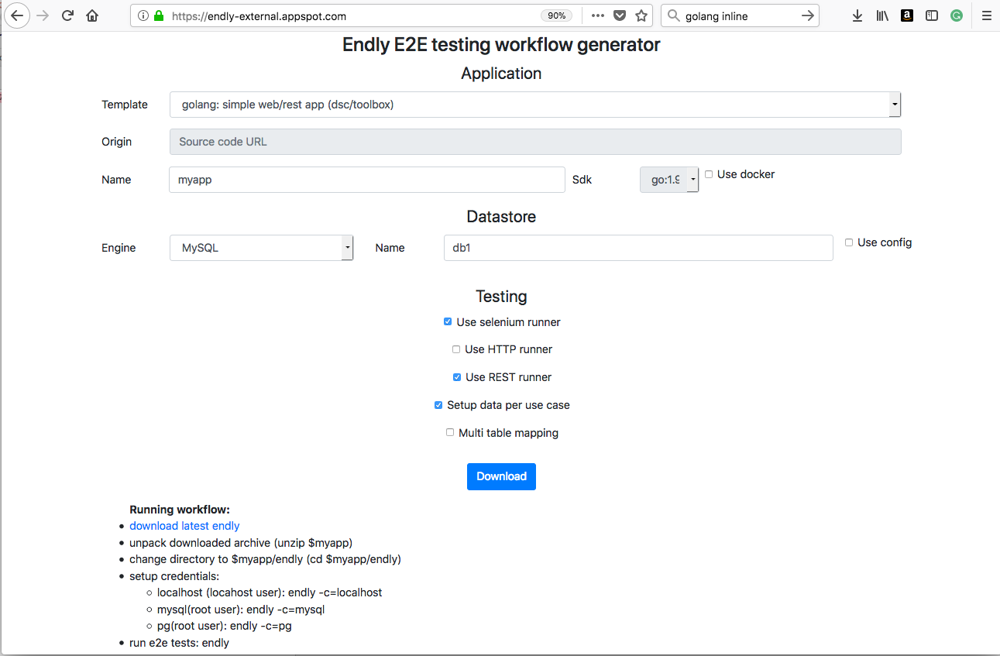
Workflow generator
http://endly-external.appspot.com/

Slide 14
Beyond e2e testing

Slide 15
Q & a

