Slide 1
End to end testing with golang
By Adrian Witas

Slide 2
What is end to end testing
End-to-end testing is a methodology that:
Test the entire application in an environment that exactly imitates production with all network communication, datastore and other dependencies interaction.
Focuses on verifying the end to end testing process flow.
Verify the desired output on the basis of the input provided.

Slide 3
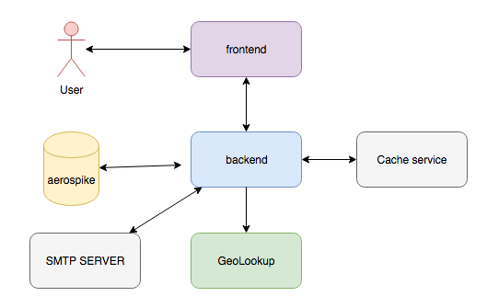
Single Sign On application USE CASE architecture

Slide 4
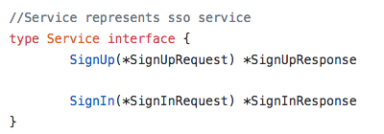
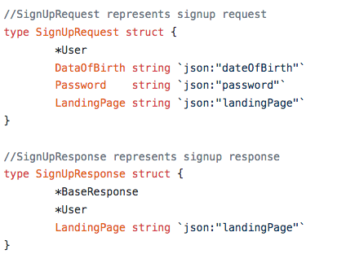
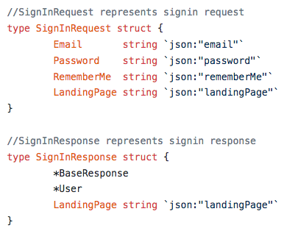
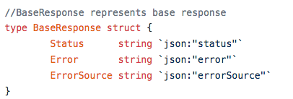
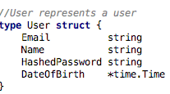
SSO application USE CASE MODEL
https://github.com/viant/endly/tree/master/example/ui/sso

Slide 5
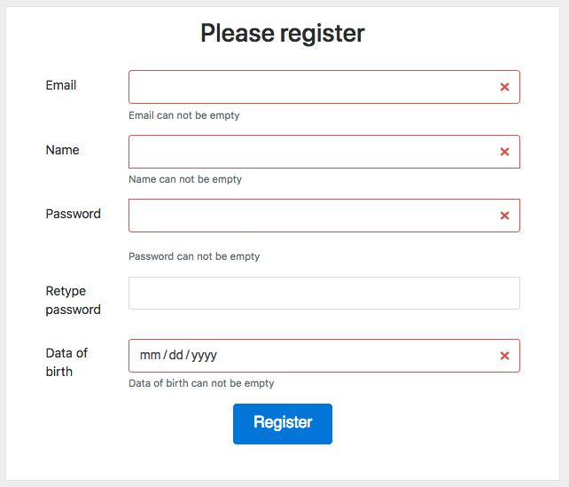
Register user process flow
empty fields use case
invalid email use case
password does not use case
email has been already registered
register user
sending activation/verification email

Slide 6
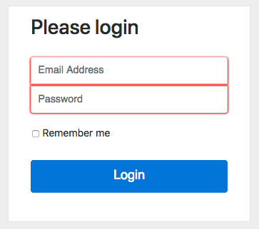
Login process flow
empty credentials use case
login non existing user use case
invalid credentials use case
sign in valid user use case

Slide 7
End to end testing breakdown
Application environment
Datastore/database
Caching services
Geo location service
Datastore
Loading schema
Pre-seeding static data
App
Build and deploy
Regression
Test plan
Data setup
Test execution
Output verification

Slide 8
What is endly Endly ?
https://github.com/viant/endly/
Engineer centric automation and end to end functional testing framework written in go.
Extendable (pluggable services)
Flexible (easy task orchestration)
Language agnostic
Declarative

Slide 9
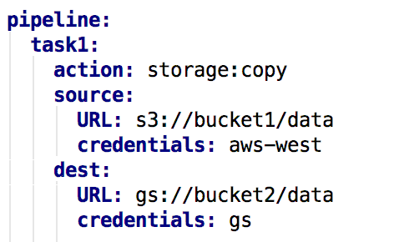
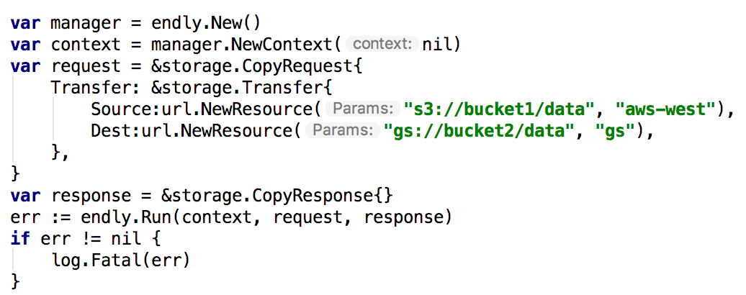
Declarative vs Imperative
Transferring data from AWS go GS task

Slide 10
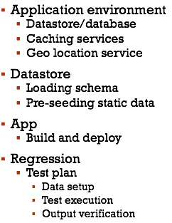
Endly testing workflow
System – application environment setup
Datastore – create & load database schema
App – build and deploy an app
Regression – test plan and execution

Slide 11
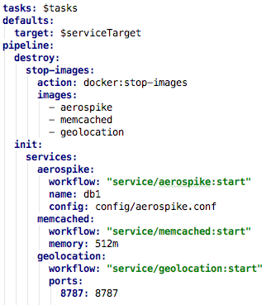
application environment workflow
Datastore/database
Caching services
Geo location service

Slide 12
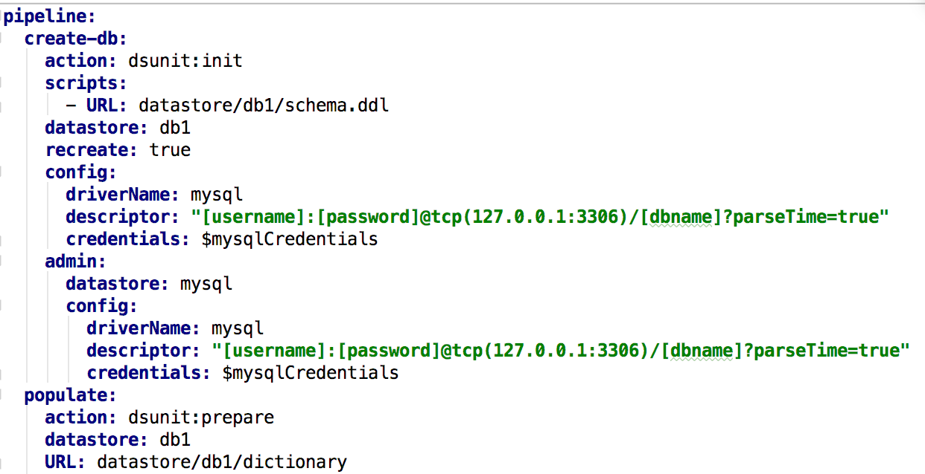
Database setup
Datastore registration with driver
Database Creation
Database schema loading
Uploading static data

Slide 13
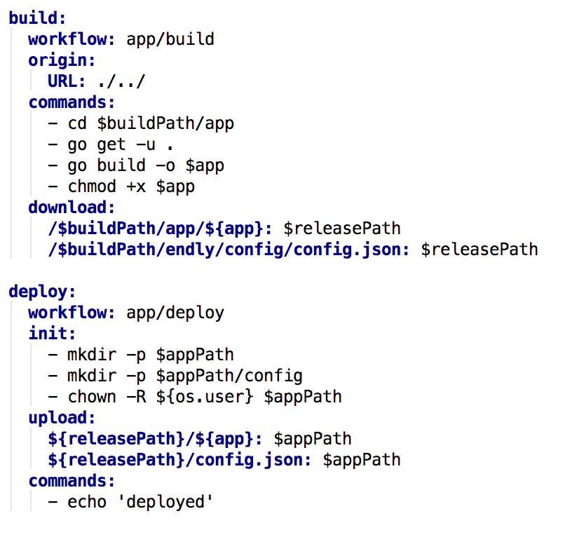
Application build and deployment
Code checkout
Application build
Application deployment

Slide 14
Regression workflow
Setting initial application state
Setting up log listeners
Starting application
Test plan execution
Setting up initial use case state
Selenium/HTTP/Rest runner
Expected output verification per use case
Post tests execution output verification

Slide 15
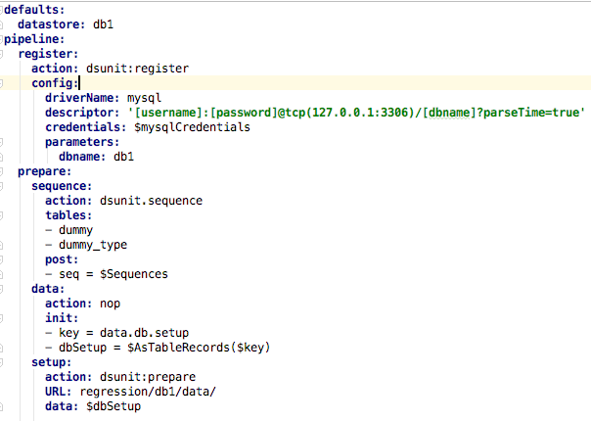
Initial application state
Load static data
Use case data
Reading sequences
updating use case data with SEQ/UUID
load data into database

Slide 16
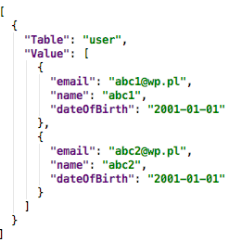
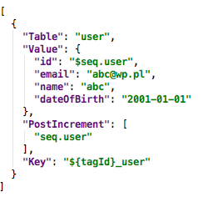
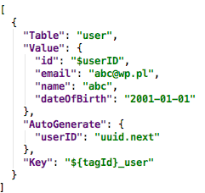
Initial Use case state

Slide 17
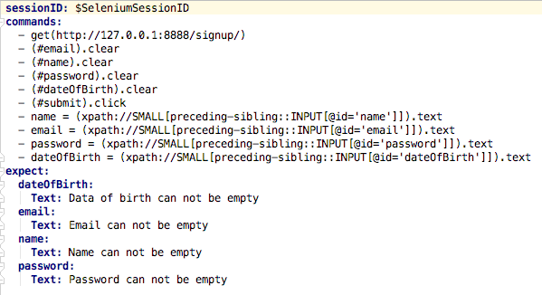
Regression testing - selenium

Slide 18
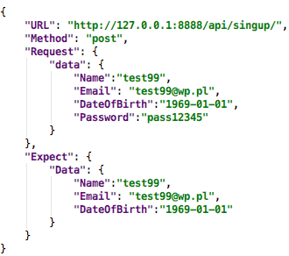
Regression testing – REST runner

Slide 19
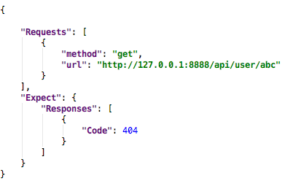
Regression testing – HTTP runner

Slide 20
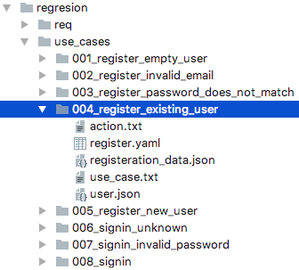
Regression test cohesion

Slide 21
Testing Workflows complexity & automation
System – application environment setup
Datastore – create & load database schema
App – build and deploy an app
Regression – test plan and execution

Slide 22
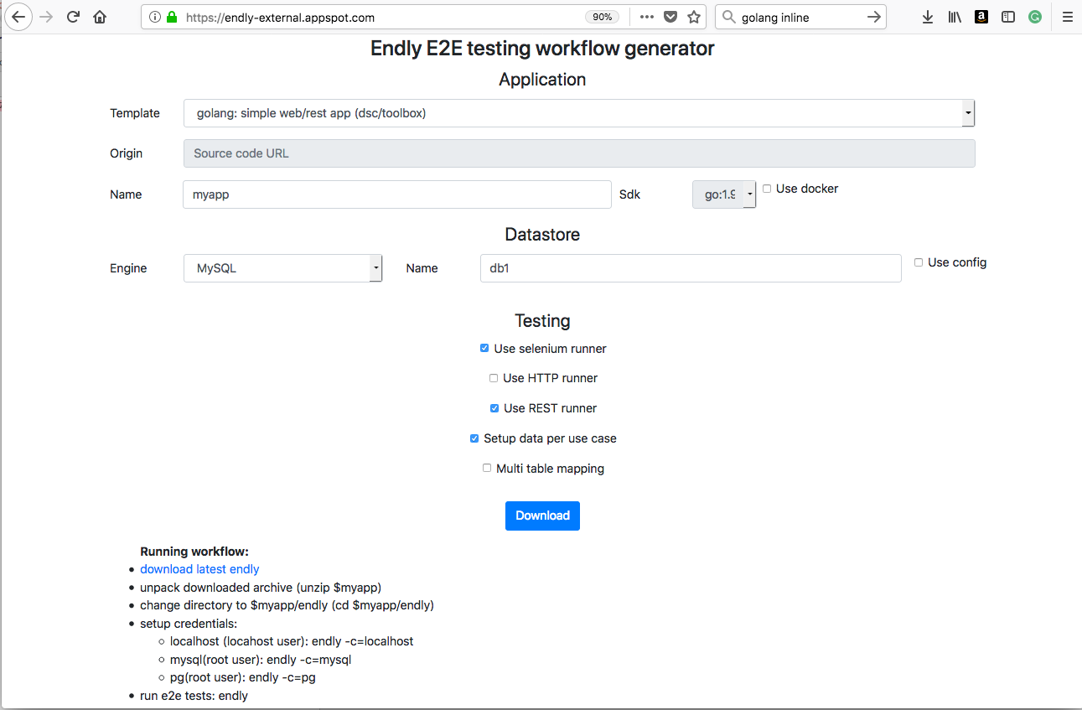
Workflow generator
http://endly-external.appspot.com/

Slide 23
Beyond e2e testing
ability to run complex system on engineer laptop or cloud
focus on deliverable’s input and output
development environment setup automation
staging system setup automation
auto generating use cases for production raised defect
debugging and troubleshooting simplification
simplifies learning complex systems with many dependencies
QA team / testing engineer integration

Slide 24
Q & a

