Slide 1
Golang end to end testing
http://github.com/viant/endly
By Adrian Witas
https://github.com/adrianwit/golang-e2e-testing

Slide 2
Software Quality
ACCEPTANCE TESTING
SYSTEM INTEGRATION
REGRESSION TESTING
SYSTEM TESTING
FUNCTIONAL TESTING
UNIT TESTING
Notes:
Unit Testing
Function Coverage
Statement Coverage
Path Coverage
Functional Testing
Created from requirement use cases, each scenario becoming a functional test
System Testing
Executes end-to-end functional tests that cross software units within one system.
Regression Testing
Ensures code modifications have not inadvertently introduced defects or changed existing functionality into the system
System integration testing
Checks software's interoperability and cooperation with other applications.
Acceptance testing
End user application testing.
End to End testing – simulates real used test, it tests all components and sub-system, even if one component is broken the whole system can fail.

Slide 3
BLACKBOX MODEL
Input
Output
Blackbox

Slide 4
BLACKBOX I/O UI Application
INPUT
User interface and user interaction (click, touch, typing)
Settings and configuration
User, meta and performance data
Output
User interface
Business transaction and application logs
User and meta data
Data reports

Slide 5
BLACKBOX I/O EXTRACT TRANSFORM AND LOAD (ETL)
INPUT
Data in database/datastore
Data/logs in local or remote file system
Transformation rules and configuration
OUTPUT
Transformed data in database
Transformed data in files system
Application logs

Slide 6
BLACKBOX I/O Web App/services
INPUT
HTTP Request (URL, Method, Headers, Payload)
Settings and configuration
User, profile business model and performance data
Output
HTTP Response(Code, Header, Content)
Business transaction and application logs
User, business model data

Slide 7
End to End testing
System preparation
Application Datastore
Application Services
Application preparation
Application Container
Code checkout
Application build
Application deployment
Application Testing
Test plan
Input preparation
Test execution and reporting
Operating System
Output verification
Use case scenarios
Notes:
System preparation
Application Container
Application Datastore
Application Services
Application preparation
Code checkout
Application build
Application deployment
Application Testing
Test plan
Input preparation
Use case scenarios
Output verification
Test execution and reporting

Slide 8
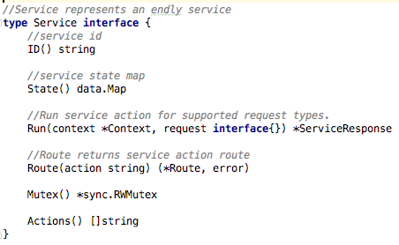
Endly service
System (exec, storage, daemon, process, docker)
Cloud(Ec2, GCE)
Deployment(build, deploy, sdk, VC)
Runner(HTTP, REST, Selenium)
Testing(Validator, DSUNIT, LOG)
workflow and Notify(SMTP)
https://github.com/viant/endly/tree/master/doc/service
Notes:
endly -s

Slide 9

Endly resource targets
Action location
Resource classification
Target
Origin
Build target
App target
Service target
Source and dest
github.com/viant/toolbox/blob/master/url/resource.go
Notes:
github.com/viant/toolbox/blob/master/url/resource.go

Slide 10
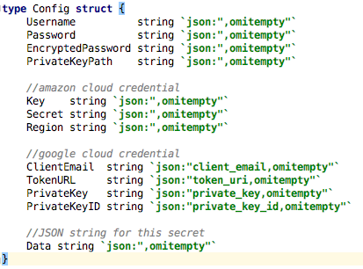

Endly secrets
Encrypts user credentials
GCloud and AWS enabled
Ssh.config enabled
GCR DOCKER enabled
secrets are NEVER revealed
github.com/viant/toolbox/blob/master/cred/config.go
github.com/viant/toolbox/tree/master/secret
github.com/viant/endly/tree/master/doc/secrets
Notes:
github.com/viant/toolbox/blob/master/url/resource.go
github.com/viant/toolbox/blob/master/cred/config.go

Slide 11
Endly secrets setup
SECRET_KEY: ${env.HOME}/.secret/SECRET_KEY.json
https://github.com/adrianwit/golang-e2e-testing
Localhost
Mysql
pG
Notes:
github.com/viant/toolbox/blob/master/url/resource.go
github.com/viant/toolbox/blob/master/cred/config.go

Slide 12
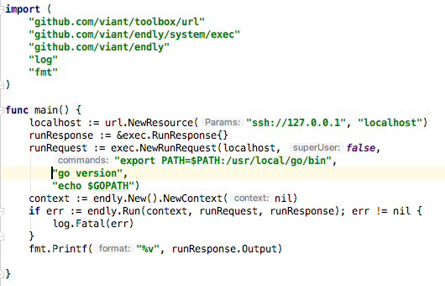
Service action
Notes:
package main import ( "github.com/viant/toolbox/url" "github.com/viant/endly/system/exec" "github.com/viant/endly" "log" "fmt" ) func main() { localhost := url.NewResource("ssh://127.0.0.1", "localhost") runResponse := &exec.RunResponse{} runRequest := exec.NewRunRequest(localhost, false, "export PATH=$PATH:/usr/local/go/bin", "go version", "echo $GOPATH") context := endly.New().NewContext(nil) if err := endly.Run(context, runRequest, runResponse); err != nil { log.Fatal(err) } fmt.Printf("%v", runResponse.Output) }

Slide 13
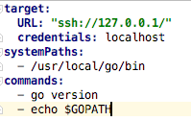
Service request
Service Request/response inspection
Define run request: @run.yaml
Run action workflow
Notes:
@run.yaml
target: URL: "ssh://127.0.0.1/" credentials: localhost systemPaths: - /usr/local/go/bin commands: - go version - echo $GOPATH
endly -w=action service=exec action=run request='@run.yaml’

Slide 14
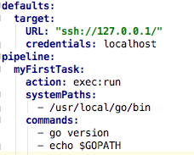
Service request: inline pipeline task
Define run request: @run.yaml
Run workflow pipeline request
https://github.com/viant/endly/tree/master/doc/pipeline
Notes:
@run.yaml
defaults: target: URL: "ssh://127.0.0.1/" credentials: localhost pipeline: myFirstTask: action: exec:run systemPaths: - /usr/local/go/bin commands: - go version - echo $GOPATH
endly -r=run

Slide 15
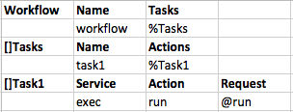
workflow
Define: @workflow.csv, @run.yaml
Run workflow
https://github.com/viant/endly/tree/master/doc/workflow
Notes:
@workflow.csv
Workflow,Name,Tasks, ,workflow,%Tasks, []Tasks,Name,Actions, ,task1,%Task1, []Task1,Service,Action,Request ,exec,run,@run
endly –w=workflow

Slide 16
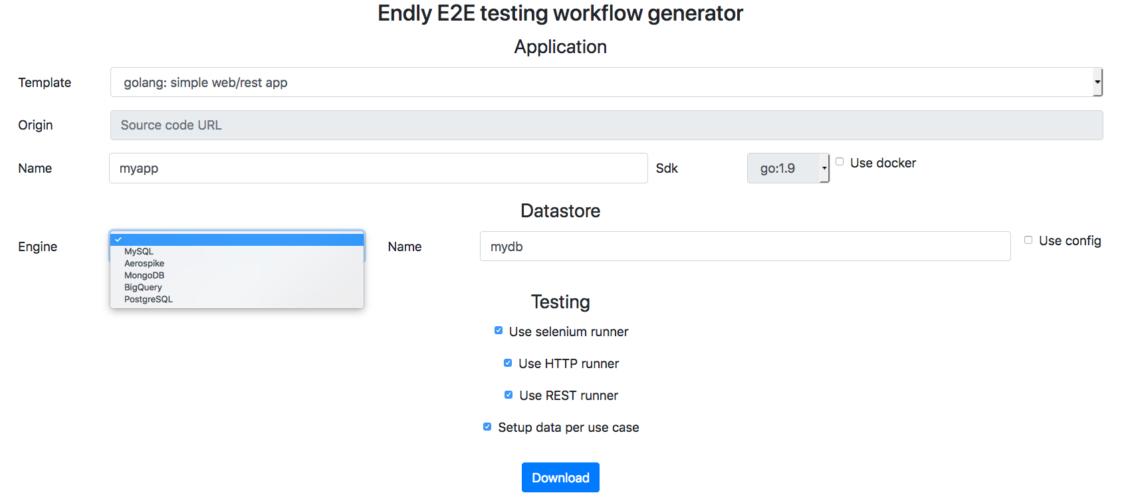
Workflow generator
endly-external.appspot.com

Slide 17
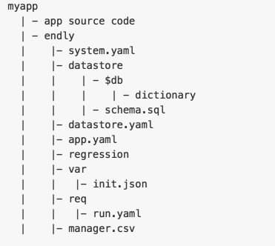
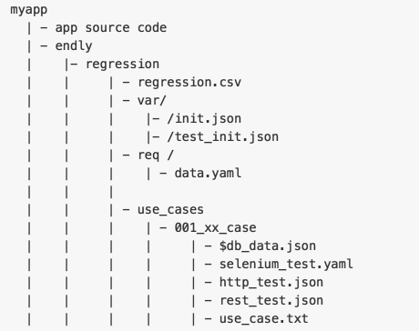
E2e Workflow structure

Slide 18
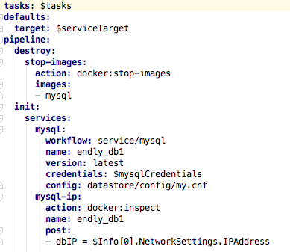
E2e - System
Notes:
tasks: $tasks defaults: target: $serviceTarget pipeline: destroy: stop-images: action: docker:stop-images images: - mysql init: services: mysql: workflow: service/mysql name: endly_db1 version: latest credentials: $mysqlCredentials config: datastore/config/my.cnf mysql-ip: action: docker:inspect name: endly_db1 post: - dbIP = $Info[0].NetworkSettings.IPAddress

Slide 19
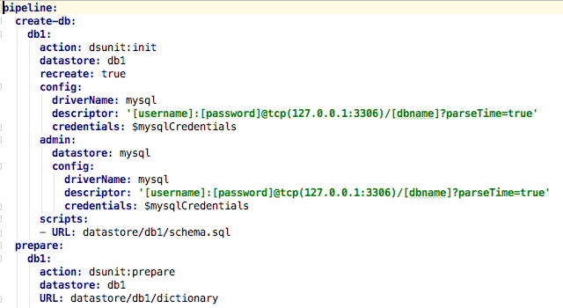
E2e - Datastore
Notes:
pipeline: create-db: db1: action: dsunit:init datastore: db1 recreate: true config: driverName: mysql descriptor: '[username]:[password]@tcp(127.0.0.1:3306)/[dbname]?parseTime=true' credentials: $mysqlCredentials admin: datastore: mysql config: driverName: mysql descriptor: '[username]:[password]@tcp(127.0.0.1:3306)/[dbname]?parseTime=true' credentials: $mysqlCredentials scripts: - URL: datastore/db1/schema.sql prepare: db1: action: dsunit:prepare datastore: db1 URL: datastore/db1/dictionary

Slide 20
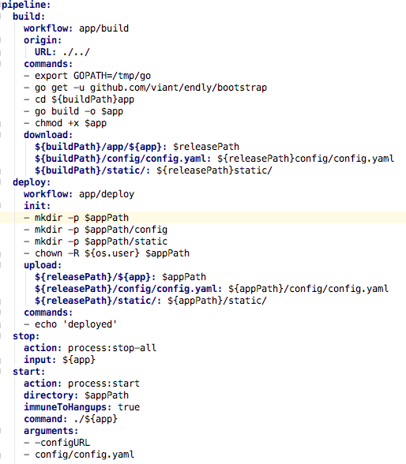
E2e – build & deployment
Code checkout to build location
SDK AND Environment setup
Dependency resolving
Application build
APP assets download to release location
App deployment to app location
App stop & start
https://github.com/viant/endly/tree/master/shared/workflow/app
Notes:
tasks: $tasks defaults: app: $app sdk: $sdk target: $target buildTarget: $buildTarget appTarget: $appTarget pipeline: build: workflow: app/build origin: URL: ./../ commands: - export GOPATH=/tmp/go - go get -u github.com/viant/endly/bootstrap - cd ${buildPath}app - go build -o $app - chmod +x $app download: ${buildPath}/app/${app}: $releasePath ${buildPath}/config/config.yaml: ${releasePath}config/config.yaml ${buildPath}/static/: ${releasePath}static/ deploy: workflow: app/deploy init: - mkdir -p $appPath - mkdir -p $appPath/config - mkdir -p $appPath/static - chown -R ${os.user} $appPath upload: ${releasePath}/${app}: $appPath ${releasePath}/config/config.yaml: ${appPath}/config/config.yaml ${releasePath}/static/: ${appPath}/static/ commands: - echo 'deployed' stop: action: process:stop-all input: ${app} start: action: process:start directory: $appPath immuneToHangups: true command: ./${app} arguments: - -configURL - config/config.yaml

Slide 21
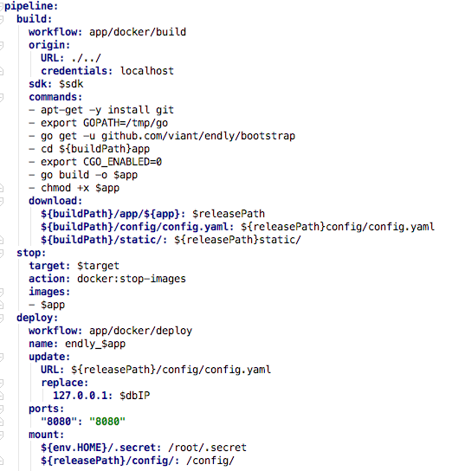
E2e – build & deployment - docker
Code checkout to docker build container
Environment setup and Dependency resolving
Application build
APP assets download to release location
Build app docker image ( config/dockerfile )
Publish APP image to docker registry (optionally)
Stop and start App docker image
https://github.com/viant/endly/tree/master/shared/workflow/app
Notes:
tasks: $tasks defaults: app: $app version: $appVersion useRegistry: false pipeline: build: workflow: app/docker/build origin: URL: ./../ credentials: localhost sdk: $sdk commands: - apt-get -y install git - export GOPATH=/tmp/go - go get -u github.com/viant/endly/bootstrap - cd ${buildPath}app - export CGO_ENABLED=0 - go build -o $app - chmod +x $app download: ${buildPath}/app/${app}: $releasePath ${buildPath}/config/config.yaml: ${releasePath}config/config.yaml ${buildPath}/static/: ${releasePath}static/ stop: target: $target action: docker:stop-images images: - $app deploy: workflow: app/docker/deploy name: endly_$app update: URL: ${releasePath}/config/config.yaml replace: 127.0.0.1: $dbIP ports: "8080": "8080" mount: ${env.HOME}/.secret: /root/.secret ${releasePath}/config/: /config/

Slide 22
E2e - Regression
Data setup
Test plan with use case
Data setup
Test runner
Output verification
Data verification
Logging verification

Slide 23
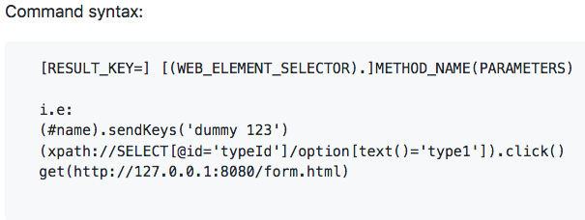
Adding use cases – seleniuM
https://github.com/viant/endly/tree/master/runner/selenium

Slide 24

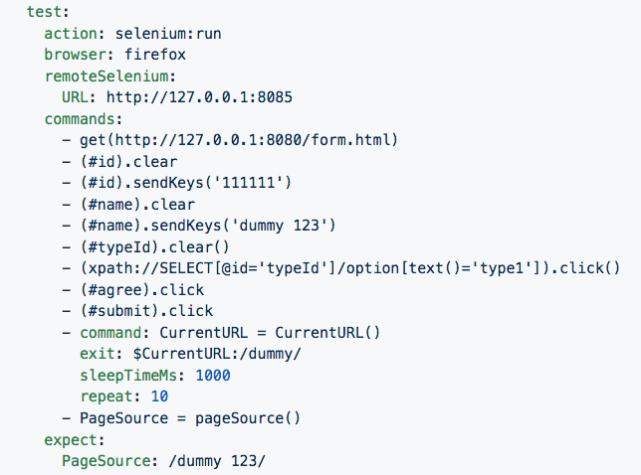
Adding use cases – selenium cont …
https://github.com/viant/endly/tree/master/runner/selenium
Notes:
@run.yaml
defaults: target: URL: ssh://127.0.0.1/ credentials: localhost pipeline: init: action: selenium:start version: 3.4.0 port: 8085 sdk: jdk sdkVersion: 1.8 test: action: selenium:run browser: firefox remoteSelenium: URL: http://127.0.0.1:8085 commands: - get(http://127.0.0.1:8080/form.html) - (#id).clear - (#id).sendKeys('111111') - (#name).clear - (#name).sendKeys('dummy 123') - (#typeId).clear() - (xpath://SELECT[@id='typeId']/option[text()='type1']).click() - (#agree).click - (#submit).click - command: CurrentURL = CurrentURL() exit: $CurrentURL:/dummy/ sleepTimeMs: 1000 repeat: 10 - PageSource = pageSource() expect: PageSource: /dummy 123/

Slide 25
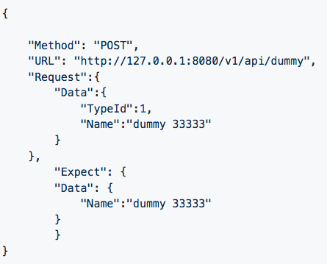
Adding use cases - REST
https://github.com/viant/endly/tree/master/runner/rest
Notes:
{ "Method": "POST", "URL": "http://127.0.0.1:8080/v1/api/dummy", "Request":{ "Data":{ "TypeId":1, "Name":"dummy 33333" } }, "Expect": { "Data": { "Name":"dummy 33333" } } }

Slide 26
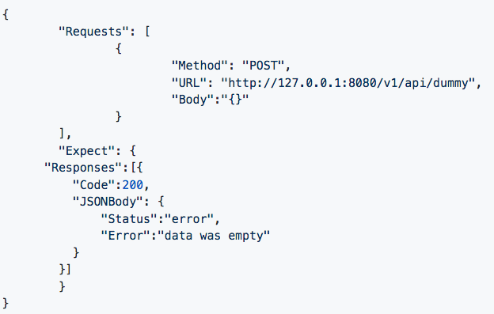
Adding use cases - HTTP
https://github.com/viant/endly/tree/master/runner/http
Notes:
{ "Requests": [ { "Method": "POST", "URL": "http://127.0.0.1:8080/v1/api/dummy", "Body":"{}" } ], "Expect": { "Responses":[{ "Code":200, "JSONBody": { "Status":"error", "Error":"data was empty" } }] } }

Slide 27
Global workflow
Services (datastore/caching services)
App (buiLd/deployment)
Cloud (ec2, gce)
Testing (assert)
https://github.com/viant/endly/tree/master/shared

Slide 28
debugging & Troubleshooting
Enable debugging: endly –d=true
Stack overflow: flag question with endly tag
Raise issue: github.com/viant/endly/issues

Slide 29
Q & A

