Slide 1
Try our 2.0 Developer Preview!
https://www.couchbase.com/downloads
Repos to Note!!
https://github.com/couchbaselabs/react-native-couchbase-lite
^^React Native Bindings^^
https://github.com/couchbaselabs/mobile-training-todo
^^Example Application^^

Slide 2
Building a Cross-Platform App with React Native, Swagger, and Couchbase Mobile
Hod Greeley, Ph.D. | Developer Advocate, Couchbase
@HodGreeley
Notes:
Who has tried out React Native?

Slide 3



Agenda
Overviews
React Native “Hello World”
To do walk through
Notes:
Overivew 3 main technologies

Slide 4
What is React Native

Slide 5


Notes:
True native app.

Slide 6

Notes:
Facebook infamously tried web app, wanted to go to native. Introduced React Native ~2 years ago. Follows paradigms of React.

Slide 7

Notes:
“React introduces a novel, radical and highly functional approach to constructing user interfaces. In brief, the application UI is simply expressed as a function of the current application state.” – RW Tutorial

Slide 8

Notes:
Composable UI, UI only

Slide 9
UI = f(state)
Notes:
“React introduces a novel, radical and highly functional approach to constructing user interfaces. In brief, the application UI is simply expressed as a function of the current application state.” – RW Tutorial

Slide 10
Declarative UI
JSX
Unidirectional data flow
Notes:
Declarative
React makes it painless to create interactive UIs. Design simple views for each state in your application, and React will efficiently update and render just the right components when your data changes.
Declarative views make your code more predictable and easier to debug.
Component-Based
Build encapsulated components that manage their own state, then compose them to make complex UIs.
Since component logic is written in JavaScript instead of templates, you can easily pass rich data through your app and keep state out of the DOM.
Learn Once, Write Anywhere
We don't make assumptions about the rest of your technology stack, so you can develop new features in React without rewriting existing code.
React can also render on the server using Node and power mobile apps using React Native.
When a user interacts with a React view, the view propagates an action through a central dispatcher, to the various stores that hold the application's data and business logic, which updates all of the views that are affected. This works especially well with React's declarative programming style, which allows the store to send updates without specifying how to transition views between states

Slide 11
Bridging
ES6 (Babel)
Styling (~CSS)
Notes:
Declarative
React makes it painless to create interactive UIs. Design simple views for each state in your application, and React will efficiently update and render just the right components when your data changes.
Declarative views make your code more predictable and easier to debug.
Component-Based
Build encapsulated components that manage their own state, then compose them to make complex UIs.
Since component logic is written in JavaScript instead of templates, you can easily pass rich data through your app and keep state out of the DOM.
Learn Once, Write Anywhere
We don't make assumptions about the rest of your technology stack, so you can develop new features in React without rewriting existing code.
React can also render on the server using Node and power mobile apps using React Native.
When a user interacts with a React view, the view propagates an action through a central dispatcher, to the various stores that hold the application's data and business logic, which updates all of the views that are affected. This works especially well with React's declarative programming style, which allows the store to send updates without specifying how to transition views between states

Slide 12
What is Couchbase Mobile

Slide 13
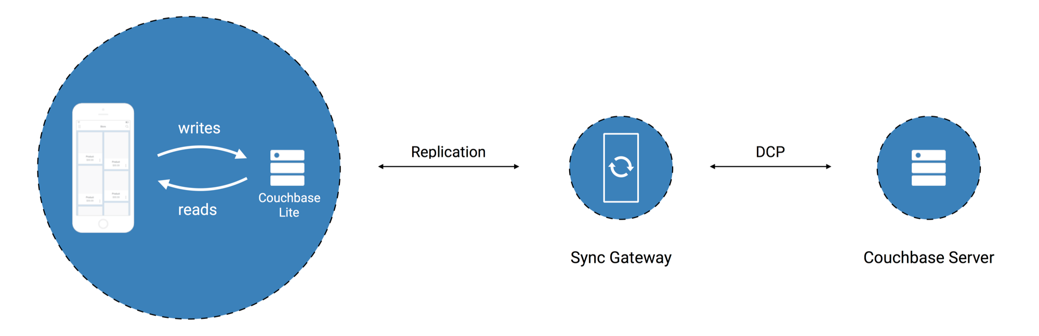
Couchbase Server
Database Server
Sync Gateway
Synchronization
Couchbase Lite
Embedded Database

Slide 14
What is Swagger

Slide 15
Swagger Editor Demo

Slide 16
React Native Hello World

Slide 17
Create New Project
$ react-native init HelloWorld
This will walk you through creating a new React Native project in /Users/hod/work/projects/RN/HelloWorld
Installing react-native...
Consider installing yarn to make this faster: https://yarnpkg.com
npm WARN deprecated node-uuid@1.4.7: use uuid module instead
HelloWorld@0.0.1 /Users/hod/work/projects/RN/HelloWorld
├── UNMET PEER DEPENDENCY react@~15.4.1
└─┬ react-native@0.42.0
├── absolute-path@0.0.0
├── art@0.10.1
├── async@2.1.5
├─┬ babel-core@6.24.0
…
│ └── string-length@1.0.1
└── react-test-renderer@15.4.2

Slide 18
Run Instructions
To run your app on iOS:
cd /Users/hod/work/projects/RN/HelloWorld
react-native run-ios
- or -
Open ios/HelloWorld.xcodeproj in Xcode
Hit the Run button
To run your app on Android:
cd /Users/hod/work/projects/RN/HelloWorld
Have an Android emulator running (quickest way to get started), or a device connected
react-native run-android

Slide 19
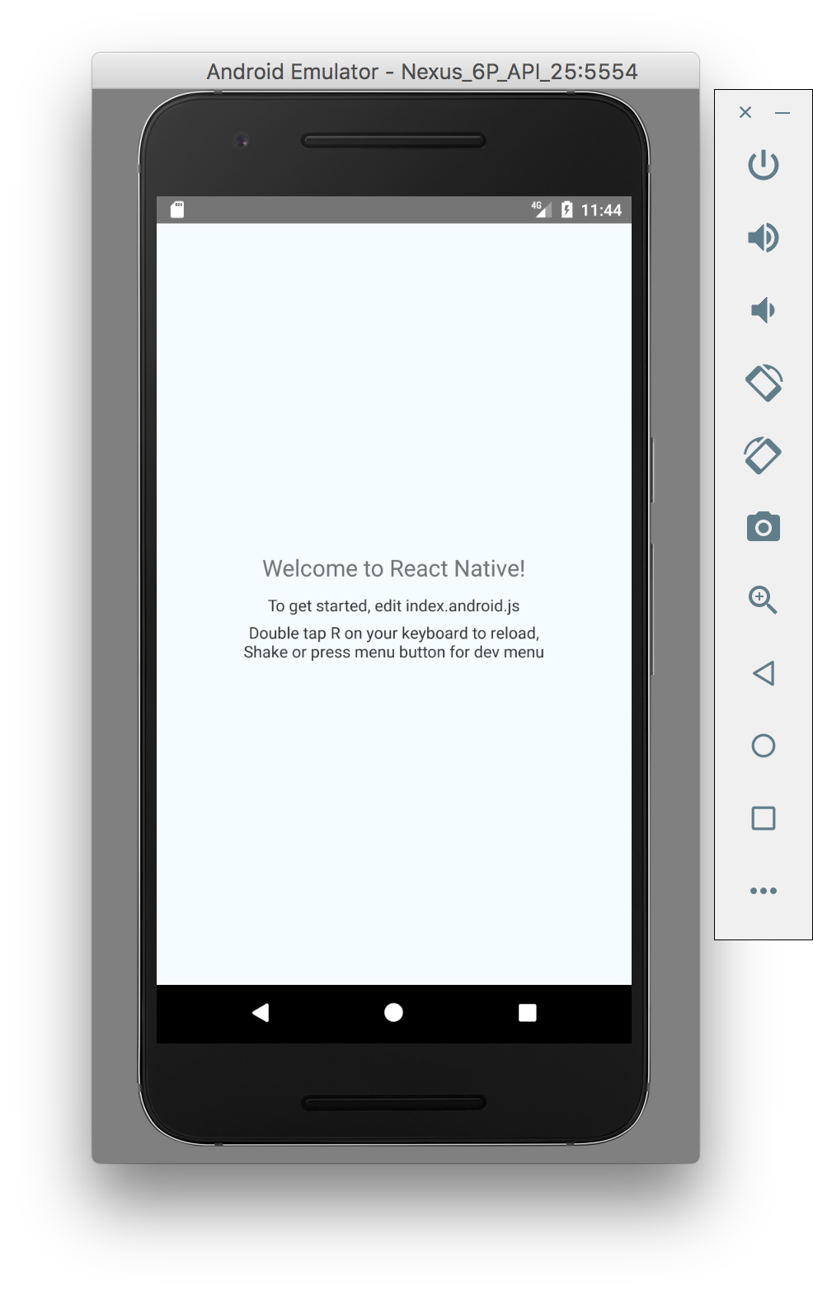
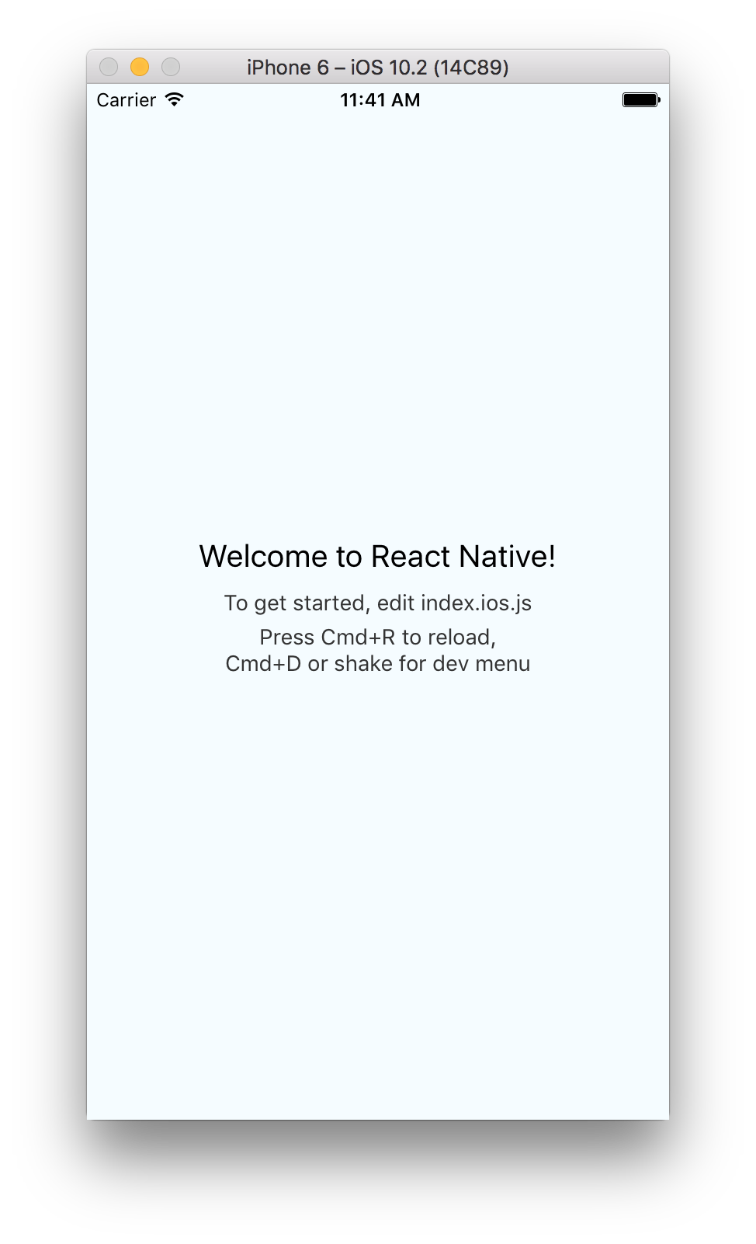

Slide 20
Hello World Code

Slide 21
Putting it together: To do List

Slide 22
To do List Code
Project Structure

Slide 24
To do List Code
UI Wiring

Slide 25
index.android.js
import {
AppRegistry,
} from 'react-native';
import Root from './app';
AppRegistry.registerComponent(
'ReactNativeCouchbaseLiteExample’,
() => Root
);

Slide 26
MainActivity.java
public class MainActivity extends ReactActivity {
@Override
protected String getMainComponentName() {
return "ReactNativeCouchbaseLiteExample";
}
}

Slide 27
app.js
export default class Root extends Component {
… componentDidMount() {
Couchbase.initRESTClient(manager => {
DataManager.init(manager);
this.setState({manager: manager});
});
}
…
render() { …

Slide 28
app.js (pt. 2)
class App extends Component {
… render() {
return (
<Router>
<Scene
key="lists"
component={Lists}
title="Lists" />

Slide 29
app.js (pt. 2)
class App extends Component {
… render() {
return (
<Router>
<Scene
key="lists"
component={Lists}
title="Lists" />

Slide 30
Lists/index.js
export default class Lists extends Component {
…
render() {
return (
<View style={styles.container}>
<CommonList
title="List"
dataSource={this.state.dataSource}
onCreate={(name) => this.createList(name)}
…

Slide 31
Lists/index.js
export default class Lists extends Component {
…
render() {
return (
<View style={styles.container}>
<CommonList
title="List"
dataSource={this.state.dataSource}
onCreate={(name) => this.createList(name)}
…

Slide 32
Lists/index.js
export default class Lists extends Component {
…
render() {
return (
<View style={styles.container}>
<CommonList
title="List"
dataSource={this.state.dataSource}
onCreate={(name) => this.createList(name)}
…

Slide 33
CommonList.js
export default class CommonList extends Component {
…
render() {
return (
<View style={styles.container}>
<ListView
dataSource={this.props.dataSource}
…
<AddButton onCreate={(text) =>
this.props.onCreate(text)}/>
…

Slide 34
CommonList.js
export default class CommonList extends Component {
…
render() {
return (
<View style={styles.container}>
<ListView
dataSource={this.props.dataSource}
…
<AddButton onCreate={(text) =>
this.props.onCreate(text)}/>
…

Slide 35
CommonList.js
export default class CommonList extends Component {
…
render() {
return (
<View style={styles.container}>
<ListView
dataSource={this.props.dataSource}
…
<AddButton onCreate={(text) =>
this.props.onCreate(text)}/>
…

Slide 36
To do List Code
Database

Slide 37
Lists/index.js
export default class Lists extends Component {
…
createList(text) {
var doc = {
name: text,
…
};
manager.document.post({db: DB_NAME, body: doc});
}
…

Slide 38
Lists/index.js
export default class Lists extends Component {
…
createList(text) {
var doc = {
name: text,
…
};
manager.document.post({db: DB_NAME, body: doc});
}
…

Slide 39
Lists/index.js
export default class Lists extends Component {
…
createList(text) {
var doc = {
name: text,
…
};
manager.document.post({db: DB_NAME, body: doc});
}
…

Slide 40
Lists/index.js
export default class Lists extends Component {
…
createList(text) {
var doc = {
name: text,
…
};
manager.document.post({db: DB_NAME, body: doc});
}
…

Slide 41
MainApplication.java
public class MainApplication extends Application
implements ReactApplication {
… @Override
protected List<ReactPackage> getPackages() {
return Arrays.<ReactPackage>asList(
…
new ReactCBLiteManager(),
…
);

Slide 42
Thank You Droidcon Boston! Follow me @HodGreeley Try Couchbase Lite 2.0 Developer Preview Repos to Note!! https://github.com/couchbaselabs/react-native-couchbase-lite ^^React Native Bindings^^ https://github.com/couchbaselabs/mobile-training-todo ^^Example Application^^

