Slide 1
The Effect of Mindfulness Meditation on Life Satisfaction and Self-Esteem
Liam Hart
Department of Psychology
Grand Valley State University
February 28, 2020
The 15th Annual Art an Science of Aging Conference

Slide 2
Overview of Mindfulness Meditation
Mindfulness is a way of thinking
Mindfulness meditation is the practice of cultivating mindfulness
Mindfulness-based programs:
Mindfulness-based stress reduction (MBSR)
Mindfulness-based cognitive therapy (MBCT)

Slide 3
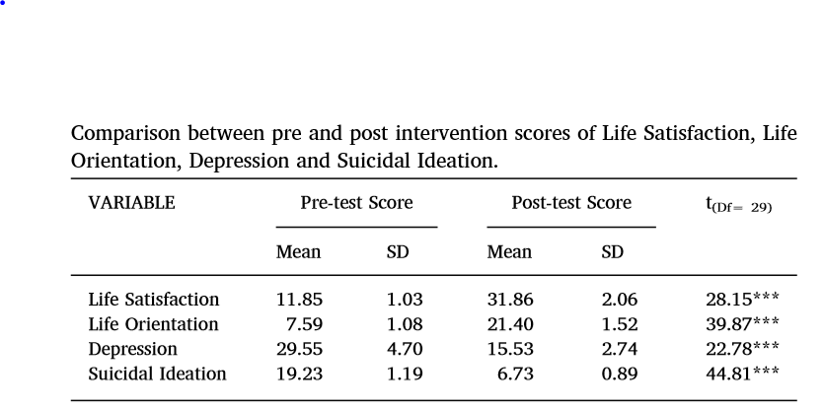
Mindfulness meditation and life satisfaction and self-esteem
Associated with higher self-esteem, life satisfaction, optimism, and self-actualization (Brown & Ryan 2003)
Measured mindfulness linked to increased sense of well-being (Branstrom et al. 2011)
MBCT increased life satisfaction in adolescents with suicidal ideation
Raj et al. 2019

Slide 4
Effects of mindfulness meditation on aging populations
MBCT-
Improved anxiety symptoms in retirement home residents (Helmes & Ward 2017)
Moderately effective in reducing depression (Kishita et al. 2017)
MBSR-
Reduced worry, anxiety, stress, and lower back pain (Kishita et al. 2017)
Reduced loneliness in older adults (Creswell et al. 2012)

Slide 5
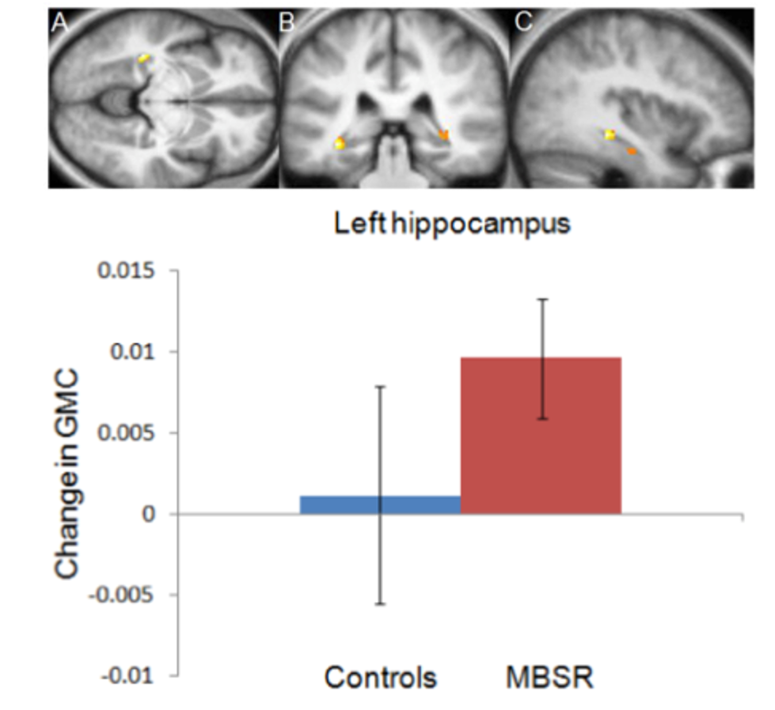
Emotion regulation
Positive emotions increased with minutes of meditation per day (Fredrickson et al. 2018)
MBSR showed an increase in hippocampal volume (Hozel et al. 2011)
Hippocampus – part of brain that regulates emotions

Slide 6
Proposed Pilot Study
Examining the effect of mindfulness meditation on life satisfaction and self-esteem in retirement home residents
Pre- and post-test experimental design
8-week intervention with 3 weekly meditation sessions
10-minute guided meditations
Waitlist control group

Slide 7
Implications of Pilot Study
Adds to growing research on mindfulness and meditation
Less intensive intervention than MBSR and MBCT
Reveals cause + effect relationship between mindfulness meditation and life satisfaction and self-esteem
Potential to be implemented into retirement homes

Slide 8
Thank you!
"Do not dwell in the past, do not dream of the future, concentrate the mind on the present moment.“
-Buddha

