Slide 1
Information about Past Beliefs Influences Current Beliefs
Liam Hart and Greg Russell
Mentors: Michael Wolfe and Todd Williams
Psychology Department
Grand Valley State University
Notes:
If we manipulate what people remember believing on a controversial topic in the past, will this influence what they believe now?
Open with universal healthcare example

Slide 2
Memory is Constructed from Current Context
People may not have direct access to memory representations
(Dunlosky & Thiede, 2013)
Researched in many domains using various methods
- Attitude about bussing to achieve integration (Goethals & Reckman, 1973)
- Political attitudes (Markus, 1986)
- Student anxiety surrounding exams (Safer, et al., 2002)
- Beliefs about spanking effectiveness (Wolfe & Williams, 2018)
Notes:
Memory is a reconstructive process, which is prone to errors and biases
The process of remembering and what you remember is influenced by the context in which you retrieve that memory – context can be a document containing relevant information or one’s own current thoughts and feelings about the subject.
So, let’s say you changed your attitude about universal health care over the past year. Would you be able to accurately remember what your previous attitude on universal healthcare were?
According to research, NO, not accurately – your recollection of previous attitude would be biased towards your current attitude towards universal healthcare
The finding that memory is reconstructed from the current context has been demonstrated in many studies in different domains using various methods. Recollection of past aspects of our self is biased according to the current moment.
Who we remember ourselves being in the past (what one believed) is biased according to who we are in the moment (what one currently believes).
What we believe now influences what we remember ourselves believing in the past
Additionally, because memory is a constructive process, people may not have direct access to memory representations. The level of accuracy of one’s memory is not available.

Slide 3
Contextual Influences on Attitudes
Attitudes are dependent on context (Schwarz, 2007)
- not stable, trait-like attributes
- influenced by salient information
- Implicit Association Test results influenced by social/environmental context (Payne et al., 2017)
Beliefs may function in a similar way
- reminders of past beliefs following belief change influenced current beliefs (Wolfe et al., 2014)
Notes:
Research has also shown that our attitudes are constructed using salient information available in the moment
Attitudes and beliefs are similar and may function in a similar way, but they are distinct from one another.
Attitude: how you feel about something
Belief: what you believe to be true about the world
There is much more research on attitudes than beliefs
Research on attitudes suggest that attitudes are dependent on context.
Instead of being a stable, trait-like attributes, they are constructed in the moment using salient information
Related research and commentary on the implicit association test suggests that the results may be influenced by the social and environmental context
We think that beliefs may function in a similar way; that is, beliefs are constructed using context/salient information in the current moment
Professor Wolfe’s previous research found that giving people who changed their beliefs on spanking effectiveness a reminder of their past beliefs influenced their current beliefs
Attitudes not reality, more based on emotion, beliefs are more based on what we think to be true in the world

Slide 4
Current Research
Investigate the influence that salient information has on belief construction
- Will people change their beliefs on a contentious topic like gun control effectiveness?
- Will people demonstrate awareness of past beliefs?
- Will providing information about one’s past beliefs influence their current beliefs?
Notes:
The research that I am presenting today aims to investigate the influence that salient information has on belief construction – more specifically, the influence that providing true or false information about one’s past beliefs has on the construction of current beliefs.
First, the current research aims to replicate the finding that people change beliefs when presented with a persuasive text that is inconsistent with their beliefs; however, this time it will be on the more contentious topic of gun control, where people may be more ‘set in’ to their beliefs
Second, we aim to investigate the influence that providing information about past beliefs has on current beliefs
Finally, and most broadly, the current research aims to generally explore the overall influence that context has on current beliefs
Contextual influences tie this together, but we are specifically looking at belief construction, not recollection or anything like that.

Slide 5
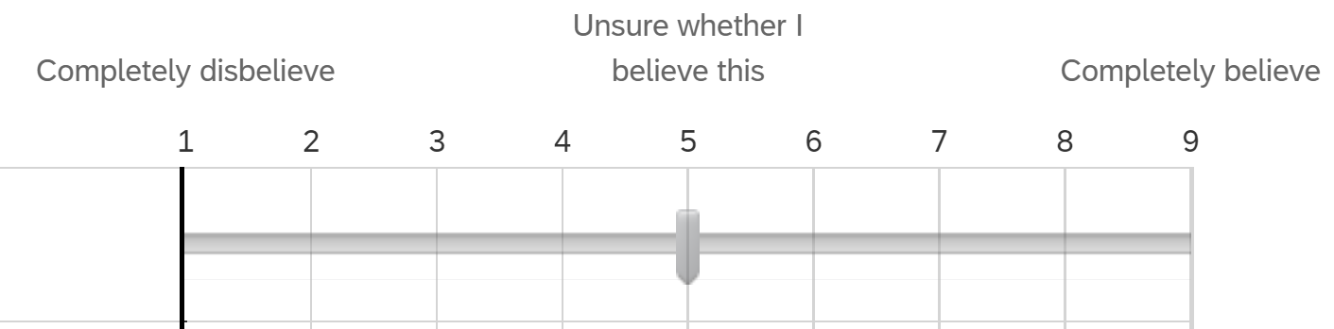
Methods - Subjects
Participants: Undergraduate students (N = 324)
Initial beliefs: On-line prescreening beginning of semester
“To what extent do you believe that increased gun control will reduce gun violence in the United States?” (9-point scale)
- believers and disbelievers invited to participate
Disbelievers
Not invited to participate
Believers
Notes:
Our experiment consisted of 324 undergraduate students
PSY 101 students participated in an online pre-screening survey at the beginning of the semester that contained this item to assess beliefs on gun control effectiveness:
1 = “completely disbelieve”, 5 = “unsure whether I believe this”, and 9 = “completely believe”.
Subjects qualified by responding either 1-3 (disbelievers) or 7-9 (believers)

Slide 6
Methods - Design and Materials
Initial subject gun control beliefs
Believer
Disbeliever
Materials:
“Pro text” – Argues gun control is effective.
“Con text” – Argues gun control is not effective.
Pro text
Belief
Consistent
Belief
Inconsistent
Text position
Con text
Belief
Inconsistent
Belief
Consistent
Notes:
Every participant read a text that supported the beliefs about gun control effectiveness;
Pro text argues gun control is effective
Con text argues gun control is NOT effective
With our believers and disbelievers reading pro and con texts, a 2x2 experimental design,
This gives us 2 groups: belief consistent, where believers read a pro text, and belief inconsistent, where believers read a con text
Text position is crossed with initial beliefs of subject, and this creates situation where they read consistent and inconsistent
2x2 matrix reading consistent or inconsistent

Slide 7
Methods - Procedure
Prescreening Survey
Report Initial Beliefs
(1-3 month delay)
Read Belief Consistent/Inconsistent Text
False Belief Verification
No Belief Verification
True Belief Verification
Experiment
Report Current Belief
Write Essay
Notes:
As discussed earlier, participants reported initial beliefs in the pre-screening, then participated in the experiment 1-3 months later
Read text; Participants were instructed to read text carefully and thoughtfully, and read at their own pace.
After finishing, subjects reflected on the text for one minute
Then, subjects get to the verification task, which is the experimental manipulation.
The cover story was that we needed to verify their identity for our records, so we would like them to verify that a series of responses were the same as what they indicated on the prescreening.
Subjects then proceeded to verify their birthdate, ID number, and responses to 5 other questions which asked participants to report their beliefs on a 9-point scale.
In the true condition, participants verified that their true initial belief that they put on pre-screen was correct. In the false condition, participants verified that the opposite of their initial beliefs. In the no gun control belief condition, participants did not verify initial beliefs about gun control effectiveness.
Finally, subjects wrote an argumentative essay in which they “describe and explain your beliefs about the effectiveness of gun control.”
These essays, which will serve as a convergent measure for beliefs, were not included in the analysis

Slide 8
Manipulation (Belief Verification Task) was Effective
82% verified false beliefs to be true
91% verified true beliefs to be true
Notes:
91% is the upper-limit of what you would expect people to verify since only 91% of people verified their true beliefs – means that some people will always not verify.
So, the manipulation was definitely effective because 82% verified false beliefs, and some people will always not verify

Slide 9
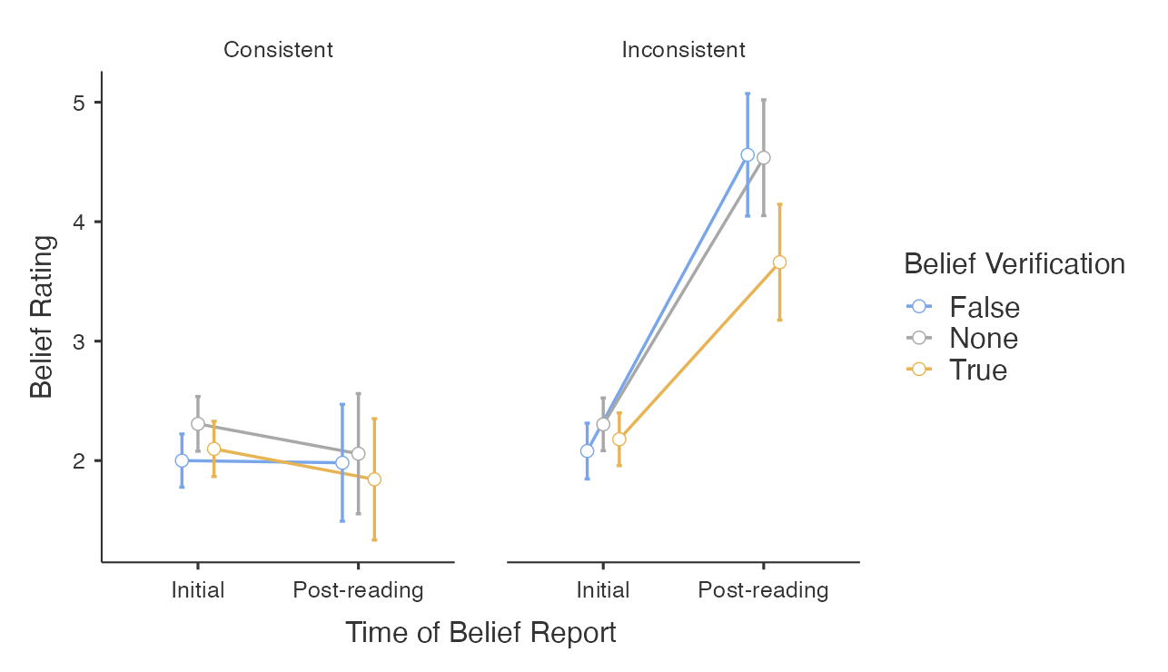
Consistency and Feedback Influences Belief Change
Less extreme
More extreme
Notes:
91% is the upper-limit of what you would expect people to verify since only 91% of people verified their true beliefs – means that some people will always not verify.
So, the manipulation was definitely effective because 82% verified false beliefs, and some people will always not verify
Extreme beliefs are low on the x-axis and moderate beliefs are high
First plot is pre-screen – no differences expected nothing is different because nothing has happened
Second plot is post-reading – so reading an inconsistent text led to more moderate beliefs compared to consistent text.
You can also see the amount of change from time 1 to time 2 – becomes more moderate by about 2 points on the scale
In addition, people who received true information about past beliefs changed beliefs less than the other conditions
This makes sense because we would expect that salient information about their past beliefs, which were extreme, would pull beliefs back closer to their initial beliefs more than the other two conditions
Add white space covering inconsistent, make new slide
True population mean 95% fall within CI

Slide 10
Consistency and Feedback Influences Belief Change
Less extreme
More extreme
Notes:
91% is the upper-limit of what you would expect people to verify since only 91% of people verified their true beliefs – means that some people will always not verify.
So, the manipulation was definitely effective because 82% verified false beliefs, and some people will always not verify
Extreme beliefs are low on the x-axis and moderate beliefs are high
First plot is pre-screen – no differences expected nothing is different because nothing has happened
Second plot is post-reading – so reading an inconsistent text led to more moderate beliefs compared to consistent text.
You can also see the amount of change from time 1 to time 2 – becomes more moderate by about 2 points on the scale
In addition, people who received true information about past beliefs changed beliefs less than the other conditions
This makes sense because we would expect that salient information about their past beliefs, which were extreme, would pull beliefs back closer to their initial beliefs more than the other two conditions
Add white space covering inconsistent, make new slide
True population mean 95% fall within CI

Slide 11
Conclusions
Reading a belief inconsistent text leads to more moderate beliefs – even on a contentious topic like gun control effectiveness
Belief recollection is poor
- 82% verified false beliefs to be true
Verifying true information about past beliefs led to less belief change than other information conditions
Verifying false information about past beliefs did not affect belief change, however it was also unnoticed
Argumentative essay ratings will serve as a convergent measure for beliefs
- Analyses ongoing
Notes:
One would think that people would be relatively set in their beliefs on gun control effectiveness, especially at that time. However, we found that when presenting persuasive evidence that is inconsistent with beliefs leads to belief change, even with a contentious and timely topic like gun control effectiveness.
Misinformation about past beliefs did not have an effect on belief change (with the current analysis without essays), however participants did not notice that the misinformation was false
Belief recollection is poor since 82% of participants in the false belief verification condition verified the false belief
As stated earlier, this is a preliminary analysis that does not include the essays that the participants wrote to substantiate their beliefs. The ratings of these essays will serve as a convergent measure for beliefs to get a more accurate measure of post-reading beliefs. Analyses are currently under way.
Make them come up one by one

Slide 12
Thank You!

Slide 13
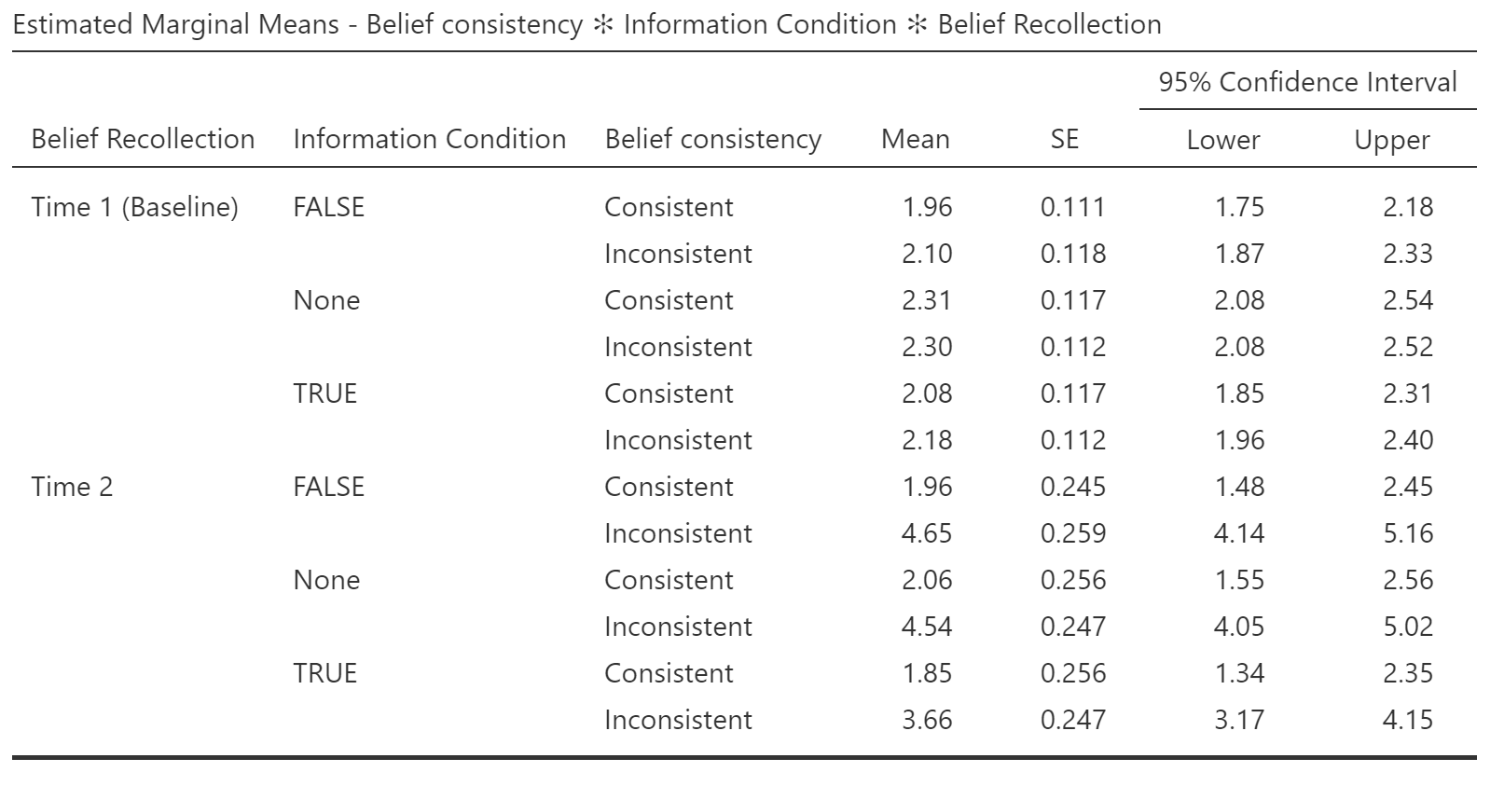
Results

Slide 14
Results

Slide 15
Results

Slide 16
Results

Slide 17
Methods - Subjects
Participants: Undergraduate students (N = 324)
Initial beliefs: On-line prescreening beginning of semester
“To what extent do you believe that increased gun control will reduce gun violence in the United States?” (9-point scale)
- believers and disbelievers invited to participate
Disbelievers
Not invited to participate
Believers
Notes:
Our experiment consisted of 324 undergraduate students
PSY 101 students participated in an online pre-screening survey at the beginning of the semester that contained this item to assess beliefs on gun control effectiveness:
1 = “completely disbelieve”, 5 = “unsure whether I believe this”, and 9 = “completely believe”.
Subjects qualified by responding either 1-3 (disbelievers) or 7-9 (believers)

Slide 18

Methods - Procedure
Prescreening Survey
Report Initial Beliefs
(1-3 month delay)
Read Belief Consistent/Inconsistent Text
False Belief Verification
No Belief Verification
True Belief Verification
Experiment
Report Current Belief
Write Essay
Notes:
As discussed earlier, participants reported initial beliefs in the pre-screening, then participated in the experiment 1-3 months later
Read text; Participants were instructed to read text carefully and thoughtfully, and read at their own pace.
After finishing, subjects reflected on the text for one minute
Then, subjects get to the verification task, which is the experimental manipulation.
The cover story was that we needed to verify their identity for our records, so we would like them to verify that a series of responses were the same as what they indicated on the prescreening.
Subjects then proceeded to verify their birthdate, ID number, and responses to 5 other questions which asked participants to report their beliefs on a 9-point scale.
In the true condition, participants verified that their true initial belief that they put on pre-screen was correct. In the false condition, participants verified that the opposite of their initial beliefs. In the no gun control belief condition, participants did not verify initial beliefs about gun control effectiveness.
Finally, subjects wrote an argumentative essay in which they “describe and explain your beliefs about the effectiveness of gun control.”
These essays, which will serve as a convergent measure for beliefs, were not included in the analysis

