Slide 1
Can Ageism be reduced by service learning built in a lecture-based aging course?
Liam Hart
Department of Psychology
Grand Valley State University

Slide 2
Outline
Overview of ageism
Psychological mechanisms behind ageism
Interventions to reduce ageism
The current study
Notes:
It is no secret that we are in the midst of a pandemic at the moment, and hopefully coming towards the end.

Slide 3
Older Adults and the COVID-19 Pandemic
“The problem of older adults” (Zhou et al., 2020; Fraser et al., 2020)
Media depicted COVID-19 to only impact older adults
Nursing home deaths – high mortality rate seen as normal
Social media and #Boomerremover (Godfrey, 2020)
Lives of elderly are seen as unimportant
The pandemic has exposed the preexisting problems
Notes:
While it is certainly important to protect vulnerable groups from infection, the pandemic has since been promoted as “the problem of older adults” (Zhou et al., 2020), along with the hashtag #Boomerremover (Godfrey, 2020). These negative attitudes towards older adults, explicitly based on age, deems the lives of the elderly as unimportant and not worthy of the combined effort of all groups. Ageist responses to COVID-19 are important to note because they may endure beyond the time of the pandemic. The viral transmission of ageist attitudes is extremely problematic as it widens the gap between generations on a global scale. and could lead to dangerous outcomes for older people. Though it is essential to protect our older adults from this infection, we are implicitly separated/segregated from them in order to do this. Younger or even middle-aged people that do not have grandparents or older people in their lives may feel even more ageist as a result of no interaction, which may be what leads to these kinds of attitudes towards older adults during the pandemic. The important thing is to try and prevent these heightened levels of ageism from staying beyond the pandemic. It may leave a “bad taste” in people’s mouths towards older people, as especially during the end, is a major reason that people are quarantining and staying inside. In addition, older adults were the first group available to get the vaccine. This may cause increased levels of animosity in those that are anxious about the pandemic and receiving their vaccine.
This response is what we call ageism – these are example of ageist attitudes. What is ageism? Funny you should ask, because the next slide talks about that.

Slide 4
What is ageism?
Like racism or sexism, but with respect to age
Stereotyping, prejudice, and discrimination based on age (Butler, 1969)
Not a popular “ism”
Affects all people across cultures (Lin & Bryant, 2009; Luo et al., 2013)
Prevalent among young adults (Levy, 2009; Levy et al., 2013)
Notes:
Not the most popular “ism” that is usually discussed in the media. Ageism is unique in that it does not target a certain ethnic group, gender, or anything that defines you; we all age. Each and every one of us may become a victim, unless we do not reach our later years in life.

Slide 5
What gives rise to ageism?
The terror management theory (TMT):
- Features of older adults remind of human vulnerability
Knowledge that age eventually leads to death (Martens et al., 2004)
Death anxiety -> rejection of older people
Young adults rated older adults lower if they had similar characteristics (Martens et al., 2004)
Characteristics and abilities that contribute to self-esteem diminish with age
Terror Management Theory (TMT; Rosenblatt, Greenberg & Solomon, 1989)
Notes:
Each of these theories have been used to explain what gives rise to ageism. Struggling to find more to say on this slide, but read the study that goes over each again

Slide 6
What else explains ageism?
The social identity theory (SIT):
- We gain a sense of self-worth through group membership
Ingroups and outgroups: “Us vs. Them”
Pervasive idea that older adults are of lower status
Outgroup bias
Social Identity Theory (SIT; Tajfel and Turner, 1979)
Notes:
Each of these theories have been used to explain what gives rise to ageism. Struggling to find more to say on this slide, but read the study that goes over each again

Slide 7
Stereotype Embodiment Theory (SET)
Negative stereotypes about aging are internalized in younger years
Ageism leads to self-ageism as we grow older
Associated with negative consequences on health, cognitive functioning, and longevity (Haslam et al., 2012; Kang and Chasteen, 2009; Levy et al., 2002, 2012; Westerhof et al., 2014; Wurm et al., 2007)
Adds to the importance of reducing ageism in young adults
Stereotype embodiment theory (SET): Levy, 2009.
Notes:
Commonly held view that the elderly and physically and mentally
handicapped

Slide 8
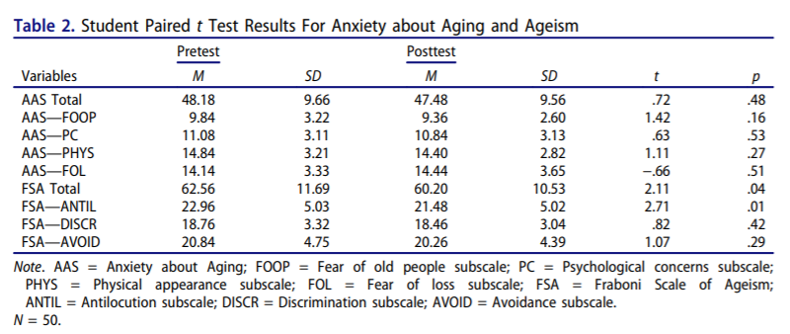
Interventions shown to Reduce Ageism
Education about aging (Edward & Aldous, 1996)
Reciprocal intergenerational interaction (Allan & Johnson, 2009; Pettigrew & Tropp, 2006)
Combination may be most effective (Burnes et al., 2019)
Andreoletti & Howard, 2018
Notes:
Most effective in young adults is explained by TMT, intergroup contact theory supports reciprocal interaction under optimal conditions

Slide 9
Current Study
Participants:
GVSU students enrolled in Perspectives on Aging (PSY366)
Perception of age (FSA) was measured at beginning and end of semester
N=32 participated in both tests
About the course:
A comprehensive view of aging from the psychological, social-cultural, and evolutionary perspectives
Six topics covered: 1. Cultural and historical views of aging; 2. Biological aging; 3. The evolving self; 4. Styles of adult thinking; 5. Creative endeavors of the elderly; and 6. The emergence of wisdom.
Curated research articles and book chapters for in-depth understanding
Strong focus on empirical research of aging

Slide 10
More about the course: Service-learning Project
Groups of 3 students visited a local independent living center
Intergenerational interaction through activities designed by students based on reviewing of previous research
Samples of activities: Painting, making birdhouses, creating a playlist
Final paper involving a review of relevant literature, a reflection of their experience, and a critical discussion of issues surrounding intergenerational integration.

Slide 11
Fraboni Scale of Ageism (FSA)
To assess ageism using 29 statements
Rated on a 1-4 scale: 1 = strongly disagree; 2 = disagree; 3 = agree; 4 = strongly agree
3 subscales:
Anticolution: “Many old people just live in the past”
Discrimination: “Old people don’t really need to use our community sports facilities”
Avoidance: “I personally would not want to spend much time with an old person”

Slide 12
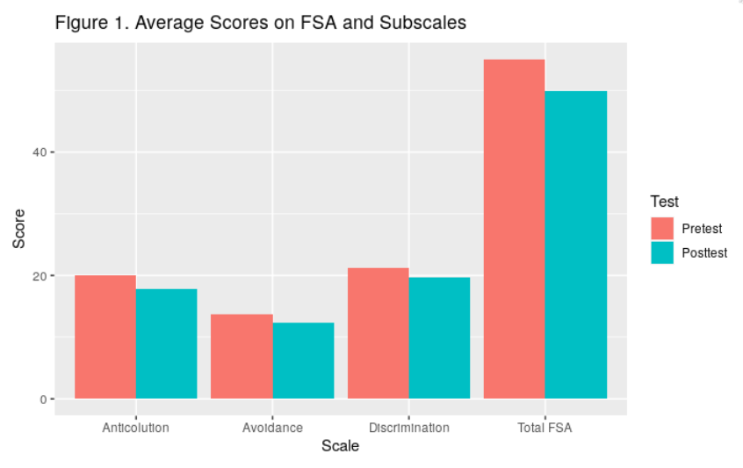
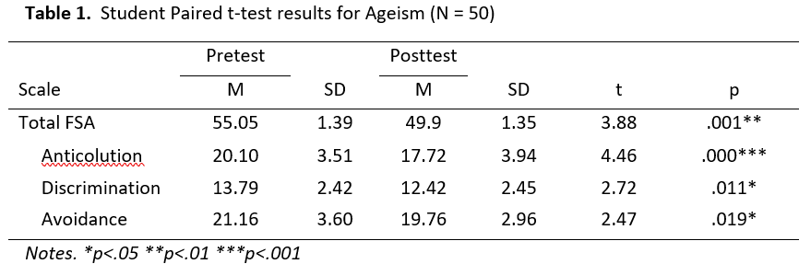
Findings
Overall scores on FSA were significantly lower
Significant decrease in all 3 subscales

Slide 13
Discussion
Preliminary evidence that a course on aging with an intergenerational interaction reduces ageism in college students
Reduced perception of outgroup homogeneity
Less misconceptions and increased acceptance and understanding of older adults
May feel more comfortable around older adults
Students may have better interactions with elderly in careers
Medical and nursing
Notes:
In the discussions following student’s visits to Lincoln Square Retirement home, many students admitted false beliefs they held about older adults and expressed appreciation of the company of the residents.

Slide 14
Limitations and future studies
No control group
Limited sample size
Response bias
Lack of behavioral measure
Long-term effectiveness is still unknown
The significant results of this study serve as a basis for future studies with larger sample sizes, control groups, and improved measurement

Slide 15
Thank You!
“Aging is an extraordinary process where you become the person you should have always been”
David Bowie

