Slide 1
MisInformation about Past Beliefs Influences Current Beliefs
Liam Hart
Mentors: Michael Wolfe and Todd Williams
Psychology Department
Grand Valley State University
Notes:
If we manipulate what people remember believing on a topic (gun control effectiveness), will this influence what they believe now?
Research has also shown that our attitudes are constructed using salient information available in the moment
Memory is a reconstructive process, which is prone to errors and biases
So, let’s say you changed your attitude toward universal health care. Would you be able to accurately remember what your previous attitude on universal healthcare were?
NO, not accurately – your recollection of previous attitude would be biased towards your current attitude towards universal healthcare

Slide 2
Memory biased according to current self
People may not have direct access to memory representations (Dunlosky & Thiede, 2013)
Memory of past aspects of self biased towards current aspects of self
- Attitude about bussing to achieve integration (Goethals & Reckman, 1973)
- Political attitudes (Markus, 1986)
- Student anxiety surrounding exams (Safer, Levine, & Drapalski, 2002)
- Beliefs about spanking effectiveness (Wolfe & Williams, 2018)
Notes:
Before getting into our research, I will give some background information on how our beliefs and memory of beliefs are formed.
This is a list of studies which demonstrate that the recollection of previous information is biased in the direction of current information.
All of these are studies which demonstrate that the recollection of previous information is biased in the direction of current information.
This leads into the idea that identifying an aspect of our self is influenced by context
Past research has shown that our memory for information is a reconstructive process; we don’t have direct access to memory representations
biased according to information in our environment – like our current beliefs or attitudes
In a number of different domains using various methods, recollection of past aspects of our self is biased according to the current moment.
What we believe now influences what we remember ourselves believing in the past
WHAT WE REMEMBER BEING IS BIASED BY WHAT WE ARE NOW

Slide 3
Contextual influences on attitudes
Attitudes are dependent on context (Schwarz, 2007)
- not stable, trait-like attributes
- salient information
Implicit Association Test
- results influenced by social/environmental context (Payne, Vulitech, & Lundberg, 2017)
Beliefs may function in a similar way
- reminders of past beliefs following belief change influenced current beliefs (Wolfe et al., 2014)
Notes:
Research on attitudes suggest that attitudes are dependent on context.
Instead of being a stable, trait-like attributes, they are constructed in the moment using salient information
Related research and commentary on the implicit association test suggests that the results may be influenced by the social and environmental context
We think that beliefs may function in a similar way; that is, beliefs are constructed using context/salient information in the current moment
Professor Wolfe’s previous research found that giving people who changed their beliefs on spanking effectiveness a reminder of their past beliefs influenced their current beliefs

Slide 4
Current research
Investigates the influence that salient information has on belief construction
- Will people change their beliefs on a contentious topic like gun control effectiveness?
- Do we accurately remember what we used to believe?
- Will providing information about one’s past beliefs influence their current beliefs?
Notes:
The research that I am presenting today aims to investigate the influence that salient information has on belief construction – more specifically, the influence that providing true or false information about one’s past beliefs has on the construction of current beliefs.
First, the current research aims to replicate the finding that people change beliefs when presented with a persuasive text that is inconsistent with their beliefs; however, this time it will be on the more contentious topic of gun control, where people may be more ‘set in’ to their beliefs
Second, we aim to investigate the influence that providing information about past beliefs has on current beliefs
Finally, and most broadly, the current research aims to generally explore the overall influence that context has on current beliefs

Slide 5
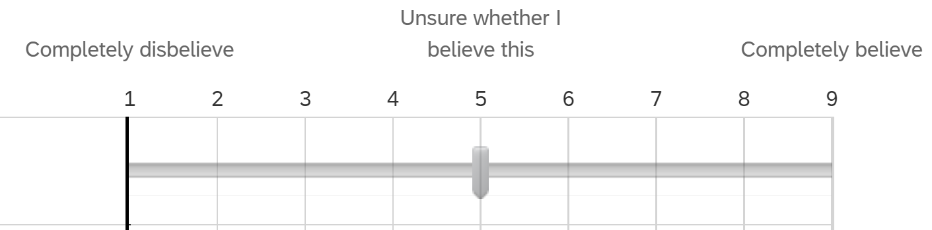
Methods - Subjects
Participants: Undergraduate students (N = 324)
Initial beliefs: On-line prescreening beginning of semester
“To what extent do you believe that increased gun control will reduce gun violence in the United States? Gun control is defined as strengthening laws or policies that regulate the manufacture, sale, transfer, possession, modification, or use of firearms by civilians.” (9-point scale)
- believers and disbelievers invited to participate
Notes:
Our experiment consisted of 324 undergraduate students
PSY 101 students participated in an online pre-screening survey at the beginning of the semester that contained this item to assess beliefs on gun control effectiveness:
1 = “completely disbelieve”, 5 = “unsure whether I believe this”, and 9 = “completely believe”.
Subjects qualified by responding either 1-3 (disbelievers) or 7-9 (believers)

Slide 6
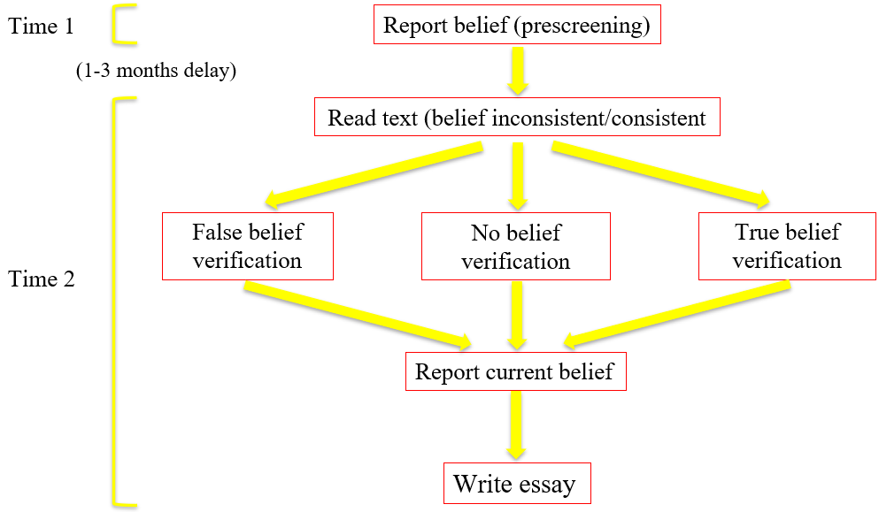
Methods
Subject gun control beliefs
Believer Disbeliever
Pro text
Con text
Belief
consistent
Belief
inconsistent
Belief
Inconsistent
Belief
consistent
Text
position
Notes:
Every participant read a text that supported the beliefs about gun control effectiveness;
Pro text argues gun control is effective
Con text argues gun control is NOT effective
With our believers and disbelievers reading pro and con texts, a 2x2 experimental design,
This gives us 2 groups: belief consistent, where believers read a pro text, and belief inconsistent, where believers read a con text

Slide 7
Methods - Procedure
1. Report beliefs in pre-screen
(1-3 month gap)
2. Read belief consistent or inconsistent text
3. Initial belief verification task
- true, false, or no gun control belief verification
4. Post-reading beliefs (same question as prescreening)
5. Argumentative essay
Notes:
As discussed earlier, participants reported initial beliefs in the pre-screening, then participated in the experiment 1-3 months later
Read text; Participants were instructed to read text carefully and thoughtfully, and read at their own pace.
After finishing, subjects reflected on the text for one minute
Then, subjects get to the verification task, which is the experimental manipulation.
The cover story was that we needed to verify their identity for our records, so we would like them to verify that a series of responses were the same as what they indicated on the prescreening.
Subjects then proceeded to verify their birthdate, ID number, and responses to 5 other questions which asked participants to report their beliefs on a 9-point scale.
In the true condition, participants verified that their true initial belief that they put on pre-screen was correct. In the false condition, participants verified that the opposite of their initial beliefs. In the no gun control belief condition, participants did not verify initial beliefs about gun control effectiveness.
Finally, subjects wrote an argumentative essay in which they “describe and explain your beliefs about the effectiveness of gun control.”
These essays, which will serve as a convergent measure for beliefs, were not included in the analysis

Slide 8
Manipulation (belief verification task) was effective
82% verified false beliefs to be true
91% verified true beliefs to be true
Notes:
91% is the upper-limit of what you would expect people to verify since only 91% of people verified their true beliefs – means that some people will always not verify.
So, the manipulation was definitely effective because 82% verified false beliefs, and some people will always not verify

Slide 9
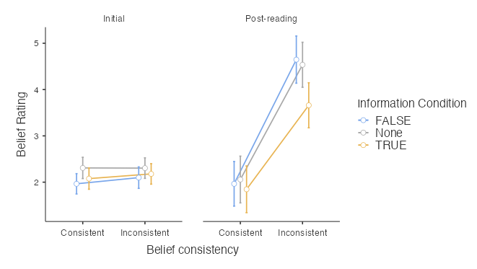
Belief change following belief inconsistent text
Notes:
91% is the upper-limit of what you would expect people to verify since only 91% of people verified their true beliefs – means that some people will always not verify.
So, the manipulation was definitely effective because 82% verified false beliefs, and some people will always not verify
Extreme beliefs are low on the x-axis and moderate beliefs are high
First plot is pre-screen – no differences expected nothing is different because nothing has happened
Second plot is post-reading – so reading an inconsistent text led to more moderate beliefs compared to consistent text.
You can also see the amount of change from time 1 to time 2 – becomes more moderate by about 2 points on the scale
In addition, people who received true information about past beliefs changed beliefs less than the other conditions
This makes sense because we would expect that salient information about their past beliefs, which were extreme, would pull beliefs back closer to their initial beliefs more than the other two conditions

Slide 10
Conclusions
Reading a belief inconsistent text leads to more moderate beliefs – even on a contentious topic like gun control effectiveness
Misinformation about past beliefs did not affect belief change, however it was also unnoticed
Verifying true information about past beliefs led to less belief change than other information conditions
Belief recollection is poor
- 82% verified false beliefs to be true
Argumentative essay ratings will serve as a convergent measure for beliefs
- Analyses ongoing
Notes:
One would think that people would be relatively set in their beliefs on gun control effectiveness, especially at that time. However, we found that when presenting persuasive evidence that is inconsistent with beliefs leads to belief change, even with a contentious and timely topic like gun control effectiveness.
Misinformation about past beliefs did not have an effect on belief change (with the current analysis without essays), however participants did not notice that the misinformation was false
Belief recollection is poor since 82% of participants in the false belief verification condition verified the false belief
As stated earlier, this is a preliminary analysis that does not include the essays that the participants wrote to substantiate their beliefs. The ratings of these essays will serve as a convergent measure for beliefs to get a more accurate measure of post-reading beliefs. Analyses are currently under way.
Make them come up one by one

Slide 11
Thank You!
The Student Summer Scholars Program was a great experience!

Slide 12
Possible theoretical explanations
Memory error:
Recollections generated using currently available mental representation.
Current beliefs bias ability to accurately recollect previous belief
(Levine & Safer, 2002; Ross, 1989; Schacter, 1999)
Desire for cognitive consistency:
Students desire to appear internally consistent across time (Aronson,
1969; Gawronski & Strack, 2012).
Belief change creates dissonance (eg. Festinger, 1957).
Dissonance reduced by recollecting previous belief as similar to current
belief.
Notes:
Some possible theoretical explanations for this recollection bias is that these recollections are generated using currently available mental representations – the available representation would be one’s current belief, so it would make sense that this would bias our recollection in the direction of current beliefs.
In addition, people have a desire for aspects of their self to appear internally consistent over time. When we change our beliefs about something, this goes against a consistent internal view of the self and creates dissonance. To reduce this dissonance, we recollect our previous beliefs as being more similar to current beliefs to see aspects of our self as consistent.

Slide 13
Methods – Design and Materials
Subject gun control beliefs
Believer Disbeliever
Materials:
“Pro text” – Argues gun control is effective.
(2,252 words)
“Con text” - Argues gun control is not effective.
(2,223 words)
Pro text
Con text
Belief
consistent
Belief
inconsistent
Belief
Inconsistent
Belief
consistent
Text
position
Notes:
Every participant read a text that supported the beliefs about gun control effectiveness;
Pro text argues gun control is effective
Con text argues gun control is NOT effective
With our believers and disbelievers reading pro and con texts, a 2x2 experimental design,
This gives us 2 groups: belief consistent, where believers read a pro text, and belief inconsistent, where believers read a con text

Slide 14
Time 1
Report belief (prescreening)
(1-3 months delay)
Read belief consistent text
Read belief inconsistent text
False belief verification
No belief verification
True belief verification
Time 2
Report current belief
Write essay

Slide 15
Time 1
Report belief (prescreening)
(1-3 months delay)
Read text (belief inconsistent/consistent
False belief verification
No belief verification
True belief verification
Time 2
Report current belief
Write essay

Slide 16
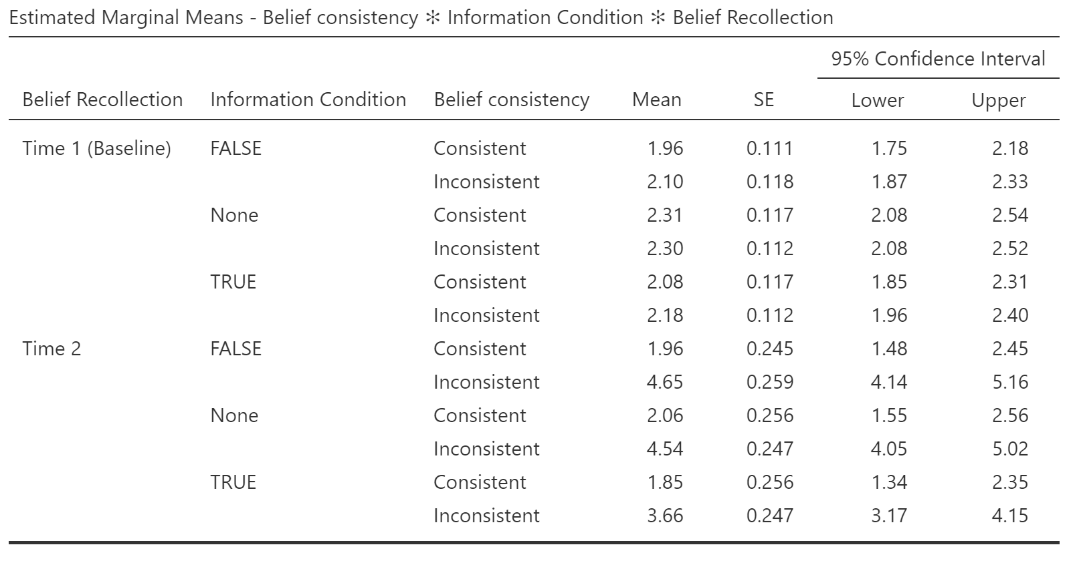
Results

Slide 17
Results

Slide 18
Results

Slide 19
Results

