Slide 1
Belief Change After Reading Predicts Argumentative Essay Content
Liam Hart, Michael Wolfe, Greg Russell, and Todd Williams
Psychology Department
Grand Valley State University
Notes:
Hello, my name is Liam Hart. I am happy to present research that I have been working on with Michael Wolfe, Greg Russell, and Todd Williams. In this experiment, we investigate how well belief change predicts argumentative essay content written after reading a text that is either consistent or inconsistent with one’s beliefs. Argumentative discourse is used in education to foster learning and critical thinking skills, and is generally used to persuade for a position on some topic.

Slide 2
Multiple Factors Determine Essay Content
Argument schema – Knowledge about what components are included in an argument
Components: claim, supporting reasons, counterarguments, and rebuttals (C. Wolfe et al., 2009; Voss & Means, 1991)
Claim has “slots” for theme, side, and predicate (Britt et al., 2008; C. Wolfe et al., 2009)
Individual variation in schema / essay quality (C. Wolfe, 2012)
Notes:
There are several factors that contribute to argumentative essay content, but I will focus on the two that are most relevant to this study. The first is the argument schema, which is knowledge about what components are included in an argument. Those components are a claim, reasons directly supporting that claim, counterarguments, and rebuttals to counterarguments. Within the claim, there are “slots” for the theme, side, and predicate. The predicate can be thought of as the verb of the claim, an example on the theme of gun control would be effectiveness (of gun control) or policy change (concerning gun control). There is individual variation in student’s argument schemas, which results in differences in which components are included in an argumentative essay, and the quality of essay.

Slide 3
Multiple Factors Determine Essay Content
Argument schema – Knowledge about what components are included in an argument
Components: claim, supporting reasons, counterarguments, and rebuttals (C. Wolfe et al., 2009; Voss & Means, 1991)
Claim has “slots” for theme, side, and predicate (Britt et al., 2008; C. Wolfe et al., 2009)
Individual variation in schema / essay quality (C. Wolfe, 2012)
Prior attitudes or beliefs
May influence selection of information included in argumentative essay
Argument schema “activates knowledge, attitudes, and beliefs relevant to the theme” (C. Wolfe, 2012)
Beliefs and attitudes are constructed by salient information at the time of report
Information recently read (Anglin, 2019; M. Wolfe & Williams, 2018)
Contributes to “side” of argument schema
Students with more polarized beliefs write more biased essays (Van Strien et al., 2014)
Influences evaluation of evidence and argument quality (Kahne & Bowyer, 2017; C. Wolfe et al., 2009; M. Wolfe & Williams, 2018)
Notes:
Another factor that determines essay content is prior attitudes or beliefs, which may influence the selection of information that is included in an argumentative essay. The argument schema activates knowledge, attitudes, and beliefs relevant to the theme. We are working from the hypothesis that beliefs and attitudes are constructed from salient information that is available at the time of report. The salient information that would be most relevant to this study is any information that has recently been read. Attitudes and beliefs would contribute to the “side” slot within the claim, or whether one believes and argues that gun control is or is not effective. This is supported by a study by Van Strien and others in 2014, which found that students with more polarized beliefs write more biased essays, which is also evidence that beliefs influenced the generation of argumentative essays. Previous research has also shown that beliefs influence evaluation of evidence and argument quality, which again may influence the information one selects to include in an argumentative essay.

Slide 4
Research Questions
Do argumentative essay contents change after reading a belief consistent vs. inconsistent text?
After reading a belief inconsistent text, variation in belief change may emerge. Is essay content associated with belief change?
Notes:
Our research questions for this study are: 1. Do argumentative essay contents change after reading a belief consistent vs. inconsistent text? And 2. We will see varying levels of belief change after subjects read a text that is inconsistent with their beliefs. Is essay content associated with belief change?

Slide 5
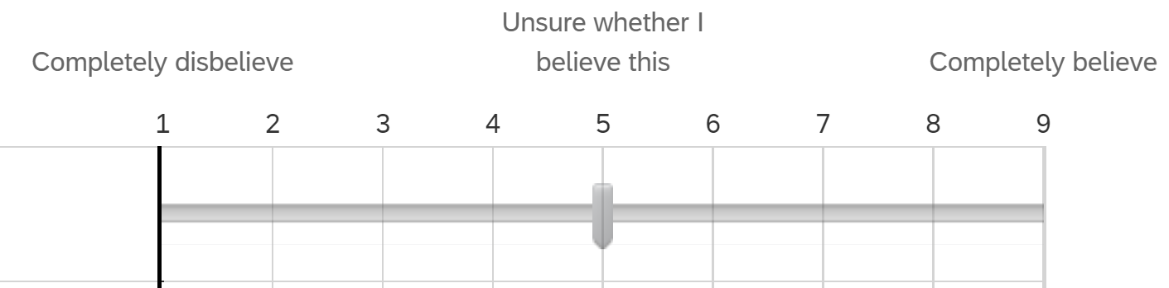
Methods
Subjects: N = 320 undergraduates
Initial beliefs: On-line prescreening
“To what extent do you believe that increased gun control will reduce gun violence in the United States?” (9-point scale)
- Believers and disbelievers invited to participate
Disbelievers
Not invited to participate
Believers
Notes:
320 undergraduate students participated in this study. Initial beliefs were assessed in an online prescreening where they answer this question “…” on a 9-point scale. We invited believers and disbelievers to participate in the study.

Slide 6
Methods
Initial gun control beliefs
Believer
Disbeliever
“Pro text” – Argues gun control is effective
2,252 words
“Con text” – Argues gun control is NOT effective
2,223 words
Pro text
Belief
Consistent
Belief
Inconsistent
Text position
Con text
Belief
Inconsistent
Belief
Consistent
Notes:
Both believers and disbelievers read either a pro text (which argues that gun control is effective) or a con text (which argues that gun control is not effective). This gives us a 2x2 design that can be simplified into conditions of the belief consistency of the text read. Belief consistent subjects read a text that’s consistent, or reinforces their initial belief, and belief inconsistent subjects read a text that’s inconsistent, or contrary to their initial belief. I’ll also note that each belief consistency condition contains believers and disbelievers, so the resulting belief change in both conditions is in both directions.

Slide 7
Methods
Prescreening Survey
Report Initial Beliefs
(1-3 month delay)
Read Belief Consistent/Inconsistent Text
Experiment
Report Current Belief
Write Essay
Notes:
This is a diagram of the procedure. About 1-3 months after reporting initial beliefs, subjects were invited back to participate in the experiment where they started by reading a belief consistent or inconsistent text, then reported their current beliefs post-reading, and finally wrote an argumentative essay.

Slide 8
Essay Task
Prompt:
“Please write an argumentative essay in which you describe and explain your beliefs about the effectiveness of gun control.”
Subjects could include information and/or opinions that were either in the text they read, or that they did not read.
240 – 270 words
Notes:
The prompt of the essay was to “write an argumentative essay in which you describe and explain your beliefs about the effectiveness of gun control”. Subjects were not limited in the information they could include in their essay, so it could be anything that they just read in the text or anything that they did not read in the text. The essays were between 240 and 270 words.

Slide 9
Coding system
Coding category | Explanation
Claim | States claim that gun control is/is not effective (as specifically instructed)
# Reasons | If claim stated, how many independent reasons support the claim
Counterargument | Argument or data mentioned that is counter to stated claim
Text Content | Specific content from text is mentioned
Policy Claim | States claim that gun control policy should/should not be implemented (note this was not the task)
Statement about Belief Change | Statement that beliefs changed during experiment
Evaluative | Positive or negative evaluation statement about text
All essays were coded by two raters (Cohen’s Kappa = .91)
Notes:
We hand-coded the essays for various characteristics, including a claim about gun control effectiveness, number of reasons directly supporting the claim, and counterargument. The claim was necessary to code for reasons and counterargument, so if there was not a claim there could be no reasons or counterargument. We also coded for any content from the text that was mentioned, and for policy claims, which are distinguished from the regular claim because of the different predicate of policy, not effectiveness (which is what was stated in the prompt). Finally, we coded for any statements that the subjects beliefs changed during the experiment, and any positive or negative evaluative statements about the text.
Does the author state a clear claim about gun control effectiveness? The statement doesn’t have to be extreme. It could contain some hedging or uncertainty. The question is whether they directly address the question and make a statement about it.
Does the author have supporting evidence/reasons that relate directly to the claim?
If there are supporting reasons, how many different supporting reasons?
Does the author address a counter argument to the claim? (Can there be a counterargument without a main claim?)
Does the author make any other claim? Policy, moral, etc (policy is most likely). Not sure that we need to score reasons for this.
Does the author mention specific content from the text?
Metacognitive – does the author make a statement about their belief changing? Don’t code for other types of metacognitive statements.
Does the author make an evaluative statement about the text? This can be credibility, trustworthiness, lack of source information, etc. The idea is that we want to know if any part of the author’s position on gun control is related to the extent to which they trusted or believed the source text.

Slide 10
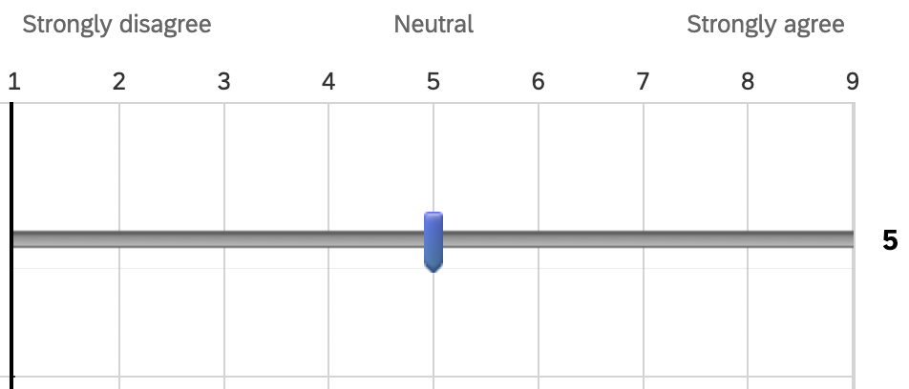
Essay Ratings
N = 680 subjects recruited through Prolific
The arguments in this essay claim that increased gun control will reduce gun violence.
The author considers both sides of the issue.
The claims made in this essay are supported by factual evidence.
The claims made in this essay are supported by personal experiences, anecdotes, or stories.
The author arrives at their conclusion based on emotion.
The author clearly articulates their position.
Notes:
We recruited 680 subjects through prolific to rate the essays holistically on the following qualities:
The arguments in this essay claim that increased gun control will reduce gun violence.
The author considers both sides of the issue.
The claims made in this essay are supported by factual evidence.
The claims made in this essay are supported by personal experiences, anecdotes, or stories.
The author arrives at their conclusion based on emotion.
The author clearly articulates their position.

Slide 11
Frequency of Characteristics
 | Belief Consistent | Belief Inconsistent
Claim | 87%*** | 70%
# Reasons | 1.80*** | 1.10
Counterargument | 39% | 35%
Text Content | 68%*** | 50%
Policy Claim | 61% | 67%
Statement about Belief Change | 4% | 10%*
Evaluative | 6% | 21%***
Positive | (89%) | (20%)
Negative | (11%) | (74%)
* p < .05; *** p < .001
Notes:
Remember that we had two questions, the first regarding the effect of reading a belief consistent or inconsistent text on essay content, which I will present here first. Then I will present the relationships between essay content and belief change.
Belief consistent subjects wrote essays that included more claims, a higher number of reasons, and more text content. Belief inconsistent subjects wrote essays that included more statements about belief change and more evaluative statements, which are mostly negative. The essays did contain counterarguments and policy claims, but they did not differ as a function of belief consistency.
The missing 6% is neutral, a balanced evaluative statement

Slide 12
Mean Ratings of Essays
 | Belief Consistent | Belief Inconsistent
Belief rating | 2.76 | 4.56***
Consider both sides | 4.63 | 5.07***
Supported by facts | 4.96*** | 4.48
Experiences, stories | 5.15 | 5.26
Emotion | 5.65 | 5.68
Clear position | 6.70*** | 6.26
*** p < .001
Notes:
This is a table of the mean ratings of essays by the prolific subjects. Belief inconsistent subjects wrote essays that contained arguments about gun control effectiveness that were more moderate (the belief rating) and considered both sides more than belief consistent subjects, but essays in the belief consistent condition were more supported by facts and had a more clear position.

Slide 13
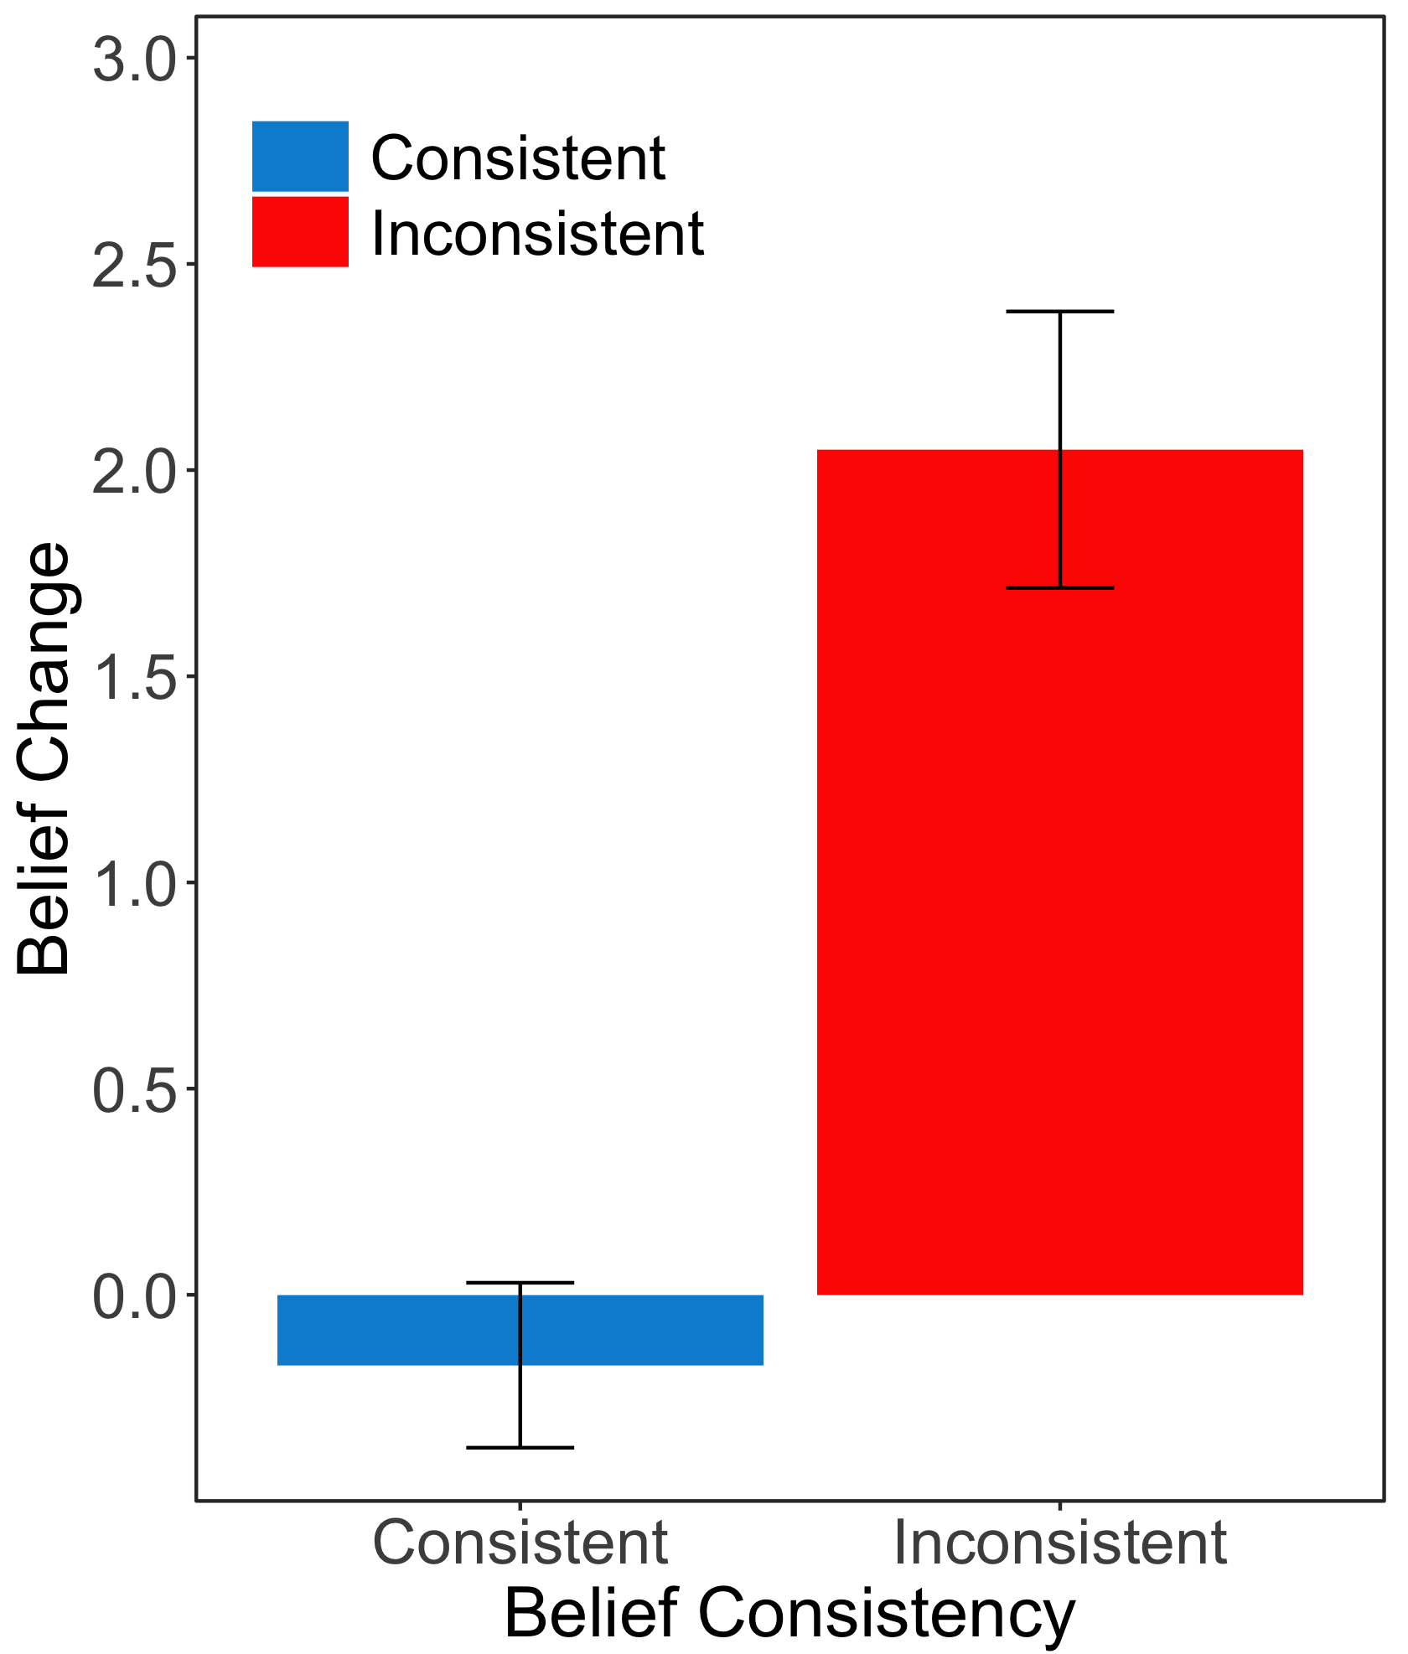
Belief Inconsistent Text Elicits Belief Change
Notes:
Now I will be getting into the relationships between belief change and essay content, which address our second research question. But before doing that, I would like to first establish that on average the belief inconsistent text did elicit belief change, about 2 points on that 9-point scale - remember that this is belief change in both directions since both believers and disbelievers read each text. And you can see the comparison to the belief change of subjects who read a belief consistent text, where there was not belief change on average.

Slide 14
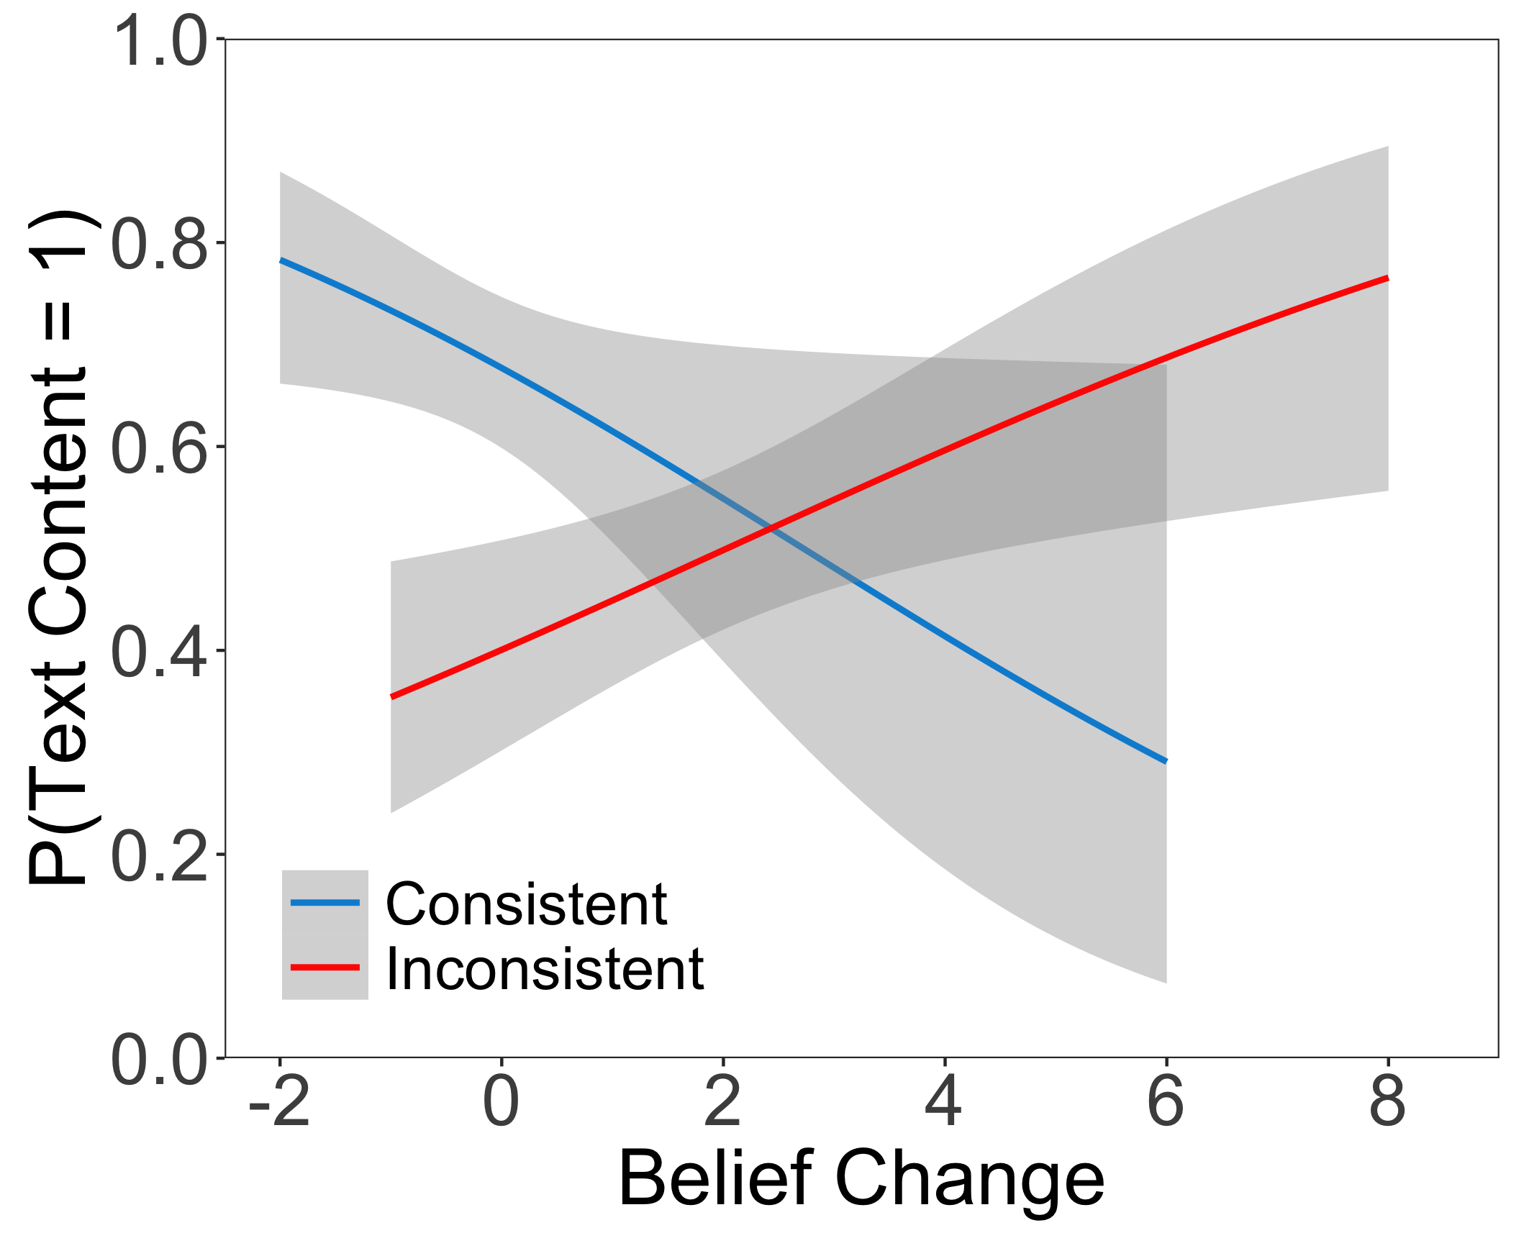
Belief Change Relationships with Essay Characteristics
 | Belief Consistent | Belief Inconsistent
Claim | -0.32* | 0.07
# Reasons | -0.16 | 0.15
Counterargument | -0.08 | 0
Text Content | -0.27* | .020*
Policy Claim | 0.21 | -0.07
Statement about Belief Change | -0.12 | 0.33**
Evaluative | 0.10 | -0.21*
* p < .05; ** p < .01
Positive values indicate change to more moderate beliefs.
Notes:
For both texts, we get individual variation in belief change. This table presents relationships between belief change and the likelihood that a characteristics is included in an essay. We can better understand how to interpret this table by looking at this plot first. Positive belief change (as you go further right on the x-axis) indicates a change to more moderate beliefs. In the belief inconsistent condition, the probability of text content being mentioned in essays (on the y-axis) increases as beliefs change to be more moderate. For the belief consistent condition, the probability of text content being mentioned in essays increases as beliefs change to be more polarized, as indicated by the negative values for belief change. Looking at the table, each coefficient is a relationship between the probability of that characteristic being mentioned in an essay and belief change. So, in the belief consistent condition, there is a higher likelihood of essays containing a claim and specific content from the text as beliefs change to be more polarized. For belief inconsistent, there is a higher likelihood of statements about belief change as beliefs change to be more moderate, and a higher likelihood of evaluative statements as belief change to be more polarized – this makes sense since most evaluative statements in the belief inconsistent condition were negative, probably by students who were not persuaded by the text.
Are the coefficients standardized or unstandardized?
Z-score tests if slopes are significantly different from each other. The probability of a code being present depends upon the amount of belief change, which depends on the belief consistency
Claim, # Reasons, and Text content correlations are significantly different from one another (significant interaction)

Slide 15
Belief Change Relationships with Essay Ratings
 | Belief Consistent | Belief Inconsistent
Belief rating | 0.34*** | 0.67***
Consider both sides | 0.15* | 0.05
Supported by facts | -0.18* | 0.06
Experiences, stories | -0.04 | -0.02
Emotion | -0.04 | -0.09*
Clear position | -0.12* | -0.03
* p < .05 ; *** p < .001
Positive values indicate change to more moderate beliefs.
Notes:
This table presents the relationship between belief change and essay ratings. Belief consistent subjects wrote essays that were rated to contained arguments about gun control effectiveness that were more polarized, have considered both sides less, were more supported by facts and had a clearer position as beliefs changed to be more polarized. Subjects who read a belief inconsistent text wrote essays that were rated to contain arguments about gun control effectiveness that were more moderate and to have made the conclusions of their essay less based on emotions as beliefs changed to be more moderate.

Slide 16
Discussion: Beliefs and Essay Content
Argument schema:
Claim
Theme
Side - belief change reflected in arguments within essays
Predicate –
Belief consistent text: Claim predicate (effectiveness) more likely, “clearly articulates position” more
More likely when beliefs become more polarized
Claim predicate (policy) stated by > 60%, but not related to belief consistency or change. Consistent with poor memory of predicate (Britt et al., 2008). Suggests fuzzy task model (Britt et al., 2018)
Notes:
Now, I will structure the discussion according to the components of the argument schema. The claim topic, gun control, was the same for all essays. For the side, the belief change reported by subjects was reflected in the side of the arguments made in their essays. For the claim predicate, belief consistent subjects were more likely to make a claim on gun control effectiveness (following the prompt) and were rated to more clearly articulate the position taken in their essay. Both of these were also more likely when beliefs were changed to be more polarized. Additionally, policy claims were state by over 60% of essays in both conditions, which was not the predicate of effectiveness in the prompt, but incidence of policy claims was not related to belief consistency or change. This is consistent with previous research which found that students have a poor memory of claim predicates and suggests a fuzzy task model.

Slide 17
Discussion: Beliefs and Essay Content
Argument schema:
Claim
Supporting reasons
Belief consistent text: Greater # reasons / “supported by facts” more. Inclusion of text content more likely
More reasons, text content, and “supported by facts” as beliefs change towards text position
Counterarguments
Unrelated to belief consistency or belief change. Suggests argument schema drives counterargument inclusion more than beliefs.
Notes:
For the supporting reasons, belief consistent subjects were more likely to include a greater number of reasons and to include text content. They were also rated to be more supported by facts, and all of these characteristics were more likely as beliefs changed towards the position of the text. It appears that reading a belief consistent text supplies more “ammunition” (no pun intended) for students’ pre-existing arguments for gun control, whereas belief change after reading a belief inconsistent text results in an essay that is less focused and has less support for a claim that directly addresses the prompt. We did not find a relationship between counterarguments and belief consistency or change. We interpret this to mean that the argument schema is the main driver for the inclusion of counterargument, at least more than beliefs.
side assigned was not predictive of the myside bias—subjects exhibited the bias at the same rate whether they personally agreed or disagreed with the position. (Wolfe, 2012)
Fact that counterarguments are not related to consistency or belief change suggests that myside bias is more related to argument schema
However, “considers both sides” ratings greater for belief inconsistent text

Slide 18
Thank You!
Please email hartli@mail.gvsu.edu with any questions

Slide 19
Discussion: Beliefs and Essay Content
(not sure yet what to do with these results in discussion)
Metacognitive comment about belief change:
More frequent after belief inconsistent text, and for greater belief change towards text position.
Evaluative comments:
Negative comments more frequent for belief inconsistent text.
More frequent when beliefs change less with belief inconsistent text.
Notes:
WHAT ASPECTS OF SCHEMA DID BELIEF CONSISTENCY AND BELIEF CHANGE INFLUENCE?
Have 2 discussion slides, one for each research question
The contents of argumentative essays were influenced in two ways:
Overall influence of the text students read
Within students who read the same text, degree of belief change predicted differences in essay content.
Adds to our understanding of what an argument schema is
Without addressing schema, we can influence probability of argument components being included by reading belief (in)consistent text
How does belief consistency influence what is included in essay
Differences between counterargument code and considers both sides codes are different, but this is just because the ratings are most sensitive, not binary like the codes – myside bias
Of the people who do experience more belief change, they write different essays – how are they different? It is not just the side, it is also the components of the essay that changes. This suggests that beliefs are a filter (or another word)
side assigned was not predictive of the myside bias—subjects exhibited the bias at the same rate whether they personally agreed or disagreed with the position. (Wolfe, 2012)

Slide 20
Discussion – Belief Change (by consistency)
Consistent essays were rated to consider both sides less and to be more supported by facts more as beliefs became more polarized
More sensitive measure
Essays written by students in belief inconsistent condition included more statements about belief change as beliefs change to be more moderate
Students who moved away from position of inconsistent text had more (negative) evaluative statements
74% were negative, suggesting they were not persuaded by text
Essays in both conditions included more text content as beliefs shifted in direction of text
The extent to which one is persuaded, the more likely one is to mention the text
Counterargument inclusion may be driven by individual differences in argument schema more than beliefs
We found no relationship between counterarguments and text read or belief change
Previous studies found no relationship between opinion polarization and myside bias (Wolfe, 2012; Wolfe & Britt, 2008)
Notes:
Have 2 discussion slides, one for each research question
The contents of argumentative essays were influenced in two ways:
Overall influence of the text students read
Within students who read the same text, degree of belief change predicted differences in essay content.
Adds to our understanding of what an argument schema is
Without addressing schema, we can influence probability of argument components being included by reading belief (in)consistent text
How does belief consistency influence what is included in essay
Differences between counterargument code and considers both sides codes are different, but this is just because the ratings are most sensitive, not binary like the codes – myside bias
Of the people who do experience more belief change, they write different essays – how are they different? It is not just the side, it is also the components of the essay that changes. This suggests that beliefs are a filter (or another word)

Slide 21
Argumentative Essay Content
Students struggle with writing argumentative essays that are clear and include these components (e.g. Ammarkrud et al., 2013; Kuhn, 2020; Wolfe et al., 2009)
Myside bias (Wolfe & Britt, 2008)
Ideal argumentative essay includes:
Claim
Reasons directly supporting the claim
Counterargument with rebuttal
Factors Contributing to Essay Content
Argument schema – Knowledge about what components are included in an argument
Components: claim, supporting reasons, and counterarguments
Claim has “slots” for theme, side, and predicate (Wolfe, Britt, & Butler, 2009)
Individual differences in the extent that a schema is used, and quality of schema (Wolfe, 2012)
Prior attitudes or beliefs
Contributes to “side” of argument schema
Comprehension success – Ability to draw upon representation for use in argument
Prior knowledge – Information and evidence used to support claim
Notes:
Make heading for “ideal argumentative essay”
Make heading for “factors contributing to essay content”
Make way less wordy
Argument schema – knowledge about what goes into essay, “slots” for different components of argument (claim, reason, etc)
not well-defined for most students, slots are fuzzy
Presumably, people have higher and lower quality argument schema
High quality argument schema – Claim, warrant, multiple supporting reasons, and a rebuttal to a counterargument
Low quality argument schema – Claim with one reason
SAY multiple things that contribute to argumentative essay, but we are primarily interested in beliefs, which is our manipulation
individual differences in the argument schema are learned in cultural context, mutable, and subject to change over time (Wolfe, Britt, & Butler, 2009)
SAY highlight that argument schema serves as a filter
SAY comprehension success is not related to belief change
SAY things in prior knowledge – evidence, anecdotes, new stories, personal experiences

Slide 22
Discussion – Belief Consistent
The greater likelihood of argument claims made in essays written by students who read a belief consistent text may be due to the availability of a strong claim for a position they already support.
The same can be said for the higher number of reasons; it is likely that subjects had one or more reason from prior knowledge.
When taken together with the increased presence of specific text content, it is likely that subjects also used one of the reasons in the text in addition to their reason from prior knowledge.

Slide 23
Discussion – Belief Inconsistent
Students who changed beliefs were likely persuaded by the arguments in the text, resulting in a higher likeliness to mention text content.
The increased number of metacognitive statements about belief change shows a recognition that they had changed beliefs after reading the text, at least to a greater degree than the belief consistent group.
Still, only a relatively infrequent number of students in both conditions explicitly mentioned their belief change/stability.
Students who read a belief inconsistent text and were not persuaded by the arguments presented (did not change beliefs/became more polarized in their beliefs) made more negative evaluative statements about the text can I say they became more polarized?
Supports Wolfe & Kruby (2017) that disbelief in an argument claim biases judgements on argument soundness

Slide 24
Discussion (basically results)
After reading a belief consistent text, subjects were more likely to state a claim (as instructed) and mention specific text content. They also listed more reasons when a claim was stated.
Subjects who read a belief inconsistent text were more likely to make a metacognitive comment on their own belief change and an evaluative comment about the text content.
After reading a belief inconsistent text, subjects who changed beliefs more were more likely to mention text content, make comments on their own belief change, and less likely to make evaluative comments about the text.
Among subjects who read a belief consistent text, subjects whose beliefs became more polarized were more likely to make an argument claim and mention text content.

Slide 25
Sources of information people can draw from
Argument schema (Britt / Wolfe). They have argued in several papers that people have an argumentation schema. This is knowledge of what typically goes into a good argument. Some of their work centers on the claim that for many people, a good argument contains facts or arguments on the side of the argument. This is an explanation for the low incidence of counterarguments. People may be capable of generating them, but they may think counterarguments weaken an argument. They don’t, as evidenced by multiple papers on which ratings of convincingness/argument quality are higher for arguments that include counterarguments.
Beliefs. Our claim in other work is that beliefs are constructed in context from salient information at the moment the beliefs are generated. This claim pretty clearly applies to the task of just reporting a belief at a moment. It should generally also apply to the task of choosing information to include in an argumentative essay. The point of our IV in the study was to manipulate the salience of prior beliefs, so that’s one possible source of salient information. The text content is more elaborated and better represented, however. The situation model representation of the text content is certainly a source of information that is available to the person at the time of the essay writing.
Comprehension success. This will matter in the person’s ability to draw on this representation in order to use the information. However we can’t analyze the essays as a measure of comprehension since subjects were specifically instructed they can use the essay content or not as they see fit. So any lack of text content in an essay could be caused by a lack of comprehension or a decision not to use it. We can mention that comprehension success is important, but don’t say much about it except that this is not a measure of comprehension. It’s also not clear how beliefs may relate to comprehension success. At best we can say that we have evidence (including in Experiment 1) that comprehension success does not appear to be related to belief change.
Prior knowledge of topic. Clearly this also matters given the amount of information people include in their essays that does not come from the text. Prior knowledge could be personal experiences, evidence or facts known beforehand, attitudes, anecdotes or individual episodes from the news, etc.

Slide 26
Myside bias
Myside Bias – failure to include any reference to other-side arguments or positions in written essays (Wolfe, Britt, & Butler, 2009)
Essays that contain a counterargument and rebuttal are rated as higher quality (Wolfe, Britt, & Butler, 2009)
Inconsistent in student argumentative essays under typical conditions (Wolfe & Britt, 2008)
50% of essays written by students instructed to read as many or as few articles as they wish
Myside bias present regardless of whether student agrees with position or not
Originates from underdeveloped argumentation schema (Wolfe & Britt, 2008)
Not from an unwillingness to read other-side information (80% read every article)
Notes:
There are a few other citations that talk about presence or absence of counterarguments, add to 3rd bullet

Slide 27
Results
Multilevel Model of Essay Ratings
 | Belief Consistent | Belief Inconsistent | Relation with belief change
Considers both sides | 4.63 [4.46, 4.80] | 5.07 [4.90, 5.24]*** | .011***
Supported by facts | 4.96 [4.79, 5.14]*** | 4.48 [4.30, 4.65] | -0.06*
Experiences, stories | 5.15 [4.98, 5.33] | 5.26 [5.08, 5.44] | -.01
Emotion | 5.65 [5.48, 5.81] | 5.68 [5.52, 5.85] | -.05
Clear position | 6.70 [6.56, 6.83]*** | 6.26 [6.13, 6.40] | -.09***
* p < .05; *** p < .001
Notes:
Table title: essay characteristics predicted by belief change
Add prolific ratings table after this
Add table that has column for whether code is significantly different from each other for each condition

Slide 28
Methods - Procedure
Prescreening Survey
Report Initial Beliefs
(1-3 month delay)
Read Belief Consistent/Inconsistent Text
Belief Verification
Experiment
Report Current Belief
Write Essay
Notes:
Just say (manipulation connected to the verification task did not influence subject essays and will not be discussed)
Set up belief consistency effects and belief change correlations – highlight how this design allows us to do that
Consider just deleting belief verification box

Slide 29
Methods - Procedure
Prescreening Survey
Report Initial Beliefs
(1-3 month delay)
Read Belief Consistent/Inconsistent Text
Report Current Belief
Experiment
Write Essay
Notes:
Just say (manipulation connected to the verification task did not influence subject essays and will not be discussed)
Set up belief consistency effects and belief change correlations – highlight how this design allows us to do that
Consider just deleting belief verification box

Slide 30
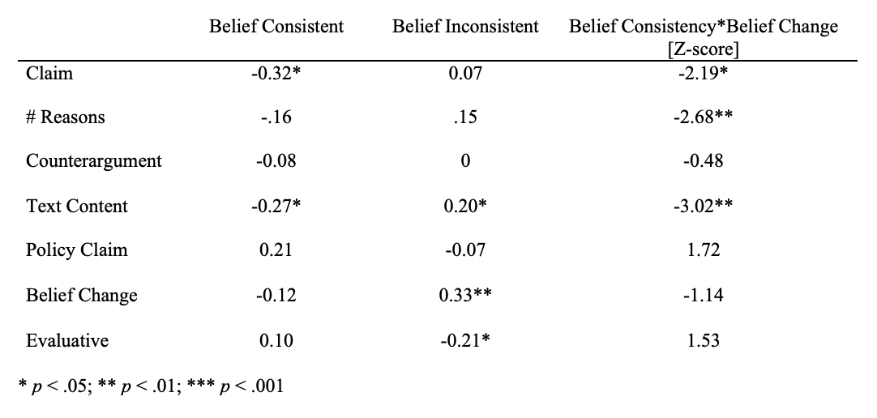
Predicting Essay Characteristics as a Function of Belief Change
Positive values indicate change to less extreme beliefs.
Notes:
CHANGE TO BE STATEMENT ABOUT BELIEF CHANGE
What does significance mean? Significant from 0? Contributes a significant amount of variance?
The probability of a code being present depends upon the amount of belief change, which depends on the belief consistency
The effect of belief consistency on probability of code being 1 depends on the amount of belief change
Each coefficient is relationship between prob of code and belief change
Interaction between belief consistency and the slope of belief change and essay content
Are the coefficients standardized or unstandardized?
Z-score tests if slopes are significantly different from each other

