Slide 1
Secondary Protein structure prediction
Pranav Dutthan K S (22MID0065)
Harsh Raj A (22MID0185)

Slide 2
TITLE:
Develop a deep learning model that can accurately predict protein structures from amino acid sequences.

Slide 3
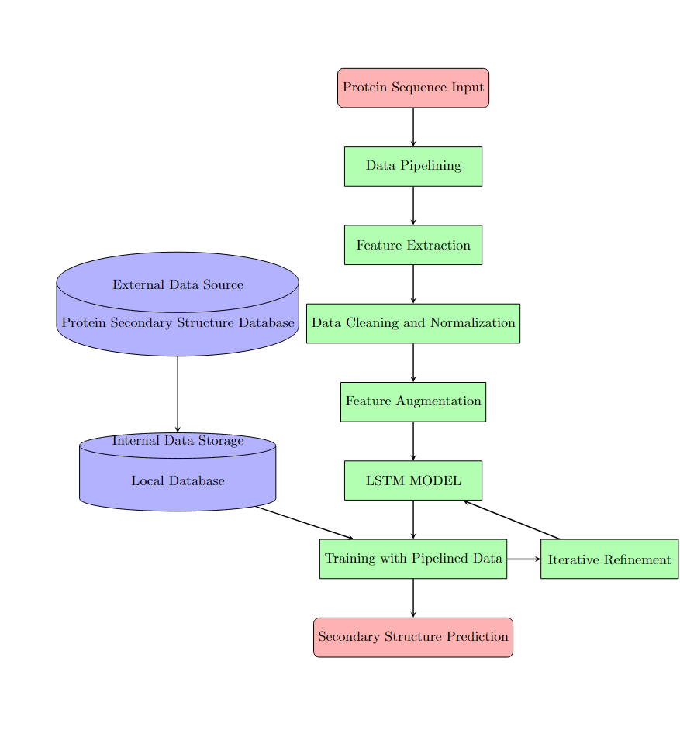
BLOCK DIAGRAM:

Slide 4
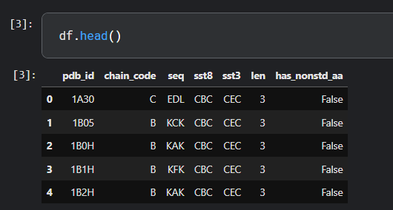
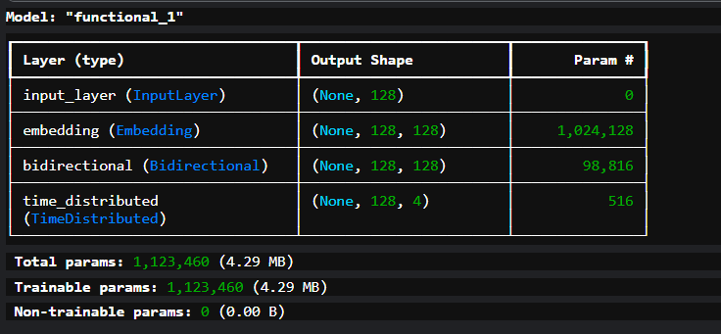
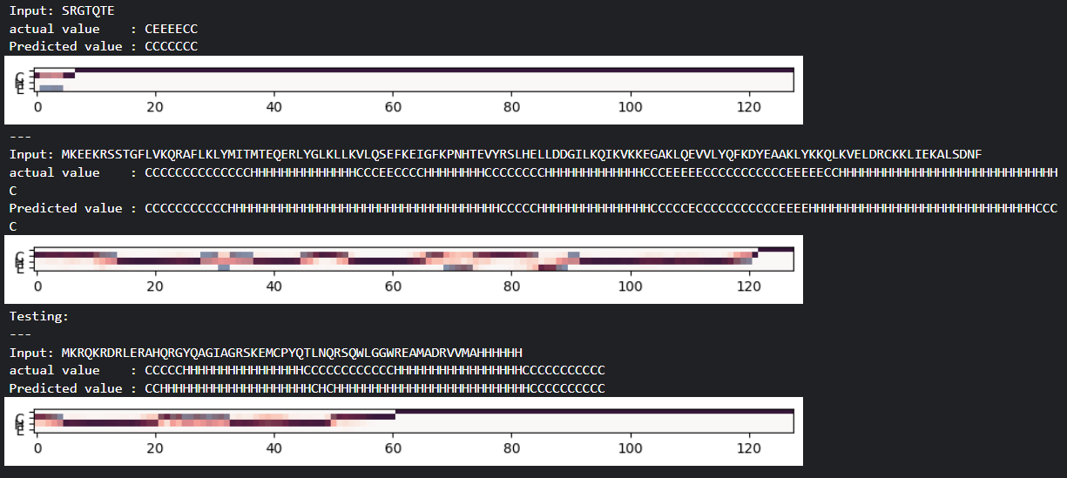
Implementation :

Slide 5
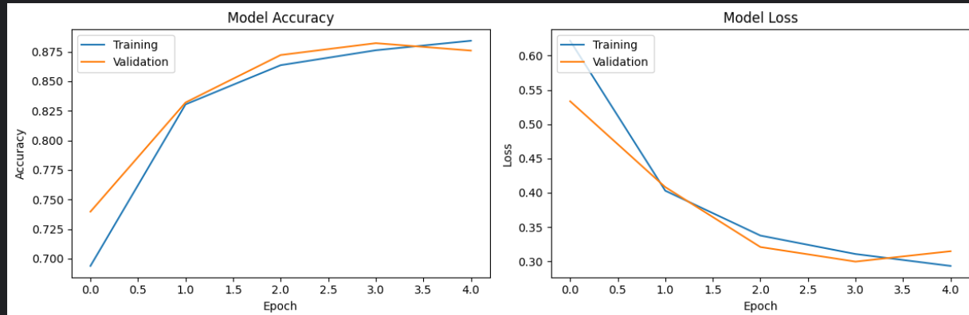
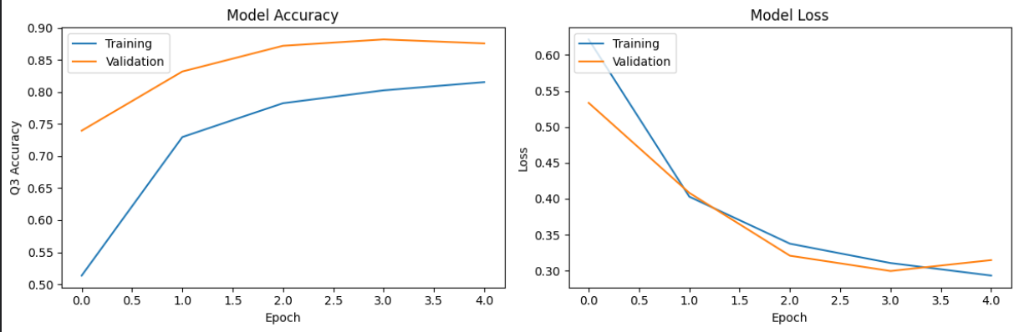
Results :

Slide 6
Reference Materials:
https://arxiv.org/abs/1412.7828
https://web.iitd.ac.in/~amittal/1973_Anfinsen_Science.pdf (Christian B Anfinsen)
https://link.springer.com/article/10.1186/s12859-019-3199-1
https://arxiv.org/pdf/2403.05314
https://www.mdpi.com/1420-3049/29/4/832
https://www.rcsb.org
https://www.science.org/doi/10.1126/science.181.4096.223
https://www.researchgate.net/publication/335232635_A_Review_of_Quasi-perfect_Secondary_Structure_Prediction_Servers?enrichId=rgreq-80c17d090f5566bf76f7f4a111c9ee4a-XXX&enrichSource=Y292ZXJQYWdlOzMzNTIzMjYzNTtBUzo4NTAyNTM0Mzk4NTY2NDFAMTU3OTcyNzYyNTE4OA%3D%3D&el=1_x_3&_esc=publicationCoverPdf
https://www.biorxiv.org/content/10.1101/705426v1.abstract
https://link.springer.com/article/10.1186/s12859-019-3199-1
https://ieeexplore.ieee.org/abstract/document/9075552
https://link.springer.com/article/10.1186/s12859-019-2940-0
https://pubs.rsc.org/en/content/articlehtml/2019/ra/c9ra05218f
https://ieeexplore.ieee.org/abstract/document/9085378

