Slide 1
Directories
1. Initialize PostgreSQL
2. Enable remote Access to PostgreSQL
3. Set PostgreSQL admin user’s password
4. Create Database
5. Issue fixed
This is to configure the DB and create database after using cfg file installed the PostgreSQL DB

Slide 2
1. Initialize PostgreSQL
# Initialize PostgreSQL database
sudo /usr/pgsql-13/bin/postgresql-13-setup initdb
# Enable postgresql database service
sudo systemctl enable --now postgresql-13
systemctl status postgresql-13

Slide 3
2.Enable remote Access to PostgreSQL
sudo firewall-cmd --add-service=postgresql --permanent
sudo firewall-cmd --reload
# set Listen address
sudo vi /var/lib/pgsql/13/data/postgresql.conf
listen_addresses = '*'
# set PostgreSQL to accept remote connections from allowed hosts.
sudo vi /var/lib/pgsql/13/data/pg_hba.conf
# Accept from anywhere and trusted subnet
host all all 0.0.0.0/0 md5
host all all 10.10.10.0/24 md5
# restart
sudo systemctl restart postgresql-13

Slide 4
3. Set PostgreSQL admin user’s password
sudo su - postgres
psql -c "alter user postgres with password ‘dj123 '

Slide 5
4. Create Database
psql –version
sudo -u postgres psql
postgres=# create database nexusiqdb;
postgres=# create user nexusiquser with encrypted password ‘dj123';
postgres=# grant all privileges on database nexusiqdb to nexusiquser ;

Slide 6
5.Issue fixed
issue- Confluence PostgreSQL JDBC direct connection refused
Sln:
https://www.ibm.com/docs/en/capm?topic=pm-no-data-is-displayed-in-all-widgets-postgresql-instance-resource-database-resource
https://confluence.atlassian.com/confkb/confluence-postgresql-jdbc-direct-connection-refused-683543784.html

Slide 7
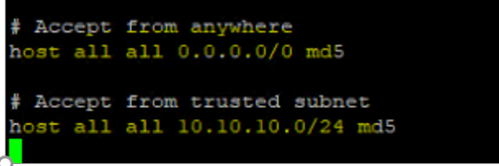
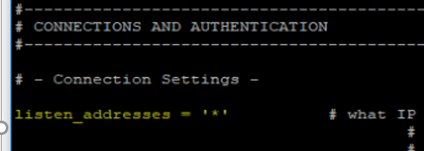
/var/lib/pgsql/13/data/pg_hba.conf
/var/lib/pgsql/13/data/postgresql.conf

