Slide 1

Smart Slides
Make Slides in a flash

Slide 2
Sound leakage investigation of ANC headphones
Authors: Fanyu Meng, Anbo Yu, Dani Fernandez
Objective: Investigate the sound leakage in ANC headphones.
Methodology: Use of particle velocity sensors.

Slide 3
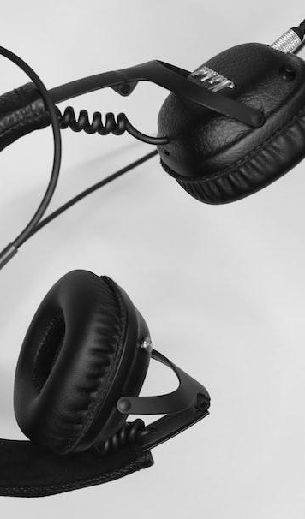
Challenges & Solutions
Challenges in ANC headphones: Advanced noise cancellation algorithms, microphone positioning.
Solution: Particle velocity sensor for in-situ sound localization.
Result: Improved noise cancellation performance.
Photo: black corded headphones on white surface
Photo by Robert Stemler
Powered by Unsplash

Slide 4
Key Findings
Feedforward ANC performance is influenced by microphone positioning.
Particle velocity sensor provides higher spatial resolution in near-field.
Main leakage spot identified at the bottom of the cushion across various frequencies.

Slide 5
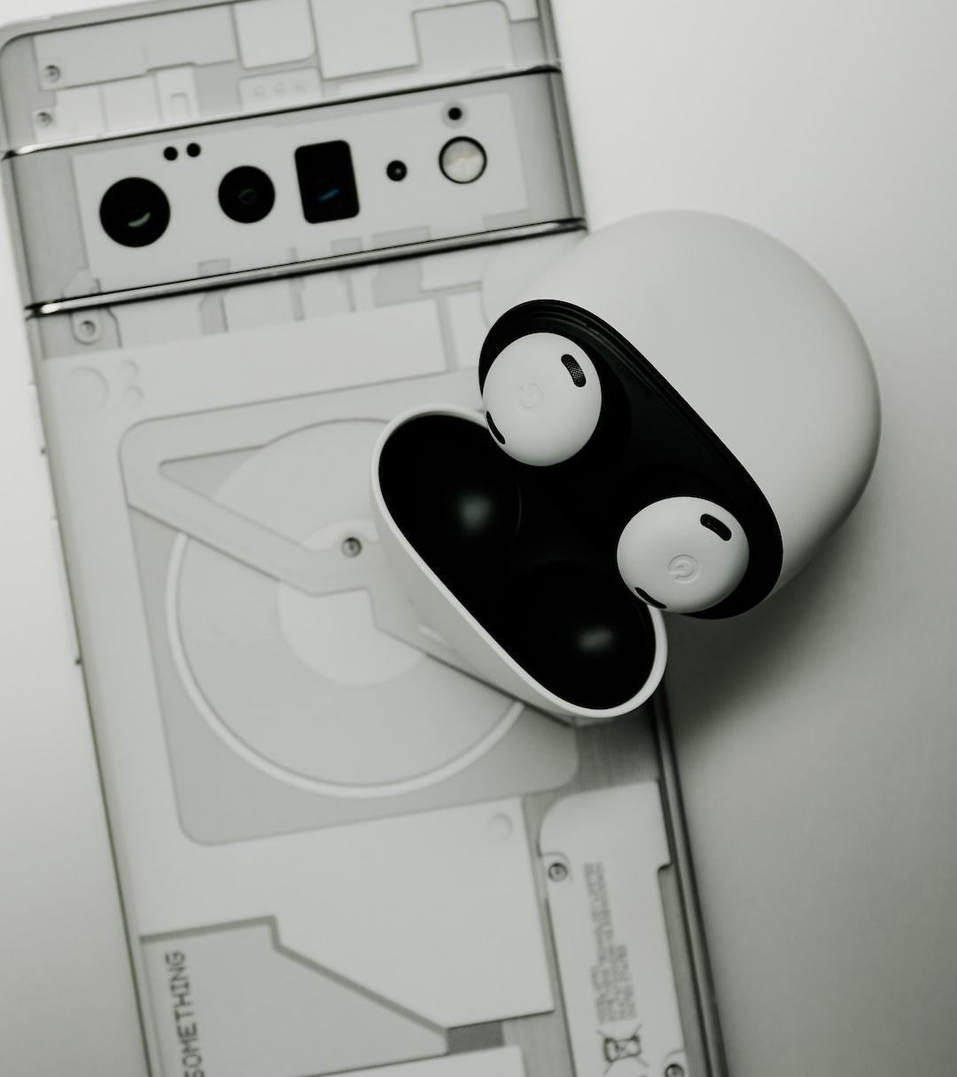
Recommendations & Conclusion
Combine passive and active noise reduction for optimal performance.
Modal behavior observed in particle velocity spectra and 3D field.
Future work: Further optimization of microphone positioning and algorithm development.
Photo: a white game controller
Photo by Triyansh Gill
Powered by Unsplash

Slide 6
Welcome to Smart Slides
Smart Slides is a presentation tool that uses AI to create beautiful presentations in seconds
You can also ask the model to add more image slide layouts, add more slides, vary the layout more or even use a specific color like #F47C00 or orange.
If you ever have issues just uninstall then reinstall the plugin and it should work. Or email us at contact@smart-slides.co
If you don't want to include helper slides just say 'dont include help slides'

Slide 7
Prompt examples: Try them now!
Make me 5 slides about the swiss alps using the red color #FF5A5F with half images of mountains and lakes
Make me a 5 slide tourist presentation about Norway and lofoten islands with varied layouts and images of the northern lights
Create a presentation with 5 slides about Sydney with images of Bondi Beach and the Opera House
Make me a presentation about the future of work with no images and basic layouts
Make me a pitch deck with this color #FF5A5F about a business that lets you rent out your house

Slide 8
Custom Layouts
We use a range of layouts which you can call specifically in the chat. Here is a list ['1st_Slide_FULL_LAYOUT', 'BASIC_CONTENT', 'BASIC_CONTENT_V1', 'AGENDA', 'HEADING_LEFT_CONTENT_RIGHT', 'FULLPAGE_IMAGE_QUOTE', 'HALF_IMAGE_RIGHT', 'HALF_IMAGE_LEFT', '23RD_IMAGE_RIGHT', '23RD_IMG_LEFT', 'HALF_TOP_WITH_IMAGE_RIGHT', 'END_SLIDE']
Experiment with these by telling the model to use specific layouts and try it out!
Example prompt: create 2 slides using HALF_IMAGE_LEFT and 23RD_IMAGE_RIGHT about cats

