Slide 1

Smart Slides
Make Slides in a flash

Slide 2
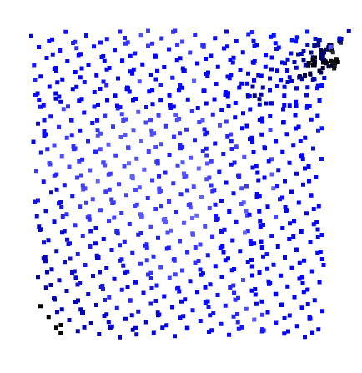
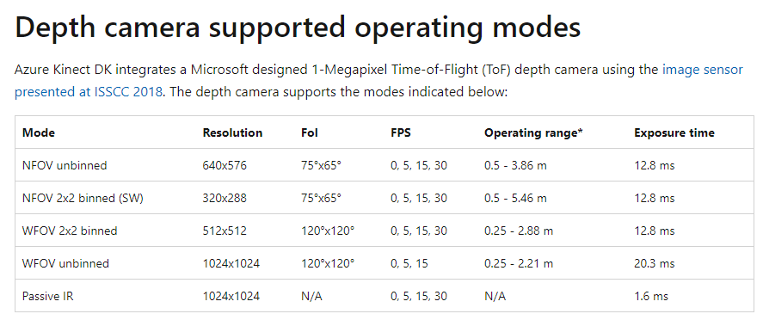
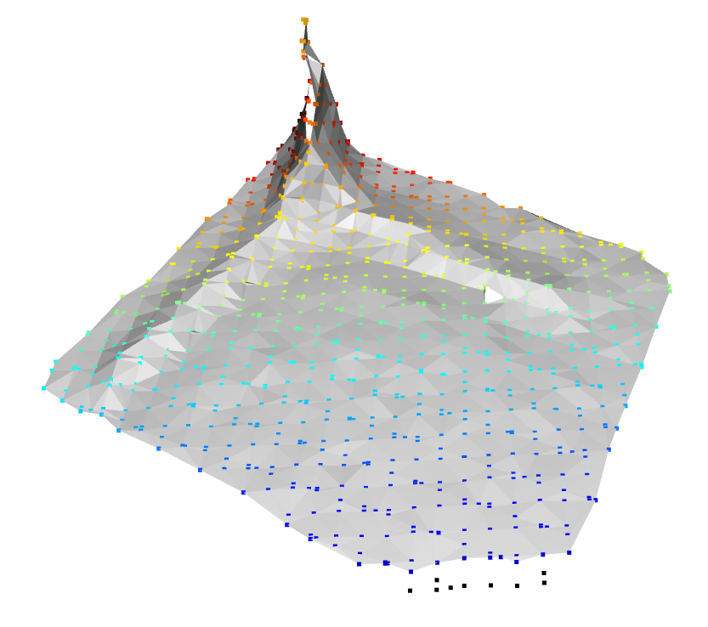

Azure Kinect: Depth camera Resolution
The maximum spatial resolution is 1024 x 1024 in WFOV unbinned mode
The theoretical resolution (distance of two points) is 0.8mm – 1.6 mm, when scan from 0.25m – 0.5m
Real resolution is around 3mm, due to ICP registration = smallest reconstruct-able feature is 9-12mm (nose, mouth)
On the highest resolution mode, the frame rate is 15fps, but it can only be 1-2fps, due to the laptop performance.
The resolution might be improved by manual combine multiple scans, instead of ICP registration
However, from Azure Kinect Viewer, the official software for visually operate Kinect, the point cloud resolution are much higher. It’s open source, but cannot output point cloud.
100mm, 30 points
Mesh

Slide 3
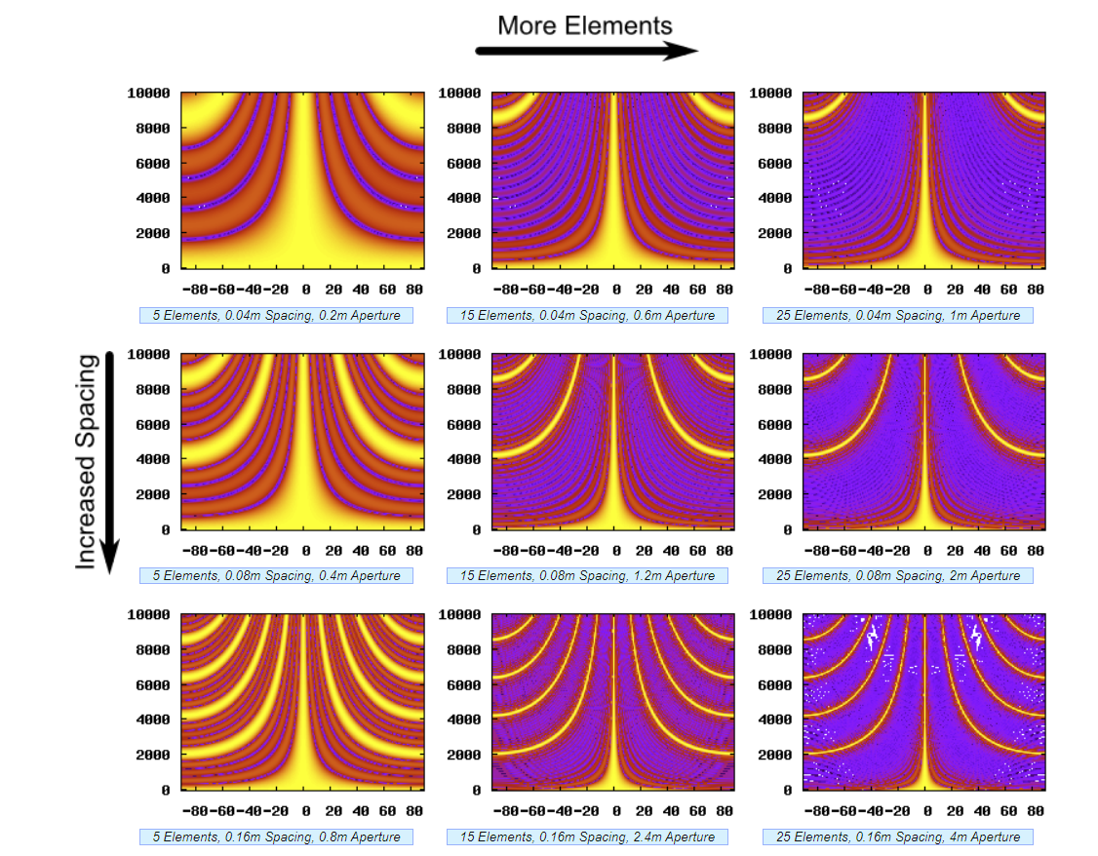
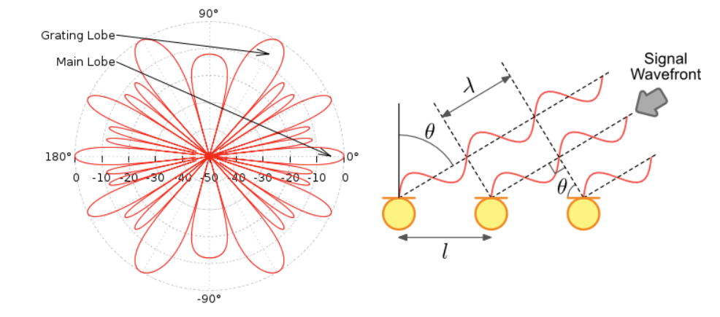

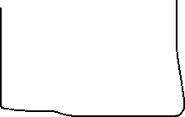

Delay And Sum: Traditional Beamforming
Q: If I specially apply a window to the mic output efficiency, will that equivalent to applying a different window (instead of rectangular window) to it? E.g., the mic at the edge of the array output is less than the middle one.
A: The density of mic distribution spatially are playing that role
Higher aperture with narrower elements arrangements => Higher resolution and Wider detectable angle, respectively.
Sufficient Detectable Angle
Less elements, Same Detectable Angle, But lower resolution
Compressive Sensing
increasing sidelobes number = narrower Detectable angle
Grating Lobes:
Delay Syncolizated peak
Side lobes
comes from the delay Syncolizated peak of some but not all mics

Slide 4
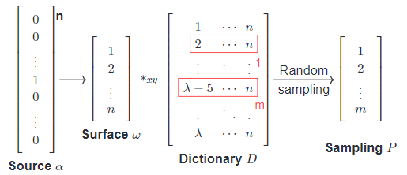
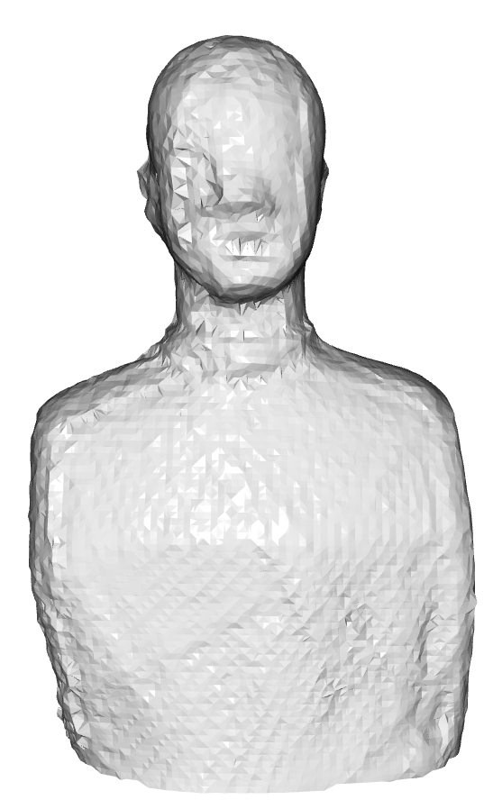



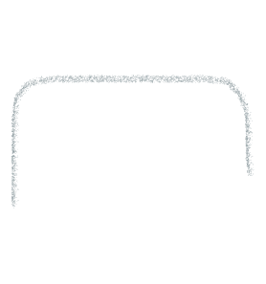



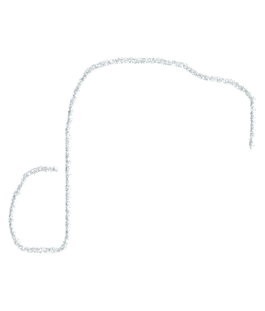
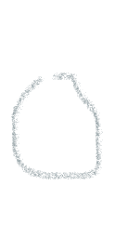
Compressive Sensing: First half, ACQUISITION
One dimensional operation. Actual 2/3 dimension.
Sparse Matrix: the source location under space, Subject
Dictionary, D:
HATS surface scattering
Free field Green’s function ( radiation of sound )
Surface interaction ( radiate and scatter )
Noise.
Radiation of structure – mode
BEM – sufficient? -------- wavelength [0.1m/3kHz]; [0.03m/10kHz]
Or statistic approach. -------- mode density: 0.4/1kHz at 3kHz. But increasing rapidly, also depend on which region.
All above contribution to the sound field, and recorded in few points on Mic array
One benefit gain by 3d scanner, the actual geometry scanning allows a more accurate approximation of dictionary D, ?
There might only two point are leaking sound, but that two points are generating the entire sound field through multiple pathways.
By compressive Sensing, we can decrease the dimension to real solution
Notes:
First, describe what is compressive sensing.
Then talk about choice of BEM and Statistic approach
Conclusion is the BEM is good enough at 3kHz to 10kHz, but the statistic approach match better with the compressive sensing’s concept, also it has wider application scenario

Slide 5
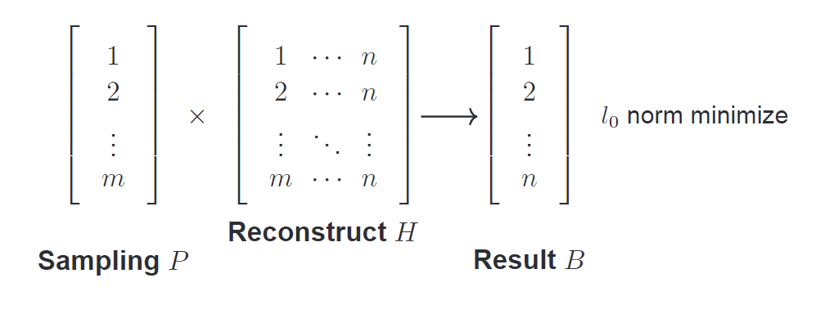
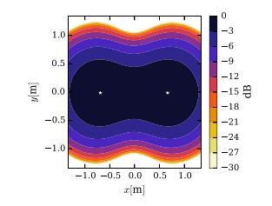
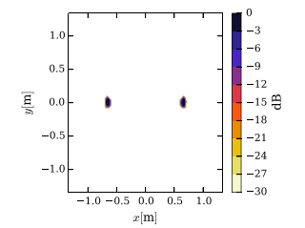
Compressive Sensing: Second half, Reconstruction
Convex optimization, CVX --- L1/L2 norm approximation
Tikhonov regularization (L2 minimize) – ESM, equivalent source method. L2 minimize tend to give an average source distribution (equivalent source)
Lasso regularization (L1 minimize)
Wide band holography, WBH --- side lobe suppression
Inverse BEM?
What is the difference between inverse BEM and NAH? The later one also used the free field green’s function, so should I consider the Inverse BEM to be a complex form of NAH?

Slide 6
Deconvolution Beamforming, PSF
Direct solving with Non-zero assumption, shift-invariant Point Spread Function

Slide 7
Questions
How to verify the Reconstruction results? = the way we get the groundtruth
With the microphone arc, we can have the sound intensity and get rid of noise?

Slide 8
Main Idea of WBH
Iteratively suppress ghost sources associated with real sources.
Starts with the strongest real sources.
Uses steepest descent iteration to minimize the quadratic residual function.

Slide 9
Mathematical Formulation
Residual Vector: r(q) = p - Aq
Quadratic Residual Function: F(q) = 0.5 ||p - Aq||^2
Gradient Vector: ∇F(q) = A^H (p - Aq)

Slide 10
Dynamic Range Limitation
Initial threshold set to a small value D0.
Threshold increased during iteration by DD.
Suppresses ghost sources by setting components in q below the threshold to zero.

Slide 11
Comparison with Convex Optimization
WBH uses a source model based on a grid of monopole sources.
Doesn't minimize the 1-norm of the coefficient vector for sparsity.
Uses a dedicated iterative solver to promote sparsity in a different manner.

Slide 12
Python Implementation of WBH
Function WBH takes in system matrix A, measured data p, and other parameters.
Computes residual, gradient, and updates q using steepest descent.
Applies dynamic range limitation to suppress ghost sources.

Slide 13
Code Snippet
def WBH(A, p, max_iter=100, D0=0.1, DD=1): ...
Compute residual: r = p - np.dot(A, q)
Compute gradient: gradient = np.dot(A.T.conj(), r)
Update q using steepest descent: q += gradient

Slide 14
Conclusion
WBH offers an efficient method for acoustic field reconstruction.
Combines principles of holography, beamforming, and compressed sensing.
Provides a full-band solution with a focus on sparsity and computational efficiency.

Slide 15
Custom Layouts
We use a range of layouts which you can call specifically in the chat. Here is a list ['1st_Slide_FULL_LAYOUT', 'BASIC_CONTENT', 'BASIC_CONTENT_V1', 'AGENDA', 'HEADING_LEFT_CONTENT_RIGHT', 'FULLPAGE_IMAGE_QUOTE', 'HALF_IMAGE_RIGHT', 'HALF_IMAGE_LEFT', '23RD_IMAGE_RIGHT', '23RD_IMG_LEFT', 'HALF_TOP_WITH_IMAGE_RIGHT', 'END_SLIDE']
Experiment with these by telling the model to use specific layouts and try it out!
Example prompt: create 2 slides using HALF_IMAGE_LEFT and 23RD_IMAGE_RIGHT about cats

