Slide 1
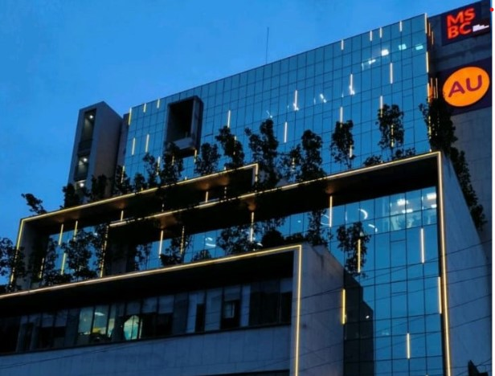

Internship Project – Credit Card Alert Management System
Organization – AU Small Finance Bank, Jaipur
Supervisor – Sourabh Agrawal (Lead – Credit Card Support)
Submitted By – Ishika Aggarwal(2116769)
Submitted To - Faculty of Mathematics and Computing
Banasthali Vidyapith
Session: 2025

Slide 2





Table Of Content
Key Learnings
Challenges
Outcome
Other Contributions
Objective

Slide 3

Problem Statement
Gaps in the communication chain between the customers and the bank.
No bifurcation of alerts as resolvable and non resolvable alerts.

Slide 4
Objective
Credit Card Alert Management System aimed at maintenance of uninterrupted communication by identifying the touchpoints throughout the credit card lifecycle.
To increase the success rate of the alerts being sent to the customers by identifying the reasons of failure and bifurcating them further into curable and non-curable alerts.
Techstack Used:
Database – Oracle
Frontend – HTML, CSS, Javascript
Backend – Python with Flask framework
Objective

Slide 5
Key Learnings
Onboarding journeys understanding. For example: Self, Assisted, DIY, etc.
Credit card lifecycle
Authentication and authorization flow in POS and E-commerce.
Vision Plus Screens(ARQB, ARQE, ARQN, ARTD, ARSD)
Understanding the divisions and subdivisions of alerts. Divisions – Decimal, VisionBatchSMS, Fiserv Alerts.
Understanding of failure reasons and categorization of them as curable and non-curable alerts.
Key Learnings

Slide 6
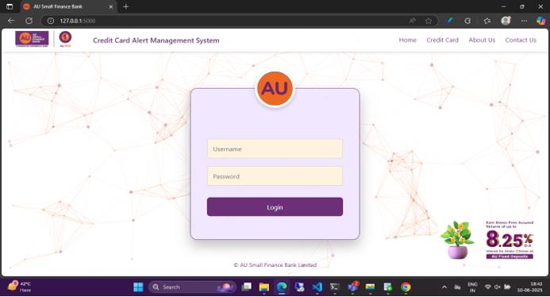
Outcome –Login Page
Outcome

Slide 7
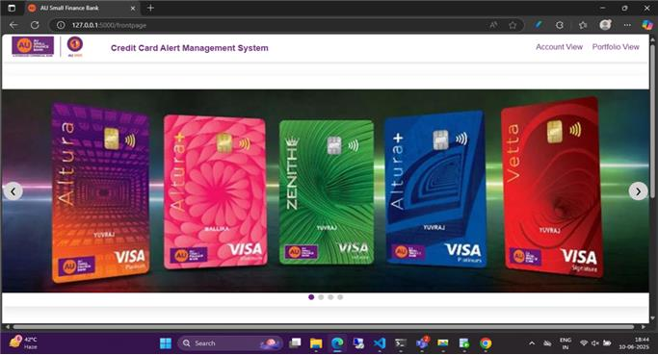
Landing Page

Slide 8


Credit Card Alert Management System has two modules:
Account-Level View – It provides an individual journey view of the customer.
Portfolio-Level View - It provides summary level view of the number of alerts sent(success, failure), curable and non-curable alerts.
Portfolio-Level View
Account-Level View

Slide 9
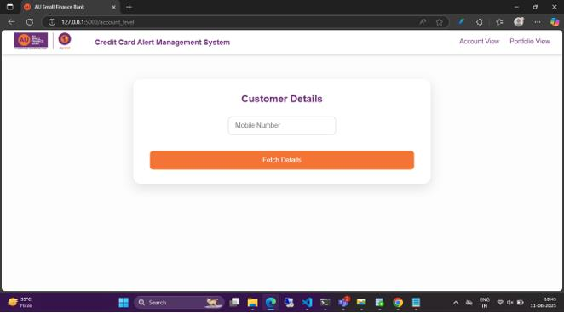
Account-Level View

Slide 10
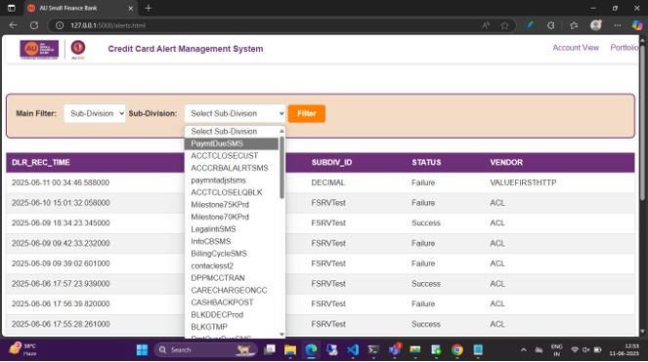

Slide 11
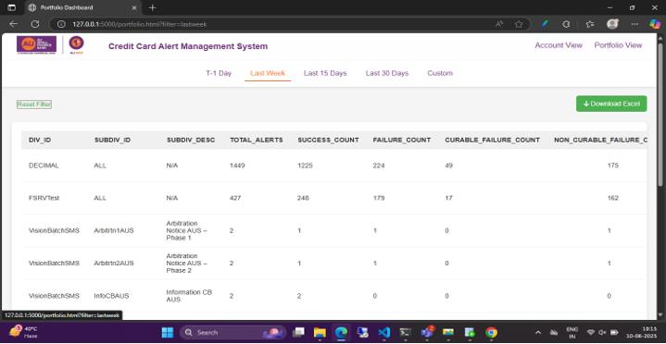
Portfolio-Level View

Slide 12
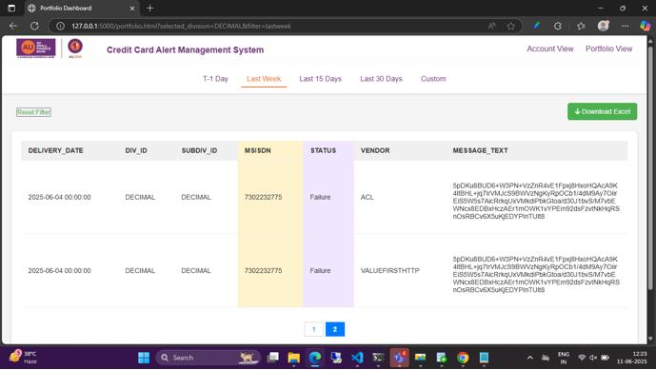

Slide 13

Challenges & Future Scope
No divisions for onboarding alerts.
Understanding of the onboarding journeys.
Integration of LDAP API.
Integration of mail service

Slide 14

Other Contributions
Raised 10 change requests.
Addition of Billing cycle on 7th of every month.
Extending the card expiry from 60 to 84 months on all Logos.
Auro chatbot and AU0101 testing.

Slide 15
THANK YOU

